Slide 1
DIGESTIVE SYSTEM II.

Slide 2
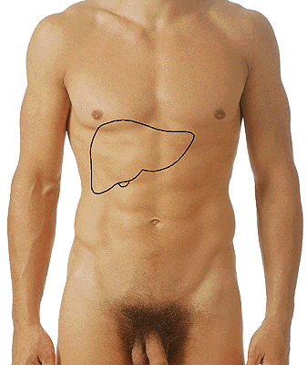
HEPAR
Regio hypochondriaca dextra
Regio epigastrica

Slide 3
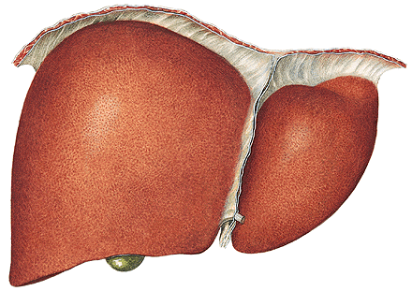
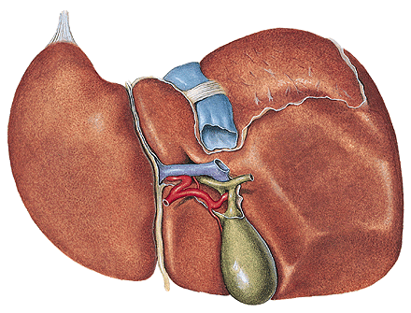
Facies diaphragmatica
- pars anterior
- lig. falciforme hepatis
- lobus dexter
- lobus sinister
pars superior (area nuda)
- lig. coronarium
- lig. triangulare dextrum
- lig. triangulare sinistrum
Facies visceralis
Fissura ligamenti teretis
(lig. teres hepatis)
Fissura ligamenti venosi

Slide 4
Fossa vesicae biliaris
Sulcus venae cavae
Lobus dexter
sinister
caudatus
quadratus
Porta hepatis
- vena portae
- a. hepatica propria
- ductus hepaticus
communis
(portal triad)

Slide 5
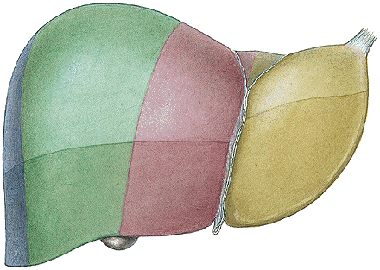
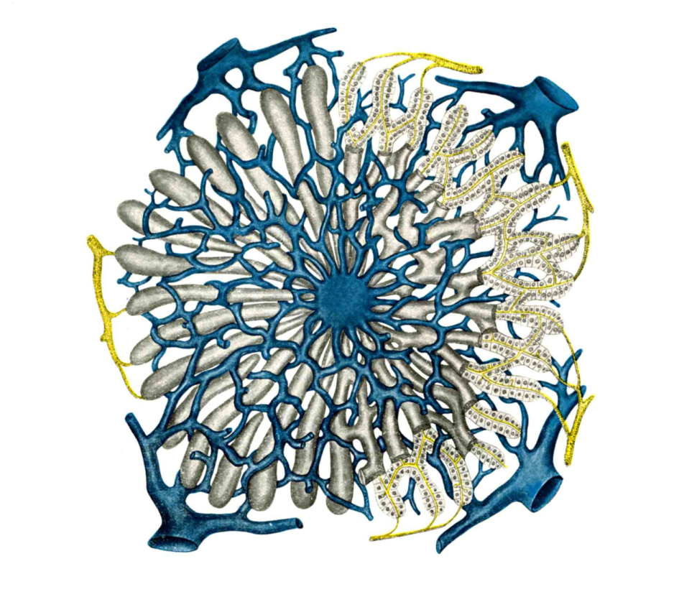

Slide 6
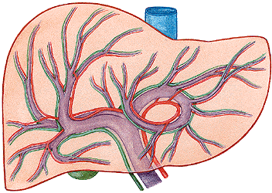
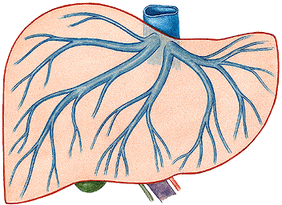
V. PORTAE
(v. mesenterica sup.
+ v. lienalis)
A. HEPATICA PROPRIA
- a. hepatica communis
→ RAMUS DEXTER ET SINISTER
→ VV. HEPATICAE

Slide 7
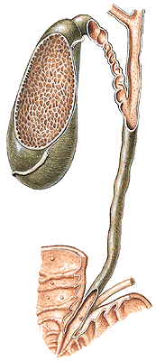
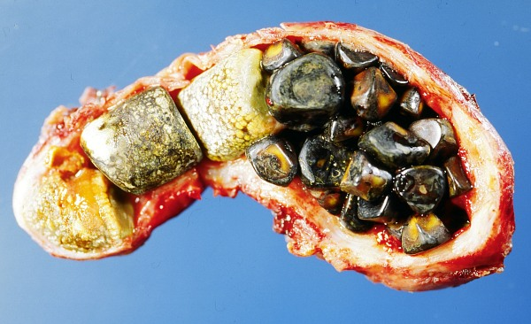
Intrahepatic ducts ductus hepaticus dexter
et sinister – ductus hepaticus communis
+ ductus cysticus = ductus choledochus
Ampulla hepatopancreatica
M. sphincter ampullae (Oddi)
Papilla duodeni major (Vater)
(Plica longitudinalis duodeni)
Vesica biliaris (fellea)
- fundus, corpus,
infundibulum, collum
- ductus cysticus
(plica spiralis)

Slide 8
Murphy’s
point

Slide 9
Impressio renalis
Impressio suprarenalis
Impressio colica
Impressio duodeni
Impressio oesophagea
Impressio gastrica

Slide 10
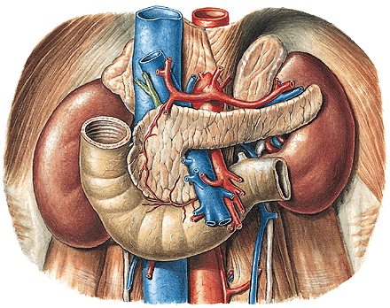
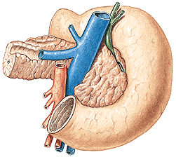
PANCREAS
Caput, collum, corpus, cauda,
incisura pancreatis,
processus uncinatus
(a. et v. mesenterica sup.)

Slide 11
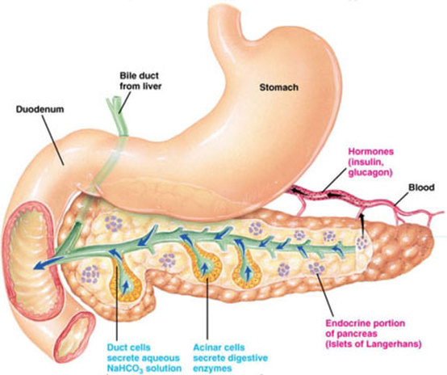
Exocrine pancreas: Endocrine pancreas:
ductus pancreaticus insulae pancreaticae
ductus pancreaticus accessorius (islets of Langerhans
succus pancreaticus 0.1-0.5 mm in diameter )
insulin, glucagon

Slide 12
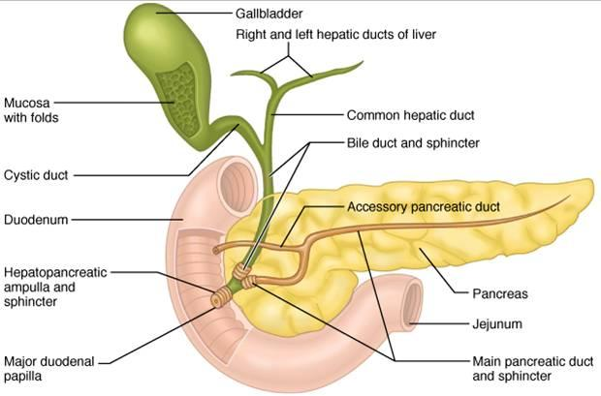
M. sphincter ductus pancreatici
M. sphincter ductus choledochi
M. sphincter ampullae hepatopancreaticae

Slide 13
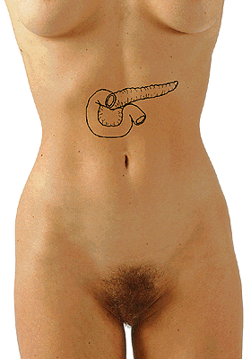
Umbilico-axillary line
- point of Desjardin

Slide 14
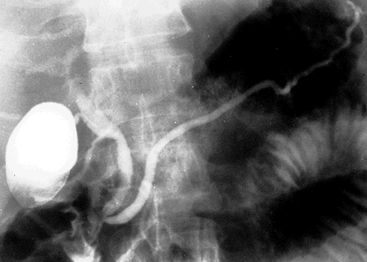
ERCP – endoscopic retrograde cholangio-pancreatography

Slide 15
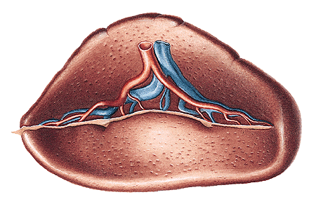
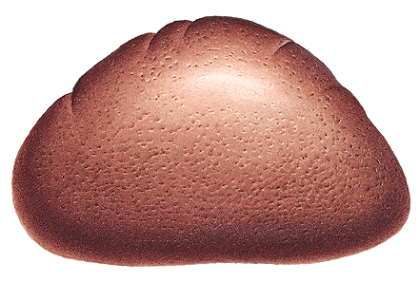
LIEN, SPLEN
- extremitas anterior
- extremitas posterior
- margo superior – crenae lienis
- margo inferior
- facies diaphragmatica
- facies visceralis – hilum lienis
- capsula lienis

Slide 16
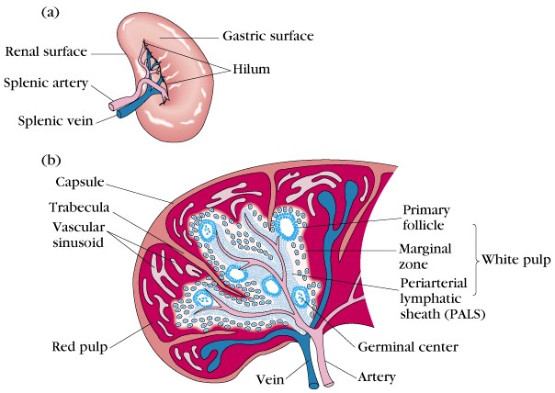

Slide 17
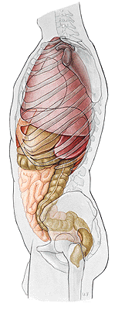
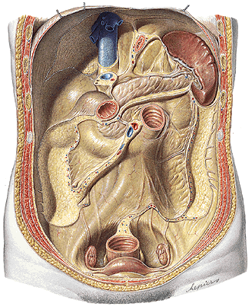
Costoarticular line

Slide 18
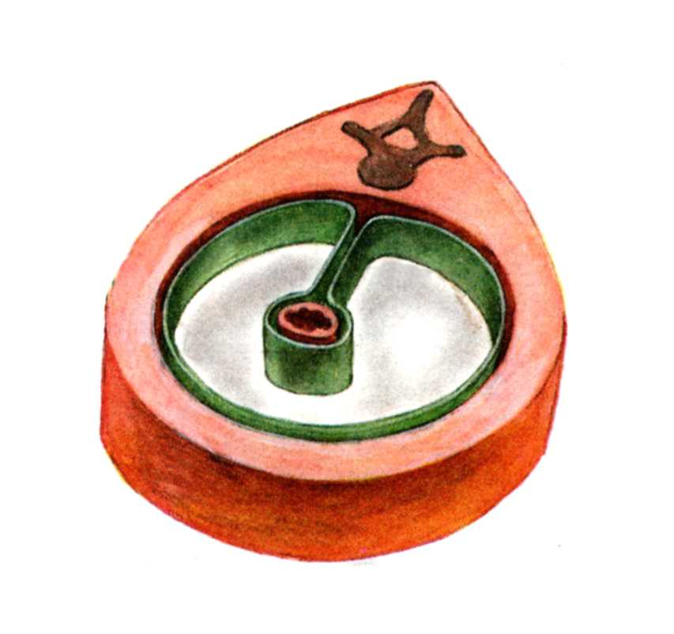
CAVITAS PERITONEALIS
PERITONEUM PARIETALE
PERITONEUM VISCERALE

Slide 19
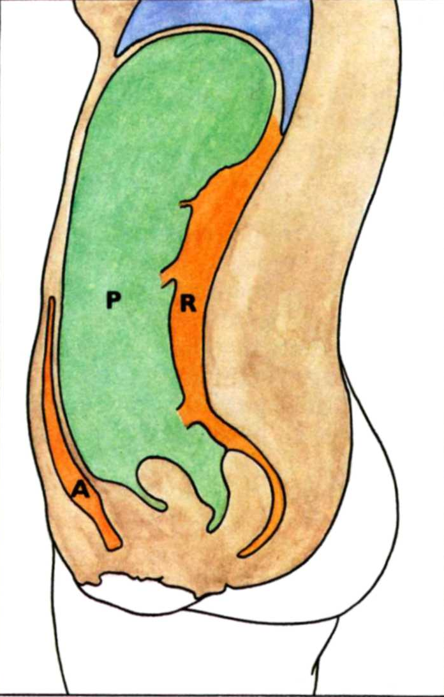
CAVITAS ABDOMINALIS
P – cavitas peritonealis
A – spatium preperitoneale
R – spatium retroperitoneale
S – spatium subperitoneale
(infraperitoneale)
ascites
S

Slide 20
Intraparitoneal organs:
Abdominal part of the oesophagus, stomach, superior
part of the duodenum, jejunum, ileum, vermiform appendix,
transverse colon, sigmoid colon, liver, spleen
Secondarily retroperitoneal organs:
Most of the duodenum, pancreas, caecum, ascending colon,
descending colon
Primarily retroperitoneal organs:
Kidneys + ureters, suprarenal glands, aorta, inferior vena cava

Slide 21
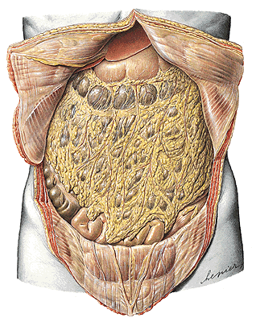
Cavitas peritonealis - pars supramesocolica, inframesocolica

Slide 22
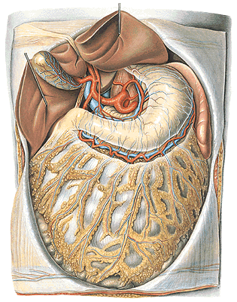
Pars supramesocolica
Truncus coeliacus

Slide 23
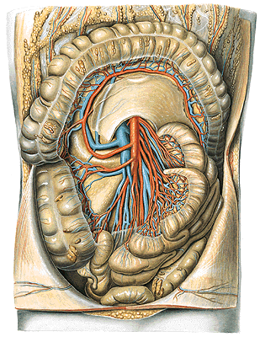
Pars inframesocolica
A. mesenterica superior

Slide 24
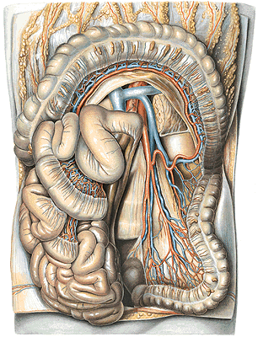
Pars inframesocolica
A. mesenterica inferior

Slide 25
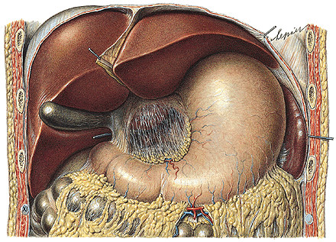
Omentum minus - lig. hepatogastricum
- lig. hepatoduodenale - a. hepatica propria
- v. portae
- ductus hepaticus
comm.
(d.choledochus)

Slide 26
Omentum majus
- lig. gastrocolicum

Slide 27
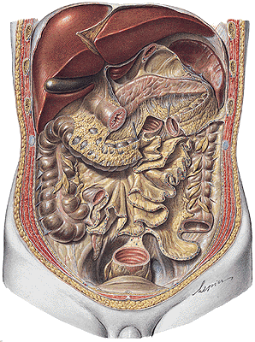
Lig. gastrosplenicum, phrenicosplenicum, splenorenale
Mesenterium – radix mesenterii
Mesocolon transversum, mesoappendix, mesocolon
sigmoideum, lig. phrenicocolicum

Slide 28
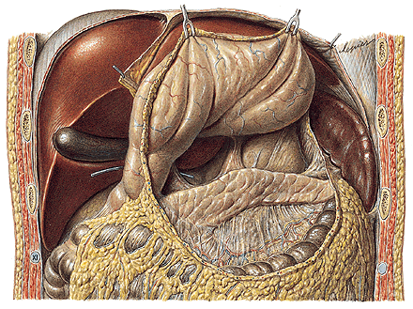
RECESSUS PERITONEI
Bursa omentalis
Internal hernias

Slide 29
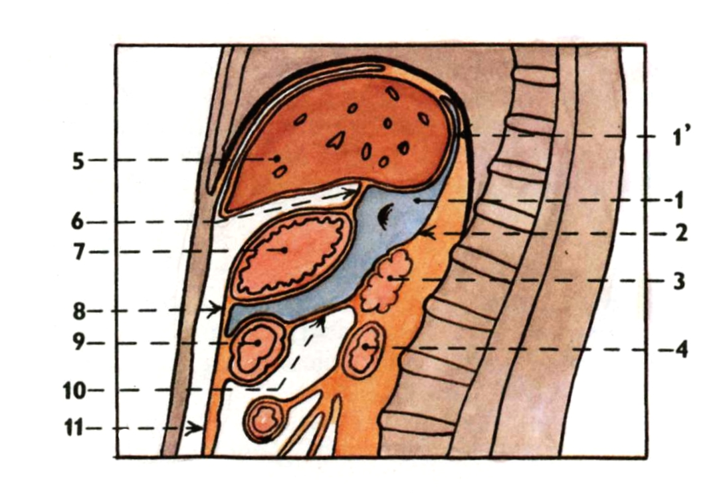
Bursa omentalis

Slide 30
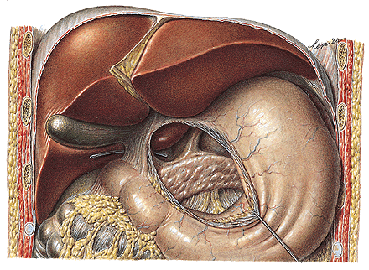
Foramen omentale/epiploicum (Winslow)
Recessus sup., splenicus, inf.

Slide 31
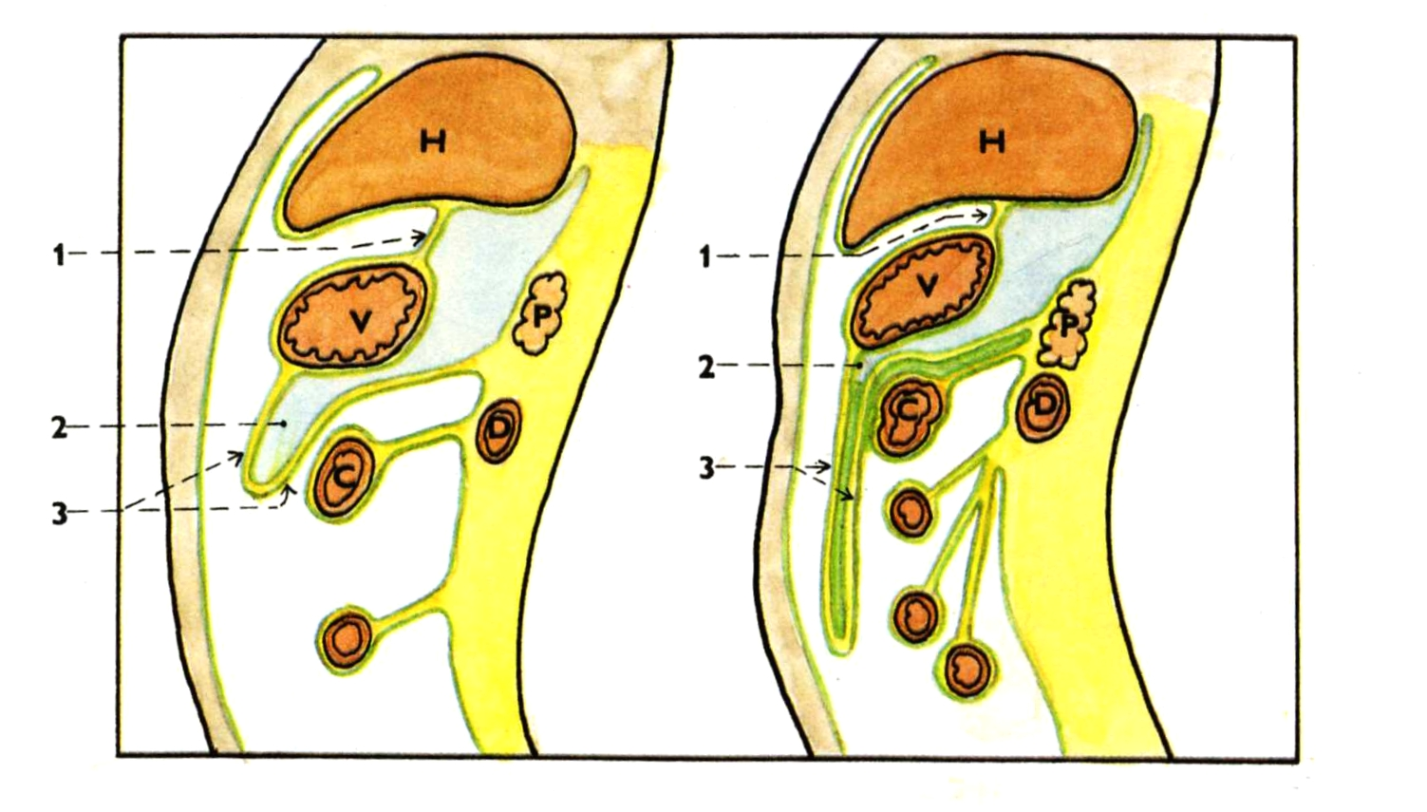
Recessus inferior bursae omentalis

Slide 32
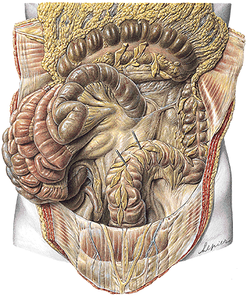
Recessus duodenalis
sup., inf., sinister,
retroduodenalis
Recessus ileocaecalis sup.
Recessus ileocaecalis inf.
Recessus intersigmoideus
Recessus paracolici

Slide 33
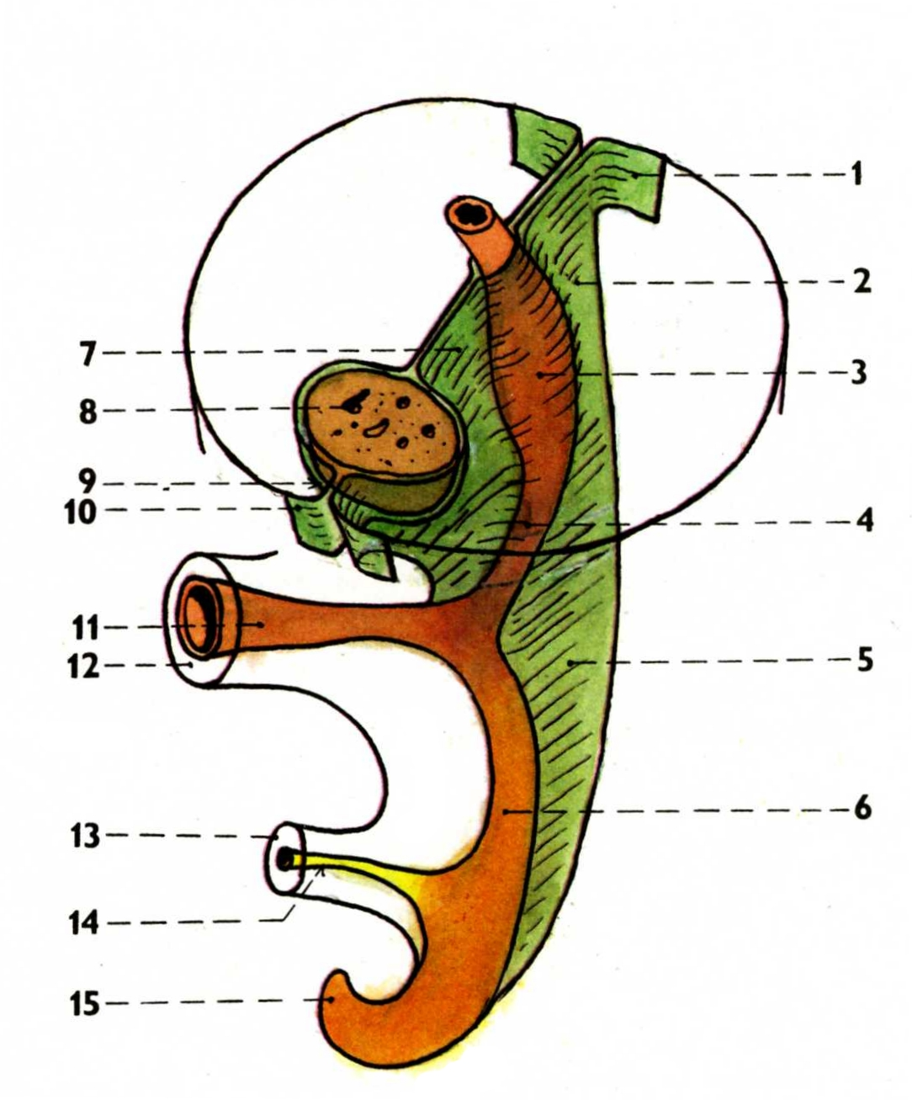
Development of the peritoneum
Mesenterium dorsale
Mesogastrium ventrale

Slide 34
Development of the peritoneum
peritoneum parietale
mesogastrium dorsale
anlage of the stomach
anlage of the duodenum
mesenterium
hindgut
mesogastrium ventrale
liver
mesogastrium ventrale
peritoneum parietale
ductus omphaloentericus
umbilicus
connecting stalk
allantois
hindgut

Slide 35
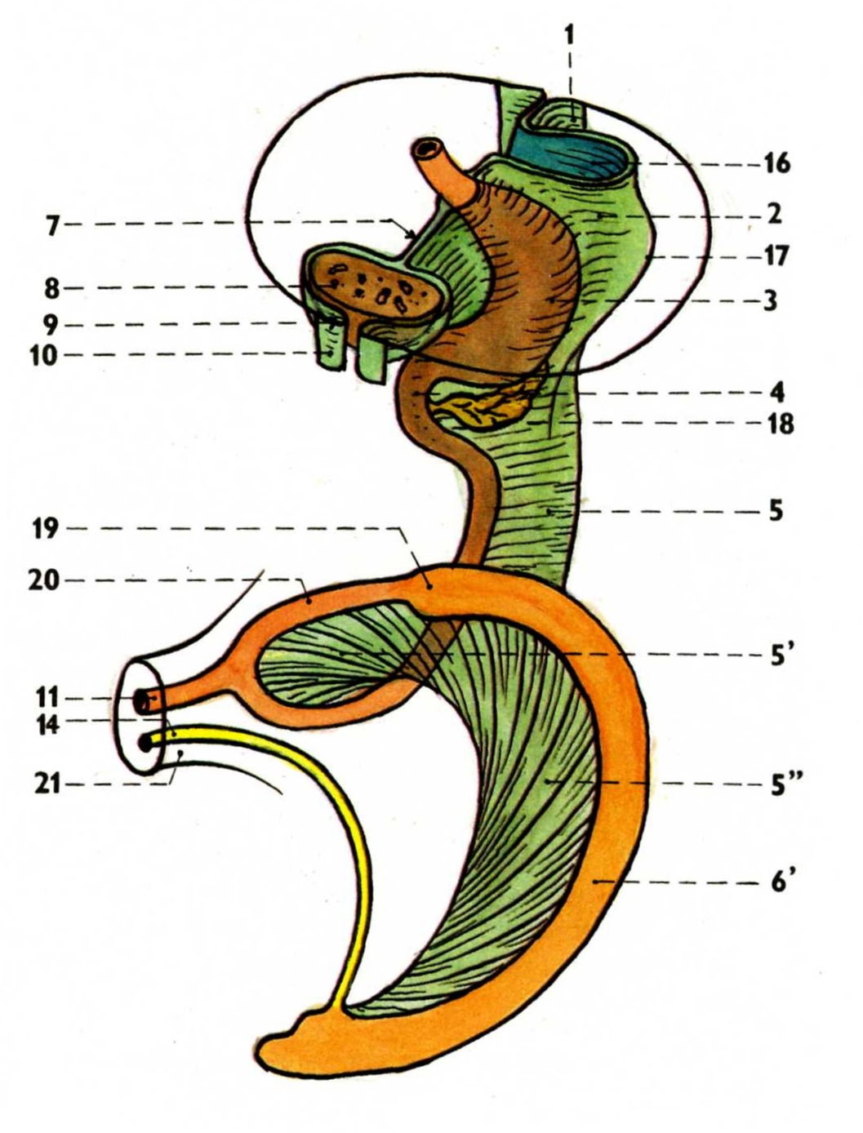
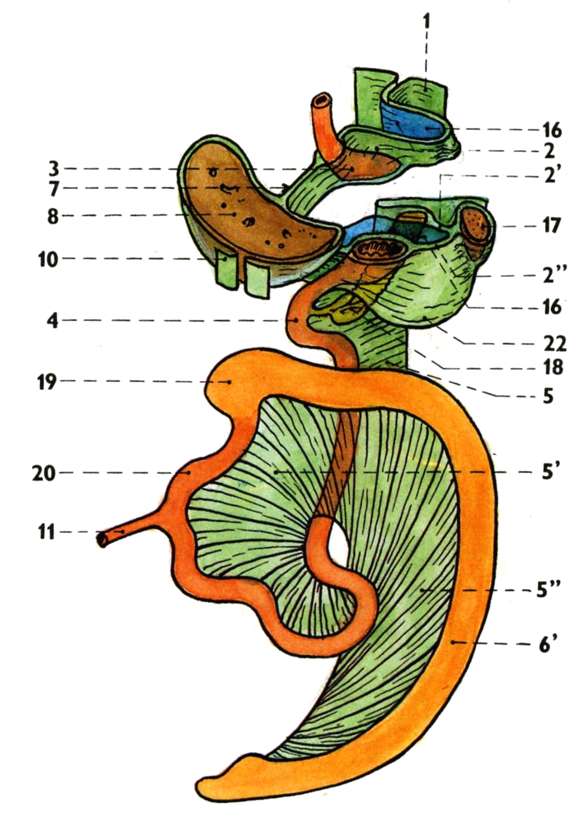
Development of the peritoneum

Slide 36
Development of the peritoneum
2’. lig. phrenicolienale
2’’. lig. gastrolienale
5’. mesenterium
5’’. mesocolon
6’. anlage of the large intestine
22. omentum majus

Slide 37
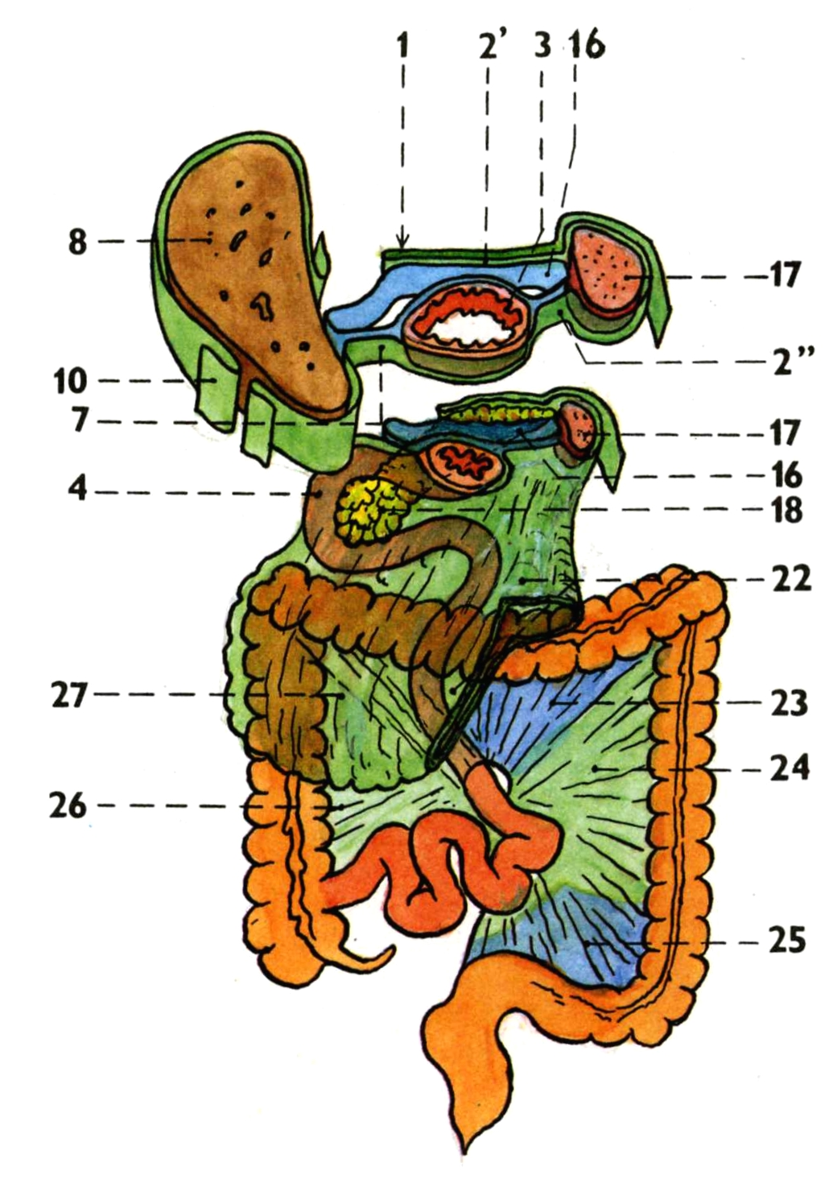
Development of the peritoneum
23. mesocolon transversum
24. mesentery of the colon
descendens
25. mesocolon sigmoideum
26. mesentery of the colon
ascendens
27. omentum majus

Slide 38
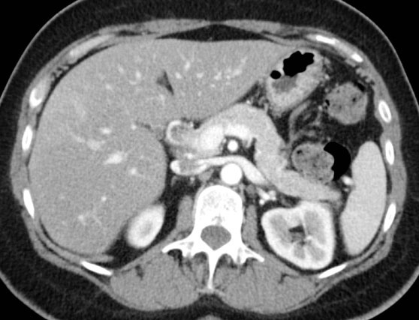

Slide 39
Illustrations 27-31 were copied from:
Čihák R: Anatomie 2 (Splanchnologia). Avicenum,
zdravotnické nakladatelství, Praha, 1988.
Remaining illustrations, photographs, and radiographs were
copied from:
Atlas der Anatomie des Menschen/Sobotta.
Putz,R., und Pabst,R. 20. Auflage. München:
Urban & Schwarzenberg, 1993

