Slide 1
RESPIRATORY SYSTEM

Slide 2
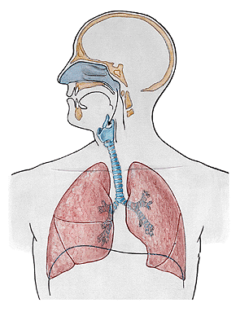

Slide 3
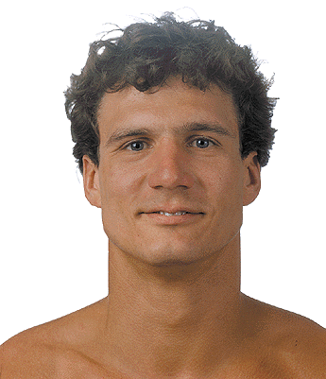
NASUS EXTERNUS
Radix nasi
Dorsum nasi
Apex nasi
Nares
Alae nasi

Slide 4
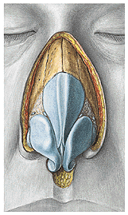
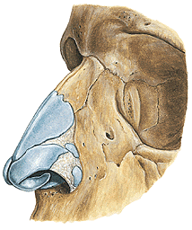
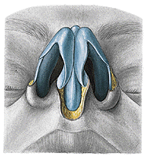
Cartilago nasi lateralis
Cartilago septi nasi
Cartilago alaris major
- crus laterale
- crus mediale
Cartilagines alares minores

Slide 5
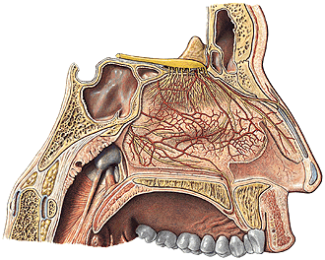
Septum nasi
- pars membranacea
- pars cartilaginea
- pars ossea

Slide 6
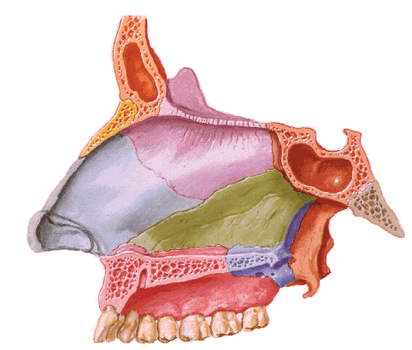
SEPTUM NASI
Cartilagines alares majores – crura medialia
Cartilago septi nasi – processus posterior
Lamina perpendicularis ossis ethmoidalis
Vomer

Slide 7
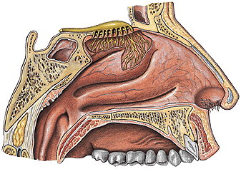
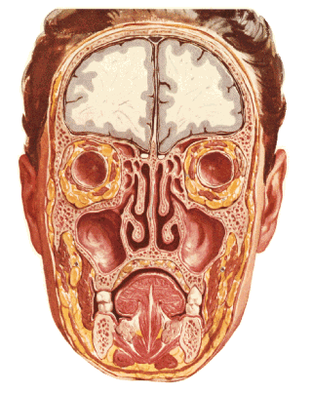
CAVITAS NASI
- vestibulum – limen, vibrisae, recessus apicis nasi
- cavitas nasi propria – meatus nasi sup., medius, inf.
meatus nasi communis, meatus nasopharyngeus, choanae

Slide 8
Superior wall: cartilago nasi lateralis, os nasale,
pars nasalis ossis frontalis, lamina cribrosa
ossis ethmoidalis, corpus ossis sphenoidalis
Inferior wall:
processus palatinus
maxillae, lamina
horizontalis ossis
palatini
canalis incisivus

Slide 9
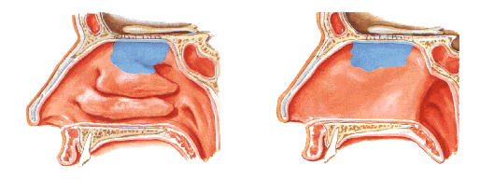
NASAL MUCOSA
Regio respiratoria
plexus cavernosi - epistaxis
Regio olfactoria

Slide 10
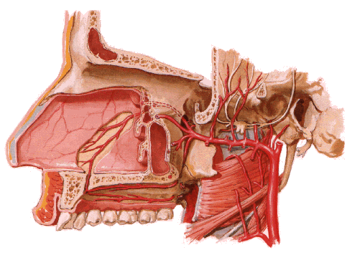
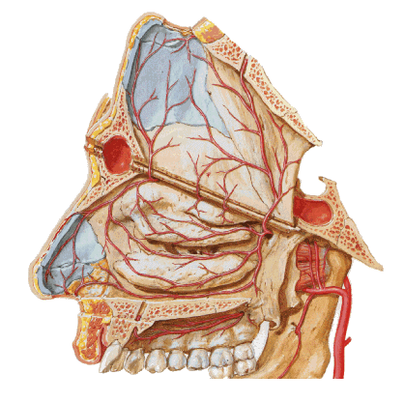
A. sphenopalatina, a. palatina major (a. maxillaris)
A. ethmoidalis ant., post. (a. ophthalmica)
R. septalis a. labialis sup. (a. facialis)
V. sphenopalatina, facialis, vv. ophthalmicae
Nll. submandibulares, retropharyngei, parotidei
Kiesselbach area

Slide 11
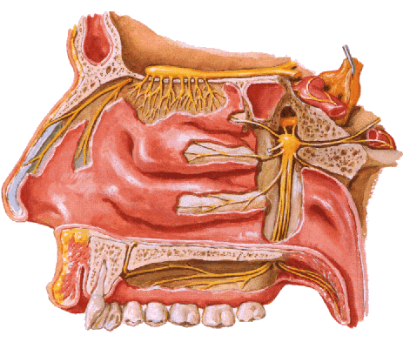
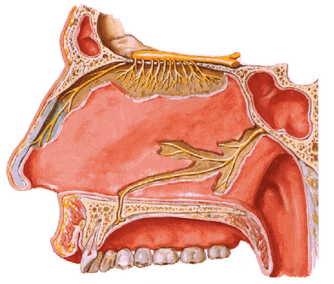
N. trigeminus (CN V)
- n. ethmoidalis ant. (V1)
- rr. nasales posteriores med. et lat.
(n. nasopalatinus) (V2)
Nn. olfactorii

Slide 12
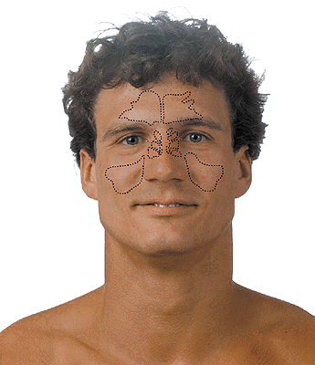
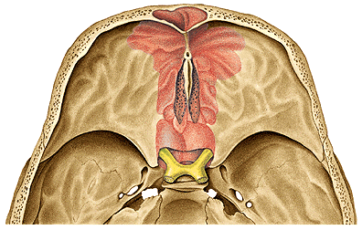
SINUS PARANASALES
Sinus maxillaris
Sinus frontalis
Sinus ethmoidales
Sinus sphenoidalis

Slide 13
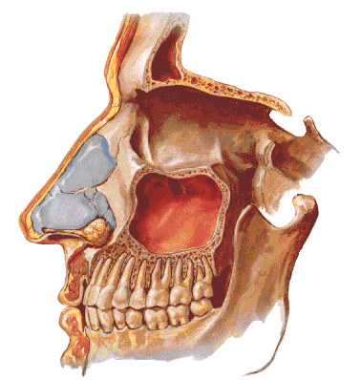
SINUS MAXILLARIS – hiatus sinus maxillaris
(Antrum of Highmore)

Slide 14
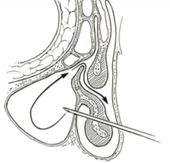
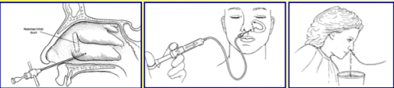
Maxillary sinus puncture (Antral washout)

Slide 15
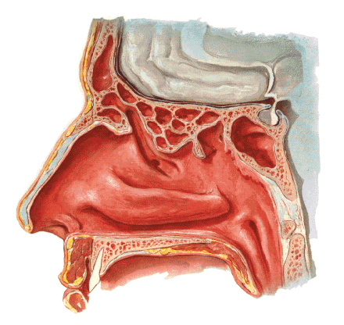
SINUS FRONTALIS
Septum sinuum frontalium
Hiatus semilunaris

Slide 16
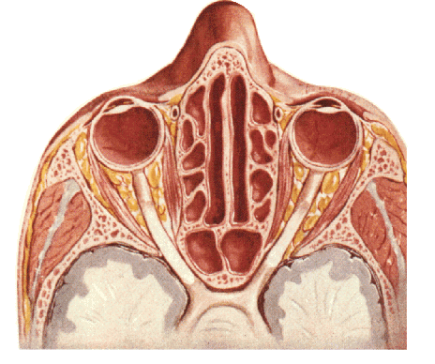
CELLULAE ETHMOIDALES
SINUS SPHENOIDALIS
Septum sinuum sphenoidalium
Apertura sinus sphenoidalis

Slide 17
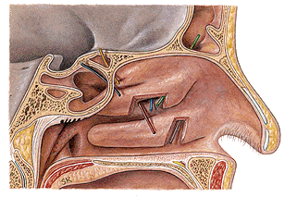
Meatus nasi inf. – ductus nasolacrimalis
Meatus nasi medius – hiatus semilunaris – sinus maxillaris,
sinus frontalis, cellulae ethmoidales anteriores
Meatus nasi sup. – cellulae ethmoidales posteriores, sinus
sphenoidalis

Slide 18
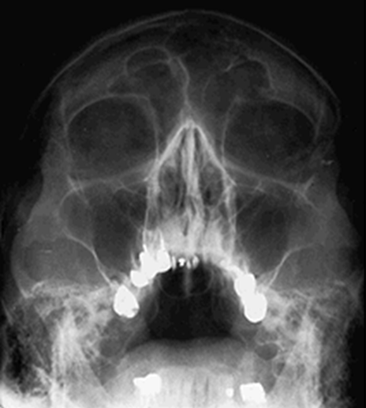
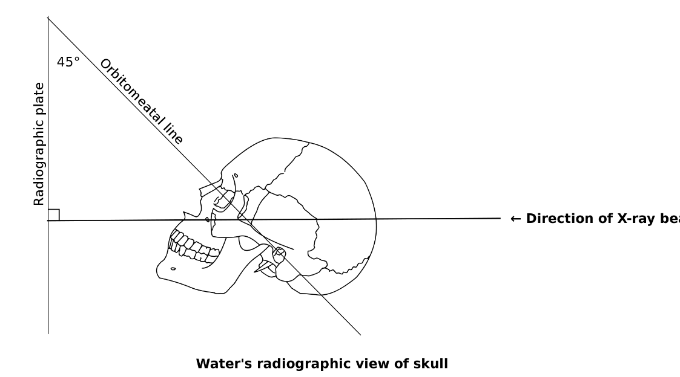
Waters' (Occipitomental) view

Slide 19
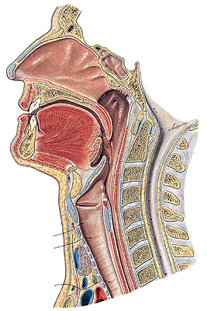
PHARYNX

Slide 20
NASOPHARYNX
Ostium pharyngeum
tubae auditivae:
Torus tubarius
Plica salpingopharyngea
Torus levatorius
Plica salpingopalatina

Slide 21
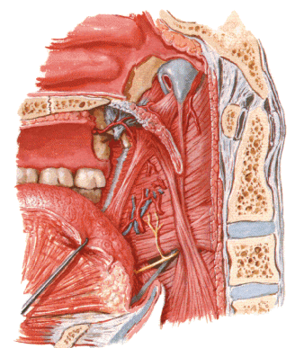
Cartilago tubae auditivae
M. salpingopharyngeus
M. levator veli palatini

Slide 22
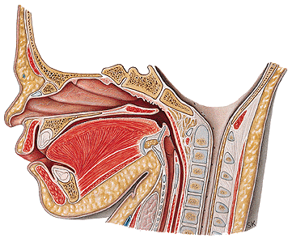
LARYNX
NEONATE
ADULT

Slide 23
Prominentia laryngis

Slide 24
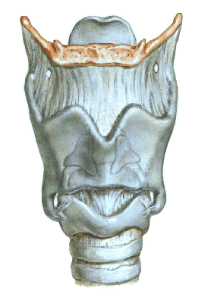
CARTILAGINES LARYNGIS:
Cartilago thyroidea
Cartilago cricoidea
Cartilago arytenoidea
Cartilago epiglottica
Cartilago corniculata
Cartilago cuneiformis

Slide 25
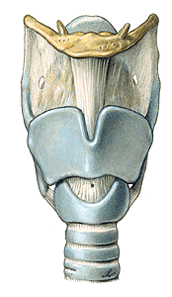
LARYNX
Membrana thyrohyoidea
(thyroidea)
Cartilago thyroidea
lamina dextra
lamina sinistra
incisura thyroidea sup.
incisura thyroidea inf.
cornua superiora
ligg. thyroidea lateralia
cornua inferiora
facies art. cricoidea
linea obliqua

Slide 26
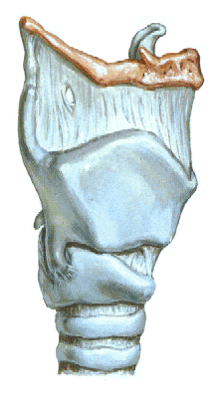

Slide 27
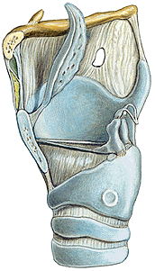
CARTILAGO CRICOIDEA
-arcus
-lamina
-facies articularis
arytenoidea
-facies articularis
thyroidea

Slide 28
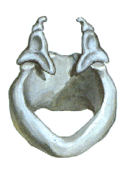
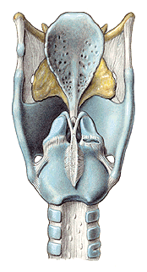
CARTILAGO ARYTENOIDEA
- apex
- basis
- facies art. cricoidea
- processus vocalis
- processus
muscularis
- facies anterolateralis
- facies medialis
- facies posterior

Slide 29
CARTILAGO EPIGLOTTICA
petiolus epiglottidis
lamina
CARTILAGO CORNICULATA
CARTILAGO CUNEIFORMIS

Slide 30
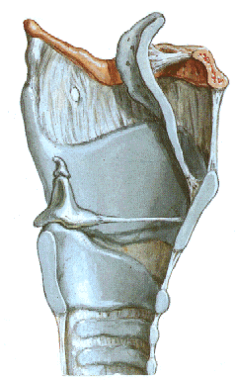

Slide 31
ARTICULATIO CRICOARYTENOIDEA
-lig. cricoarytaenoideum post.
ARTICULATIO CRICOTHYROIDEA

Slide 32
MEMBRANA THYROIDEA
lig. thyroideum laterale
lig. thyroideum medianum

Slide 33
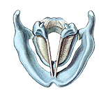
CONUS ELASTICUS
lig. cricothyroideum- coniotomy
lig. vocale – plica vocalis
Lig. cricotracheale

Slide 34
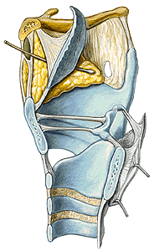
Lig thyroepiglotticum
Lig. hyoepiglotticum
Spatium praeepiglotticum
MEMBRANA QUADRANGULARIS
lig. ventriculare – plica vestibularis
MEMBRANA FIBROELASTICA
LARYNGIS = conus elasticus +
membrana quadrangularis

Slide 35
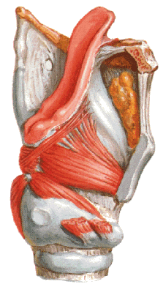
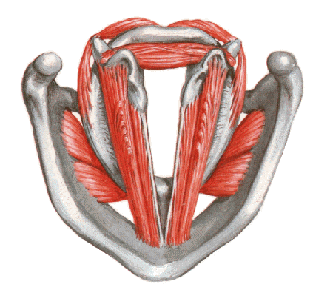
MUSCULI LARYNGIS
M. thyroarytenoideus
(thyroepiglotticus)
M. vocalis
Rima glottidis – pars intermembranacea
– pars intercartilaginea

Slide 36
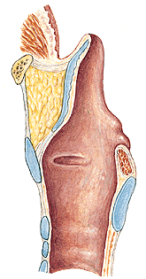
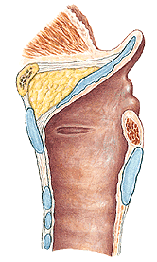

Slide 37
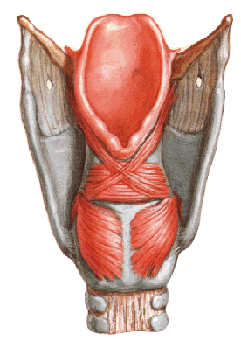
M. cricoarytenoideus post.
- respiration

Slide 38
M. cricoarytenoideus lateralis
M. arytenoideus transversus
M. arytenoideus obliquus (aryepiglotticus)

Slide 39
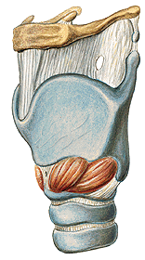
M. cricothyroideus

Slide 40
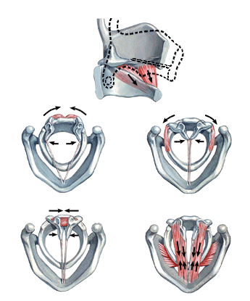
M. cricothyroideus
M. cricoarytenoideus
post.
M. cricoarytenoideus
lateralis
M. arytenoideus trans. et obliq.
M. thyroarytenoideus

Slide 41
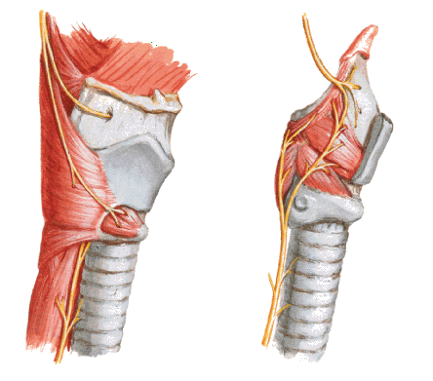
N. laryngeus sup. (CN X)
N. laryngeus inf. – N. laryngeus recurrens (CN X)

Slide 42
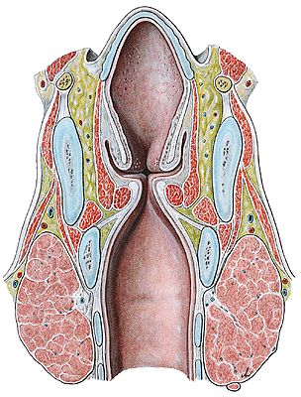
CAVITAS LARYNGIS
vestibulum laryngis
plicae vestibulares
rima vestibuli
plicae vocales
rima glottidis
-glottis
-ventriculus laryngis
cavitas infraglottica

Slide 43
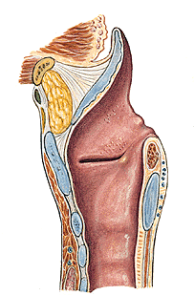
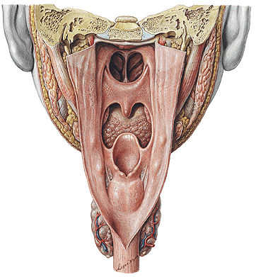
CAVITAS LARYNGIS
aditus laryngis-plicae aryepiglotticae (tuberculum cuneiforme
et corniculatum), plica interarytenoidea,incisura inter-
arytenoidea
plicae vestibulares
plicae vocales

Slide 45
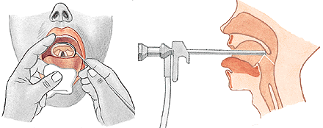
LARYNGOSCOPY
indirect
direct

Slide 46
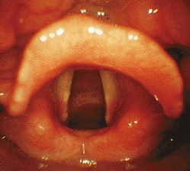
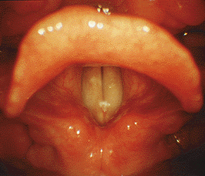
RESPIRATION
PHONATION

Slide 47
Vocal Cords up close while singing
YouTube video

Slide 48


Slide 49


Slide 50


TRACHEA
pars cervicalis
pars thoracica
bifurcatio tracheae
- carina tracheae
15-20 cartilagines tracheales
ligg. anularia
paries membranaceus
(m. trachealis)
- glandulae tracheales

Slide 51
M. sternohyoideus
M. sternothyroideus
Lamina pretrachealis fasciae colli

Slide 52

TOPOGRAPHY OF THE TRACHEA
isthmus glandulae thyroideae
vv. thyroideae inferiores
truncus brachiocephalicus
arcus aortae
v. brachiocephalica sinistra
v. cava sup.
a. carotis communis
v. jugularis int.
n. vagus
oesophagus
n. laryngeus recurrens
nodi lymph. paratracheales

Slide 53



Slide 54

CONIOTOMIA (CRICOTHYROTOMIA)
TRACHEOTOMIA SUPERIOR
TRACHEOTOMIA INFERIOR

Slide 55
INFERIOR TRACHEOTOMY
vv. thyroideae inferiores
a. thyroidea ima
- v. brachiocephalica sinistra
arcus venosus juguli
pleura
thymus
TRACHEOSTOMY

Slide 56


BRONCHI
- principales
- lobares
- segmentales
BRONCHIOLI
ALVEOLI
Arbor bronchialis

Slide 57


PULMO DEXTER
Lobus superior,
medius et inferior
Fissura obliqua
et horizontalis
Apex pulmonis
Basis pulmonis
(facies diaphragmatica)
Facies costalis
Facies mediastinalis
Margo anterior
inferior
posterior
PULMO SINISTER
Lobus superior et
inferior
Fissura obliqua
Incisura cardiaca
Lingula

Slide 58


FACIES MEDIASTINALIS
hillum pulmonis
radix pulmonis
lig. pulmonale
impressio cardiaca

Slide 59


SEGMENTA BRONCHOPULMONALIA DEXTRA
s. apicale 4. s. laterale 6. s. apicale
s. posterius 5. s. mediale 7. s. basale mediale
s. anterius 8. s. basale anterius
9. s. basale laterale
10. s. basale posterius

Slide 60


SEGMENTA BRONCHOPULMONALIA SINISTRA
1+2. s. apicoposterius 6. s. apicale
3. s. anterius (7. s. basale mediale)
4. s. lingulare superius 8. s. basale anterius
5. s. lingulare inferius 9. s. basale laterale
10. s. basale posterius

Slide 61


PLEURA - visceralis
- parietalis - costalis
- diaphragmatica
- mediastinalis
Cavitas pleuralis
Cupula pleurae
Recessus pleurae:
r. costodiaphragmaticus
r. costomediastinalis
r. phrenicomediastinalis
Pneumothorax

Slide 62

Area interpleuralis sup. (thymica)
Area interpleuralis inf. (pericardiaca)

Slide 63



Slide 64



Slide 65

EXPIRATION
INSPIRATION

Slide 66


Slide 67


GLANDULA THYROIDEA – lobus dexter
- lobus sinister
- isthmus
- lobus
pyramidalis

Slide 68


Slide 69

Capsula propria, folliculi, colloid – thyroid hormone, calcitonin
Fascia externa s. perithyroidea
A. et v. thyroidea sup. et inf., a. thyroidea ima,
nll. cervicales prof., nll. paratracheales

Slide 70

GLANDULAE PARATHYROIDEAE –sup. et inf.
Parathormone (parathyroid hormone; PTH)

Slide 71

THYMUS

Slide 72



MEDIASTINUM
- superius
- inferius - anterius
- medium
- posterius

Slide 74



Slide 76




Slide 77


T8

Slide 78
MUSCULI THORACIS

Slide 79

EXTRINSIC MUSCLES
M. pectoralis major
M.pectoralis minor
M. subclavius
M. serratus ant.

Slide 80


Slide 81

M. sternalis

Slide 82

INTRINSIC MUSCLES
M. intercostales externi
M. intercostales interni
M. intercostales intimi
M. subcostales

Slide 84

M. transversus thoracis

Slide 85

DIAPHRAGM
Centrum tendineum
- foramen VCI
Pars sternalis
Pars costalis
Pars lumbalis
- crus dextrum
- crus sinistrum
- lig. arcuatum medianum
- lig. arcuatum mediale
- lig. arcuatum lat.

Slide 86

Hiatus esophageus
Hiatus aorticus

Slide 87


Slide 88
Illustrations and photographs were copied from:
Atlas der Anatomie des Menschen/Sobotta.
Putz,R., und Pabst,R. 20. Auflage. München:
Urban & Schwarzenberg, 1993
Netter: Interactive Atlas of Human Anatomy.
Windows Version 2.0

