Slide 1
URINARY SYSTEM

Slide 2
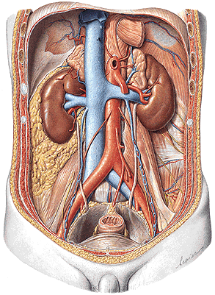
FUNCTIONS
PARTS
Removal of waste product
from the body
Regulation of electrolyte
balance
Regulation of acid-base
homeostasis (blood pH)
Controling blood
volume and maintaining
blood pressure
Kidney (ren)
Efferent urinary tract:
renal calices
renal pelvis
ureter
urinary bladder
urethra

Slide 3
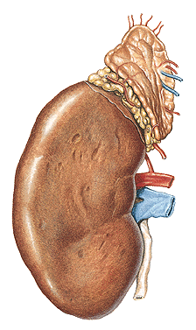
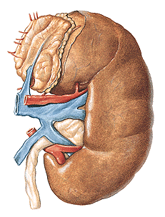
REN, NEPHROS - facies anterior et posterior
- margo medialis - hilum renale (sinus renalis)
- margo lateralis
- extremitas superior et inferior
L
R

Slide 4
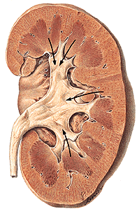
Capsula fibrosa
Sinus renalis
Cortex renalis
Medulla renalis
– 6-20 pyramides renales
Columnae renales
Papilla renalis
Ductus papillares
Foramina papillaria
Area cribrosa
Lobus renalis

Slide 5
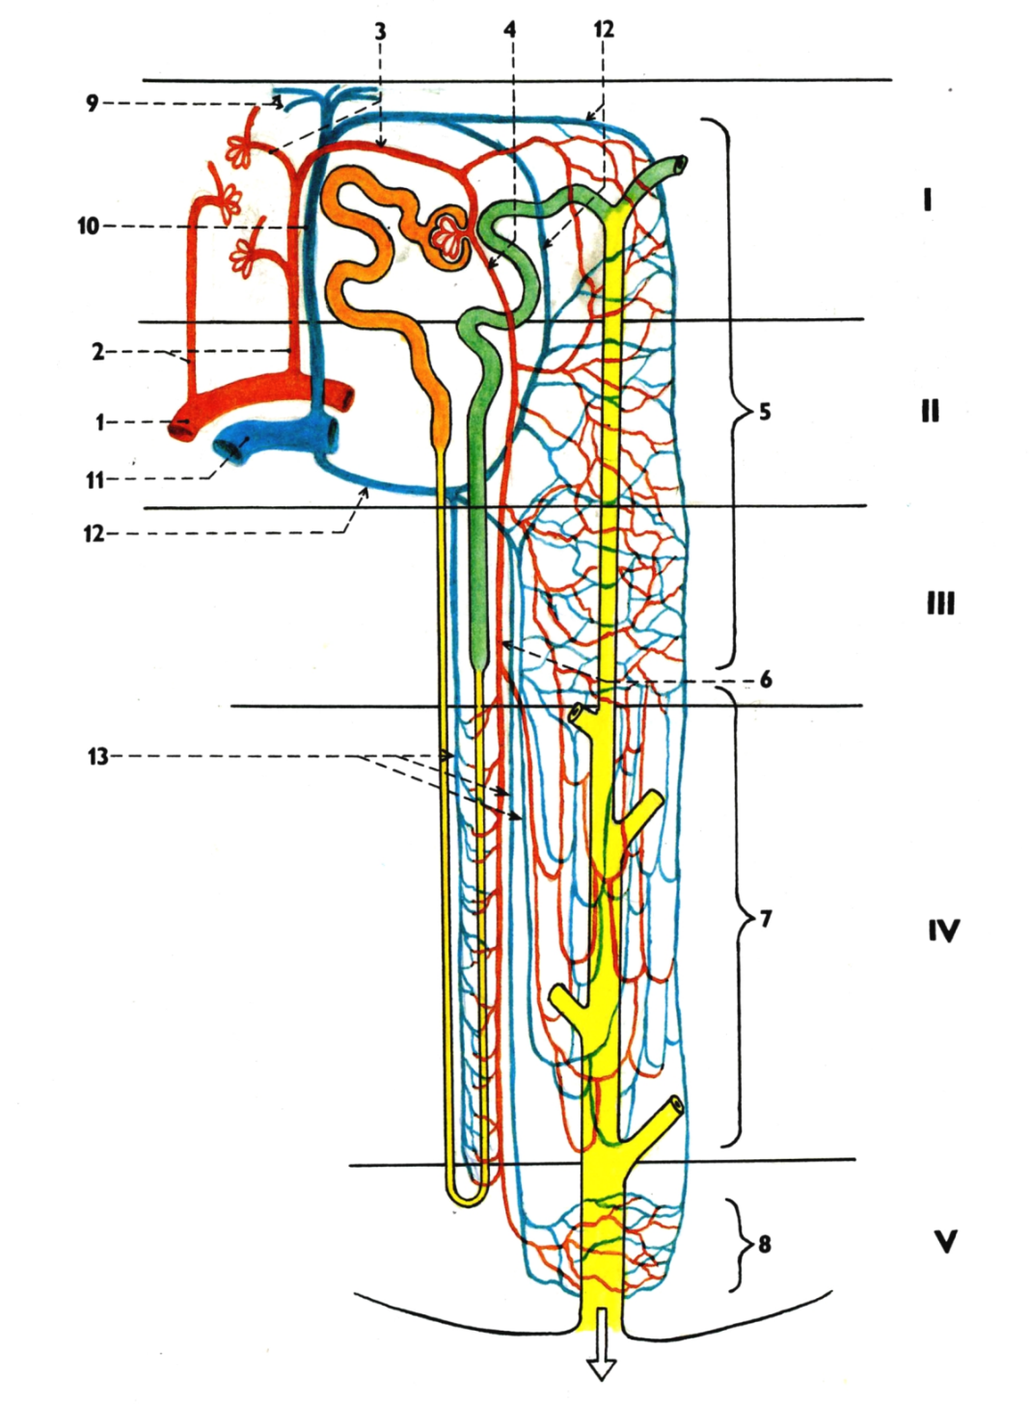
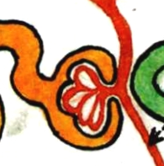
NEPHRON
Corpusculum renale (Malpighi)
- Glomerulus
- Capsula glomeruli (Bowman)
Tubulus proximalis
Henle’s loop
Tubulus distalis
Tubulus colligens
Ductus papillaris
Foramen papillare
200 µm

Slide 6
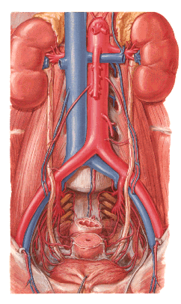
renalis
- r. anterior – 4 rr. praepelvici
- r. posterior – r. retropelvicus

Slide 7
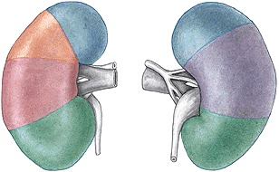
Segmenta renalia – s. superius
- s. anterius superius
- s. anterius inferius
- s. inferius
- s. posterius

Slide 8
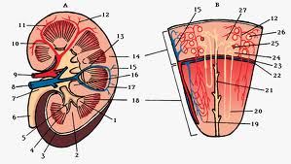
- aa. lobares – aa. interlobares – aa. aruateae

Slide 9
Aa. interlobares:
1. A. arcuata
2. A. interlobularis
3. Vas afferens
4. Vas efferens
5. Peritubular capillary plexus
6. Arteriola recta
7. Capillary plexus in the medulla
8. Capillary plexus around
papillary duct
9. Venulae stellatae
10.V. interlobularis
11.V. arcuata
12.Vein from the peritubular plexus
13.Venulae rectae

Slide 10
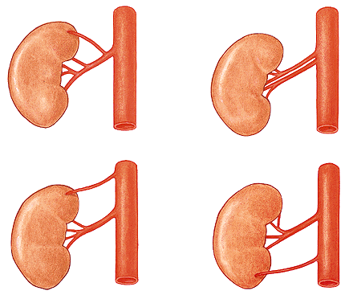
Aa. renales accessoriae

Slide 11
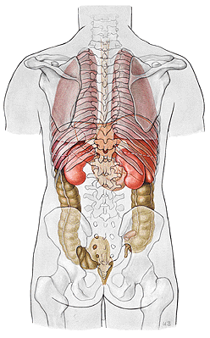
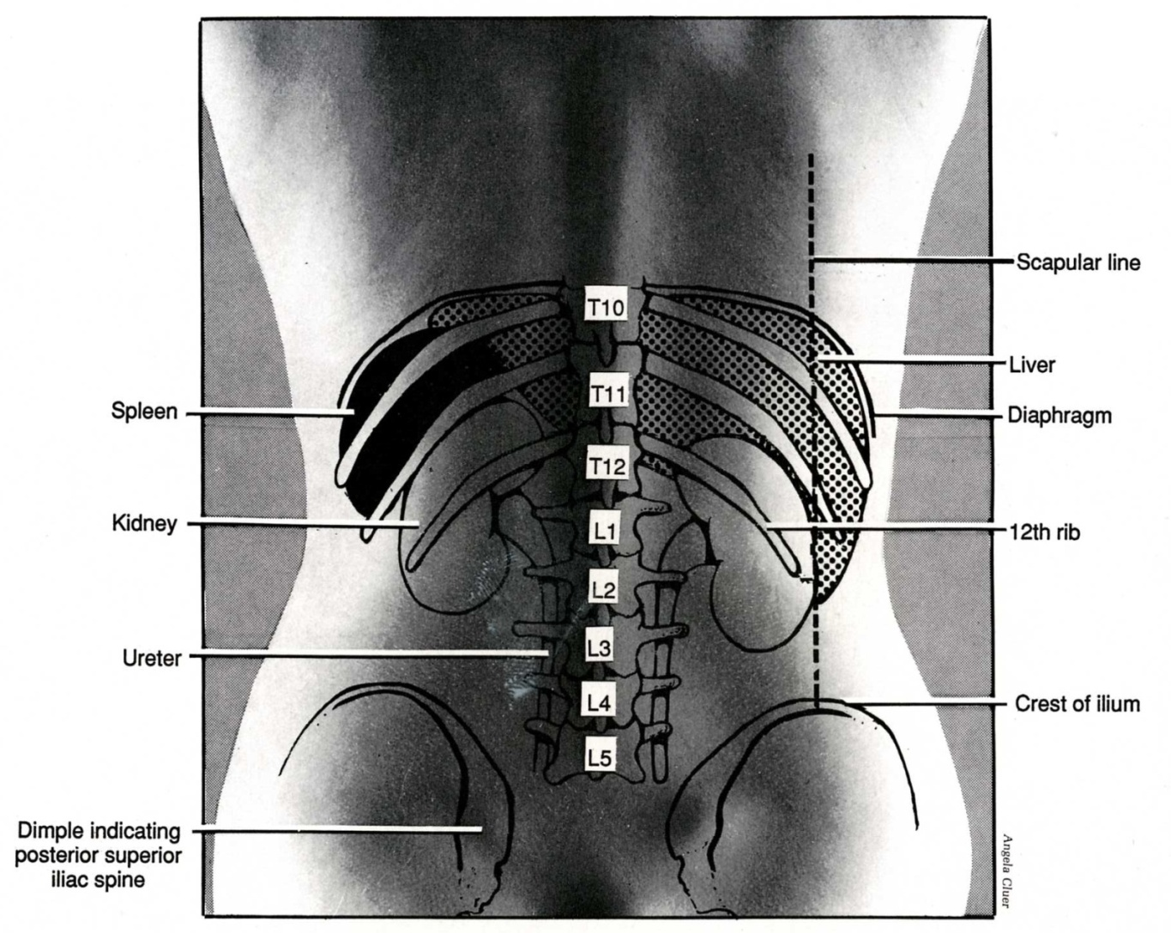

Slide 12
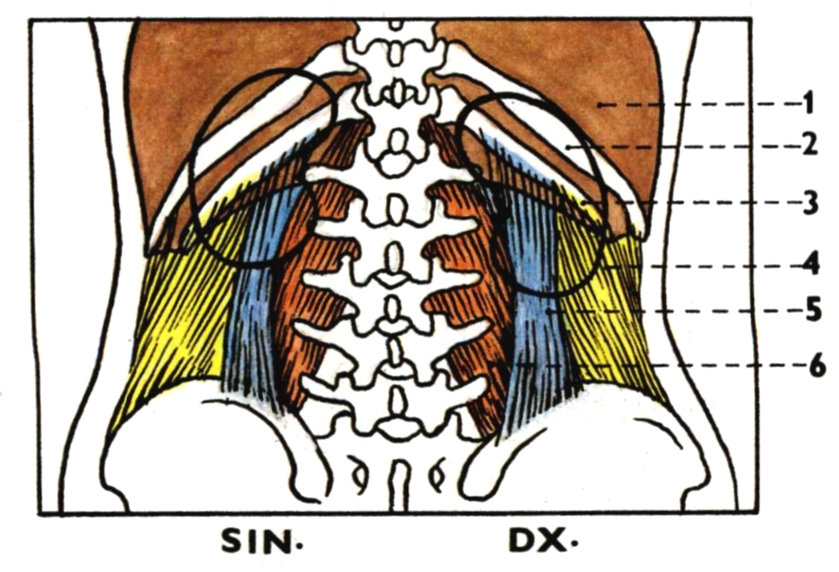
Diaphragma 4. M. transversus abdominis
11th rib 5. M. quadratus lumborum
12th rib 6. M. psoas major

Slide 13
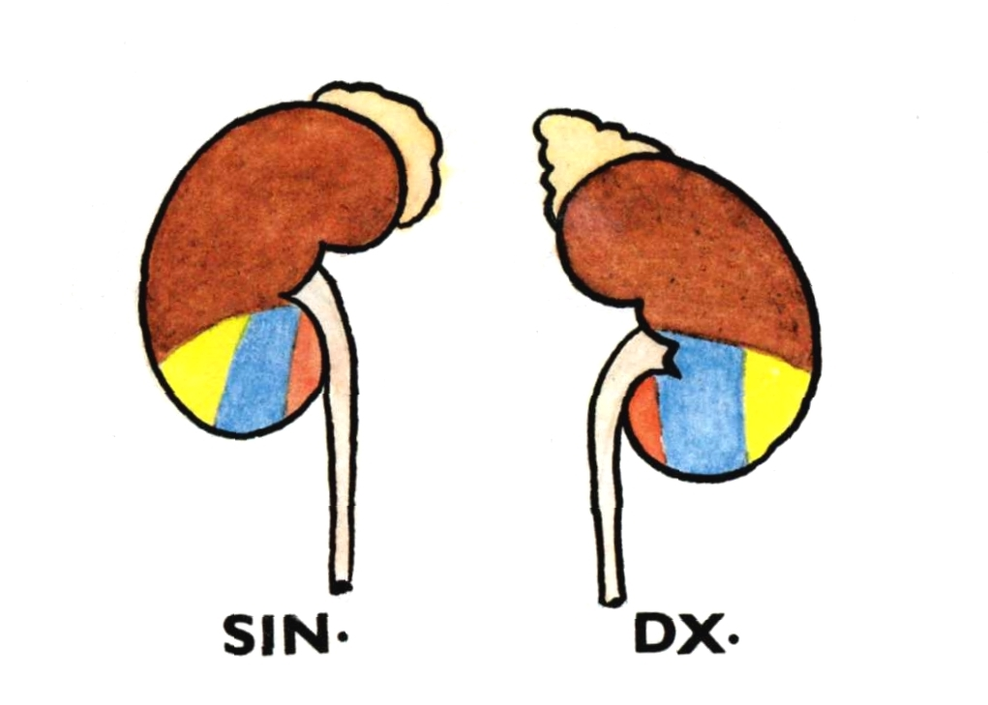

Slide 14
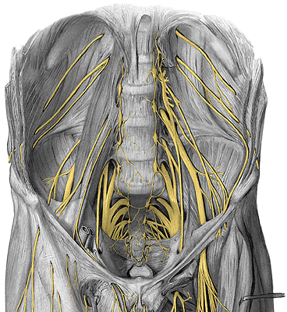
N. subcostalis
N. iliohypogastricus
N. ilioinguinalis

Slide 15
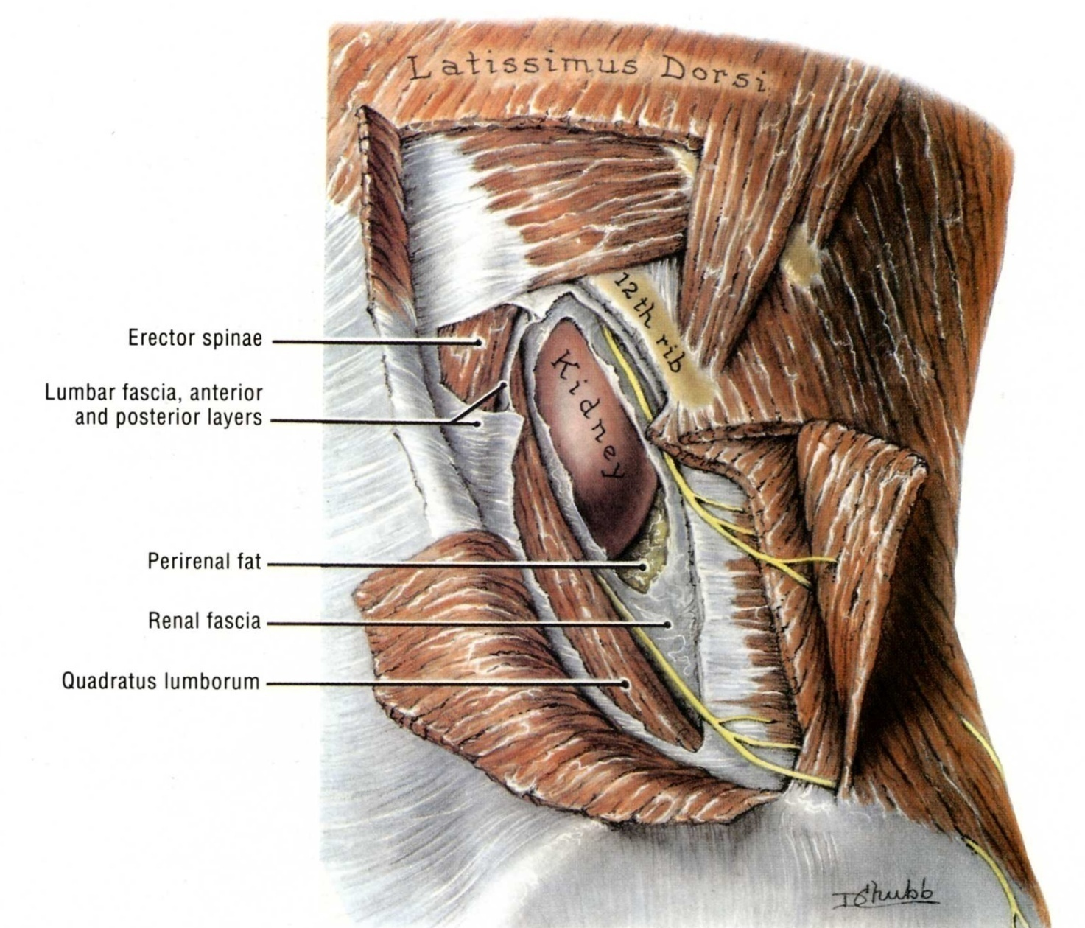

Slide 16
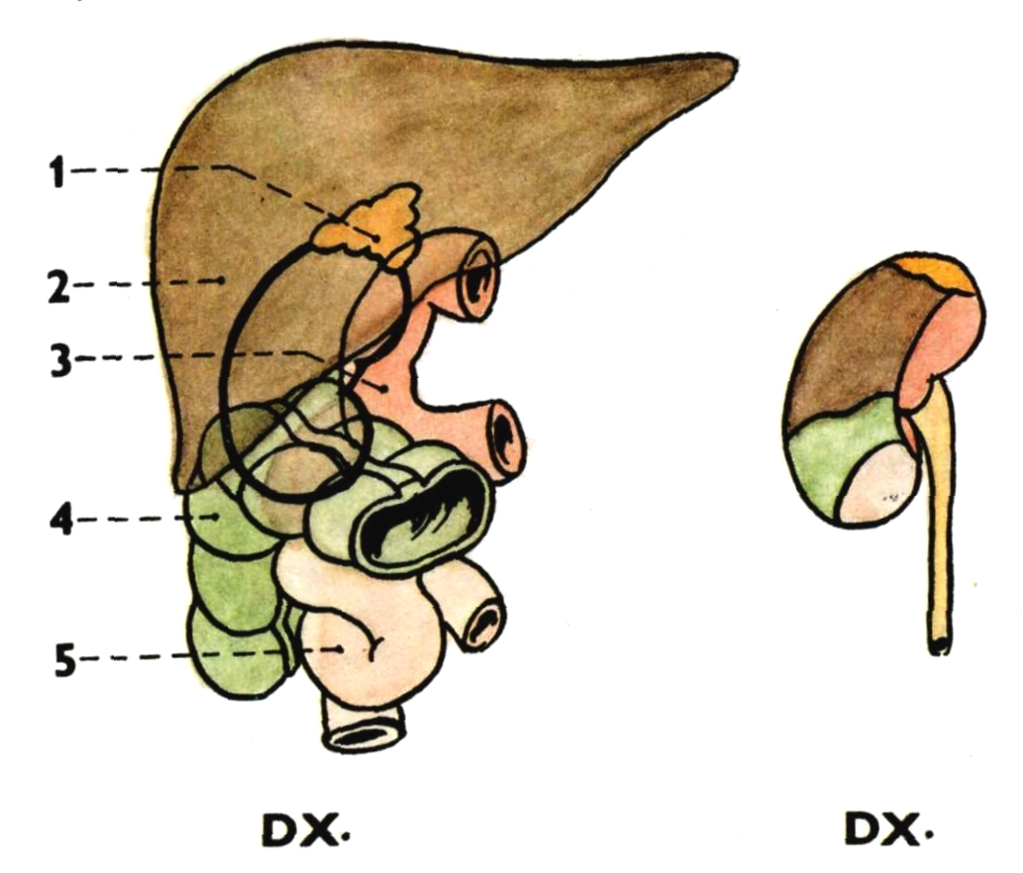
Gl. suprarenalis dx.
Liver
Duodenum
Flexura coli dx.
Jejunum

Slide 17
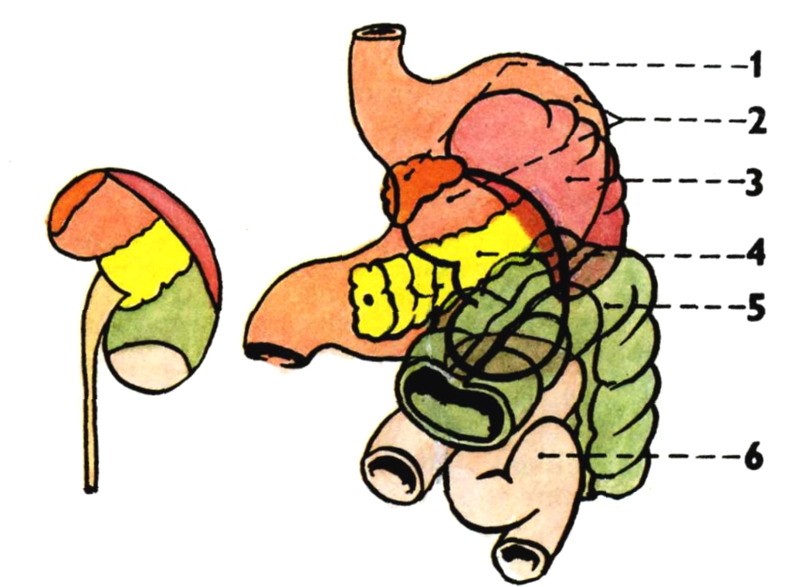
Gl. suprarenalis sin.
Stomach
Spleen
Pancreas
Flexura coli sin.
Jejunum
SIN.

Slide 18
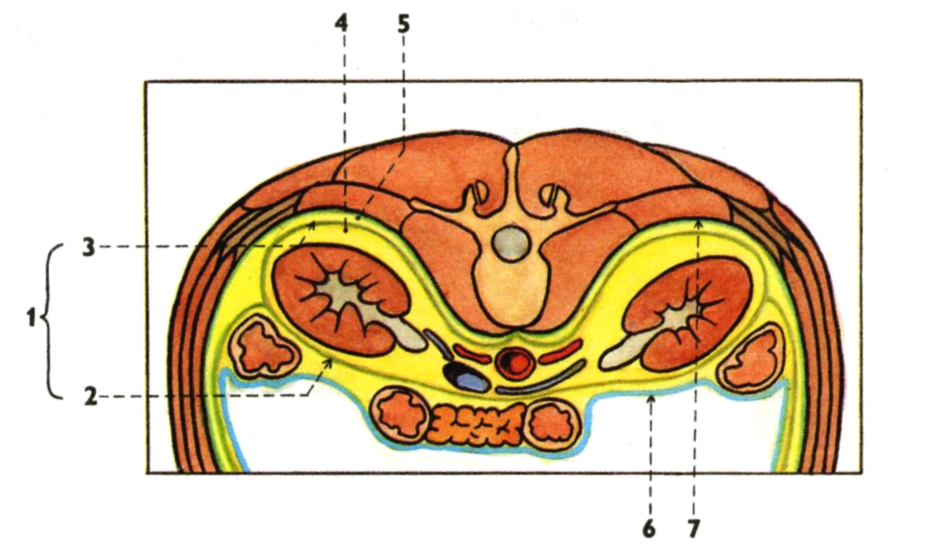
Fascia renalis 5. Corpus adiposum pararenale
Lamina praerenalis 6. Peritoneum
Lamina retrorenalis 7. Fascia transversalis
Capsula adiposa
REN MIGRANS

Slide 19
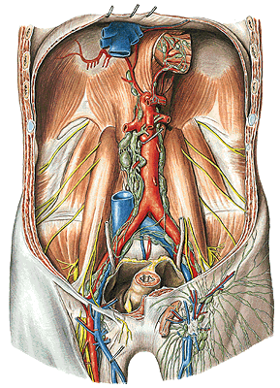
Nll. lumbales
(paraaortici)
tr. lumbalis dx. et sin.
Notes:
Lymphatic vessels, Vasa lymphatica, lymph nodes, Nodi lymphatici, of the pelvic wall in the female; the pelvis has been sectioned in the median plane; the uterus has been pulled sinistroventrally; most of the peritoneum has been removed; lateral view (right). The lymph nodes shown here are often much smaller but always present. Via the lymphatic vessels in the round ligament (Lig. teres uteri) tumor cells may spread from the uterus to the superficial inguinal lymph nodes.

Slide 20
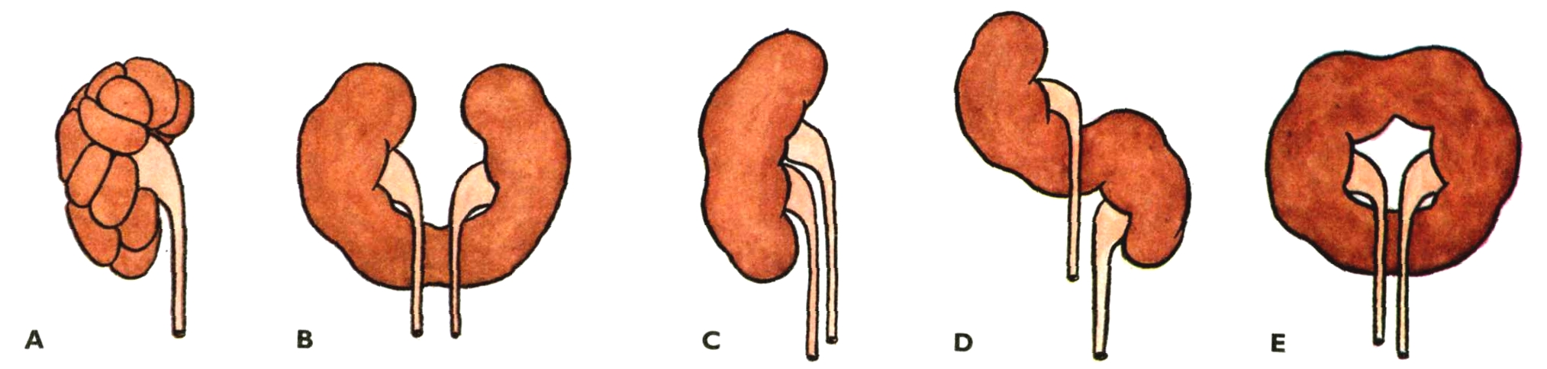
renculi marking
ren arcuatus
ren duplex
ren sigmoideus
ren fungiformis
agenesia renis

Slide 21
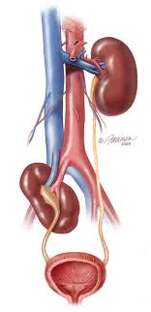
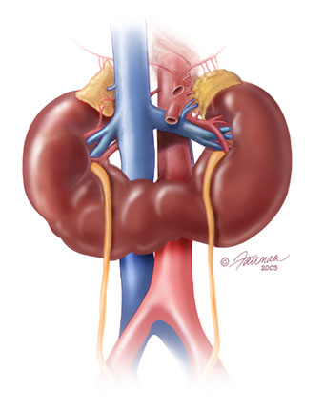
Ectopic kidney x ren migrans
Horseshoe kidney

Slide 22
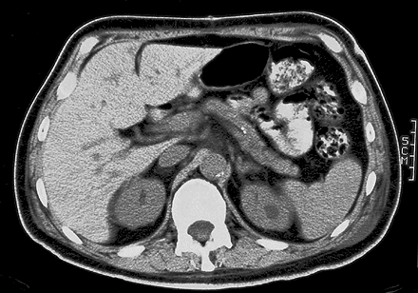
Cross-sectional image through the L1 obtained with CT

Slide 23
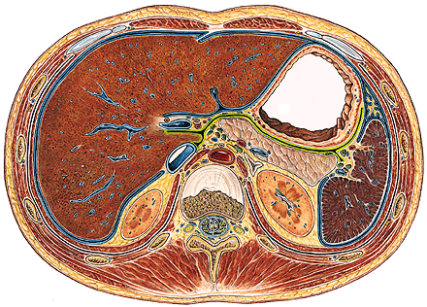
Transverse section through the intervertebral disc between T12 and L1

Slide 24
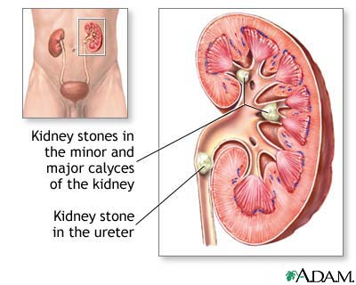
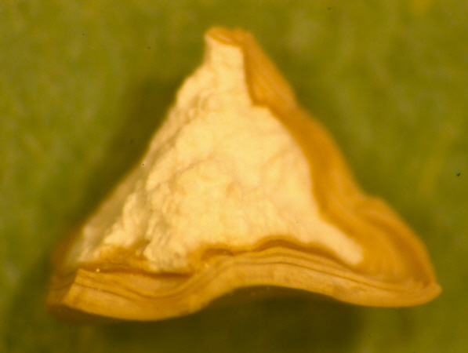
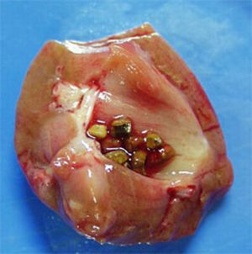
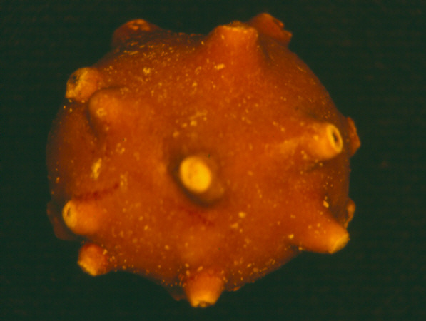
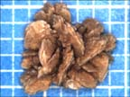
Nephrolithiasis
Calcium oxalate crystals – 80%
Uric acid – 5 - 10%

Slide 25
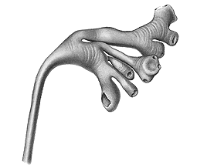
CALICES RENALES – minores et majores
PELVIS RENALIS (PYELUM)

Slide 26
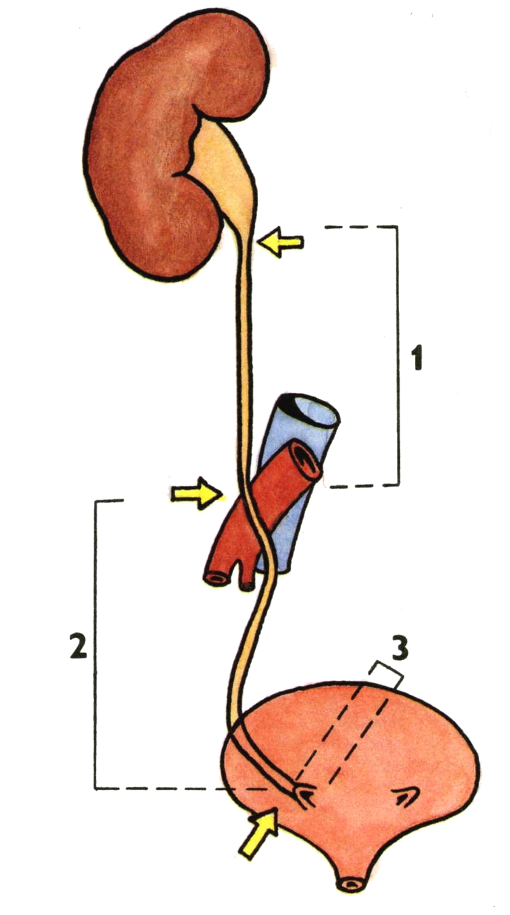
URETER
pars abdominalis
pars pelvina
pars intramuralis
ostium ureteris

Slide 27
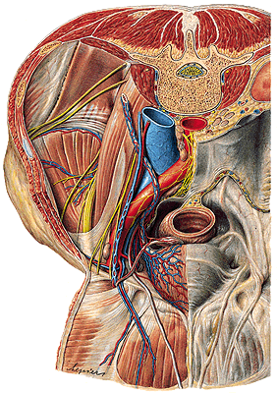
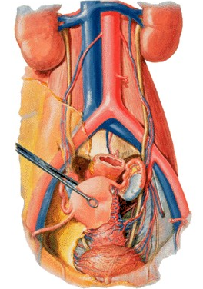

Slide 28
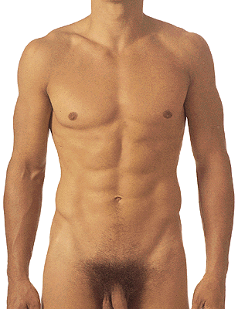

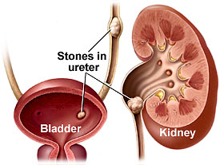
3 physiological constrictions
Point of LANZ

Slide 29
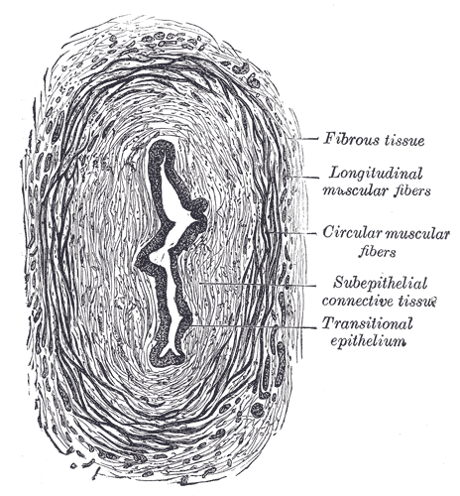
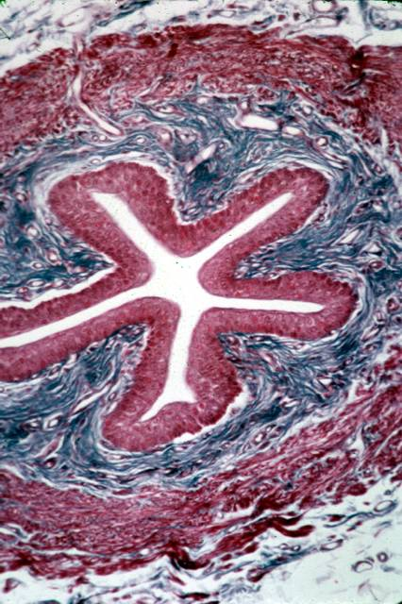
Adventitia
Plicae longitudinales

Slide 30
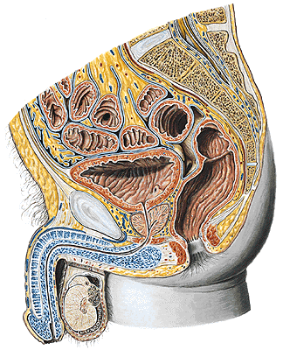
VESICA URINARIA
fundus vesicae
corpus vesicae
apex vesicae
- lig. umbilicale medianum
cervix vesicae

Slide 31
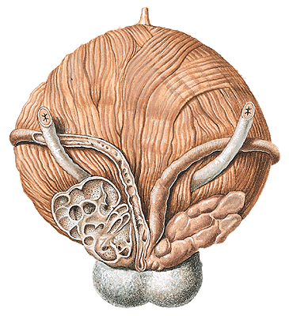
Male - dorsal aspect of urinary bladder
Ductus deferens
Female – superior view

Slide 32
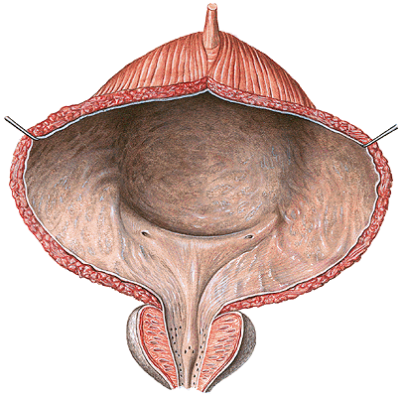
Trigonum vesicae – ostia ureterum
– ostium urethrae internum
– plica interureterica
– fossa retrotrigonalis
– uvula vesicae
– m. detrusor
– m. sphincter vesicae
– m. sphincter urethrae

Slide 33
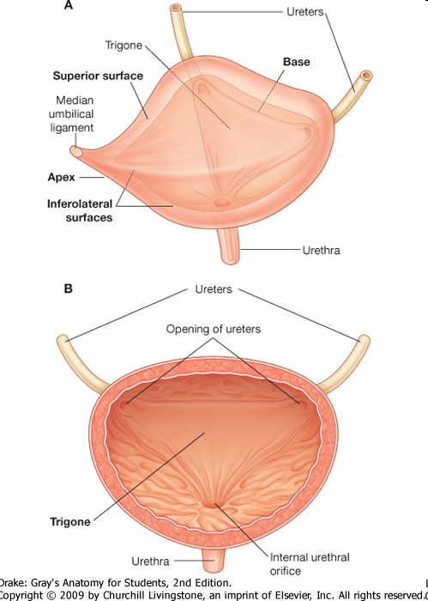
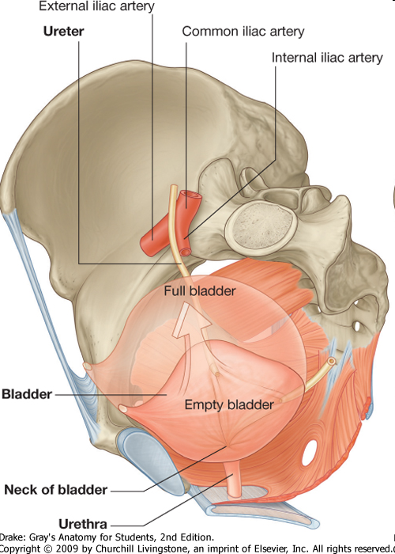

Slide 34
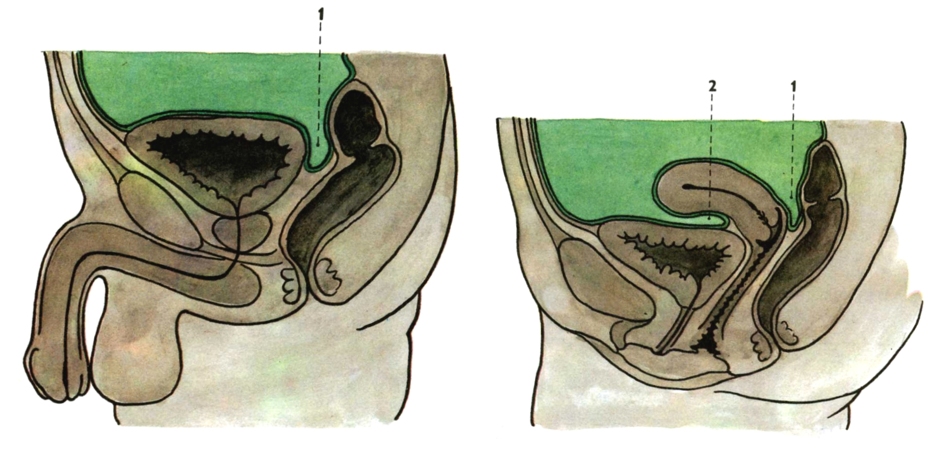
Median section through
the male pelvis
1. Excavatio rectovesicalis
Median section through
the female pelvis
Excavatio rectouterina
Excavatio vesicouterina
Paracystium

Slide 35
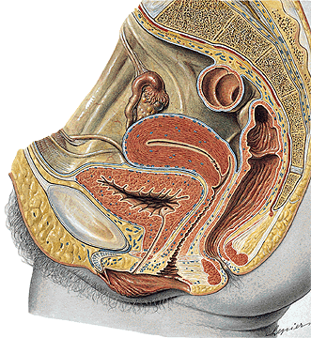
URETHRA FEMININA
Ostium urethrae internum
M. sphincter urethrae
Ostium urethrae externum

Slide 36
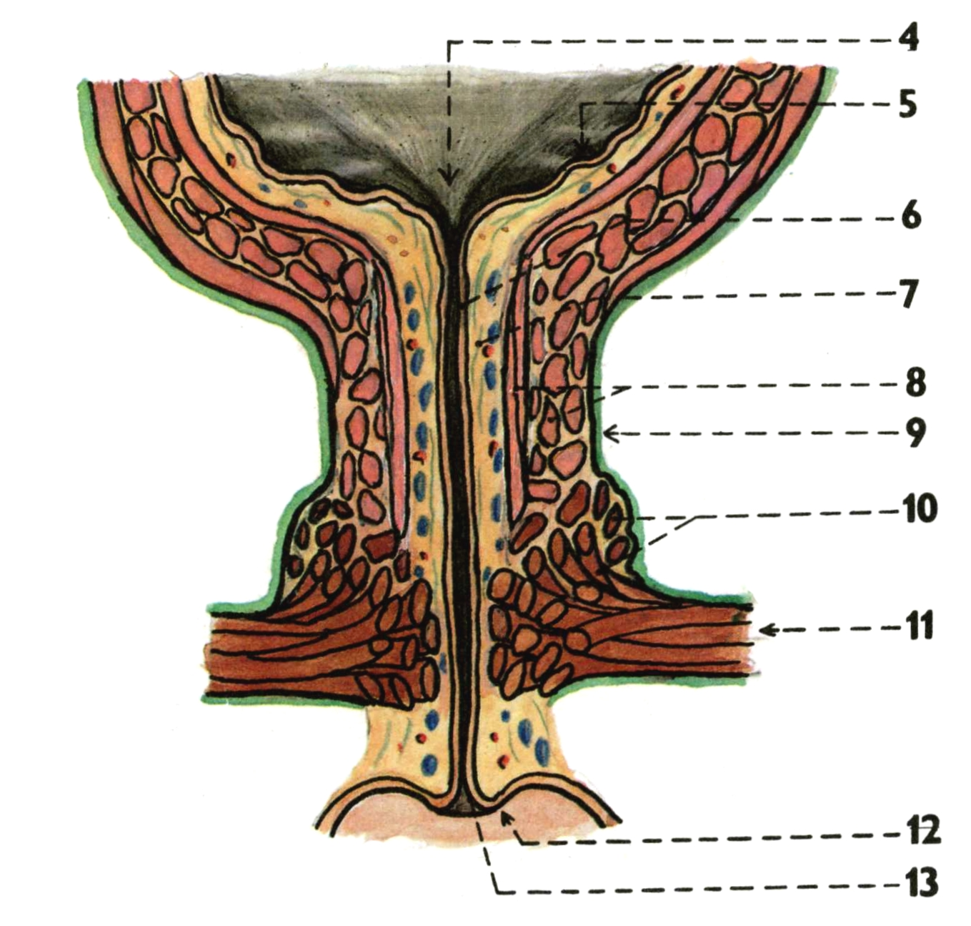
URETHRA FEMININA
Crista urethralis
Lacunae urethrales
Glandulae urethrales
Ductus paraurethrales

Slide 37
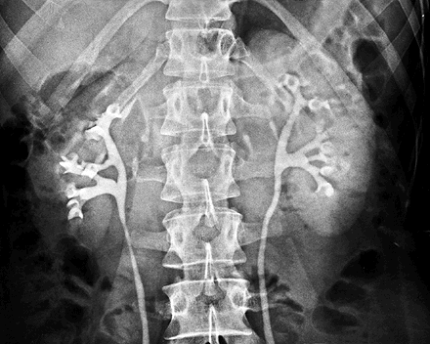
IVU

Slide 38
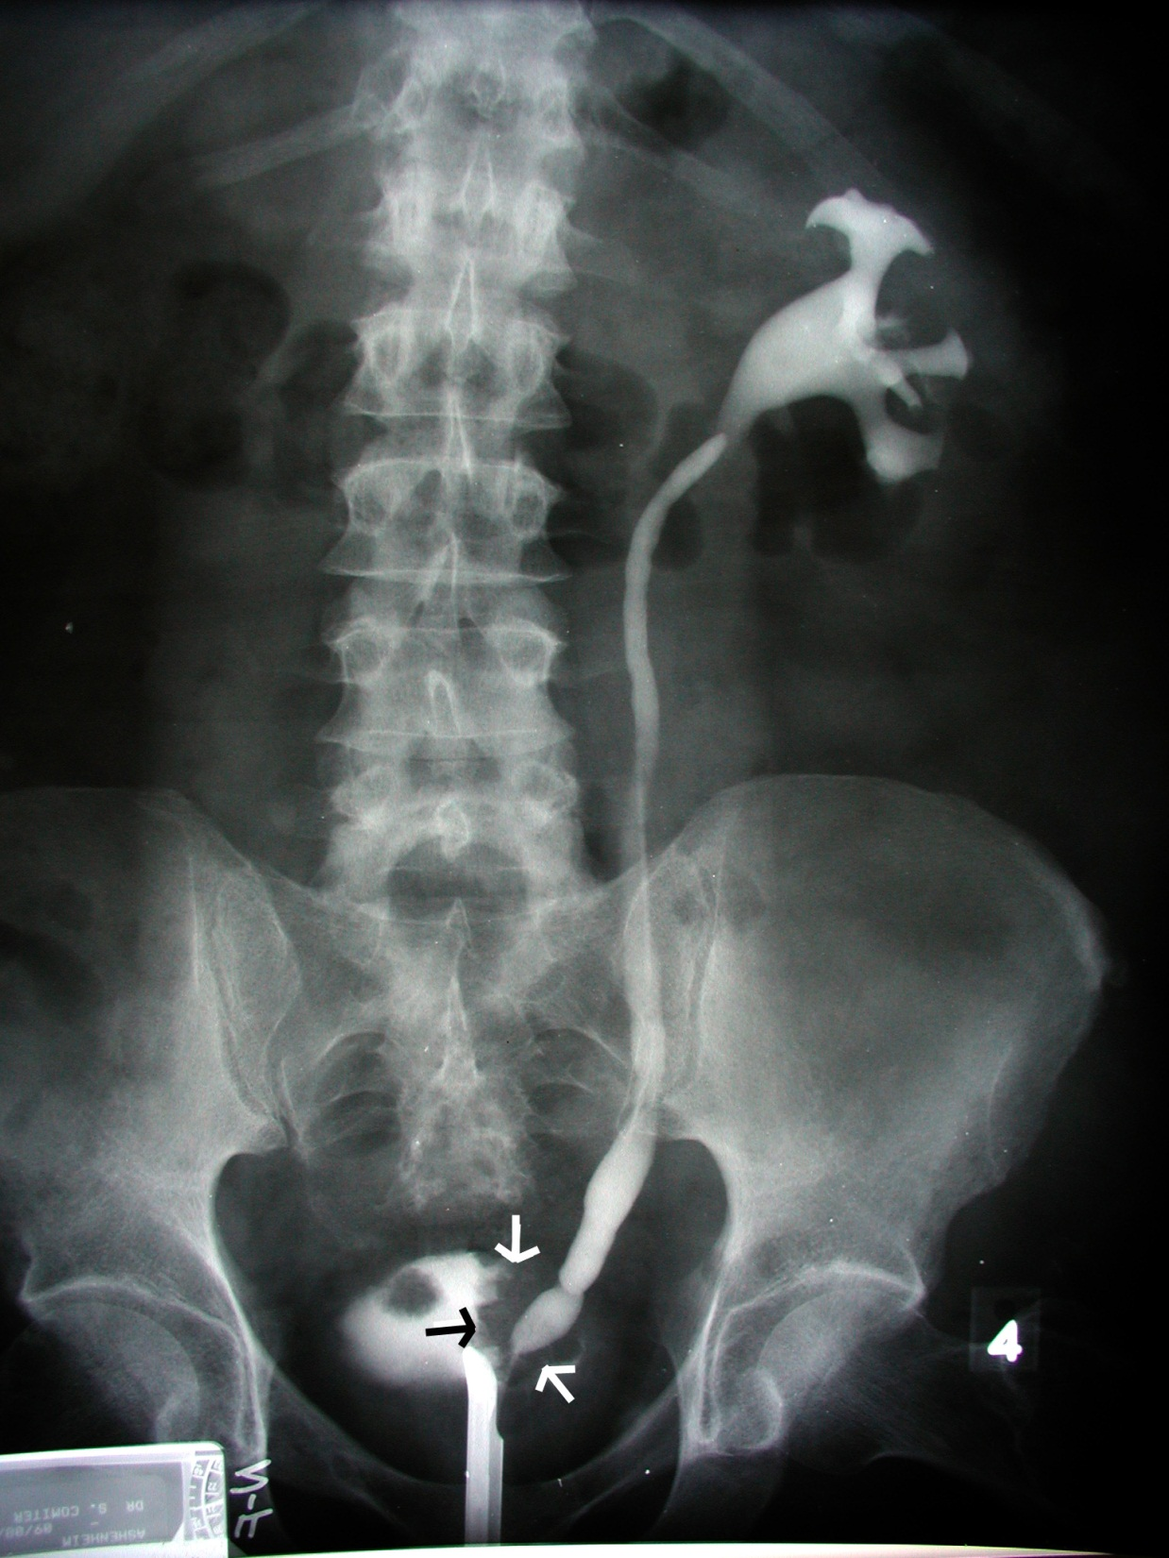
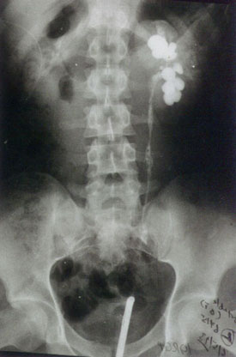
Retrograde pyelography

Slide 39
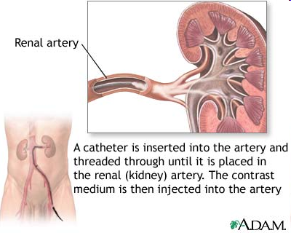



Slide 40


Vesicoureteral reflux (VUR) – voiding cystourethrogram (VCU)

Slide 41


Retrocaval ureter

Slide 42


Ureter duplex

Slide 43


Horseshoe kidney

Slide 44
MALE GENITAL ORGANS
(ORGANA GENITALIA MASCULINA)

Slide 45

Organa genitalia interna:
Testis
Epididymis
Ductus deferens
Urethra masculina
Vesicula seminalis
Prostata
Organa genitalia externa:
Penis
Scrotum

Slide 46


Development: Wolffian ducts
Müllerian ducts

Slide 47

TESTIS
Facies medialis
Facies lateralis
Extremitas superior
Extremitas inferior
Margo anterior
Margo posterior
Lamina visceralis tunicae vaginalis
(Epiorchium)

Slide 48

Tunica albuginea
Mediastinum testis
Septula testis
Lobuli testis
Hilum testis
Tubuli seminiferi contorti
Spermatozoa
Interstitial cells of Leydig
Tubuli seminiferi recti
Rete testis
Ductuli efferentes testis

Slide 49
A. testicularis
Plexus pampiniformis
- vv. testiculares
Nll. lumbales

Slide 50

EPIDIDYMIS
Caput epididymidis
Corpus epididymidis
Cauda epididymidis
Sinus epididymidis
Lig. epididymidis sup. et inf.
Lig. scrotale
(Gubernaculum testis)
Lobuli epididymidis
Ductus epididymidis

Slide 51





DESCENSUS TESTIUM
Gubernaculum testis → Lig. scrotale
Processus vaginalis → Tunica vaginalis
Lig. vaginale
Retentio testis (cryptorchidism). Ectopia testis.

Slide 52



DUCTUS DEFERENS (VAS DEFERENS)
Pars epididymica
Pars funicularis
Pars inguinalis
Pars pelvina
Ampulla ductus deferentis - diverticula ampullae
Ductus ejaculatorius – colliculus seminalis

Slide 53


FUNICULUS SPERMATICUS: A. testicularis
Plexus testicularis
Plexus pampiniformis
Ductus deferens
A. ductus deferentis
Plexus deferentialis

Slide 54

COVERINGS OF THE TESTIS, EPIDIDYMIS AND SPERMATIC
CORD
Epiorchium (Lamina visceralis tunicae vaginalis)
Periorchium (Lamina parietalis tunicae vaginalis)
Cavum serosum scroti

Slide 55

Fascia spermatica interna (Fascia transversalis)
Fascia cremasterica - M. cremaster
(M. obliquus abdominis internus, M. transversus abdominis)
Fascia spermatica externa (Fascia abdominis superficialis)

Slide 56

CANALIS INGUINALIS
Posterior wall:
Fascia transversalis:
Falx inguinalis
Trigonum inguinale
(Hesselbachi)
Lig. interfoveolare
Anulus inguinalis prof.
Tractus iliopubicus
Anulus femoralis

Slide 57


CANALIS INGUINALIS
Inferior wall:
Lig. inguinale

Slide 58

CANALIS INGUINALIS
Anterior wall:
Aponeurosis m. obliqui
externi abdominis
Anulus inguinalis spf.
- crus mediale
- crus laterale
- fibrae intercrurales
- lig. inguinale reflexum

Slide 59

CANALIS INGUINALIS
Superior wall:
M. obliquus internus abdominis
M. transversus abdominis
- M. cremaster

Slide 60

Plica umbilicalis mediana
- lig. umbilicale medianum
Plica umbilicalis medialis
- lig. umbilicale mediale (laterale)
(pars occlusa a. umbilicalis)
Plica umbilicalis lateralis
- vasa epigastrica inf.
Fossa supravesicalis
Fossa inguinalis medialis
(trig. Inguinale)
Fossa inguinalis lateralis
(anulus inguinalis prof.)

Slide 62

Fossa supravesicalis
- hernia supravesicalis (c)
Fossa inguinalis medialis
- hernia inguinalis directa (b)
Fossa inguinalis lateralis
- hernia inguinalis indirecta (a)

Slide 63
VESICULA SEMINALIS
Ductus excretorius
Ductus ejaculatorius
PROSTATA
Basis
Apex
Facies anterior
Facies posterior
Facies inferolaterales
Lobus medius
Lobus dexter et sinister
Isthmus

Slide 64

Crista urethralis
Colliculus seminalis
Utriculus prostaticus
Ductus ejaculatorii
Sinus prostatici

Slide 65

Capsula propria
Plexus venosus prostaticus
Fascia periprostatica
Lig. puboprostaticum
Lig. sacrogenitale
Septum rectovesicale
(Denonvilliersʼ fascia)

Slide 66




Slide 67

GLANDULAE BULBOURETHRALES
Ductus gl. bulbourethralis
URETHRA MASCULINA
Ostium urethrae internum
Ostium urethrae externum
Pars intramuralis – M. sphincter vesicae
Pars prostatica
Pars membranacea – M. sphincter urethrae
Pars spongiosa – Ampulla urethrae
Corpus spongiosum penis
Fossa navicularis
Valvula fossae navicularis
Glandulae urethrales
Lacunae urethrales

Slide 68
Curvatura subpubica
Curvatura praepubica
Urethra mobilis (anterior)
Urethra fixa (posterior)

Slide 69

EXTERNAL GENITAL ORGANS
PENIS: Radix
Corpus
Glans
Praeputium
SCROTUM

Slide 70

PENIS
Glans penis Glandulae praeputiales
Collum glandis Smegma praeputii
Corona glandis Frenulum praeputii
Dorsum penis Corpus cavernosum
Facies urethralis Corpus spongiosum
Raphe penis Tunica albuginea
Praeputium Trabeculae
Ostium praeputii Cavernae
A. penis prof. → aa. helicinae

Slide 71

Corpus cavernosum
- crura penis - crista phalica
A. profunda penis
Corpus spongiosum
- bulbus penis
- glans penis

Slide 72

COVERINGS OF PENIS:
Fascia penis profunda
(Aa., Nn. dorsales penis, V. dorsalis penis profunda)
Fascia penis superficialis
(Vv. dorsales penis spf.)
Lig. fundiforme penis
Lig suspensorium penis

Slide 73
SCROTUM
Raphe scroti
Pubes
Tunica dartos scroti
Septum scroti
Cavitas scroti

Slide 74
ANATOMICAL BASIS OF ERECTION
Parasympathetic stimulation
– relaxation of smooth muscle in cavernae and
aa. helicinae, compression of venous plexuses by
bulbospongious and ischiocavernous muscles → erection
Sympathetic stimulation
- contraction of smooth muscle of aa. helicinae, relaxation of
bulbospongious and ischiocavernous muscles, drainage
of blood into v. dorsalis penis prof. → detumescence
EJACULATION OF THE SEMEN
1. Emission of sperms and genital glands secretion
- sympathetic stimulation
2. Expulsion of the semen from the spongy urethra
(ejaculation) – parasympathetic stimulation

Slide 75

Drainage of the male pelvis

Slide 76
PELVIC FLOOR

Slide 77

DIAPHRAGMA PELVIS
M. levator ani – pars iliaca (M. iliococcygeus)
- pars pubica (M. pubococcygeus)
(- M. puborectalis)
M. coccygeus
Hiatus urogenitalis

Slide 78

Arcus tendineus m. levatoris ani

Slide 79

Fascia obturatoria
Canalis pudendalis
(Alcock)
Fascia sup. diaphragmatis
pelvis
Fascia inf. diaphragmatis
pelvis
Fossa ischioanalis/
- rectalis

Slide 80

PERINEUM

Slide 81

Fossa ischioanalis/-rectalis
M. sphincter ani externus
Lig. anococcygeum
N. pudendus – nn. rectales inf.
A. pudenda int. – aa. rect. inf.
V. pudenda int. – vv. rect. inf.

Slide 82

Fascia perinei (superficialis)
Spatium superficiale perinei

Slide 83

M. ischiocavernosus
M. bulbospongiosus

Slide 84

Membrana perinei
Saccus profundus perinei/diaphragma urogenitale
Recessus pubicus
fossae ischioanalis/
- rectalis

Slide 85

M. transversus perinei spf.
Membrana perinei/Fascia inf. diaphragmatis urogenitalis
V. dorsalis penis prof.

Slide 86

SACCUS PROF. PERINEI
M. transversus perinei profundus – Centrum perineale
M. sphincter urethrae
Lig. transversum perinei
Glandulae bulbourethrales

Slide 87

FEMALE SACCUS PROF. PERINEI
(M. transversus perinei profundus)
Lig. transversum perinei
M. sphincter urethrae externus
(M. sphincter urethrovaginalis)
M. compressor urethrae
M. transversus perinei superficialis
Centrum perineale

Slide 88

M. ischiocavernosus
M. bulbospongiosus (M. constrictor cunni)
M. sphincter ani externus
Lig. anococcygeum

Slide 89

A. et v. pudenda interna, n. pudendus – canalis pudendalis -
aa., vv. et nn. rectales inf.

Slide 90


dorsalis penis (clitoridis)
N. dorsalis penis (clitoridis)
V. dorsalis penis (clitoridis) profunda
A.,v. et n. perinealis
Gl. bulbourethralis

Slide 91
Fascia sup.
diaphragmatis
pelvis
Arcus tendineus
fasciae pelvis
Fascia inf.
diaphragmatis
pelvis

Slide 92
Illustrations were copied from:
Atlas der Anatomie des Menschen/Sobotta.
Putz,R., und Pabst,R. 20. Auflage. München:
Urban & Schwarzenberg, 1993)
Netter: Interactive Atlas of Human Anatomy.
Windows Version 2.0
Čihák R: Anatomie 2 (Splanchnologia). Avicenum,
zdravotnické nakladatelství, Praha, 1988.

