Slide 1

DIGESTIVE SYSTEM 2
Oesophagus
Stomach
Small intestine
Large intestine inc. Appendix
Anus

Slide 2
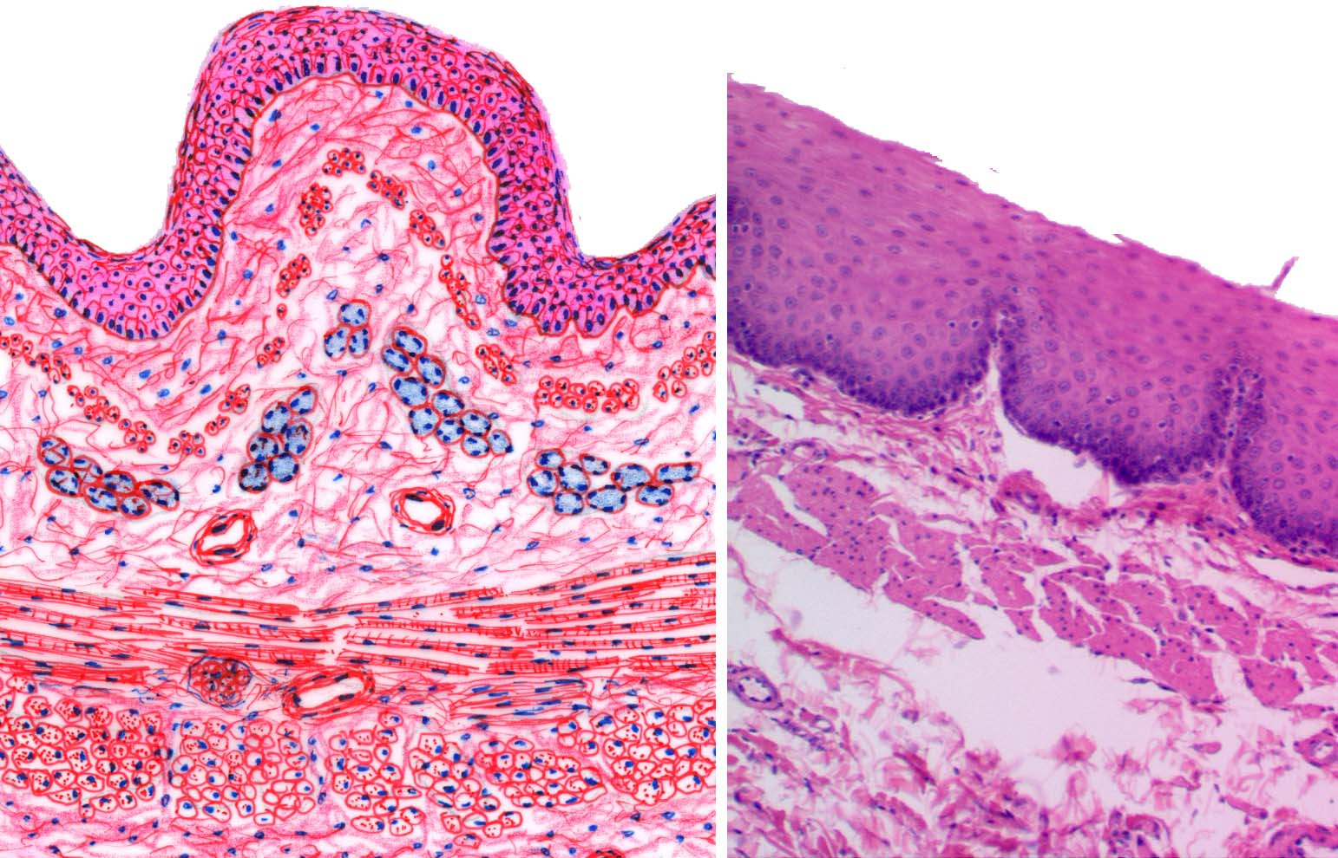
Common structure of the wall of GIT tube
The mucosa
  epithelial linning
  lamina propria
  /loose connect. tissue/
  the muscularis mucosae
The submucosa
/loose connect. tissue + Meissner´s nerve plexus/
The muscularis
  circular
    myenteric nerve plexus
  Longitudinal smooth muscle
The serose or adventitia
/loose connect. tissue -/+mesothelium/

Slide 3
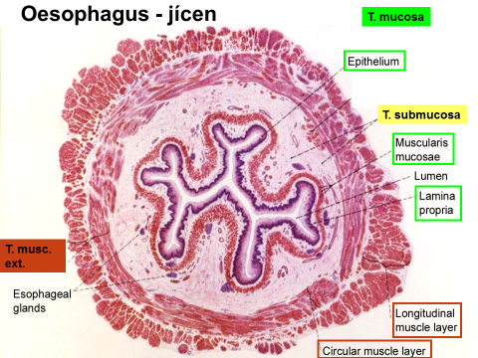
Common structure of the wall of GIT tube
The mucosa
epithelial linning
lamina propria
the muscularis mucosae
The submucosa
loose connect. tissue + Meissner´s nerve plexus
The muscularis
- Circular and Longitudinal smooth muscle
+ plexus myentericus Auerbachi
The serose or adventitia

Slide 4
Inner circular muscle layer
Outer longitudinal muscle layer

Slide 5
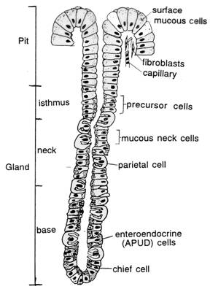
Gastric glands
Gll. cardiacae
  branched tubular mucous glands
Gll. gastricae propriae (fundic glands)
  Simple tubular
  Base, neck, isthmus, pit
    chief c. /zymogenic/- lower part
    parietal (oxyntic) c. /HCl,„intrinsic factor“/- neck
    mucous neck cells
    enteroendocrine cells - base
    (undifferentiated cells)
Gll. pyloricae
  - branched tubular mucous glands

Slide 6
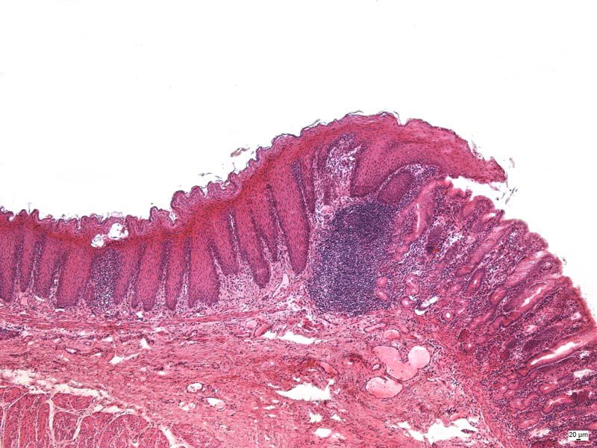
Cardia (HE)
Cardiac glands
  - branched tubular mucous glands

Slide 7
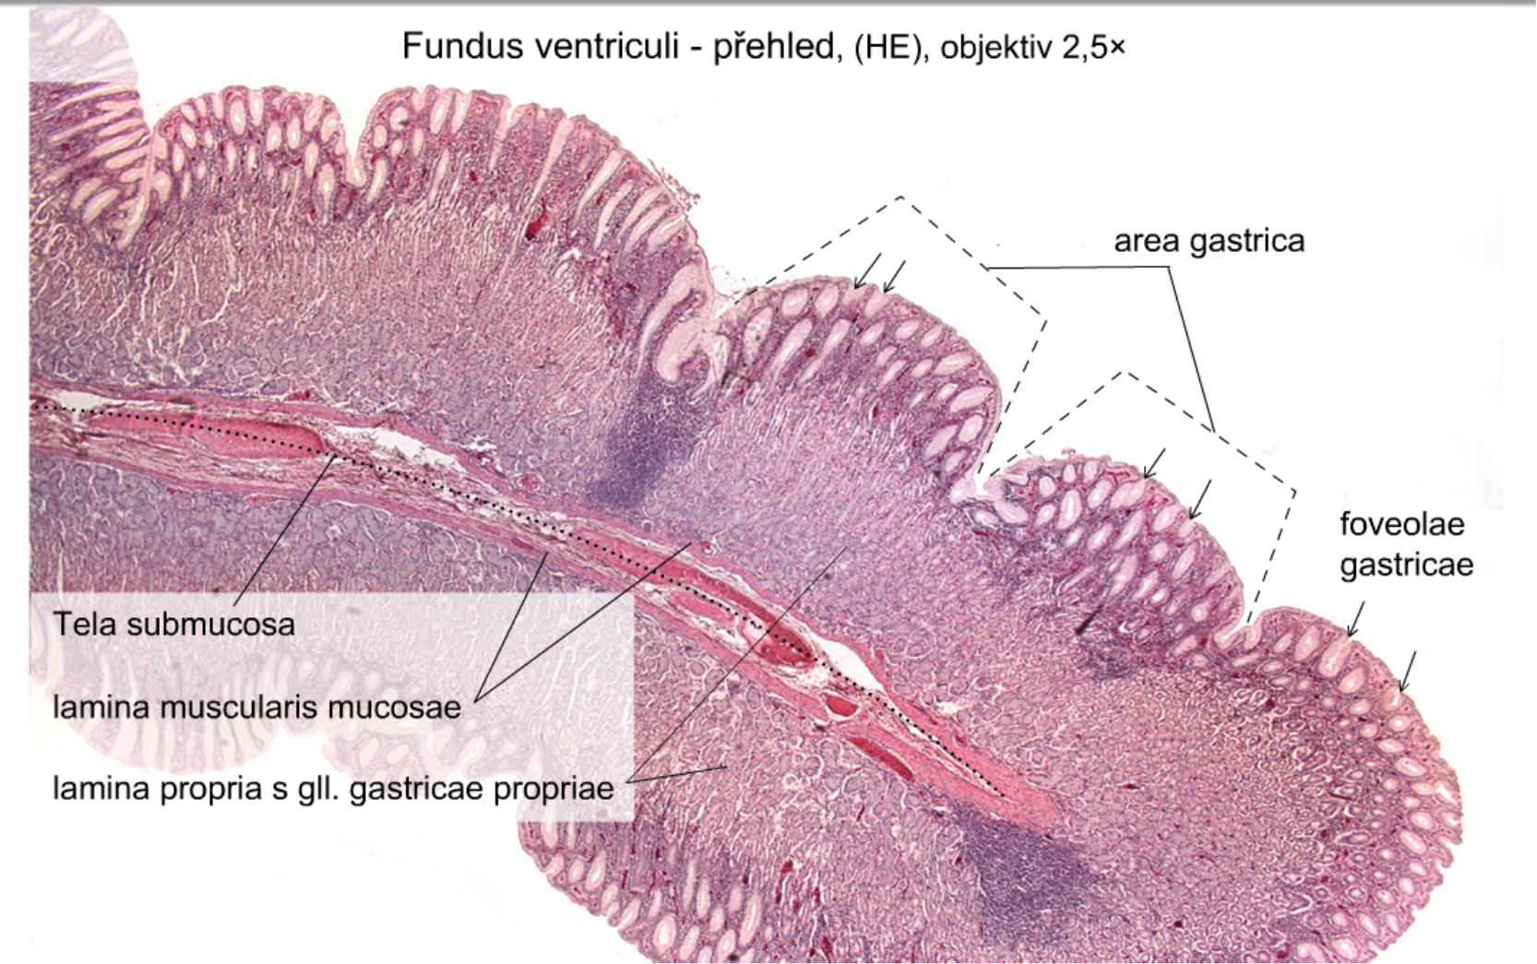
Fundus ventriculi (HE) 2,5x
Submucosa
Muscularis mucosae
Glands in lamina propria

Slide 8
Fundus ventriculi – HE, 10x
Lamina propria +glands
Muscularis mucosae

Slide 9
Fundus ventriculi (HE) – gastric glands, 10x
Chief cells
Parietal cells
Simple columnar epithelium
Lamina propria
Muscularis mucosae

Slide 10
Fundus ventriuculi – gastric glands (HE), 20x
Chief cells
Parietal cells

Slide 11
Pylorus (HE), 10x
Pyloric glands
Muscularis mucosae

Slide 12
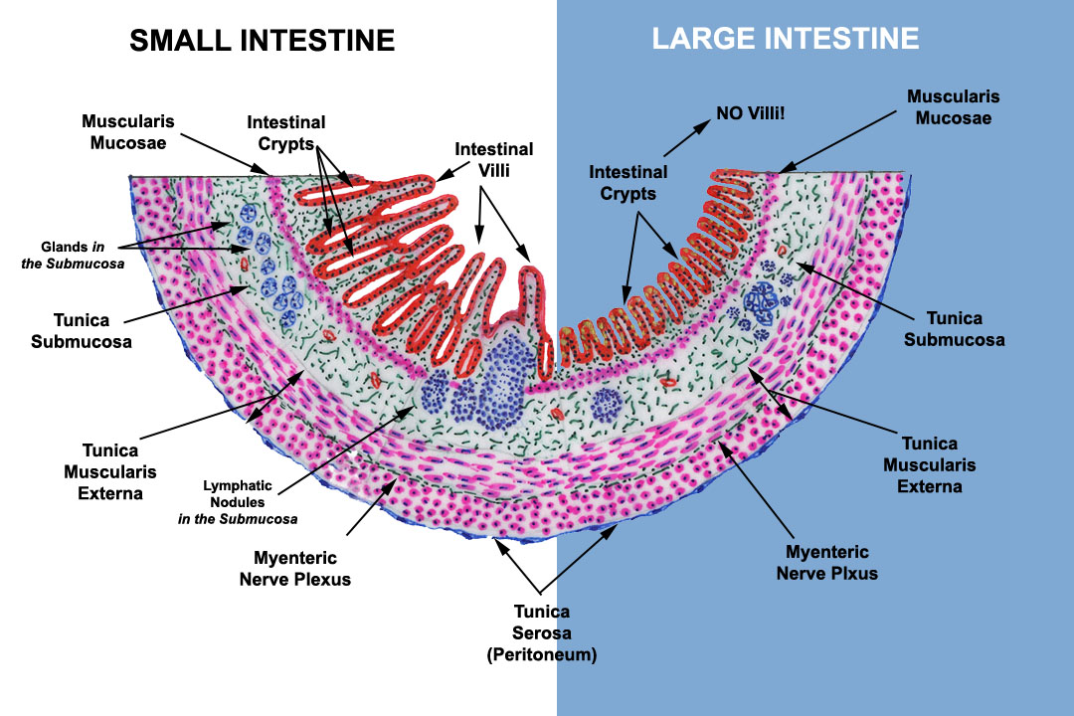
Schematic structure of the wall of the intestine

Slide 13
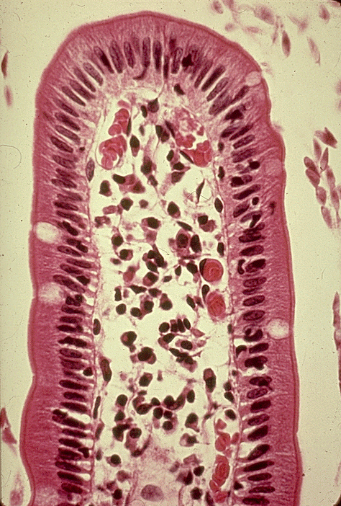
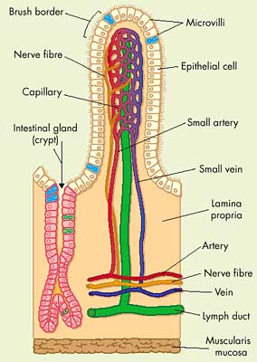
- Intestinal villi
- Crypt of Lieberkhün

Slide 14
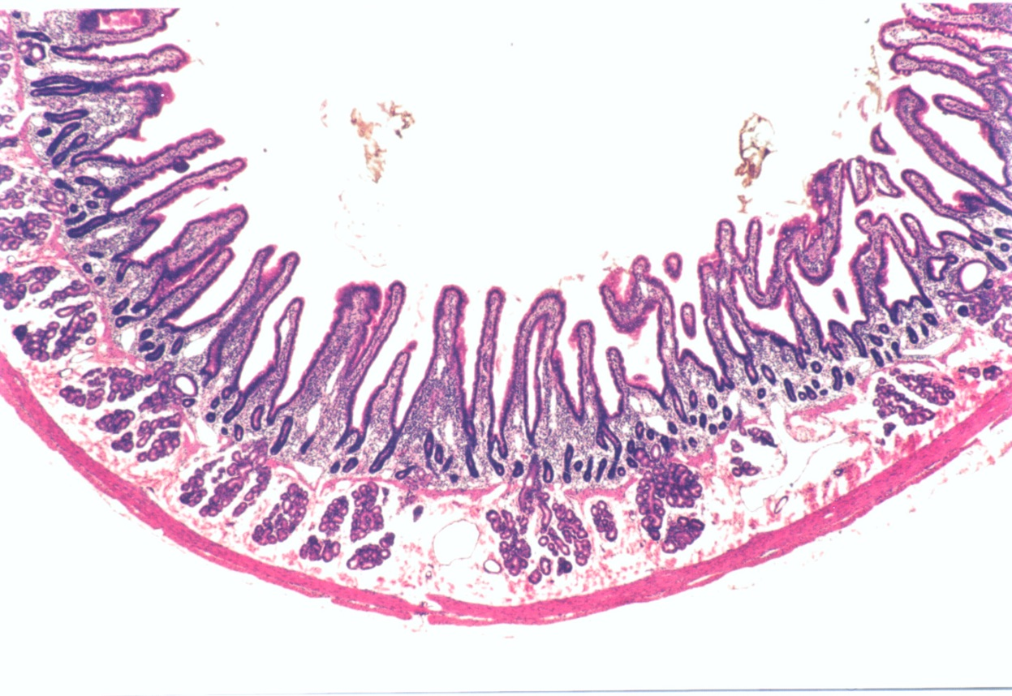
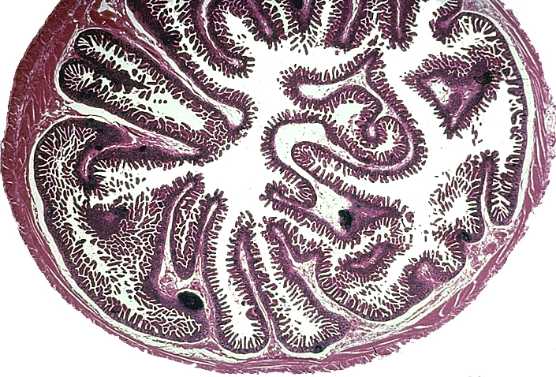
Small intestine
duodenum
jejunum

Slide 15
Duodenum
villi
Brunner‘s glands
Tunica submucosa
Crypt of Lieberkühn

Slide 16
Small intestine (HE), 2,5x
Intestinal villi
Plicae circulares (Kerckring´s)
Tunica musosa
Tunica submucosa
Tunica muscularis externa
Tunica serosa

Slide 17
Small intestine – Paneth cells, (HE), 40x
Lamina propria
Goblet cells
Absorptive cells
Crypt of Lieberkühn
Paneth cells

Slide 18
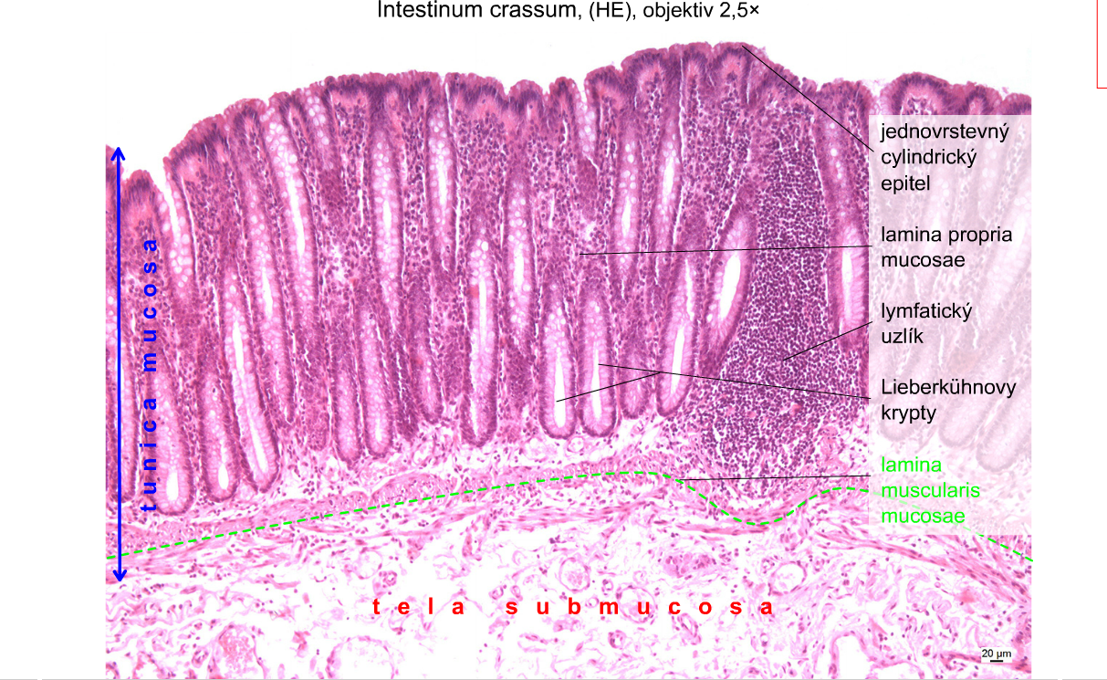
Simple columnar epithelium
Lamina propria
Lymphoid nodule
Crypts of Lieberkühn
(intestinal glands)
The muscularis mucosae

Slide 19
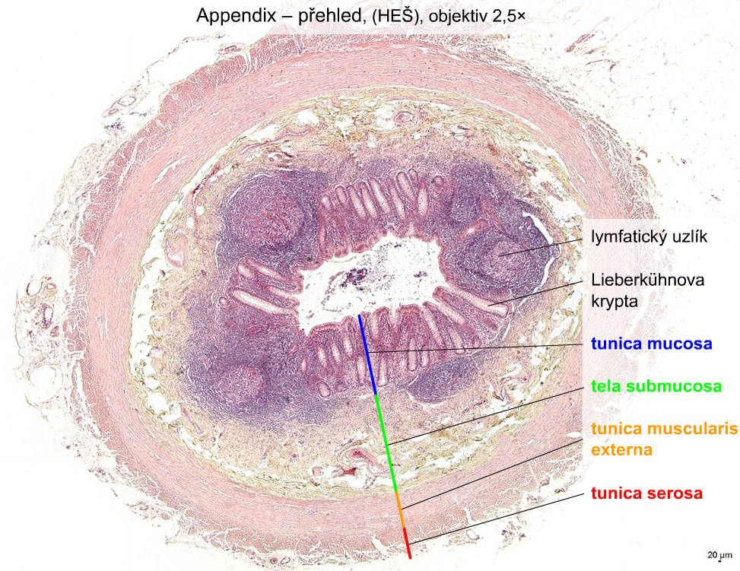
Lymphoid nodule
Crypt of Lieberkühn

Slide 20
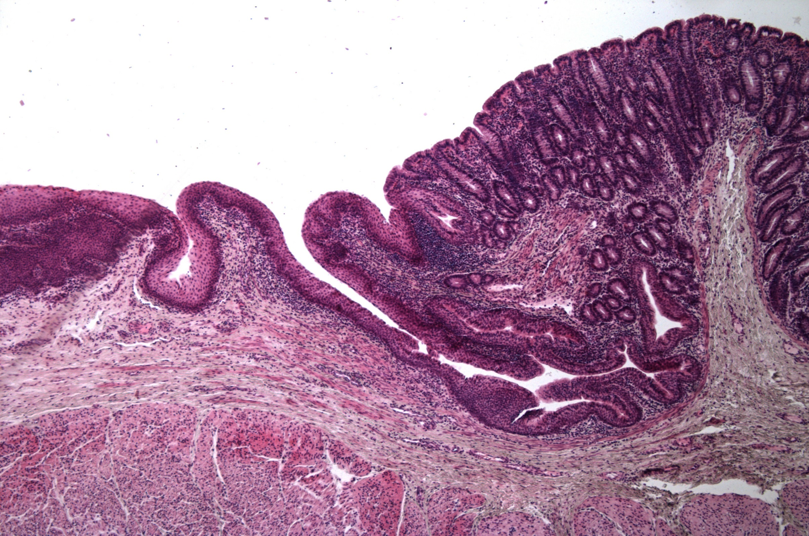
Anus
  Hemorrhoidal zone
  -epithelium replacement
  -the muscularis muc. ends

Slide 21


2.
Digestive systém II
Preparáty:
11. Oesophagus (HE)
12. Cardia(HE)
13. Fundus ventriculi(HE)
14. Pylorus (HE)
15. Duodenum (HE)
16. Small intestine (HE)
17. Large intestine (HE)
18. Appendix (HE)
19. Anus (HE)
Atlas EM:
Striated border – surface of enterocytes (28)

Slide 22
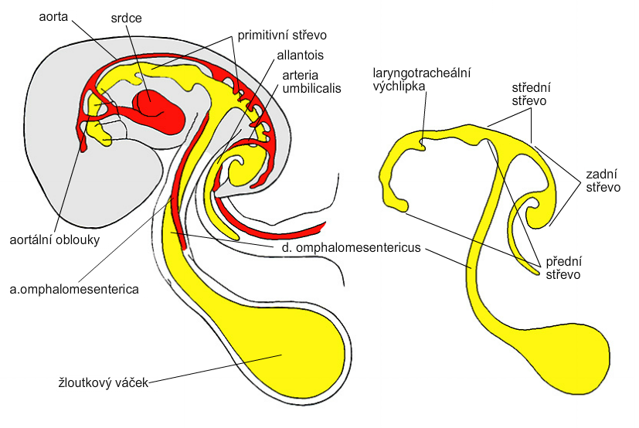
Primitive gut – embryo, day 26
heart
primitive gut
allantois
arteria
umbilicalis
laryngotracheal
divecle
midgut
hindgut
aortic arches
forgut
yolk sac

Slide 23
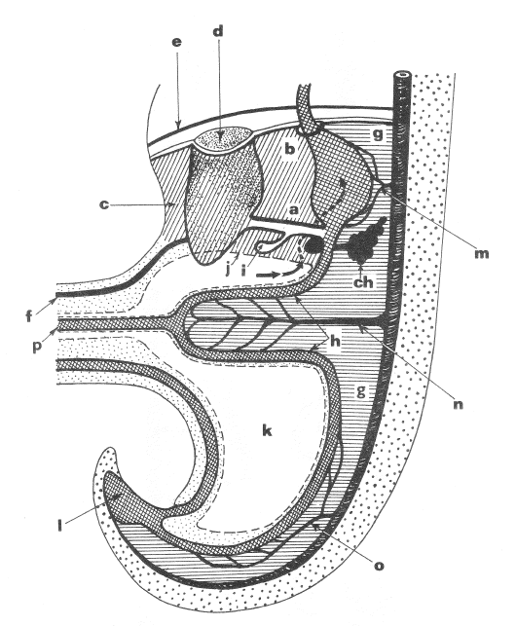
Embryo, week 5
a - pars hepatoduodenalis omenti minoris
b - pars hepatogastrica omenti minoris
c - mesohepaticum ventrale ⇨ lig. falciforme
d -liver
e - diaphragm
f - vena umbilicalis
g - mesogastrium dorsale
h - mesenterium dorsale
ch - divertikulum pancreaticum dorsale
i - pars cystica hepatis
j - lower margin of ventral mesentery
K - peritoneal cavity
L - cloaca
m - a. coeliaca
n - a. mesenterica sup.
o - a. mesenterica inf

Slide 24
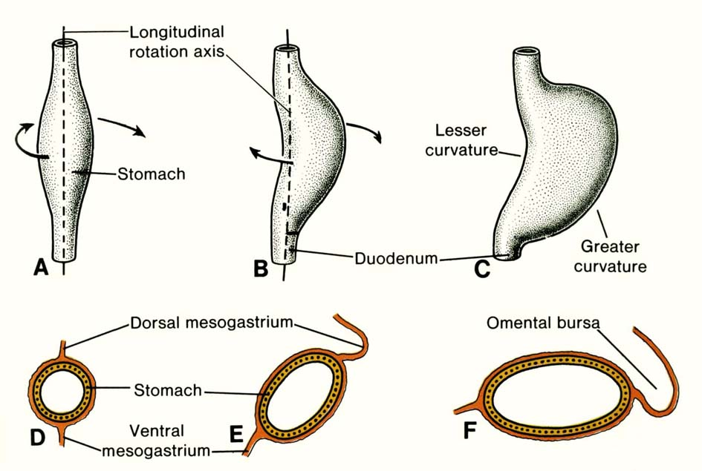
Uneven growth of ventral and dorsal wall: - curvatura minor (to the right), - curvatura major (to the left).
Rotation around sagital axis : - curvatura minor (cranial position), - curvatura major (caudal position).
Rotation around longitudinal axis: - left side → ventrally, - right side → dorsally.

Slide 25
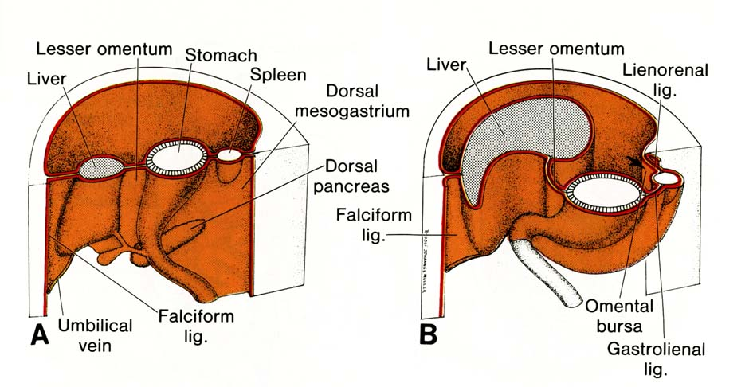
Mesenterium dorsale
Mesogastrium dorsale = omentum majus
Mesoduodenum dorsale
Mesenterium dorsale
Mesocolon dorsale

Slide 26
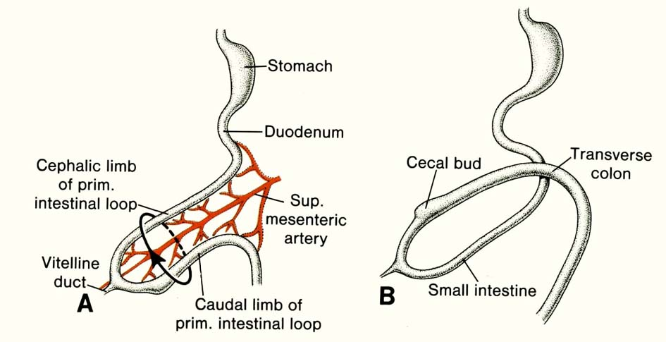
Duodenal loop and umbilical loop
Flexura
duodenojejunalis
forgut
midgut
Umbilical loop herniates into the umbilical cord (physiologic herniation, in week 6-10)

Slide 27
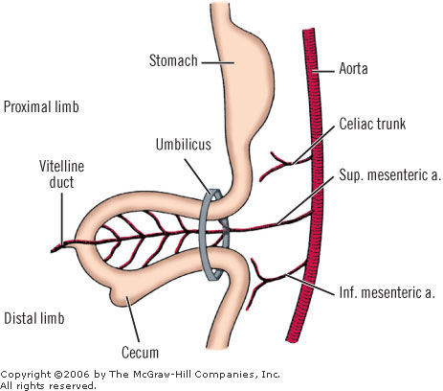
90º
after 270º
rotation
180º
In the umbilical cord, the midgut loop rotates 90° counter-clockwise around the axis of the superior mesenteric artery.
Upon returning, the gut undergoes another 180° counter-clockwise rotation, placing the cecum and appendix near the right lobe of the liver.
The total rotation of the gut is 270°.

Slide 28
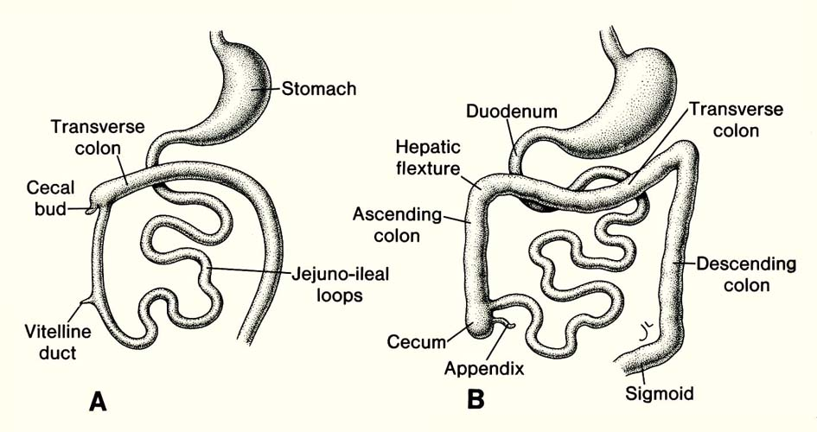

Development of intestines
Rectum

Slide 29
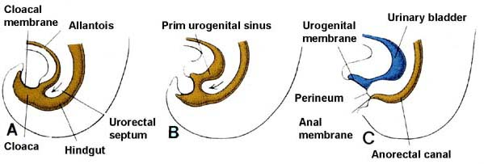
Development of rectum

Slide 30
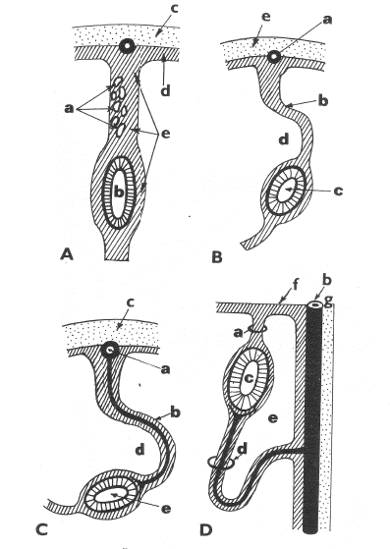
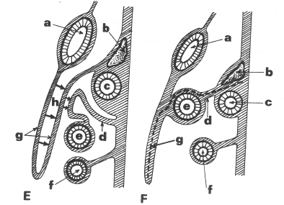
Mesenteries – development (A – E)

Slide 31
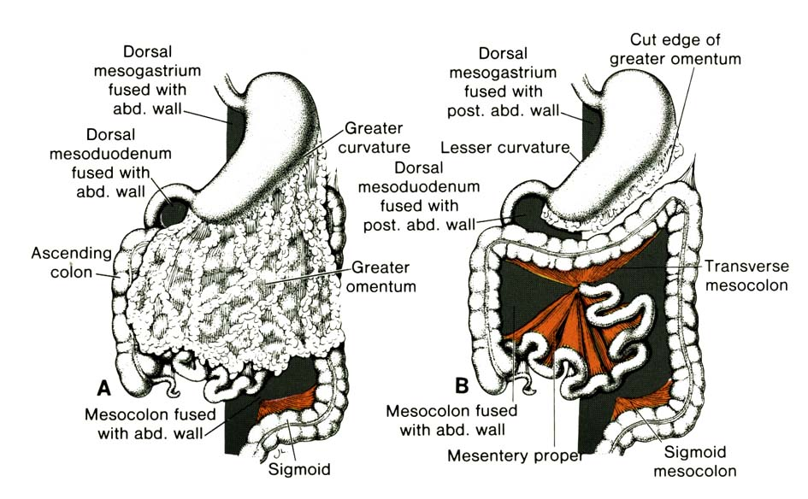
Omentum majus – duplicature of dorsal mezogastrium; both layers fuse into membrane (omentum), which „hangs“ from curvatura major though colon transversum and intestine loops

Slide 32
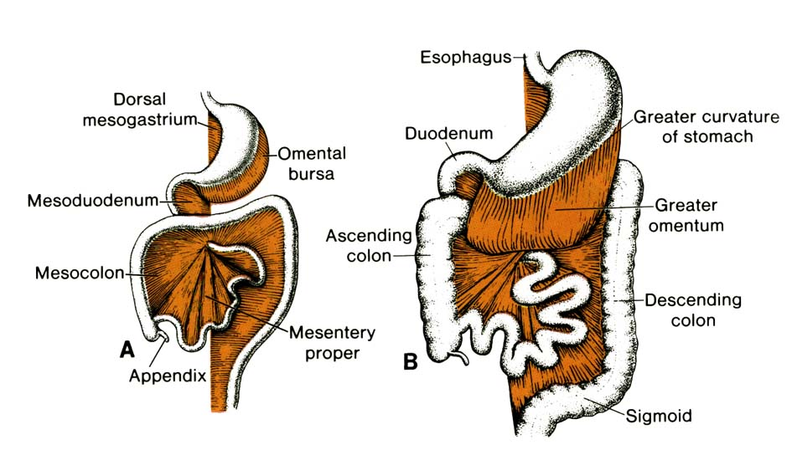
Mesenterium proprium and mesocolon

