Slide 1
Nerve system

Slide 2
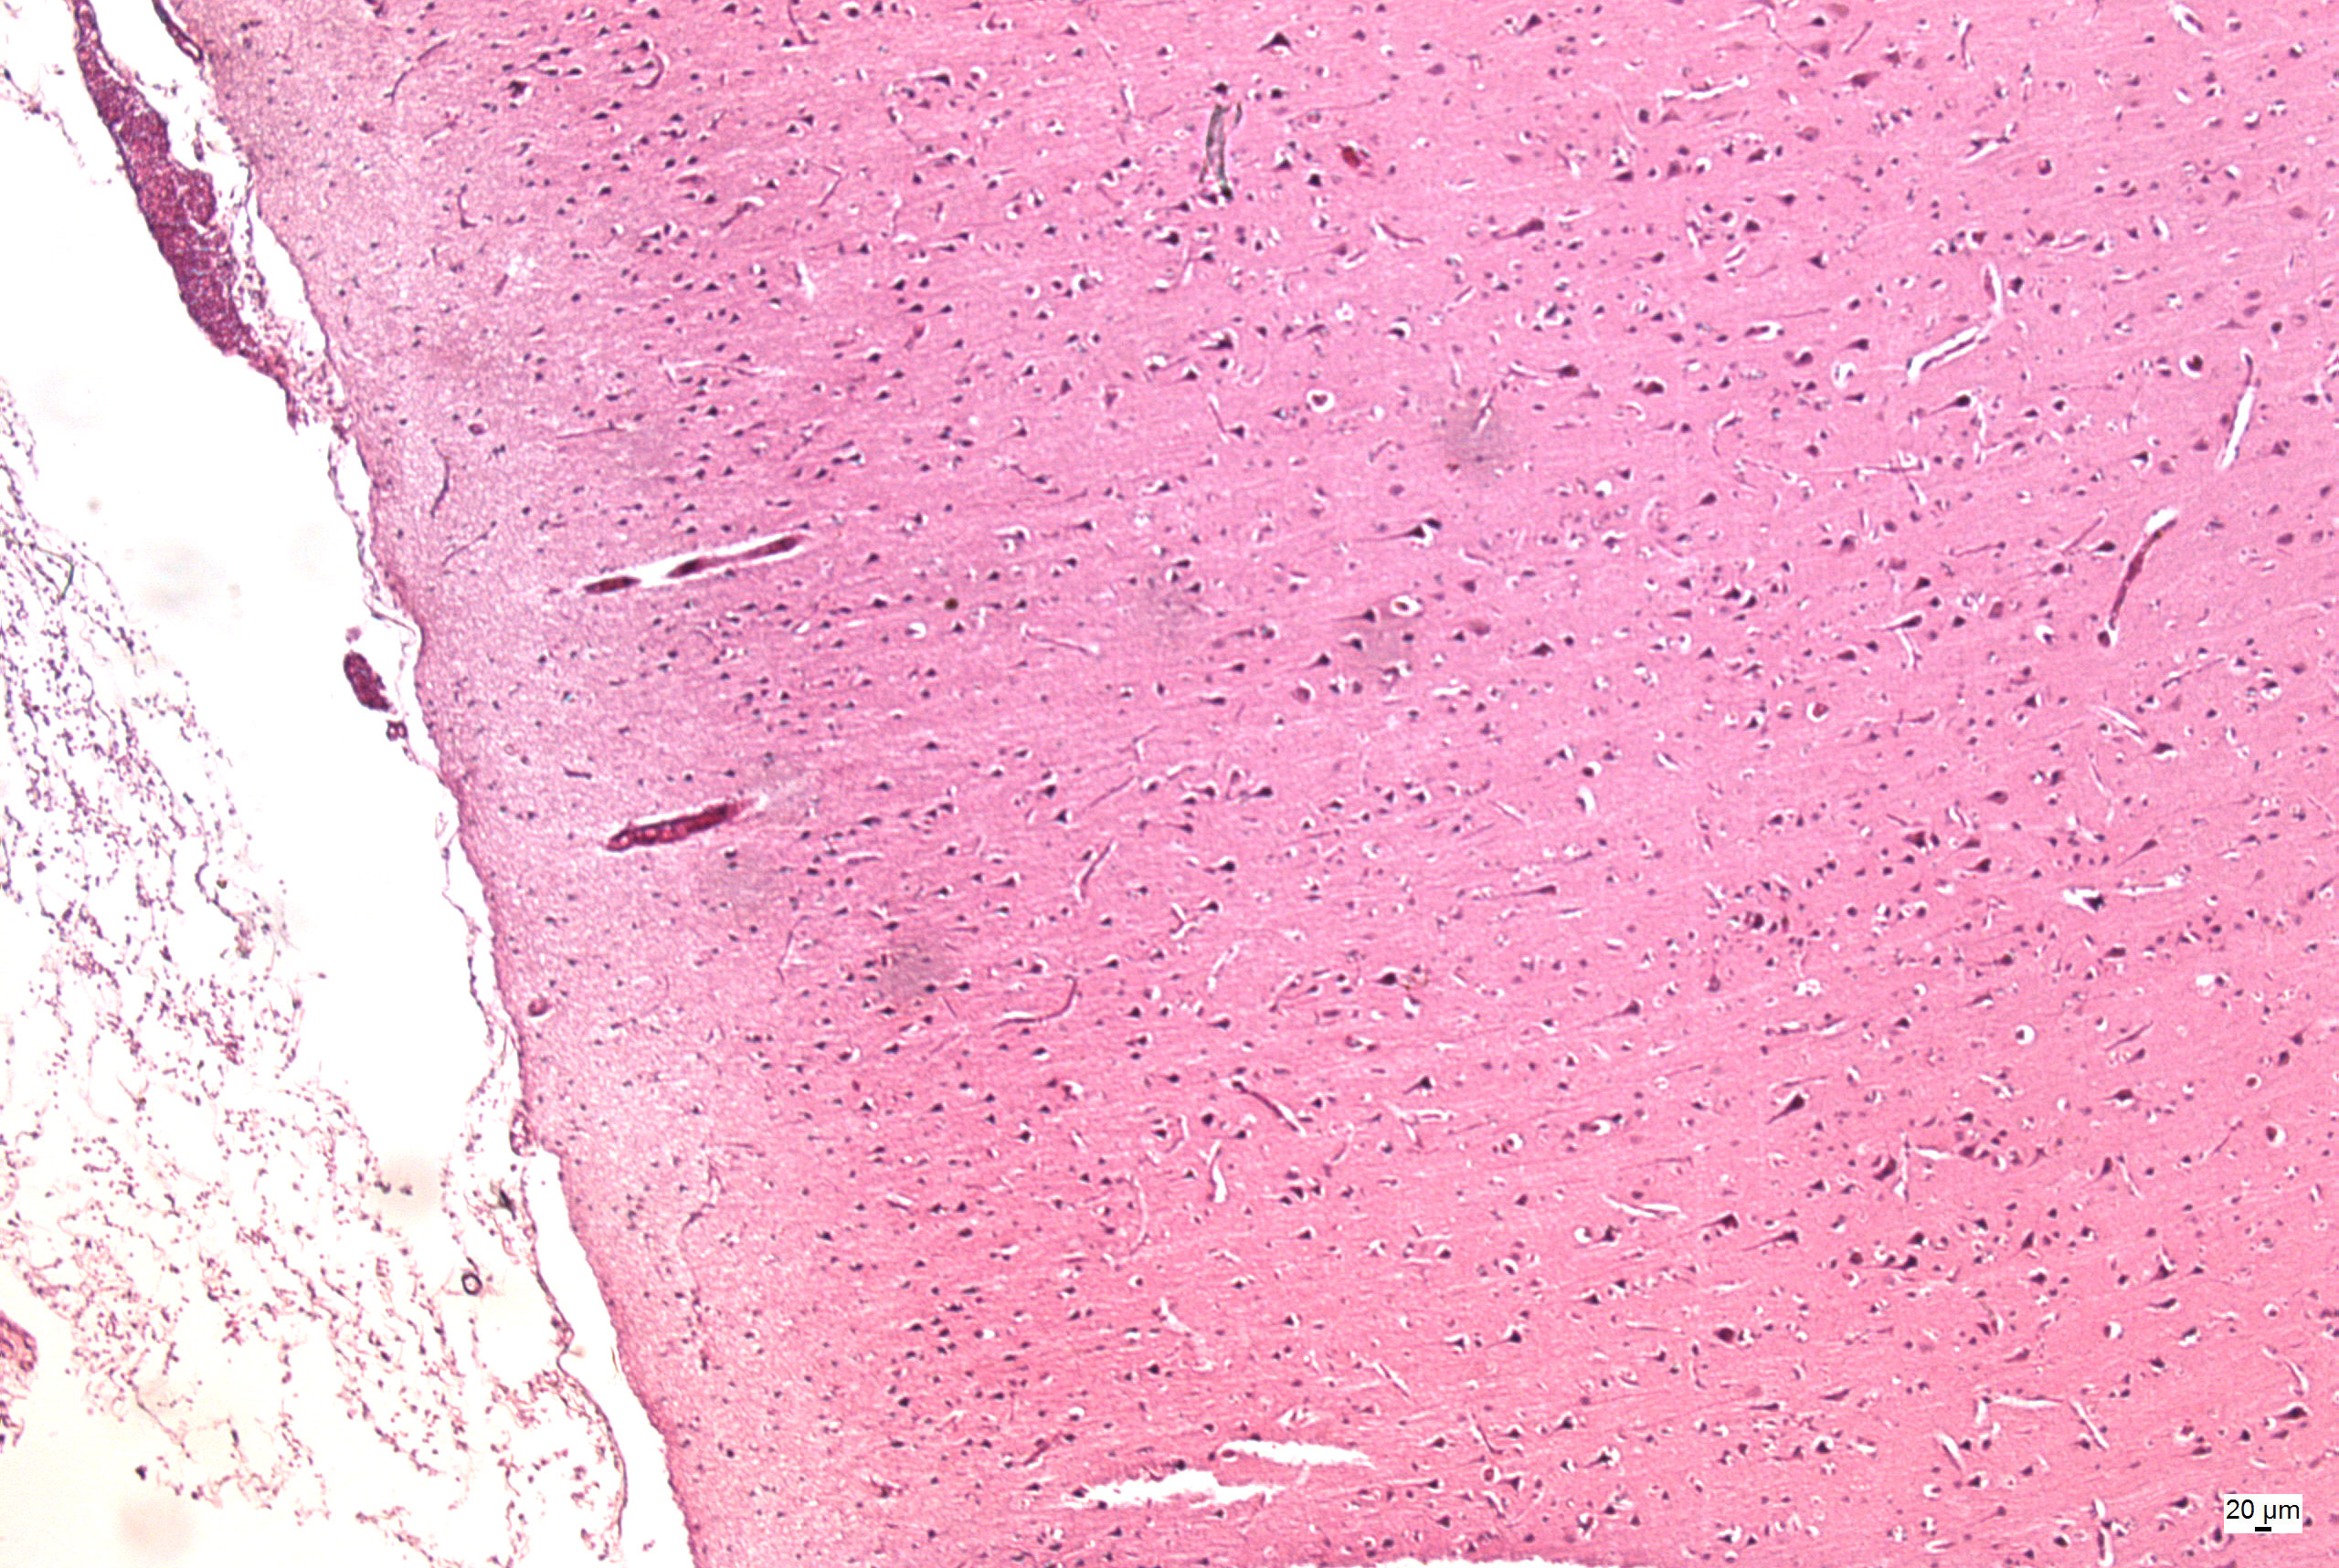
Cerebral cortex
pia mater
I
II
III
IV
V
VI
l. molecularis
l. granularis ext.
l. pyramidalis
l. granularis int.
l. ganglionaris
l. multiformis

Slide 3
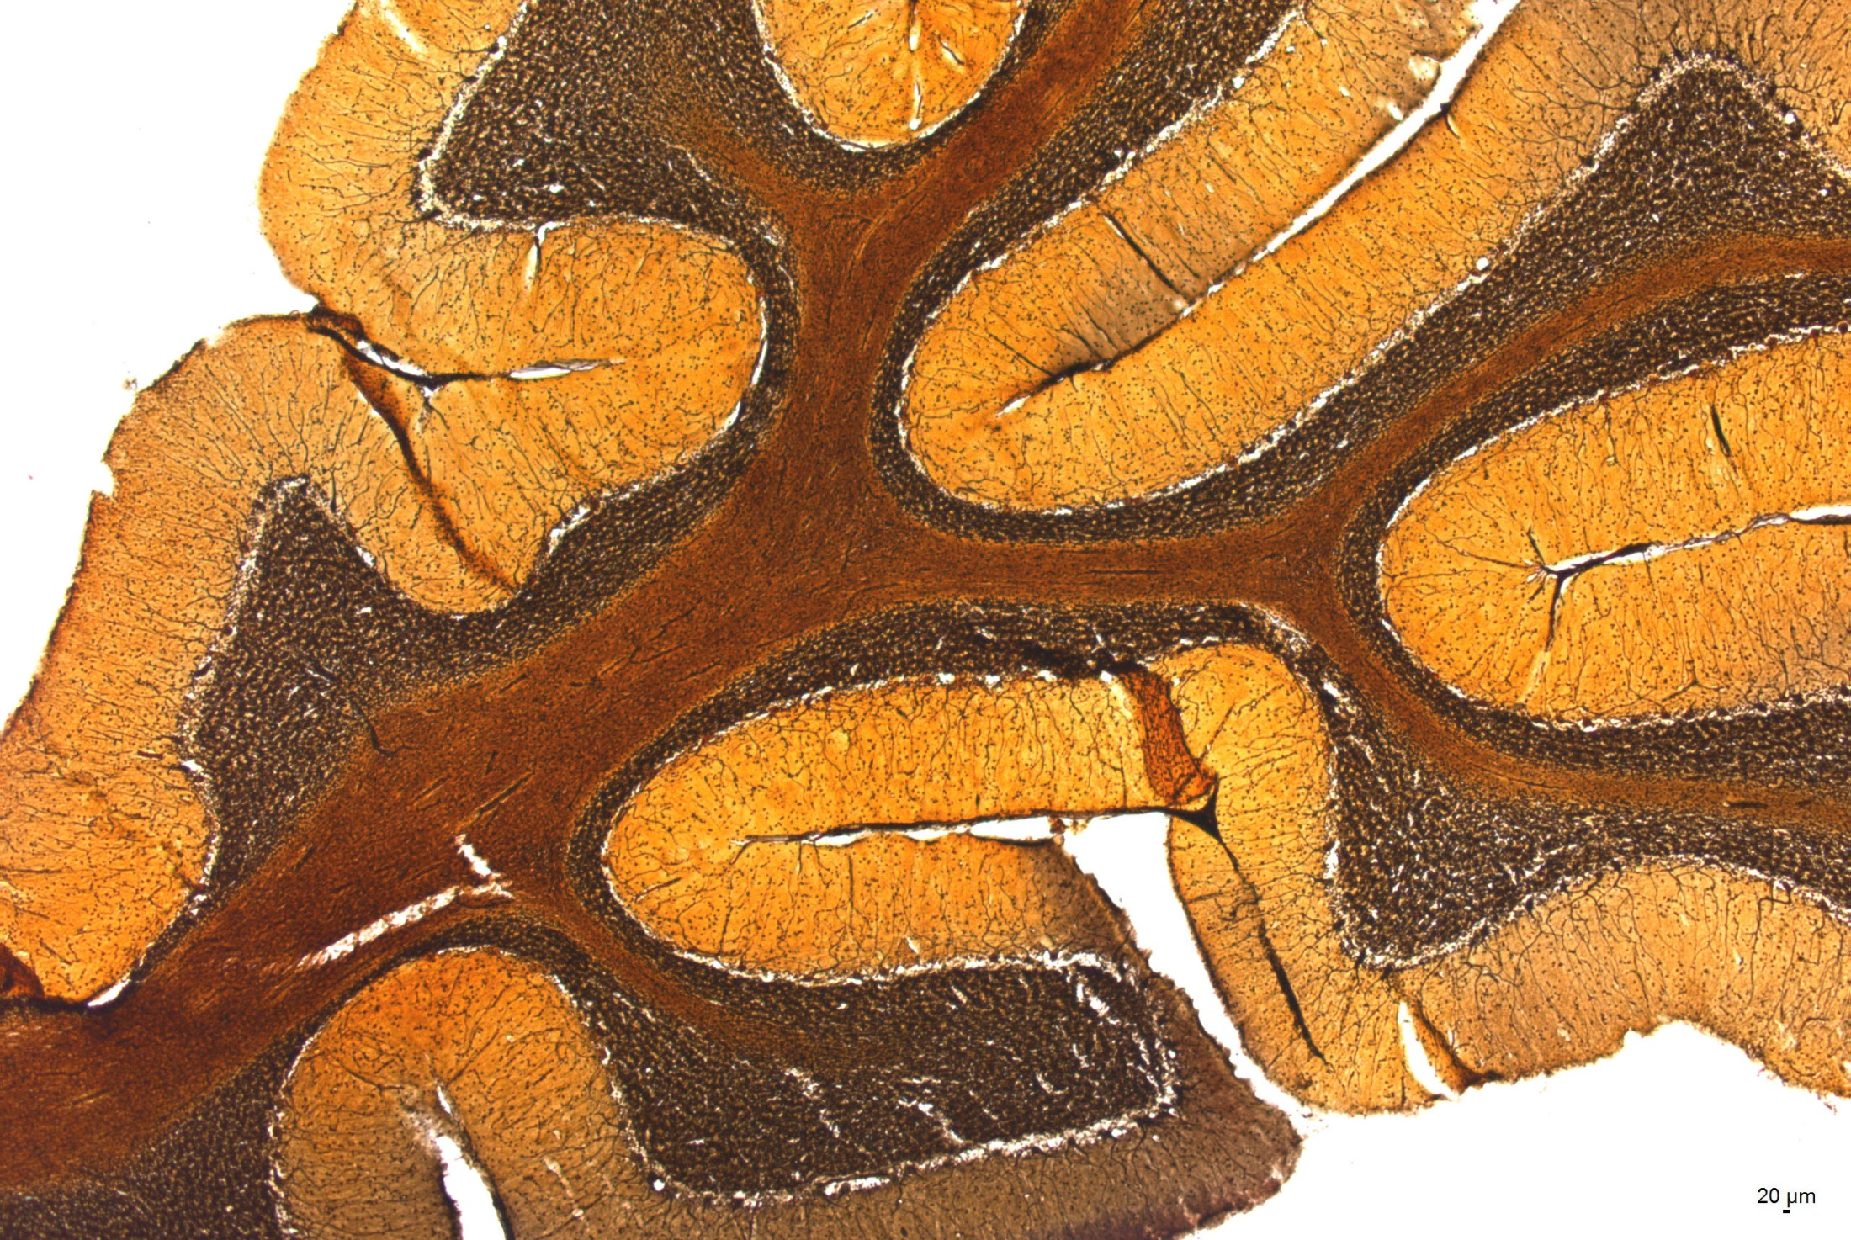
Cerebellum
s. granulosum
s. gangliosum
s. cinereum
medulla
cortex

Slide 4
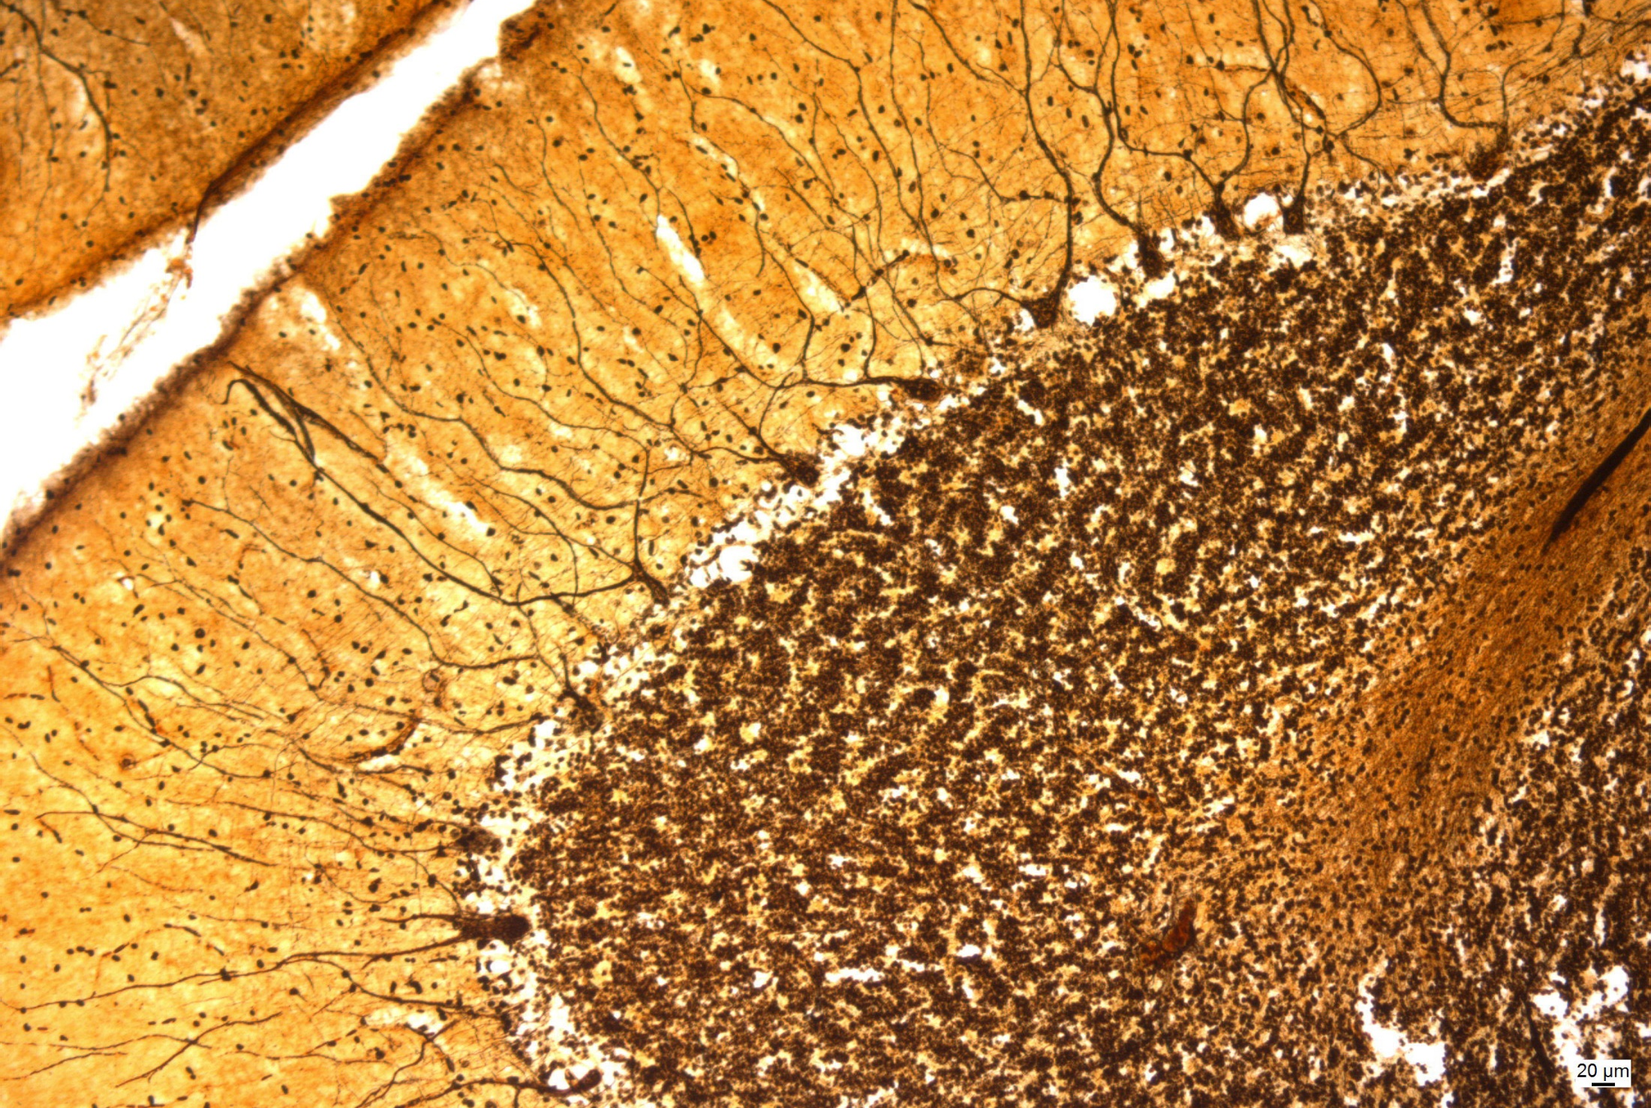
Cerebellar cortex
s. cinereum
s. gangliosum
s. granulosum
medulla

Slide 5
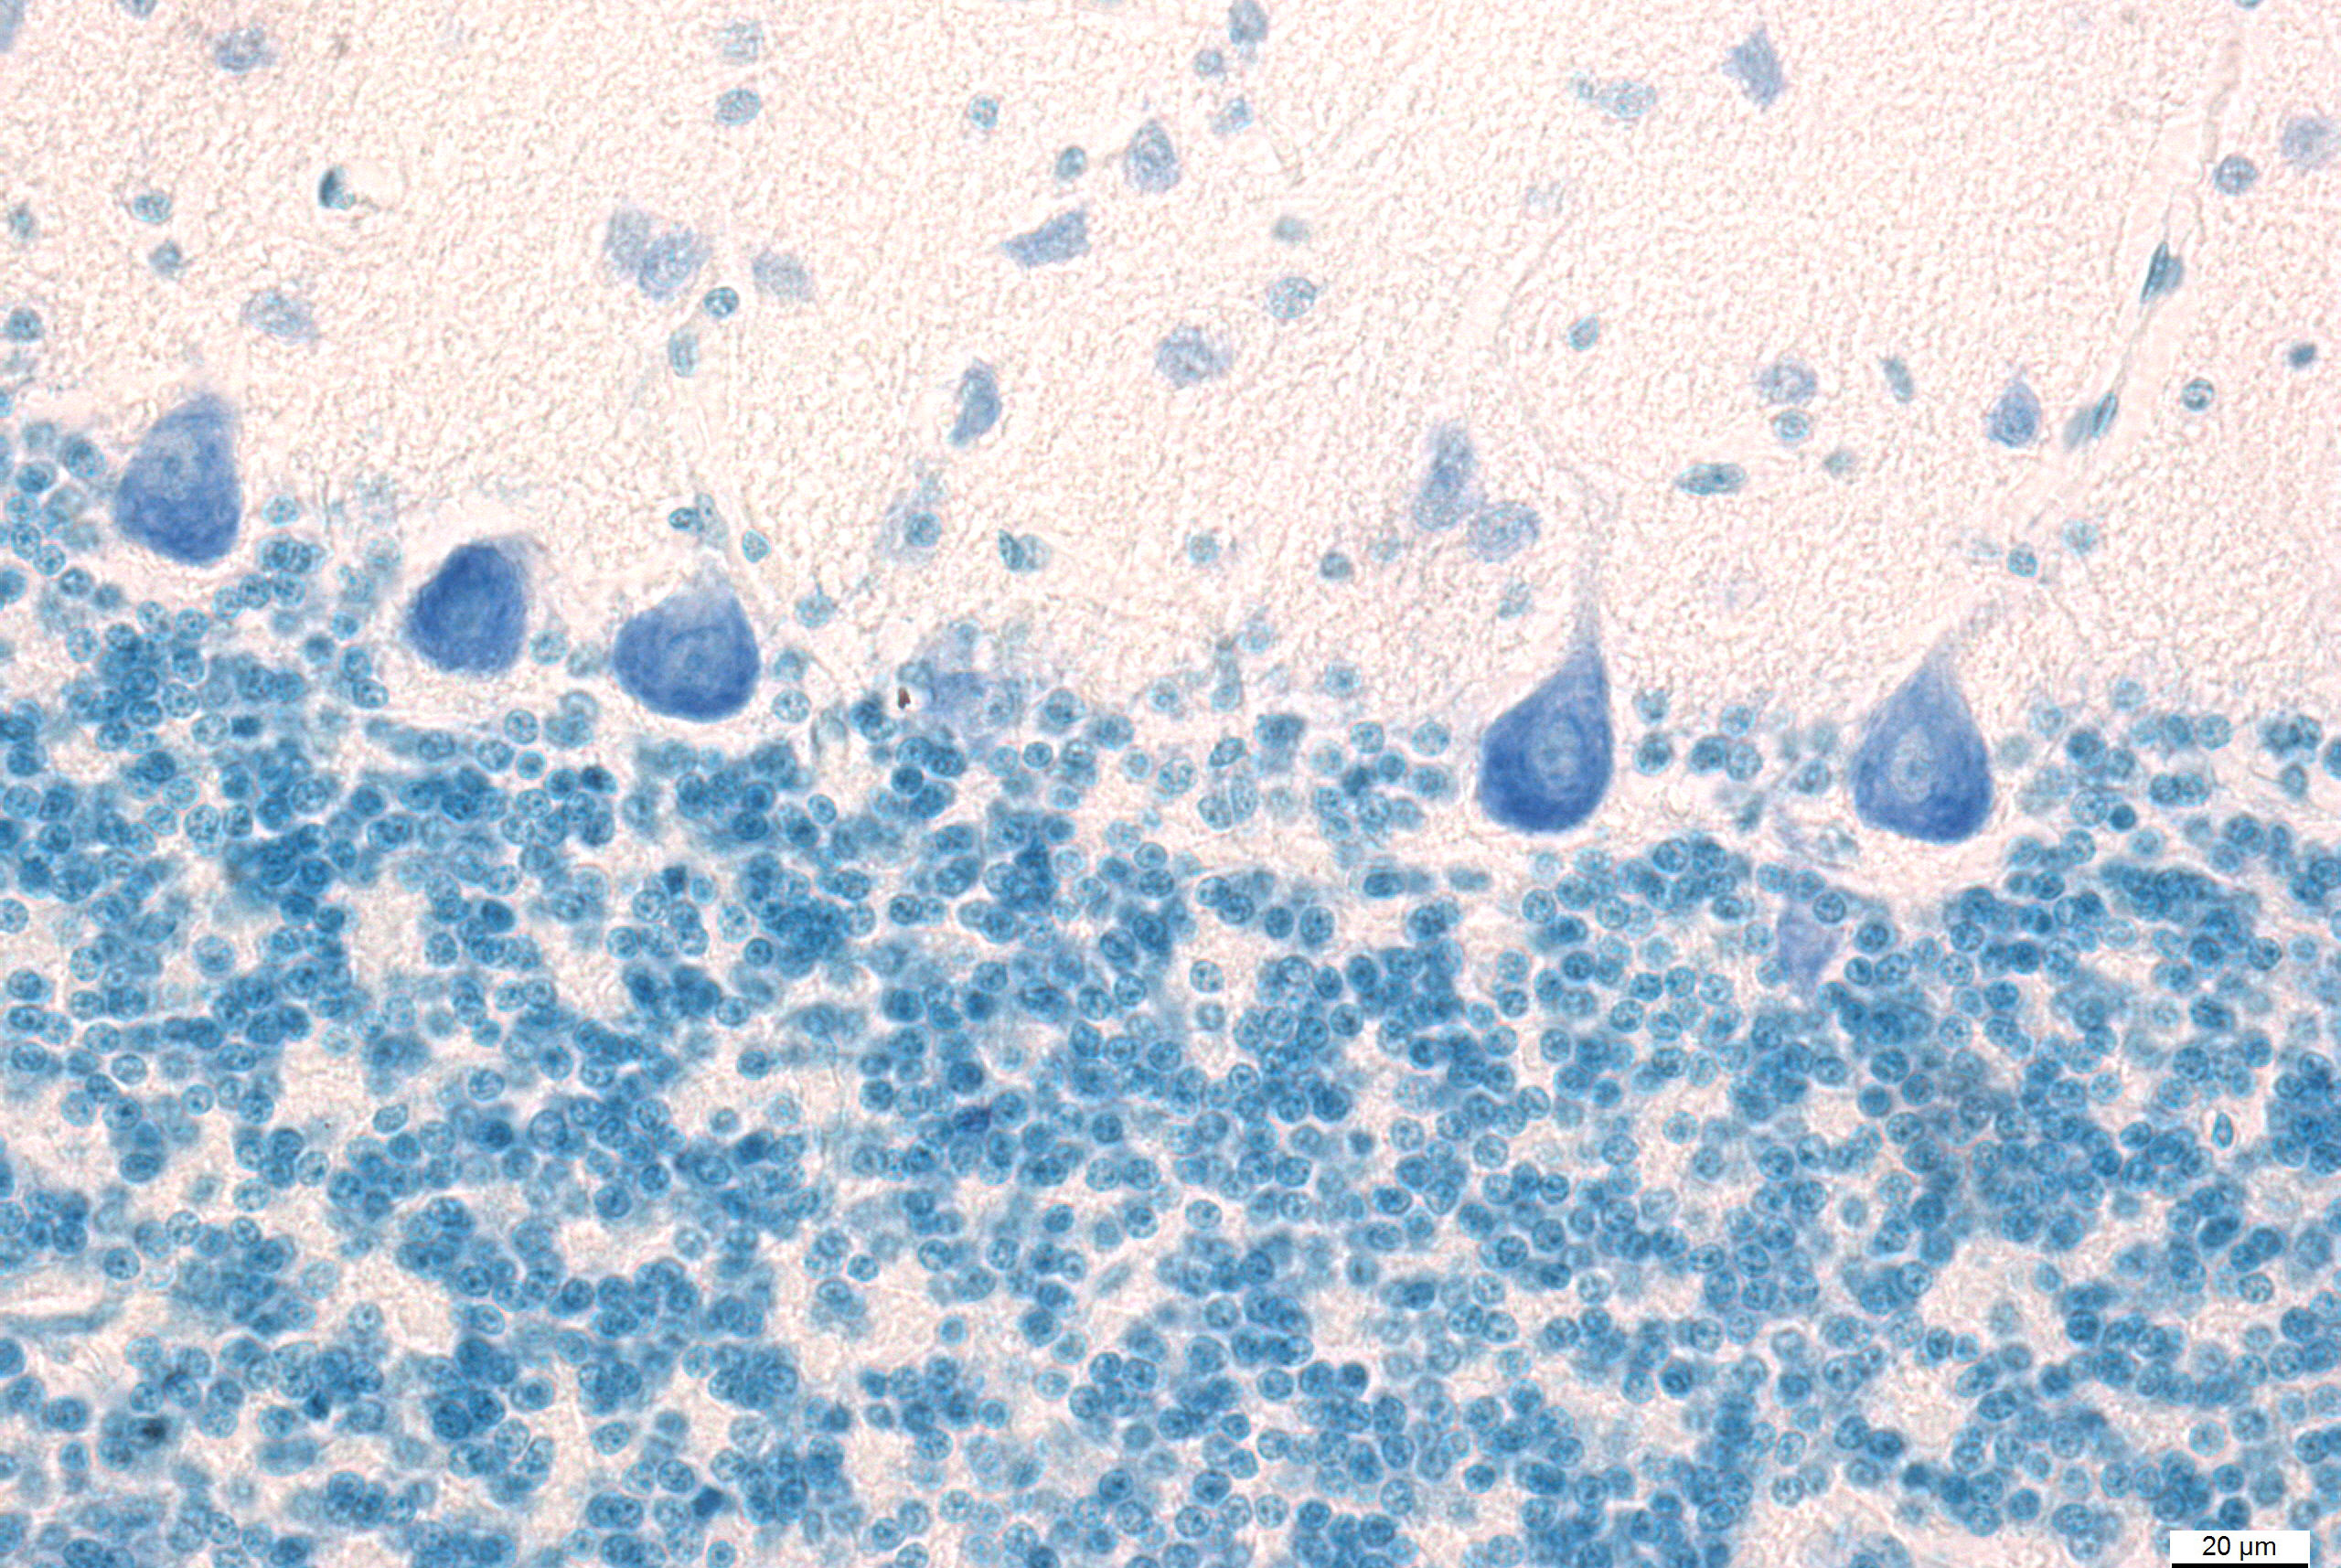
Cerebellar cortex – Purkinje cells
s. cinereum
Purkinje cells
s. gangliosum
s. granulosum

Slide 6
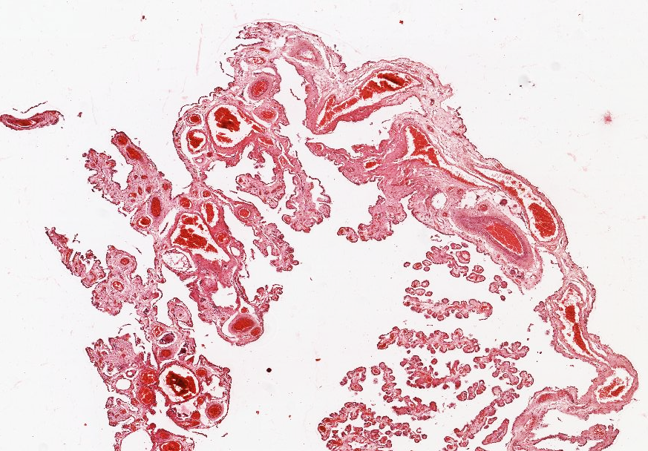
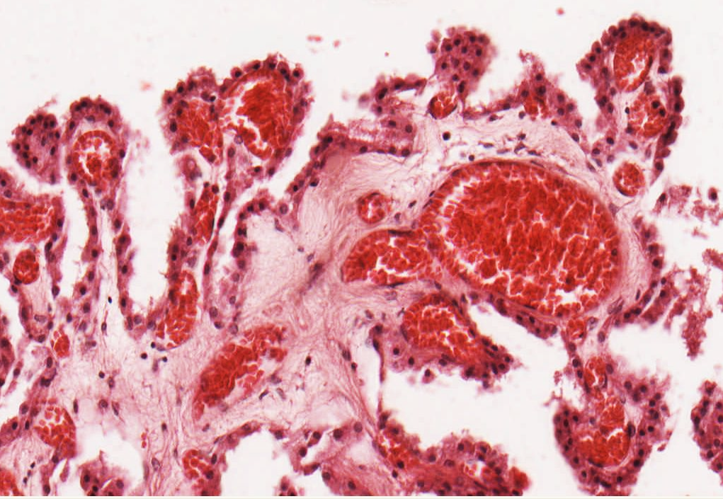
Choroid plexus
loose collagen c.t.
capillaries
simple cuboidal e.

Slide 7
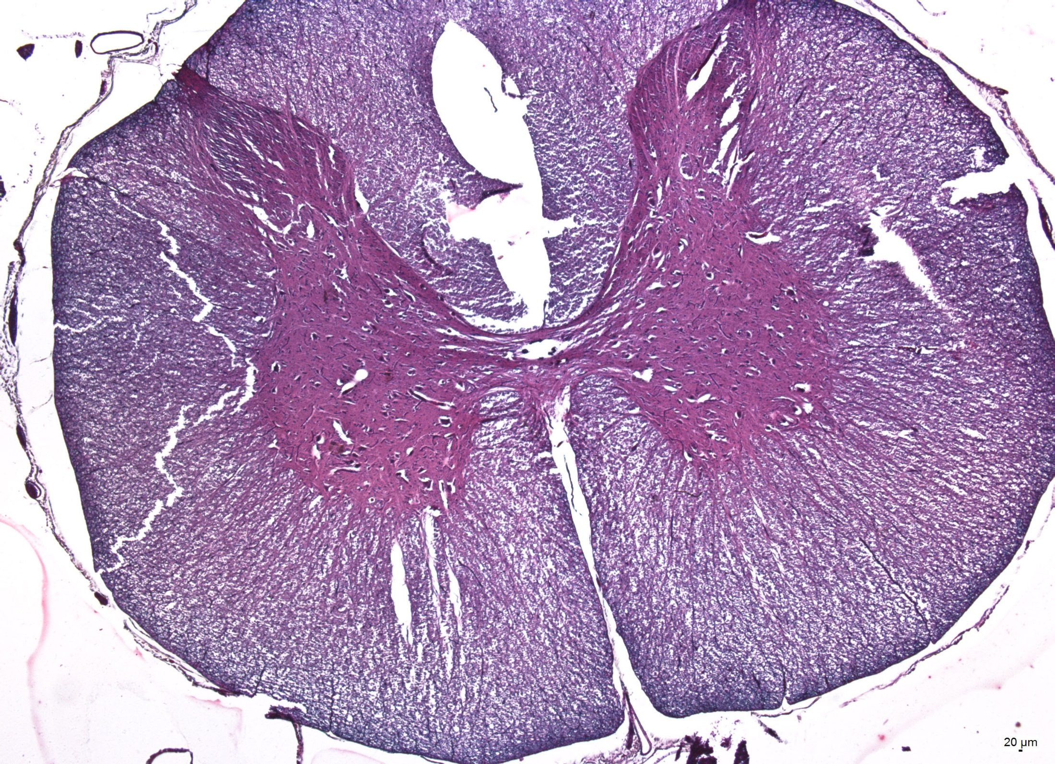
Spinal cord
- dorsal column
- dorsal horn
- lateral column
Grey matter
- ventral horn
Canalis centralis
White matter
- ventral column
Pia mater

Slide 8
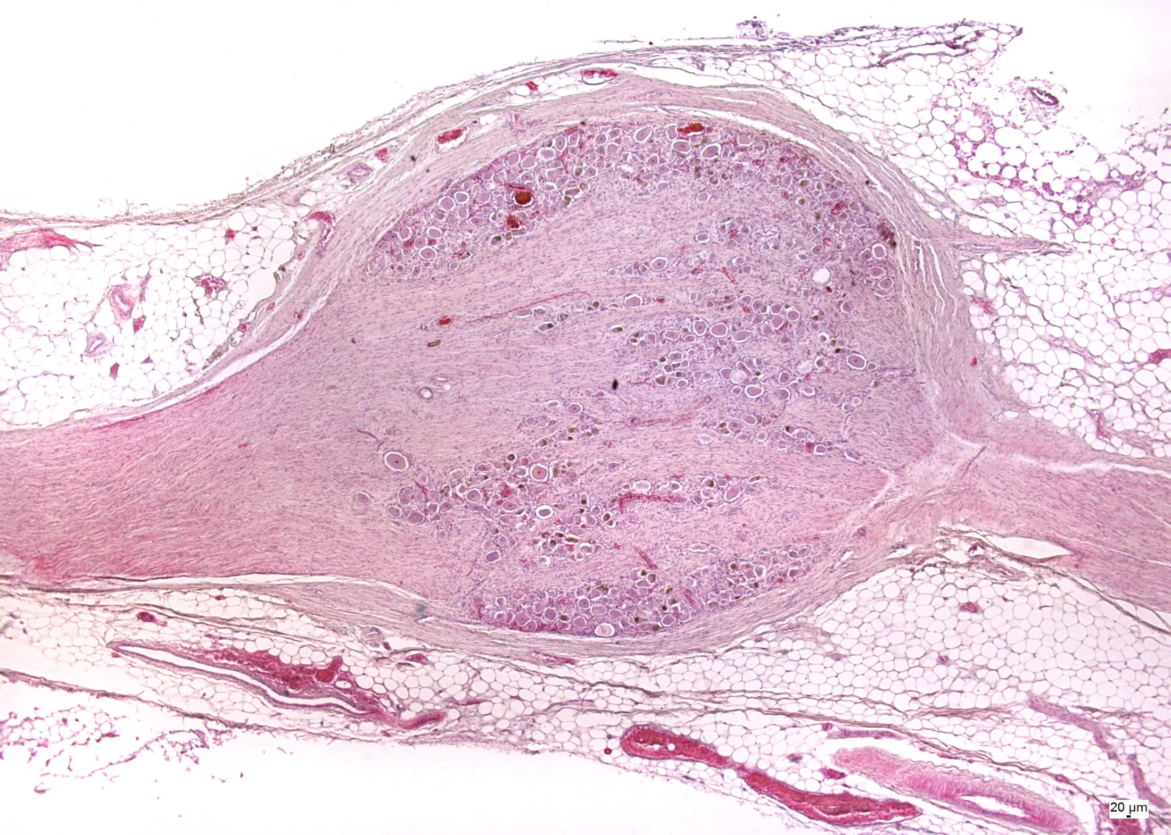
Spinal ganglion
c.t. capsule
clusters of ganglionic cells
bundles of nerve fibers
bundles of nerve fibers

Slide 9
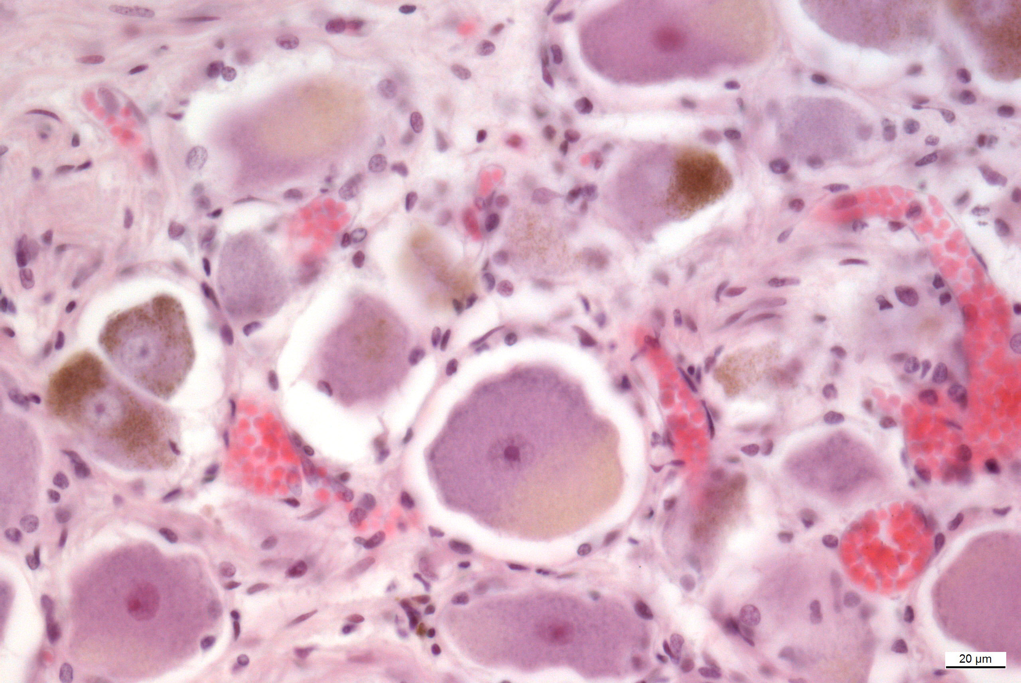
Spinal ganglion
lipofuscin
amphicytes
capillaries
pseudounipolar neurons

Slide 10
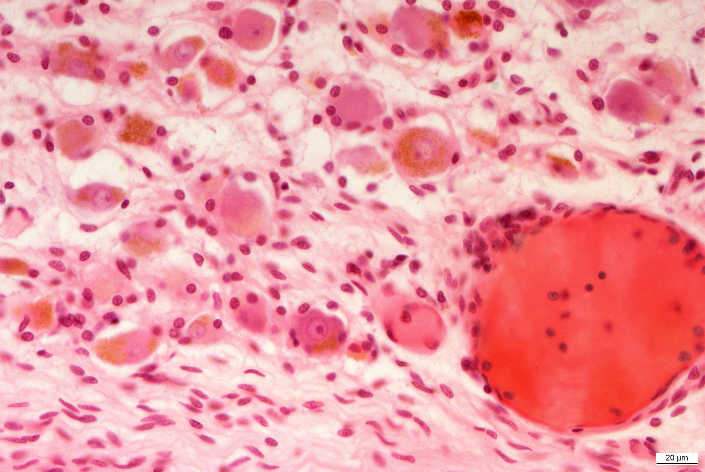
Spinal ganglion - lipofuscin
lipofuscin
lipofuscin

Slide 11
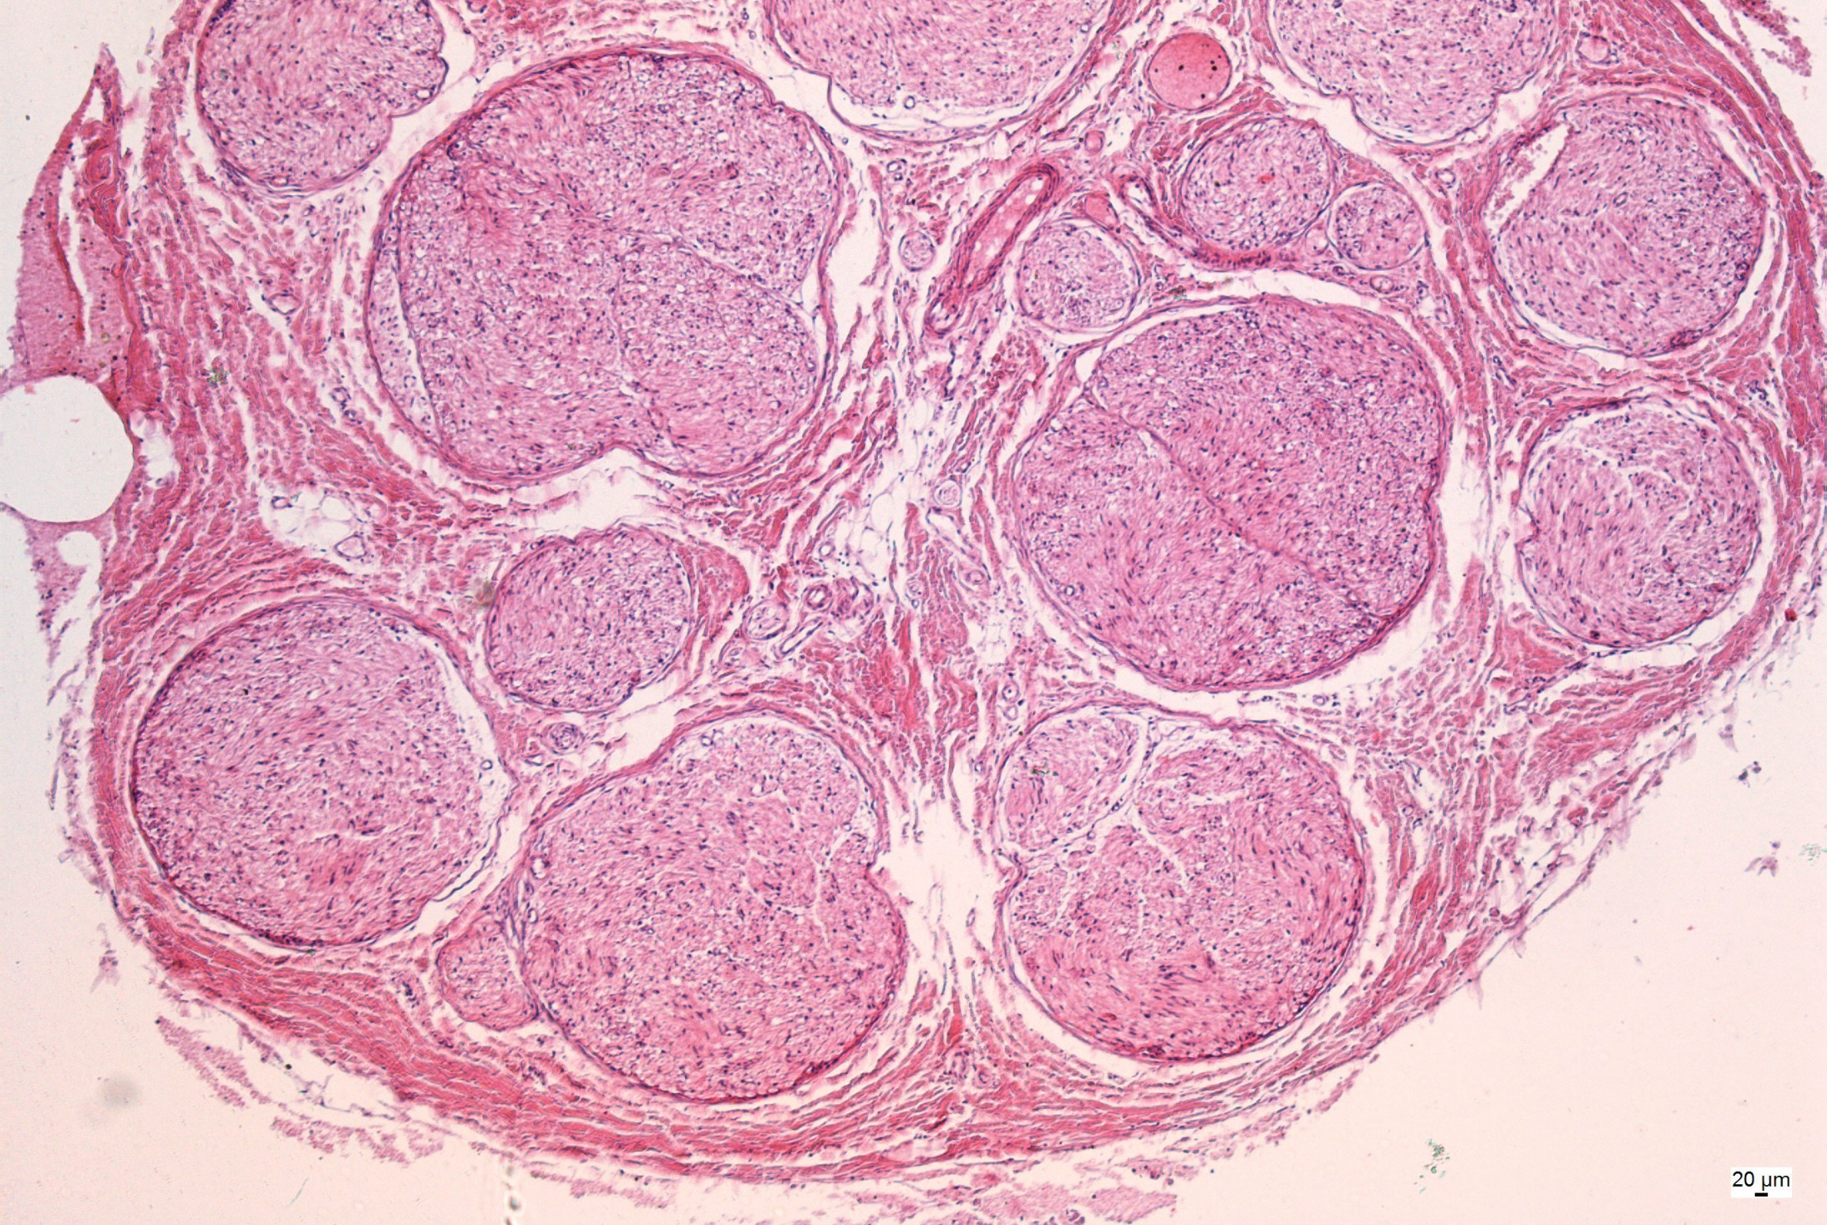
Peripheral nerve
bundles of nerve fibers
perineurium
epineurium

Slide 12
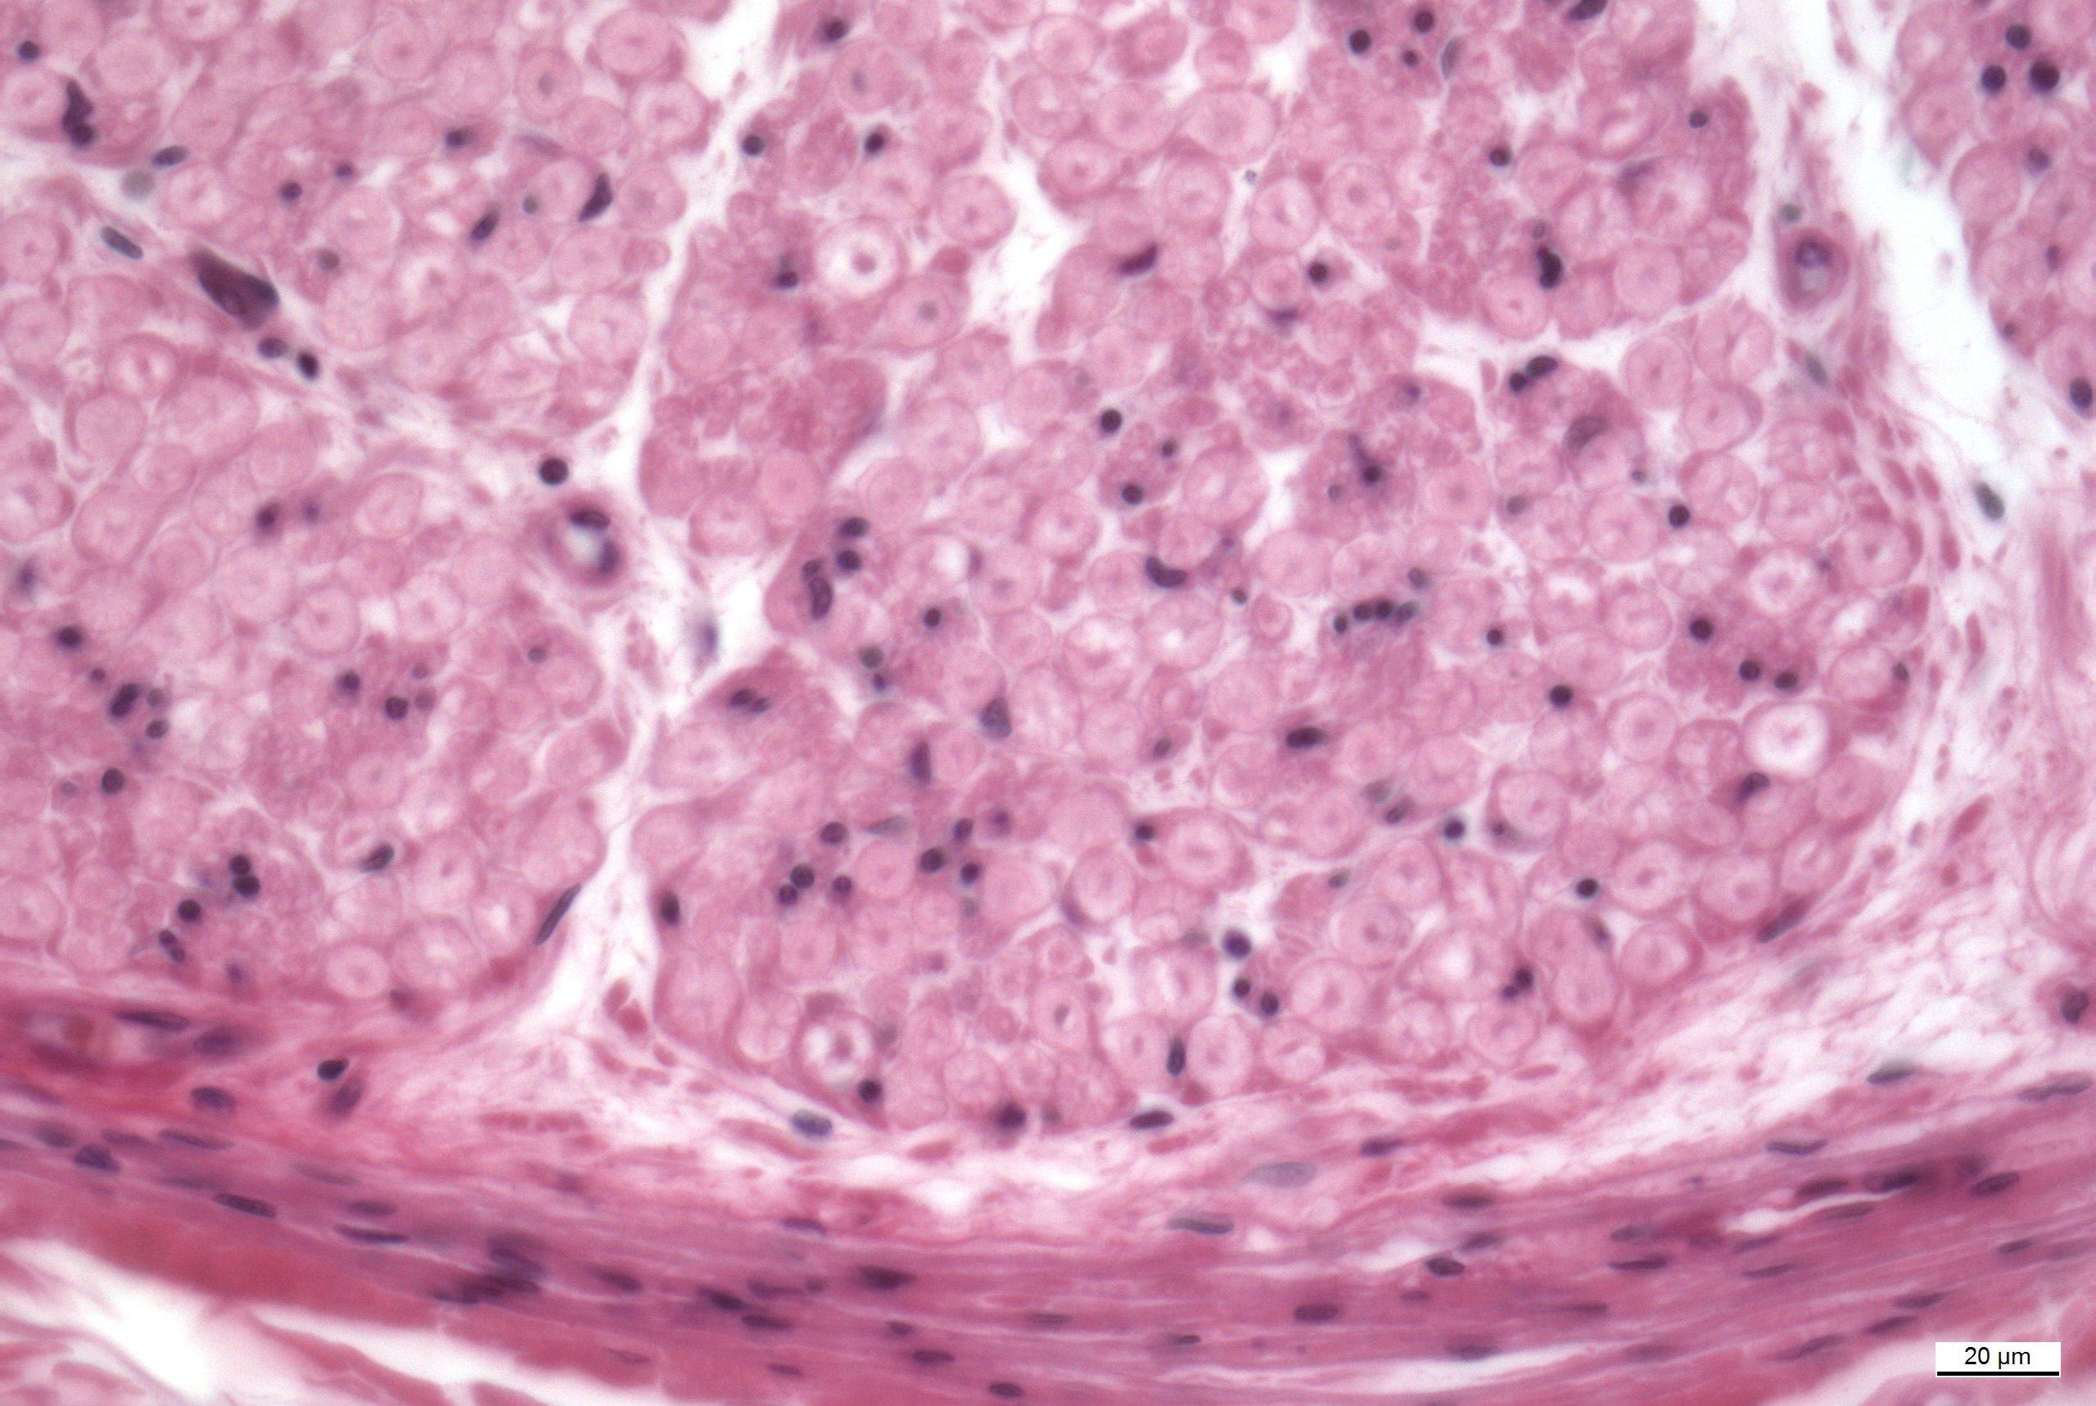
Peripheral nerve
Schwann cells
myelinated nerve fibers
endoneurium
perineurium

Slide 13
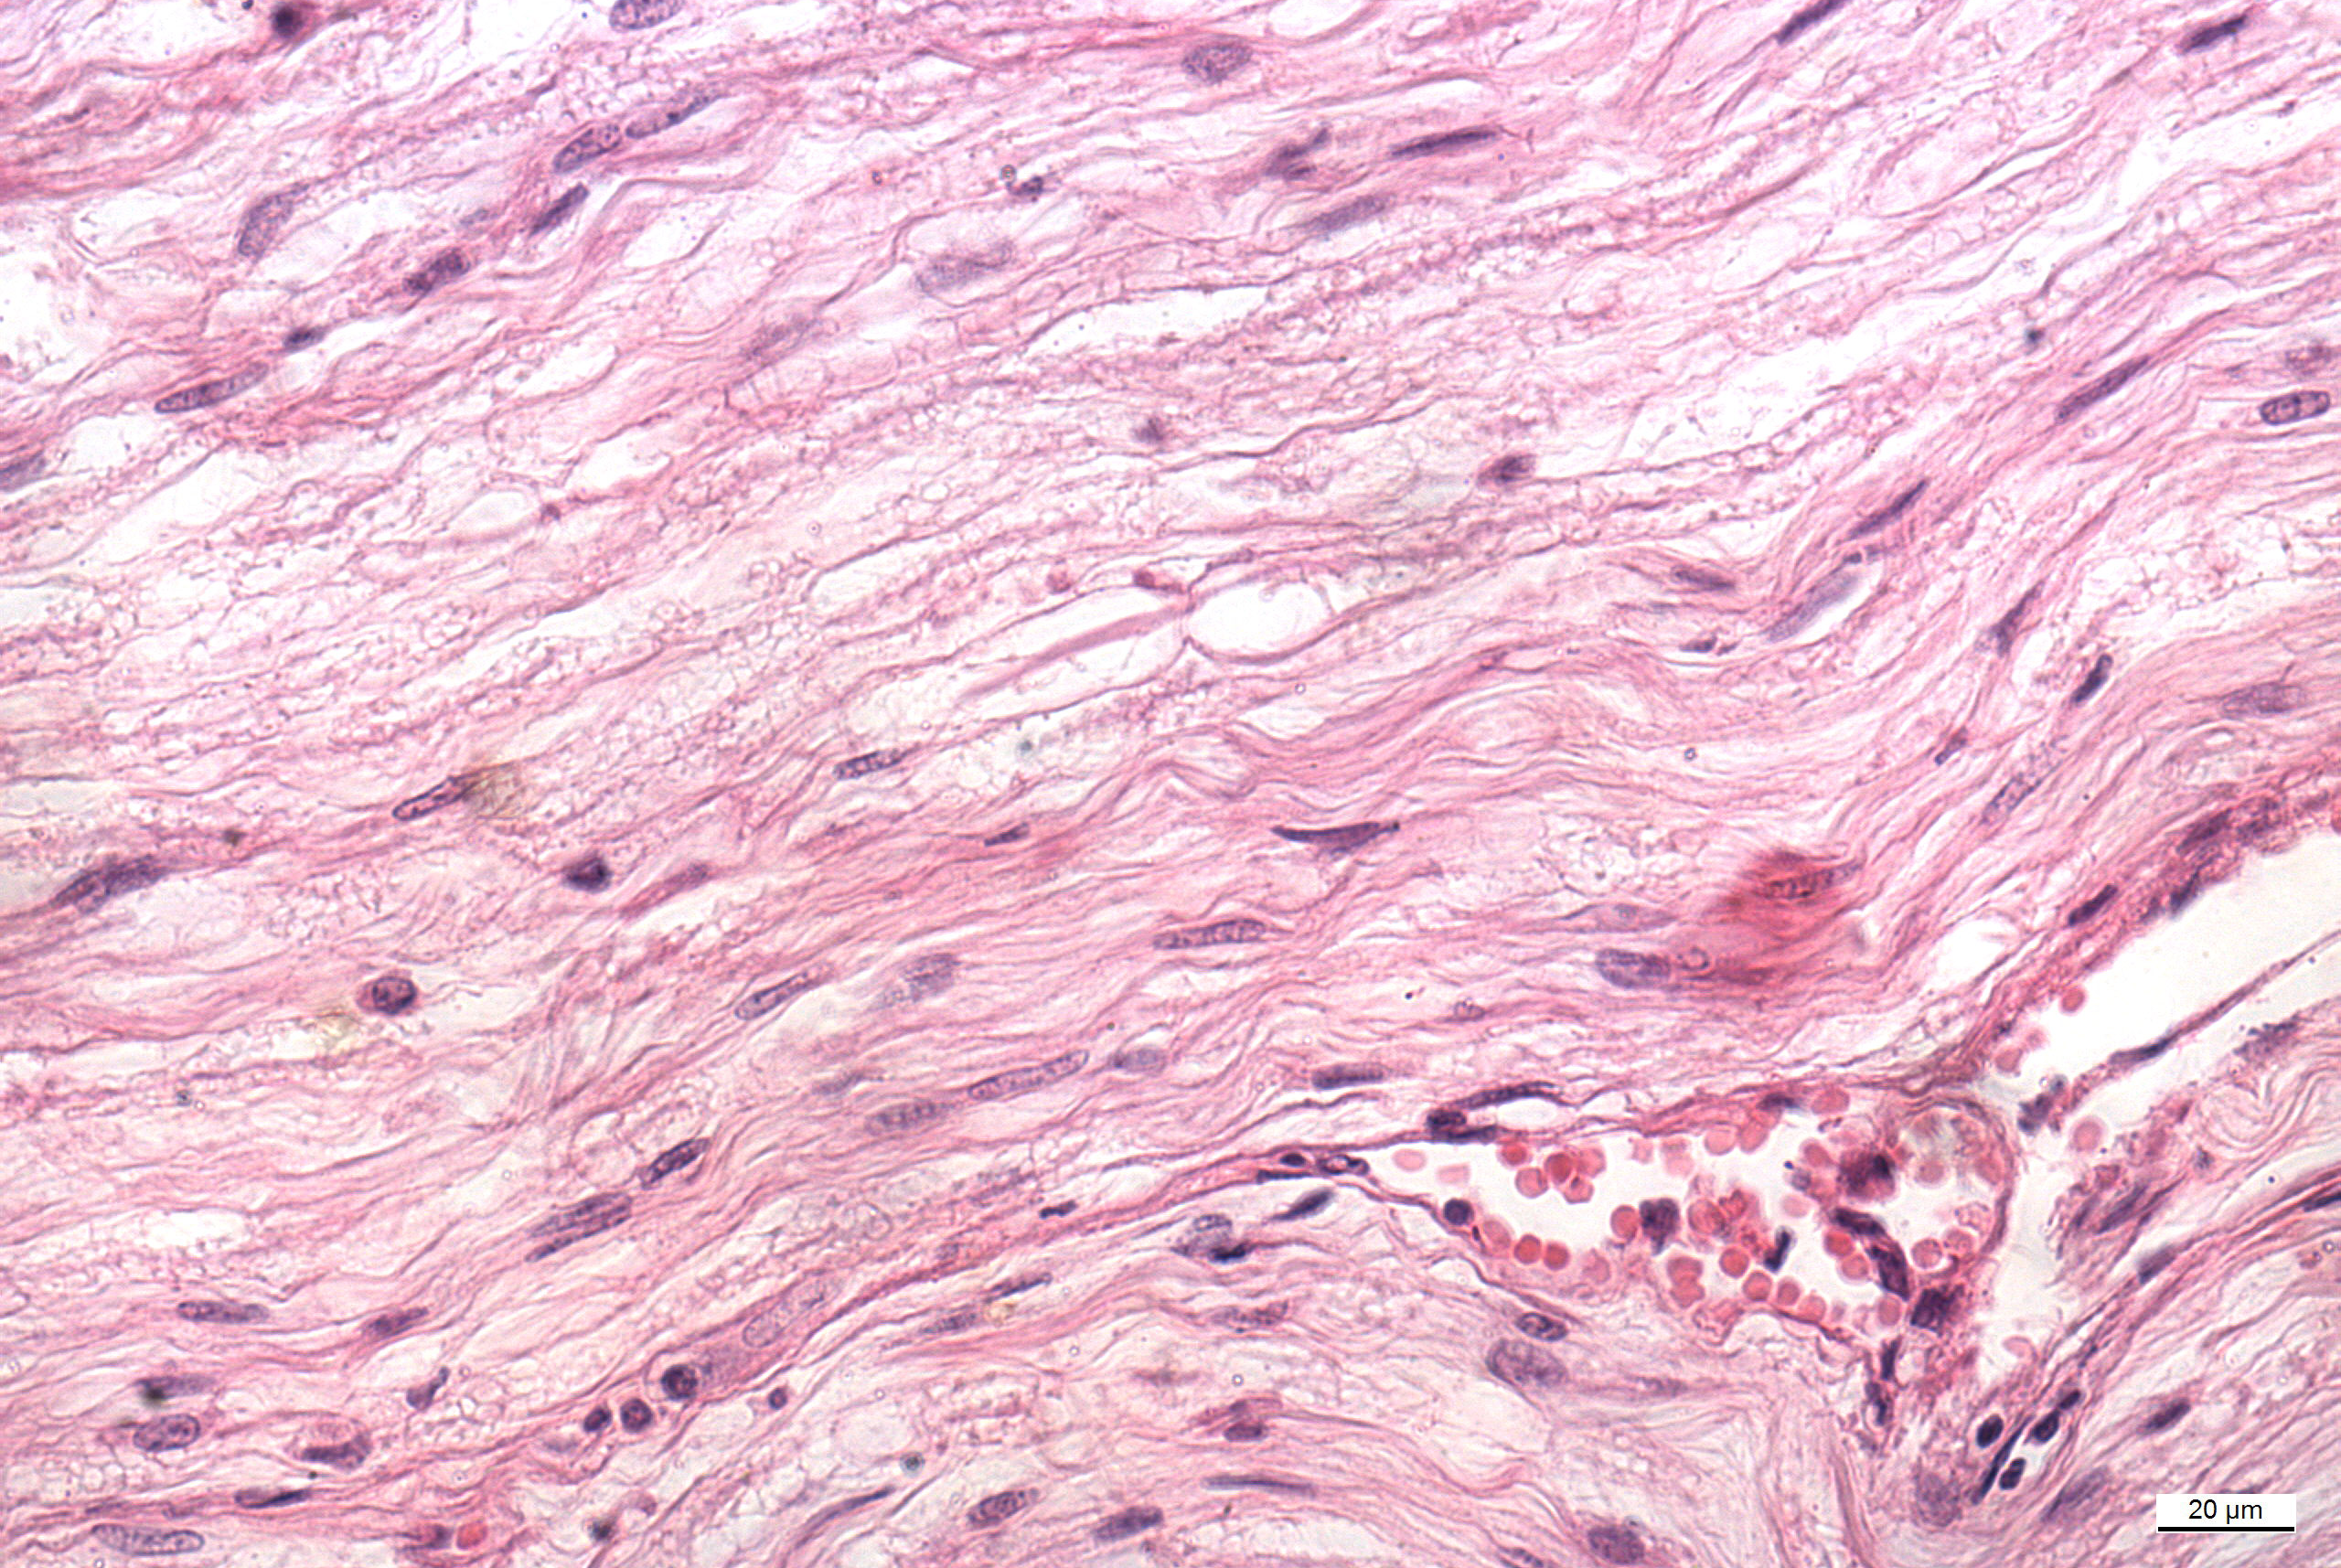
Peripheral nerve
Schwann sheath
myelinated nerve fibers
Schwann cells
node of Ranvier
endoneurium

Slide 14
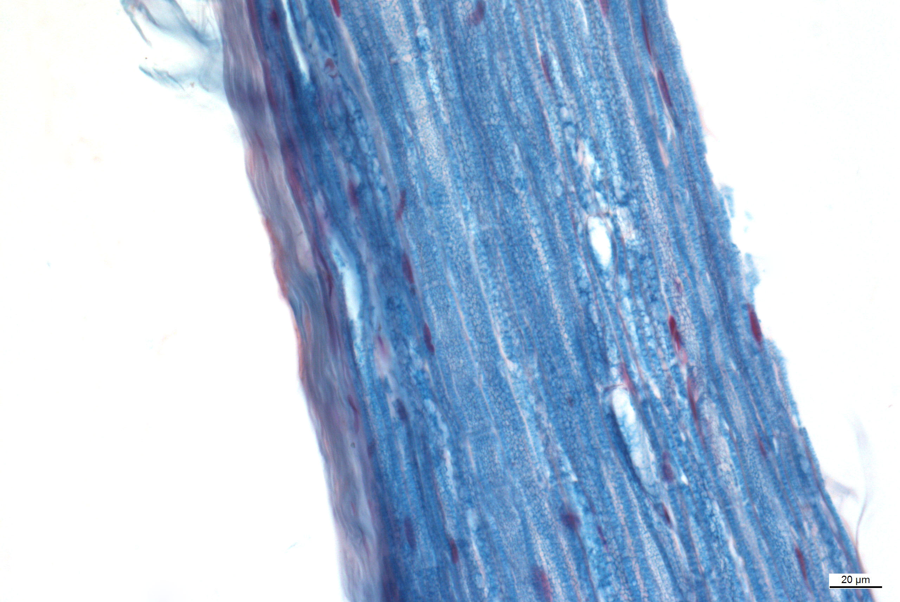
Peripheral nerve
node of Ranvier

Slide 15
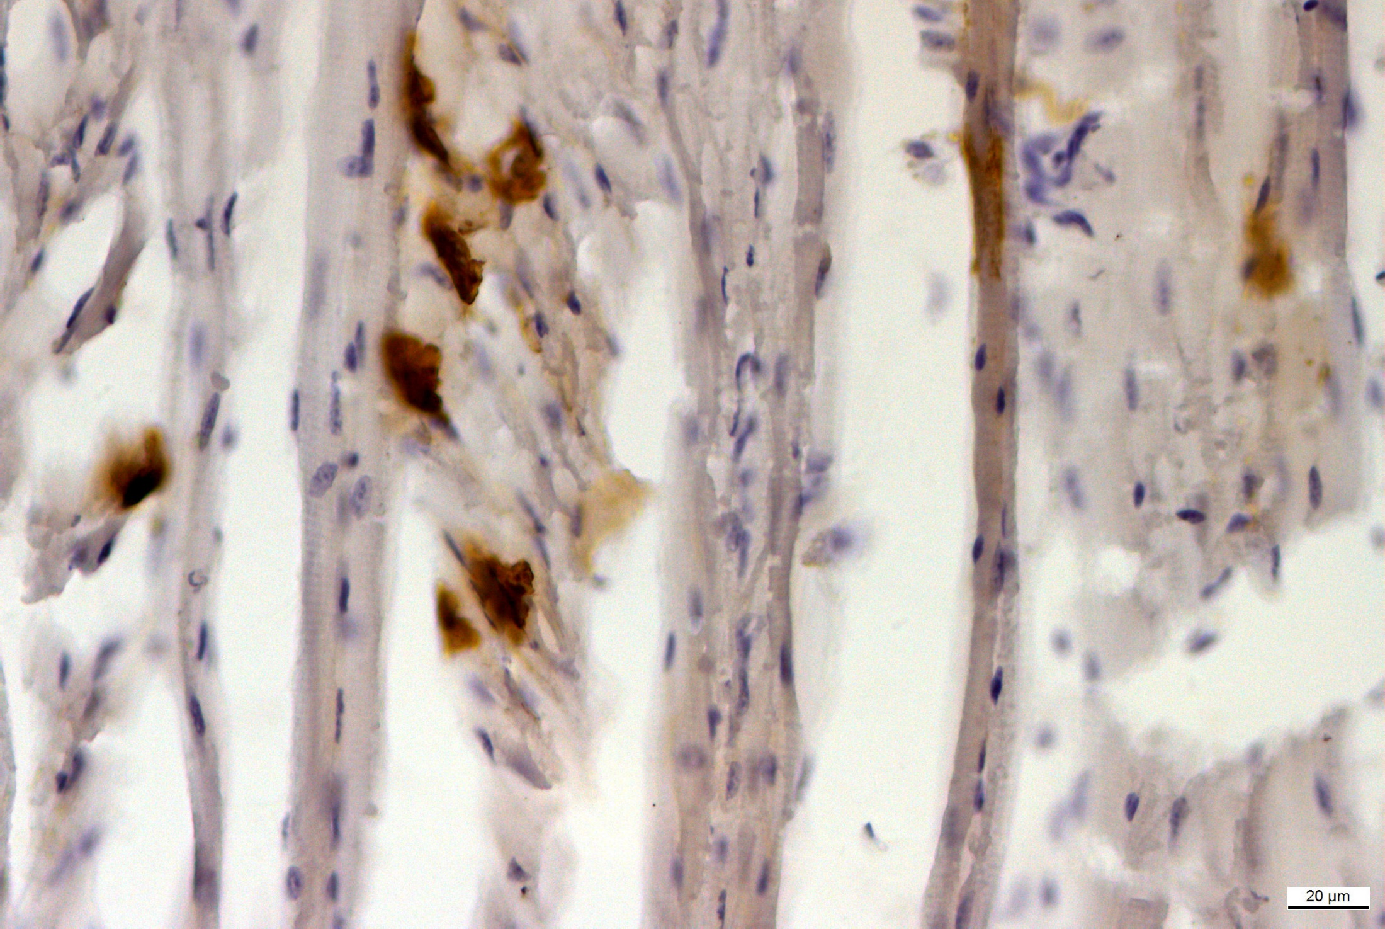
Neuromuscular junction
neuromuscular junctions positive
for acetylcholinesterase

Slide 16
List of slides
75. Cortex cerebri
76. Cortex cerebri (impregnation)
77. Cerebellum (impregnation)
78. Cerebellum (Nissl substance)
79. Medulla spinalis
80. Plexus choroideus
81. Ganglion spinale
82. Ganglion spinale (impregnation)
83. Ganglion autonomic
84. Peripheral nerve – cross section
85. Peripheral nerve – cross section (myelin)
86. Peripheral nerve – longitudinal section
87. Peripheral nerve – longitudinal section (myelin)

Slide 17
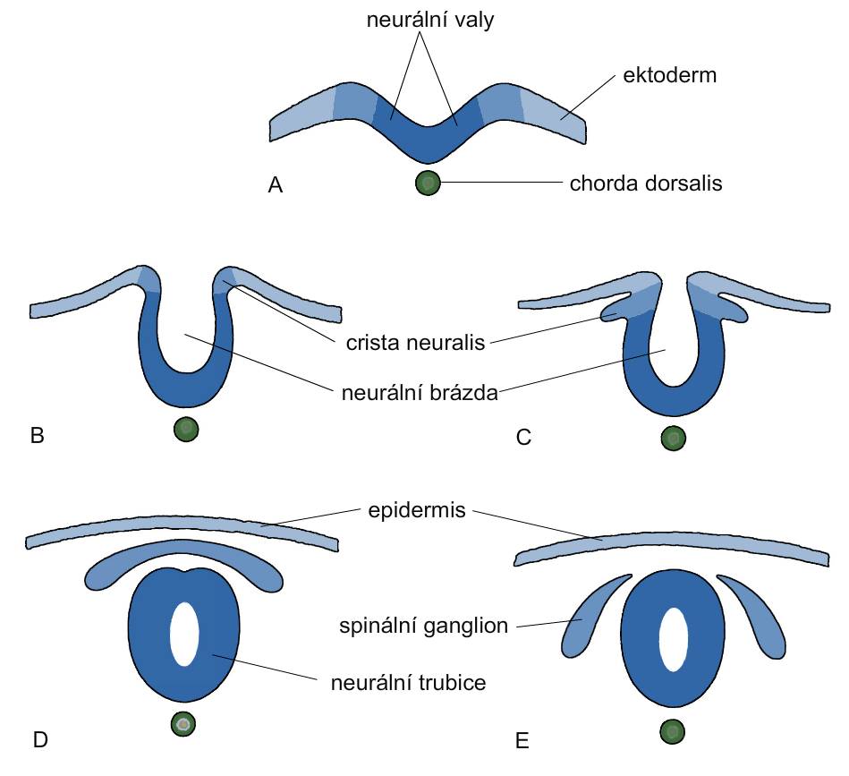
Development of neural tube
neural folds
ectoderm
neural groove
spinal ganglion
neural tube

Slide 18
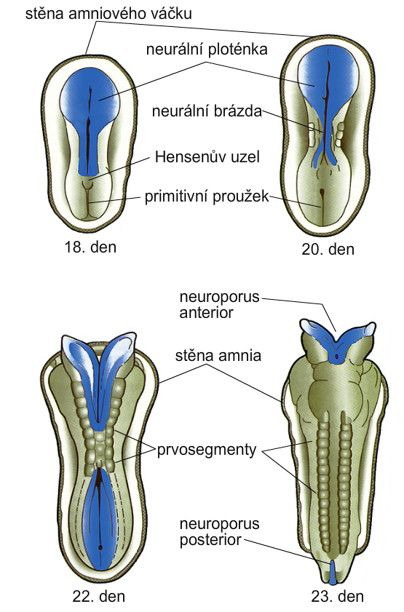
Closing of neural tube
wall of amnion
neural plate
neural groove
primitive pit
primitive streak
day 18
day 20
wall of amnion
somites
day 22
day 23

Slide 19
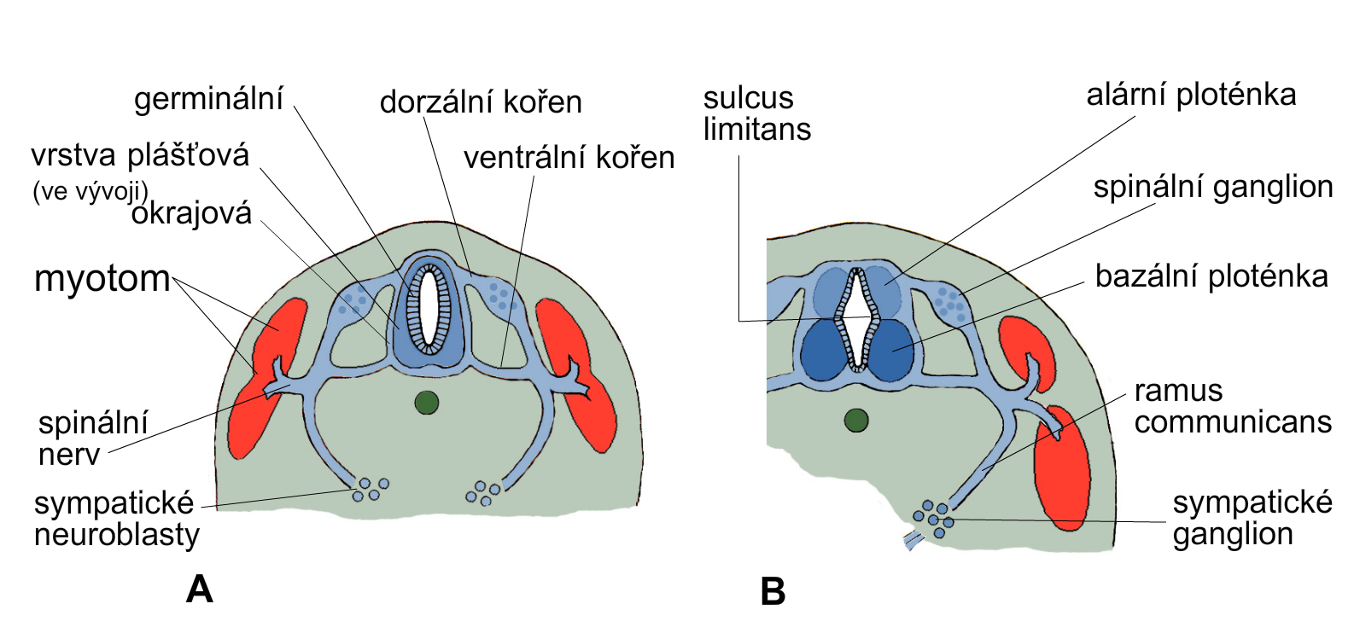
Development of spinal cord
germinal
dorsal root
sulcus
limitans
alar plate
developing mantle layer
ventral root
spinal ganglion
marginal
myotom
basal plate
ramus communicans
spinal
nerve
sympathetic neuroblasts
sympathetic ganglion
sympathetic ganglion

Slide 20
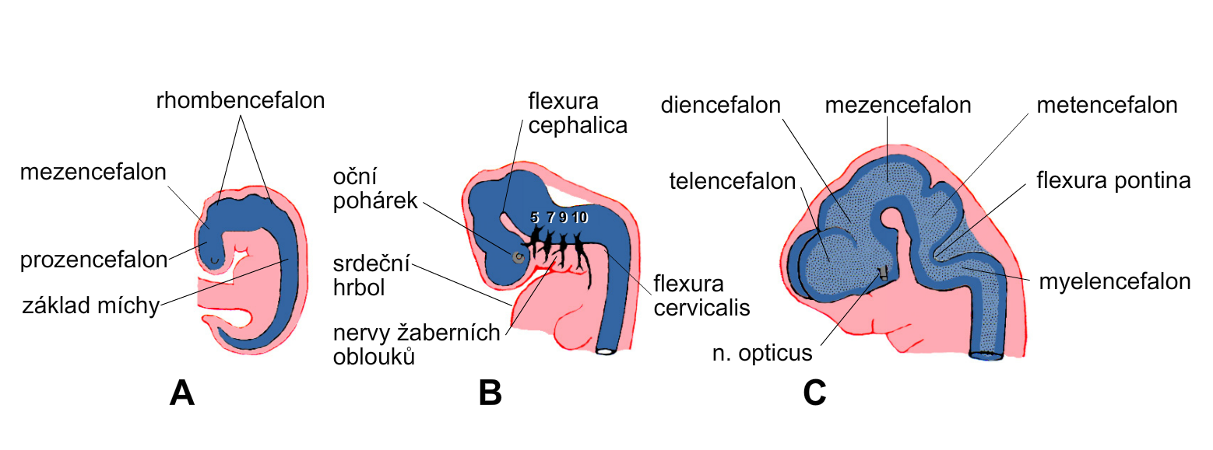
Development of brain
rhombencephalon
diencephalon
mesencephalon
metencephalon
mesencephalon
eye cup
telencephalon
prosencephalon
developing heart
developing spinal cord
myelenencephalon
nerves of pharyngeal arches

Slide 21
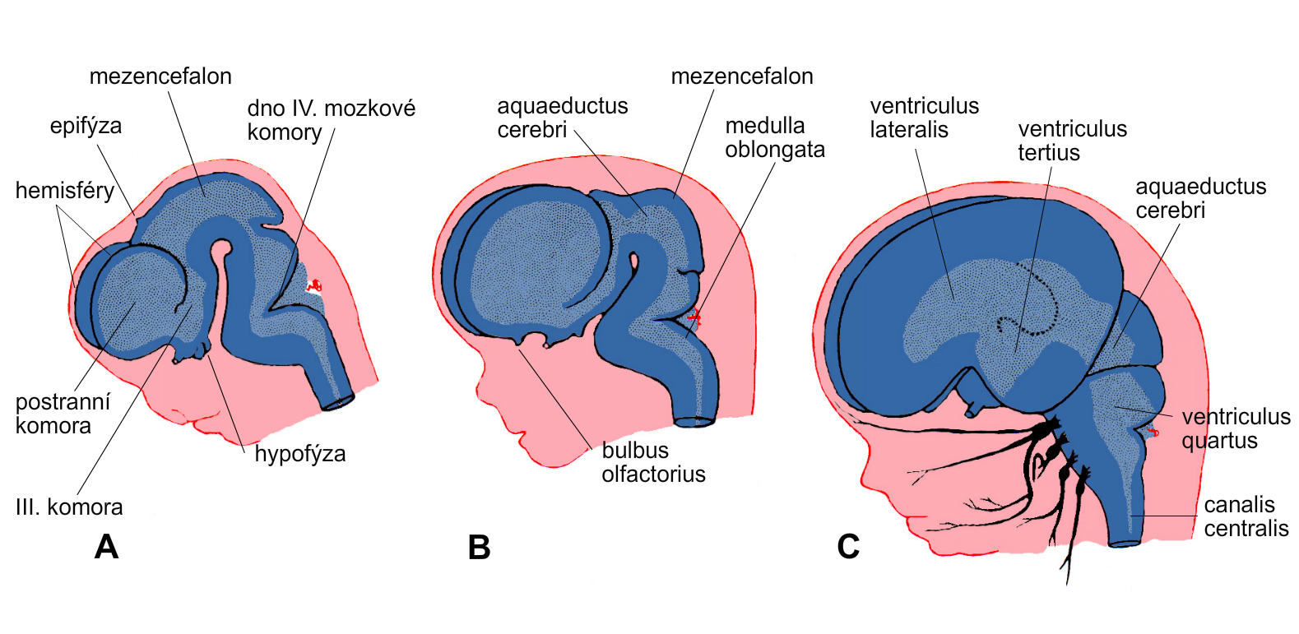
Development of brain
mesencephalon
mesencephalon
epiphysis
floor of 4th ventricle
hemispheres
lateral ventricle
hypophysis
3rd ventricle

