Slide 1

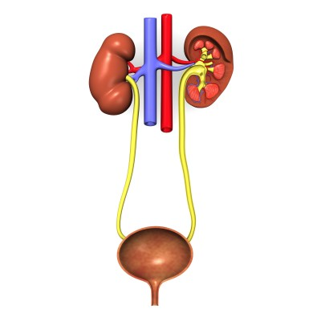
Urinary system
Ren
Calyx renalis
Ureter
Vesica urinaria
Urethra
http://www.plushbeds.com/blog/wp-content/uploads/2013/04/urinary-system.jpg

Slide 2
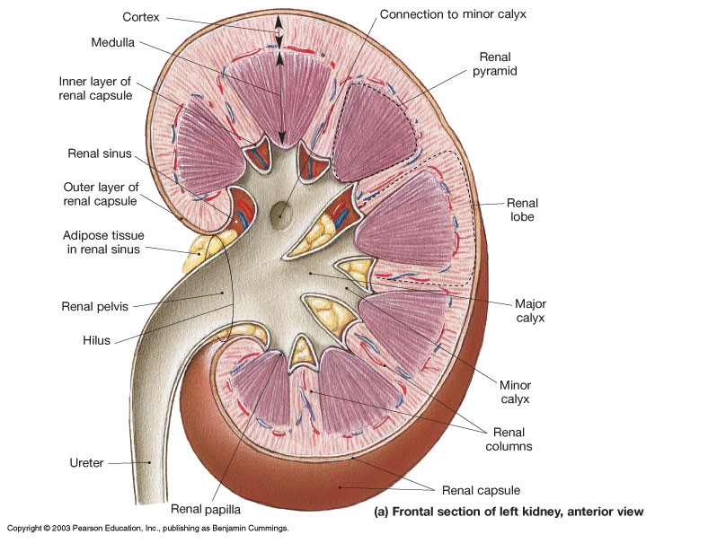
Kidney (ren, nephros)
Capsula fibrosa
Capsula adiposa
Cortex:
- cortex corticis
- pars radiata corticis
- columnae renales
(Bertini)
Medulla:
- pyramides renales (10 – 18)
- papillae renales
- foramina papillaria in area
cribrosa
- medullary rays
http://diagramreview.com/human-kidney-anatomy/

Slide 3
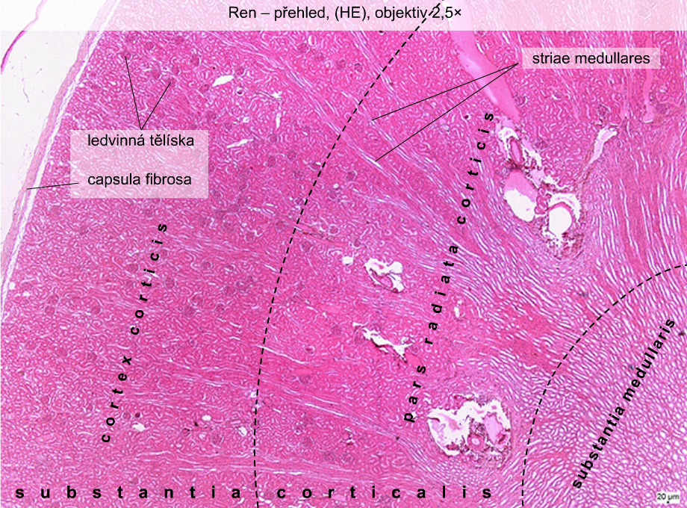
Kidney (ren), (HE)
Renal corpuscles

Slide 4
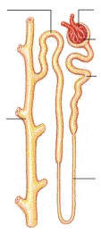

Slide 5
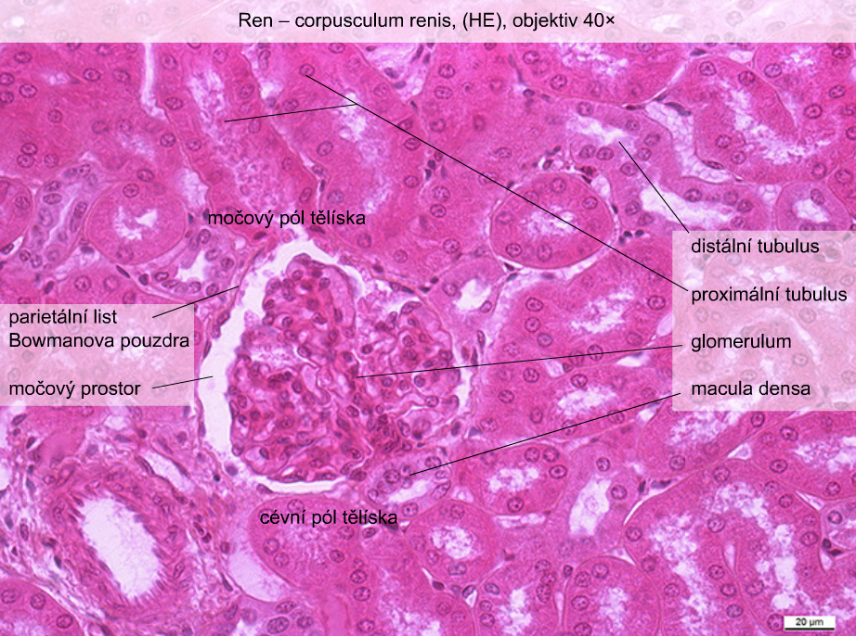
Urinary pole
Distal tubule
Proximal tubules
Parietal layer of Bowman’s capsule
Urinary space
Vascular pole

Slide 6
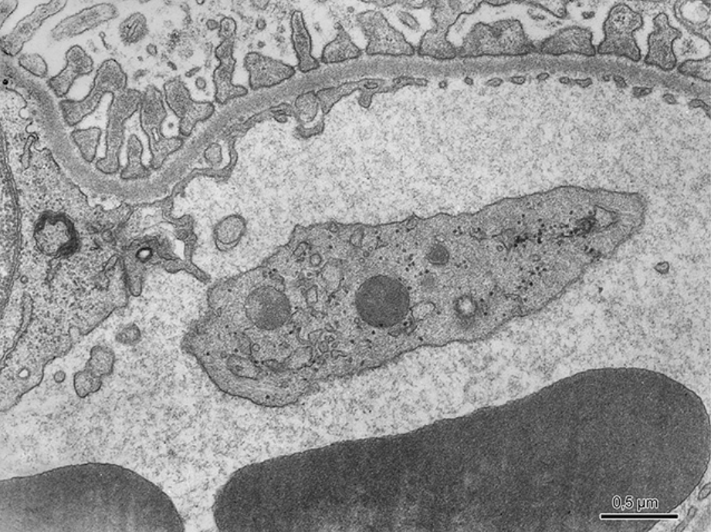
Filtration barrier

Slide 7
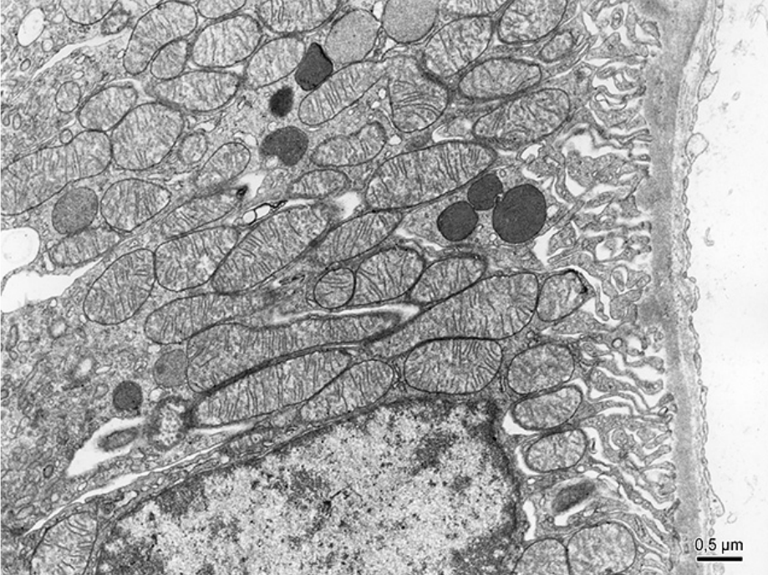
Basal labyrinth

Slide 8
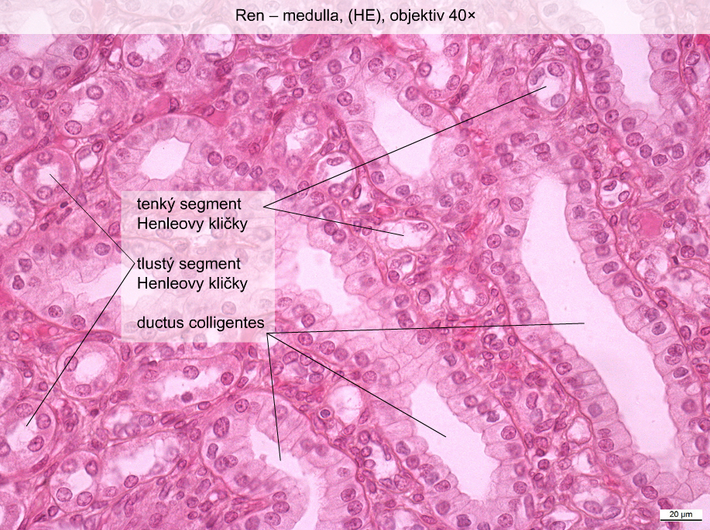
thin segment of Henle’s loop
thick segment of Henle’s loop

Slide 9
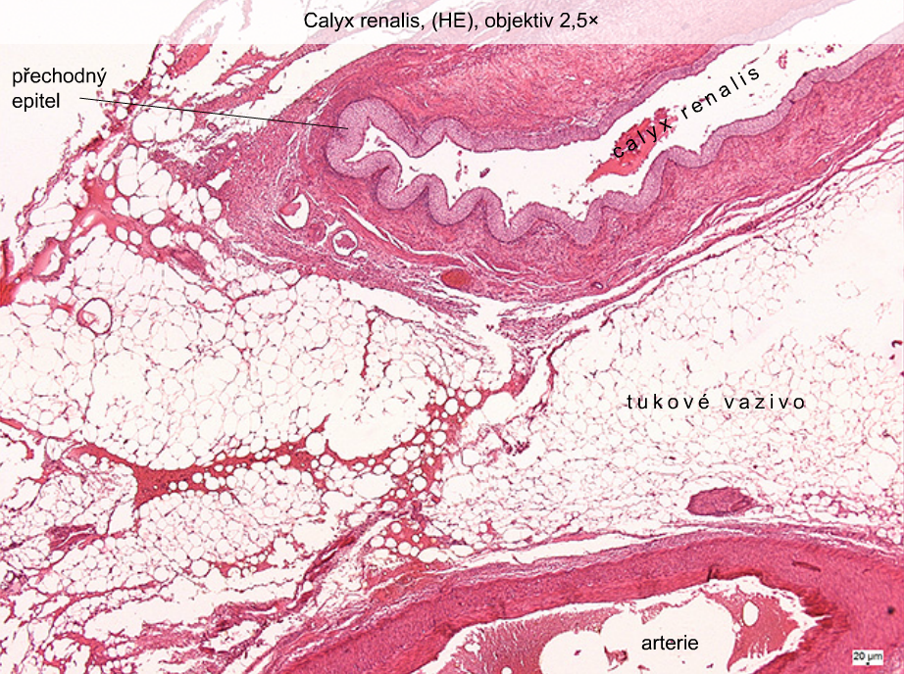
Transitional epithelium
Adipose tissue
artery

Slide 10
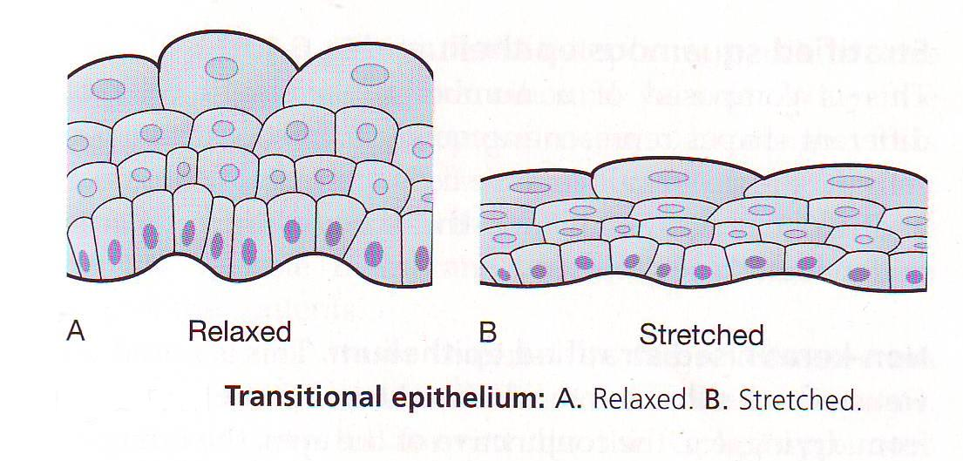
Calyx renalis (HE)

Slide 11
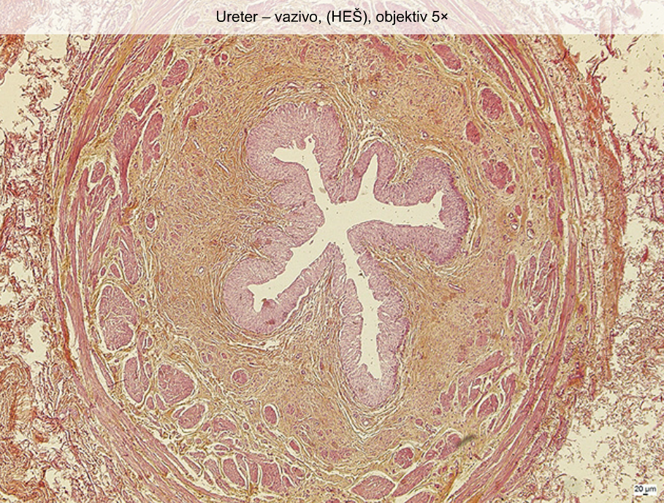
Ureter (HES)

Slide 12
Vesica urinaria (HE)

Slide 13
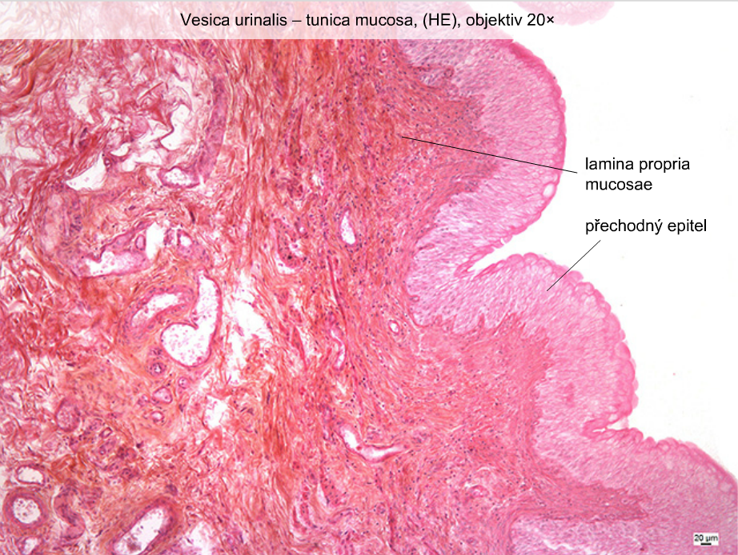
Vesica urinaria
transitional epithelium

Slide 14
Urethra feminina (HE)

Slide 15
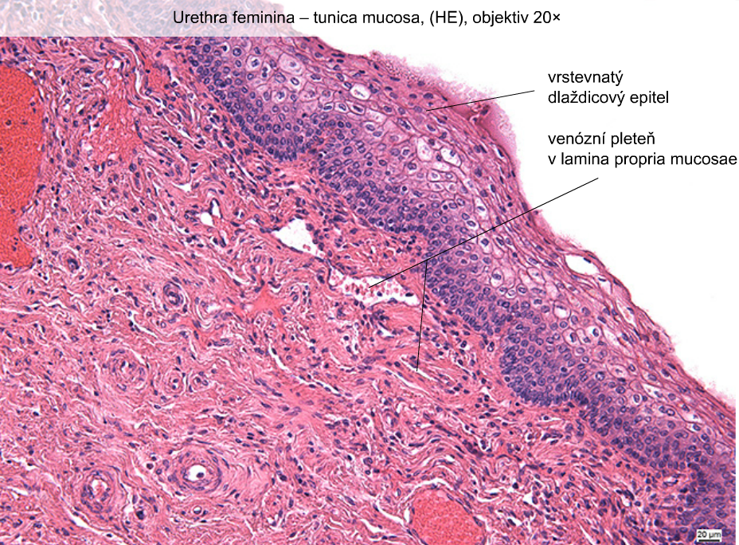
Stratified squamous epithelium
Venous plexus in lamina propria mucosae

Slide 16
Penis – pars spongiosa urethrae masculinae (HE)

Slide 17
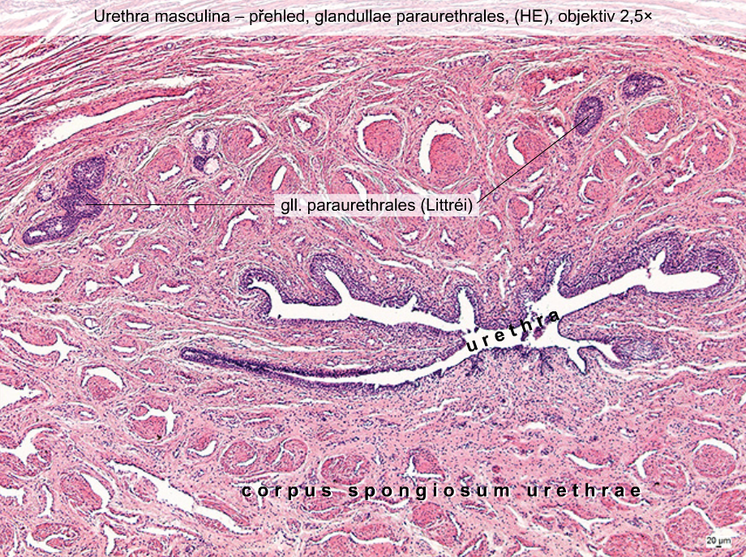

Slide 18
Penis – pars spongiosa urethrae masculinae (HE)

Slide 19
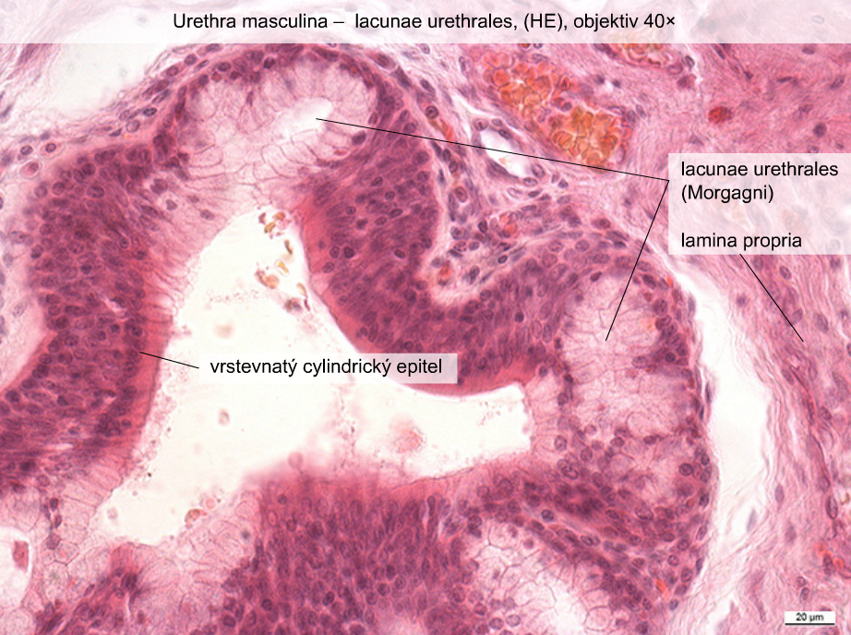
Stratified columnar epithelium

Slide 20
urinary SYSTEM
Slides:
30. Ren (HE)
31. Ren (Weigert – van Gieson)
32. Calyx renalis (HE)
33. Ureter (HE)
34. Vesica urinaria (HE)
35. Urethra feminina (HE)
41. Penis – pars spongiosa urethrae
masculinae (HE)
Atlas EM: basal labyrinth (49)

Slide 21
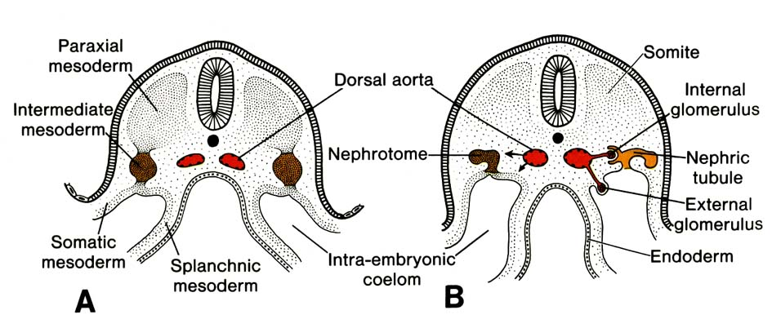
Development of urinary system

Slide 22
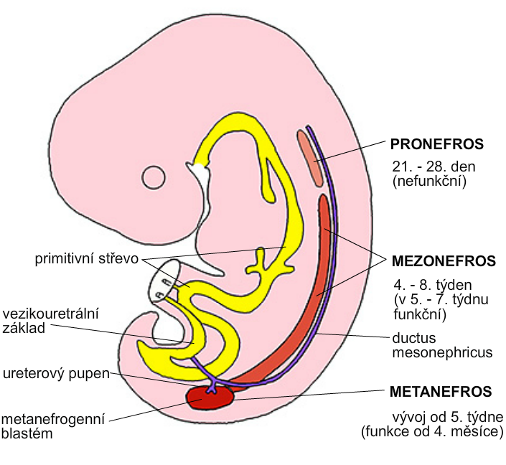
21th – 28th day
(nonfunctional)
Primitive gut
4th – 8th week
Ureteric bud
Metanephrogenic blastema
from 5th week

Slide 23
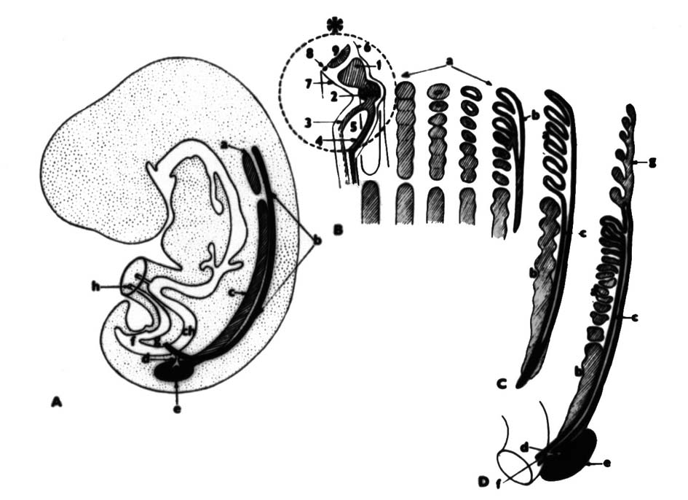

Slide 24
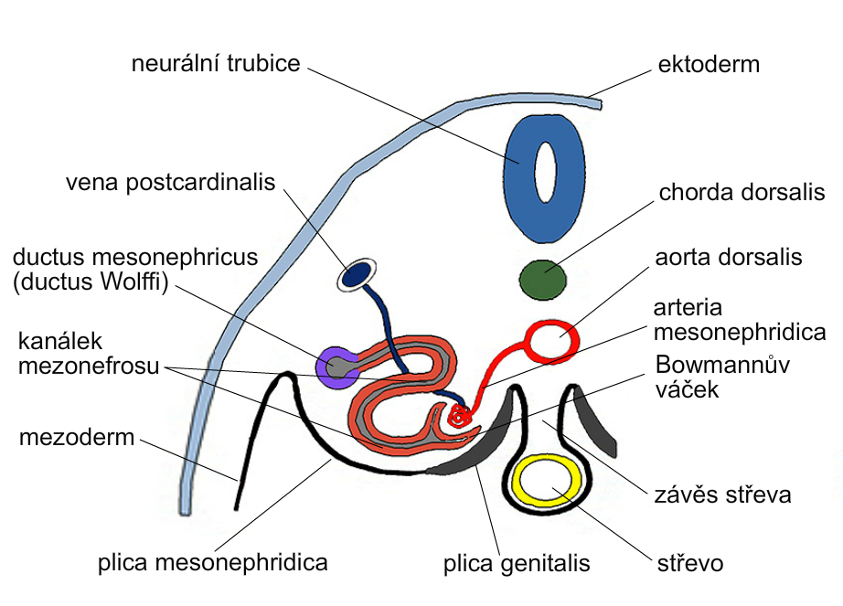
Neural tube
Tubule of mesonephros
Bowman’s capsule
mesentery
gut

Slide 25
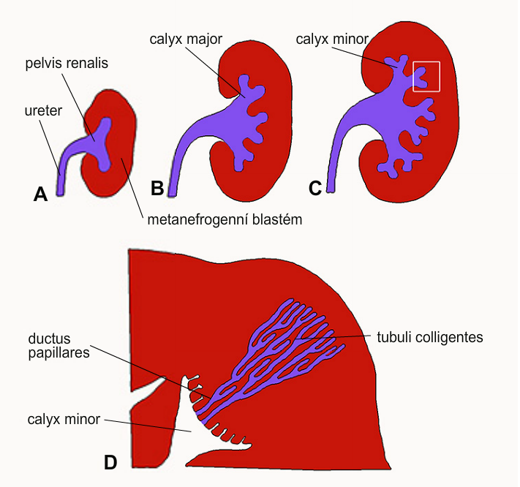
Metanephrogenic blastema

Slide 26
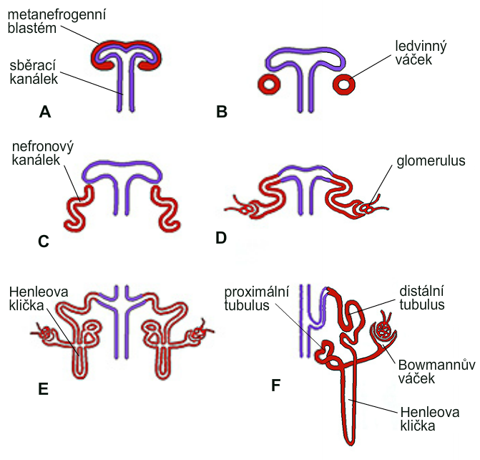
Metanephrogenic blastema
Renal corpuscle
Collecting tubule
Tubule of nephron
Loop of Henle
Proximal tubule
Distal tubule
Bowman’s capsule
Loop of Henle

Slide 27
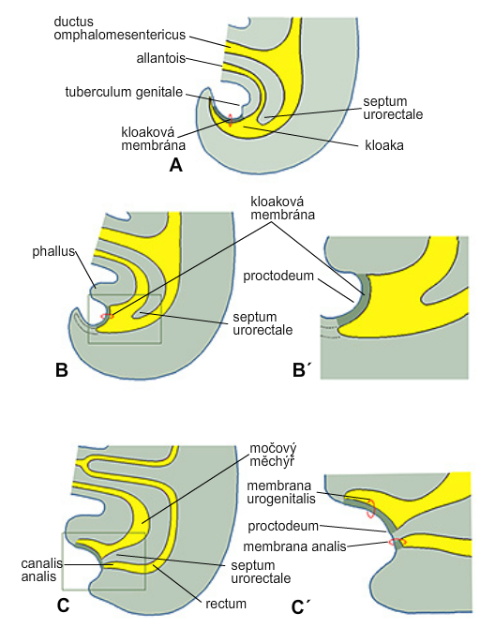
Cloacal membrane
cloaca
Cloacal membrane
Vesica urinaria

