Slide 1
Adjectives of the 3rd declension

Slide 2
a) Classify the adjectives into two groups according to their declensions. b) give the number of their nominative singular forms.
centralis, e opticus, a, um parietalis, e
ischiadicus, a, um tenuis, e crassus, a, um
ascendens, ntis sigmoideus, a, um suprarenalis, e
thyroideus, a, um biliaris, e felleus, a, um
longus, a, um brevis, e multiplex, icis
apertus, a, um cysticus, a, um migrans, ntis
solaris, e ruber, a, um rectus, a, um
biceps, itis acutus, a, um catarrhalis, e

Slide 3
1st + 2nd declension | 3rd declension | number of forms in nom. sg.

Slide 4
fractura ( ) + multiplex, icis ______________
+ apertus, a, um ______________
ren ( ) + cysticus, a, um ______________
+ migrans, ntis ______________
eczema ( ) + solaris, e ______________
+ ruber, a, um ______________
urocystitis ( ) + acutus, a, um ______________
+ catarrhalis, e ______________

Slide 5
a) Give the gender of the nouns. b) Join the nouns with the adjectives in the correct form.
canalis ( ) + centralis, e ______________
+ opticus, a, um ______________
tuber ( ) + ischiadicus, a, um ______________
+ frontalis, e ______________
intestinum ( ) + tenuis, e ______________
+ crassus, a, um ______________
musculus ( ) + rectus, a, um ______________
+ biceps, itis ______________

Slide 6
colon ( ) + ascendens, ntis ______________
+ sigmoideus, a, um ______________
glandula ( ) + suprarenalis, e ______________
+ thyroideus, a, um ______________
vesica ( ) + biliaris, e ______________
+ felleus, a, um ______________
caput ( ) + longus, a, um ______________
+ brevis, e ______________

Slide 7
A) Join the anatomical terms from the previous exercise with the word structura where appropriate. b) Join the clinical terms from the previous exercise with the word therapia where appropriate.

Slide 8
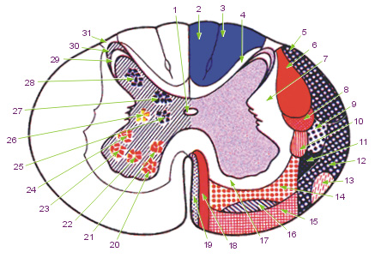
Canalis centralis

Slide 9
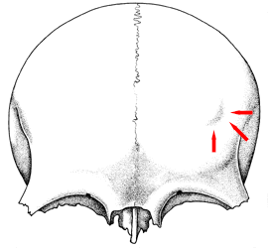
Tuber frontale

Slide 10
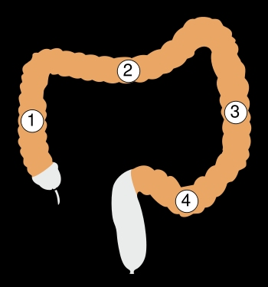
Colon Ascendens/sigmoideum

Slide 11
Join the terms with the preposition in to express direction/position.
term | in + direction propter | in + position cum/sine
intestinum crassum/tenue
colon sigmoideum/ascendens
vesica fellea/biliaris
musculus rectus/biceps
fractura aperta/multiplex
urocystitis acuta/catarrhalis

Slide 12
A) Fill in missing endings in the picture. b) Join the terms from task A) with the word fractura where appropriate. c) Put the terms from task A) in plural where appropriate. b) Join the terms from task c) with the word fracturae where appropriate.

Slide 13
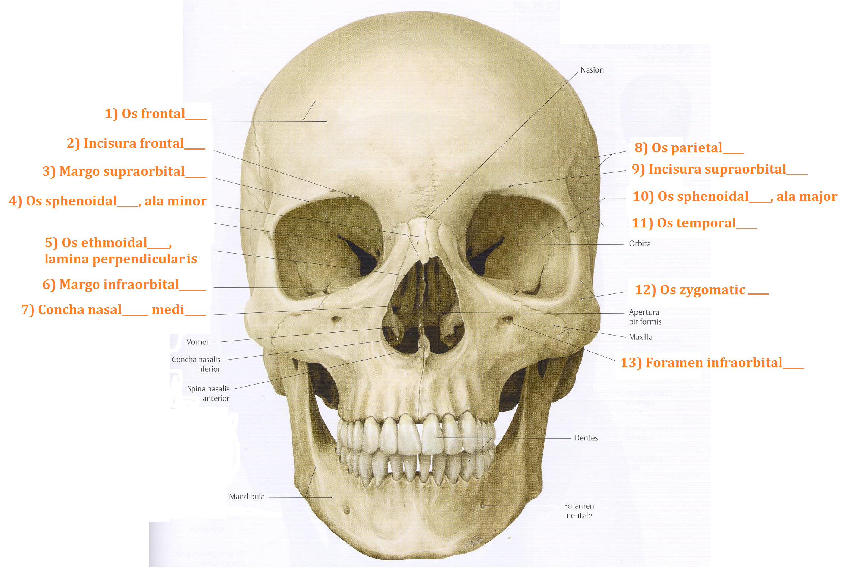

Slide 14
Give the noun which the underlined adjectives come from, its genitive singular form, gender, declension and meaning
term | nom. sg. | gen. sg. | gender | declension | meaning
os frontale
margo supraorbitalis
concha nasalis media
os parietale
os temporale
os occipitale

Slide 15
Form grammatically correct anatomical terms, do not change the word order.
fossula (pl.) --- tonsillaris, e (pl.)
rete --- articularis, e --- cubitus
musculus --- biceps, itis --- brachium
geniculum --- canalis --- nervus --- facialis, e
ligamentum --- teres, etis --- hepar/uterus
arteria --- iliacus, a, um --- communis, e
pars --- descendens, ntis --- duodenum
ramus --- communicans, antis --- cum --- nervus --- ulnaris, e
musculus (pl.) --- levator (pl.) ---- costa (pl.) --- brevis, e (pl.)

Slide 16
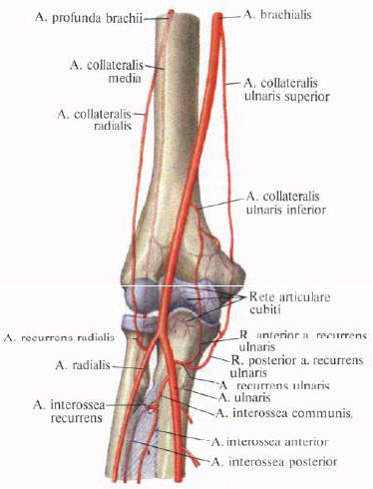
Rete articulare cubiti

Slide 17
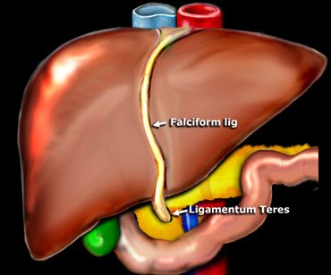
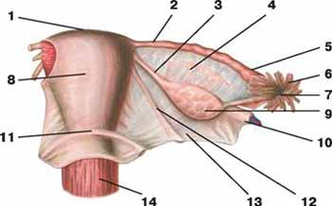
Ligamentum teres hepatis/uteri

Slide 18
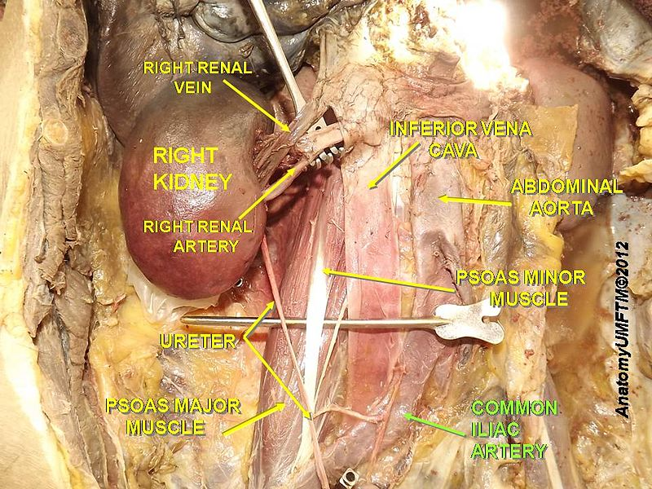
Arteria iliaca communis

Slide 19
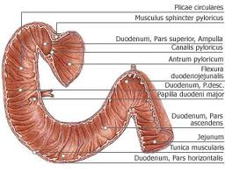
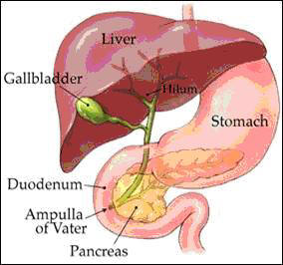
Pars descendens duodeni

Slide 20
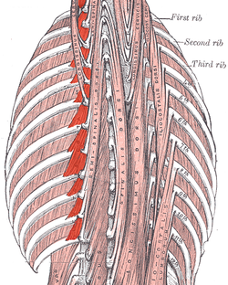
Musculi levatores costarum

Slide 21
Match the expressions on the left with the expressions on the right to form clinical terms.
Trauma grave articulationis acutae
Symptomata urocystitidis multiplices
Caries profunda dentis exacerbans
Insufficientia cordis herpetis simplicis
Therapia permanentis
Fracturae columnae vertebralis genus l. dx.

Slide 22
V. Put the terms into the correct order to form diagnoses. Do not change the endings.
lacerum mentalis
occipitalis vulnus
regionis et
l. dx. musculi
bicipitis ruptura
partialis femoris
cruris status
distalis fracturae
post l. sin.
operationem partis
nasalium fractura
dislocatione
ossium sine

Slide 23
translate into latin.
Suprarenal gland
Simple joints
Lateral margin of the nail
Fossa for the lacrimal gland (literally of the lacrimal gland)
Nucleus of the abducent nerve
Vein accompanying the hypoglossal nerve (literally Accompanying vein of the hypoglossal nerve)

Slide 24
Short gastric arteries
Common carotid artery
Fissure of the round ligament
Long/short head of the biceps muscle of the femur
Orifice of the vermiform appendix

Slide 25
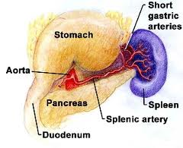
Arteriae gastricae breves

Slide 26
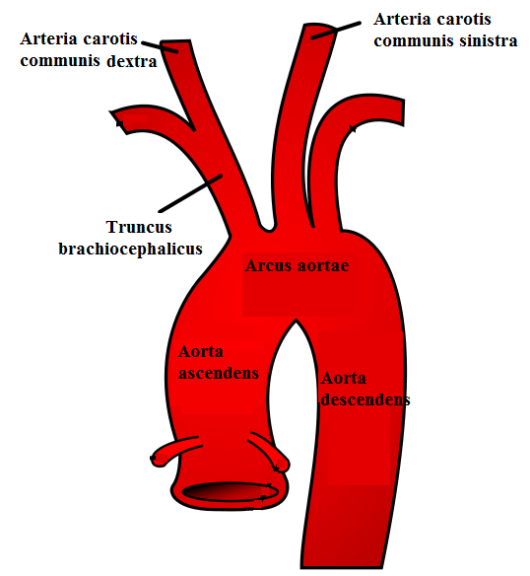
Arteria carotis communis

Slide 27
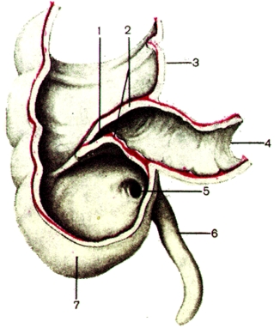
Ostium appendicis vermiformis

Slide 28
Examples of authentic diagnoses
code | diagnosis
K928 | Corpus alienum intestini tenuis perforans
C259 | Carcinoma capitis pancreatis inoperabile, metastases hepatis multiplices
S019 | Vulnera lacera regionis frontalis, dorsi nasi, labii superioris oris et vestibuli oris
C348 | Tumor lobi medii pulmonis l. dx. ad pericardium, diaphragma et nervum phrenicum increscens
C186 | St. p. colectomiam subtotalem propter carcinoma coli descendentis
M4795 | Vulnus punctum cubiti sin., corpus alienum vitreum loci vulneris
S5250 | Fractura intraarticularis partis distalis radii sin. dislocata comminutiva
S9220 | Fractura ossis cuboidei et navicularis pedis l. dx. sine dislocatione
S863 | Ruptura musculi tricipitis surae l. dx. suspecta
K928 | Corpora aliena vitrea multiplicia antebrachii l. dx.
S300 | Contusio dorsi regionis lumbalis gravis

Slide 29
I. Look up all adjectives in the diagnoses and write them down in their dictionary forms in the table.
3-form adjectives | 2-form adjectives | 1-form adjectives

Slide 30
II. Translate the diagnoses into English. III. Fill in the words from the table in the diagnoses in the correct form (see the hand-out).

Slide 31
IV. Put the underlined terms in the opposite number.
code | diagnosis
K928 | Corpus alienum intestini tenuis perforans
C259 | Carcinoma capitis pancreatis inoperabile, metastases hepatis multiplices
S019 | Vulnera lacera regionis frontalis, dorsi nasi, labii superioris oris et vestibuli oris
C348 | Tumor lobi medii pulmonis l. dx. ad pericardium, diaphragma et nervum phrenicum increscens
C186 | St. p. colectomiam subtotalem propter carcinoma coli descendentis
M4795 | Vulnus punctum cubiti sin., corpus alienum vitreum loci vulneris
S5250 | Fractura intraarticularis partis distalis radii sin. dislocata comminutiva
S9220 | Fractura ossis cuboidei et navicularis pedis l. dx. sine dislocatione
S863 | Ruptura musculi tricipitis surae l. dx. suspecta
K928 | Corpora aliena vitrea multiplicia antebrachii l. dx.
S300 | Contusio dorsi regionis lumbalis gravis

