Slide 1
Fractures

Slide 2
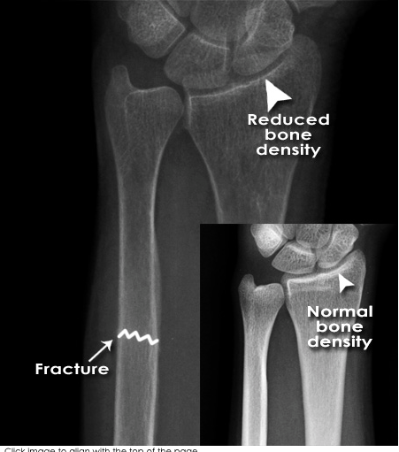
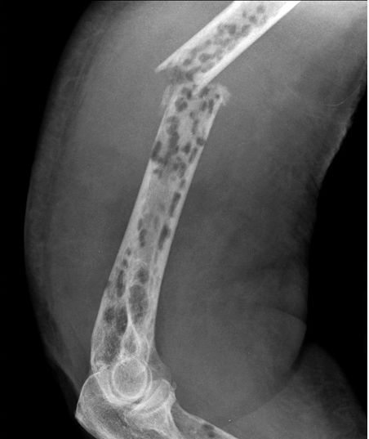
Fractura pathologica
Myeloma

Slide 3
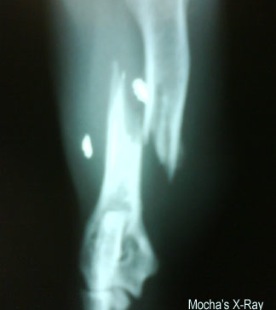
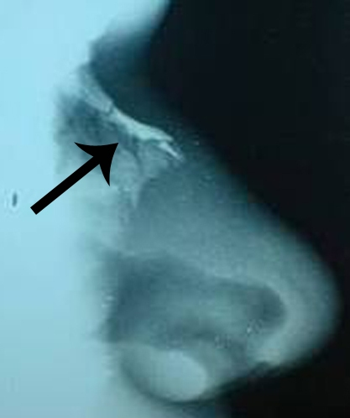
Fractura traumatica

Slide 4
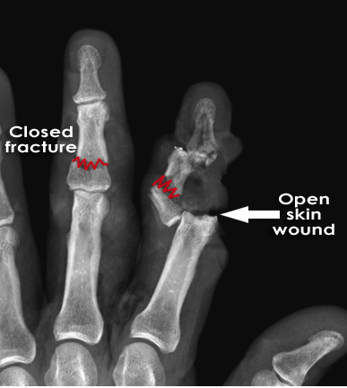
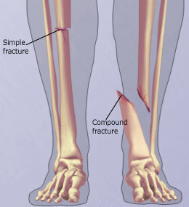
Fractura aperta/clausa

Slide 5
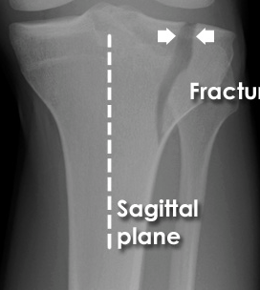
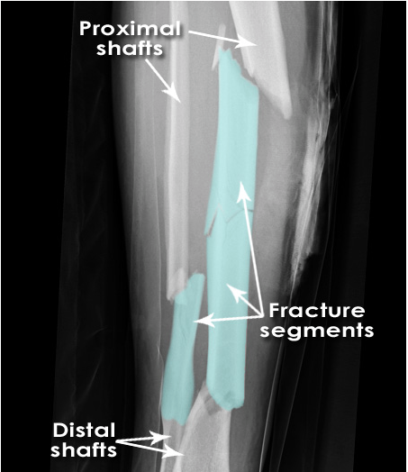
Fractura simplex/multiplex

Slide 6
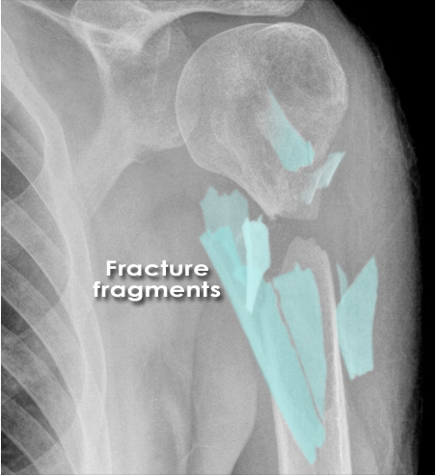
Fractura comminutiva

Slide 7
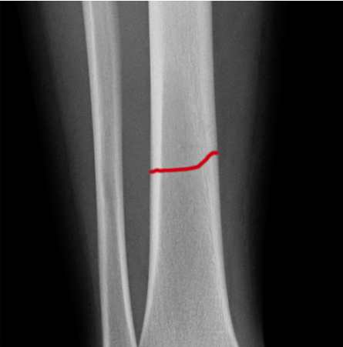
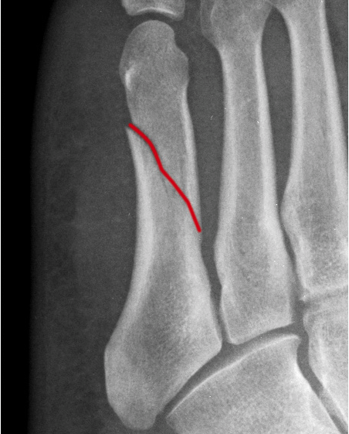
Fractura transversa/obliqua

Slide 8
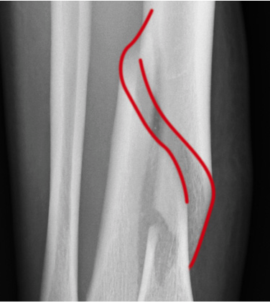
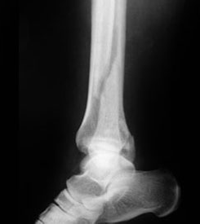
Fractura spiralis/longitudinalis

Slide 9
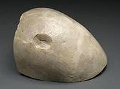
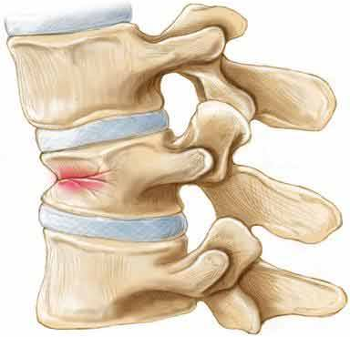
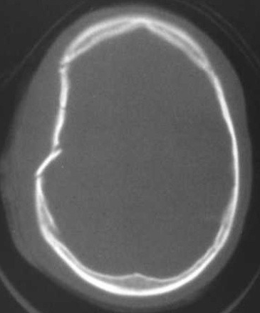
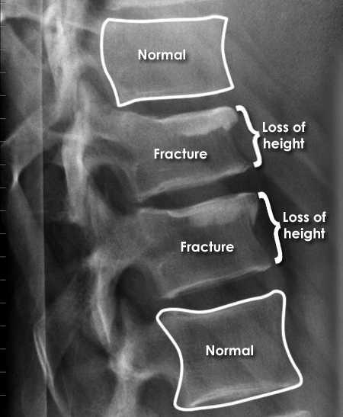
Fractura compressiva/impressiva

Slide 10
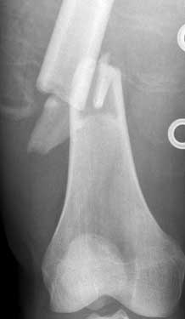
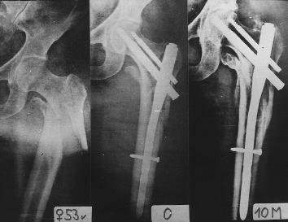
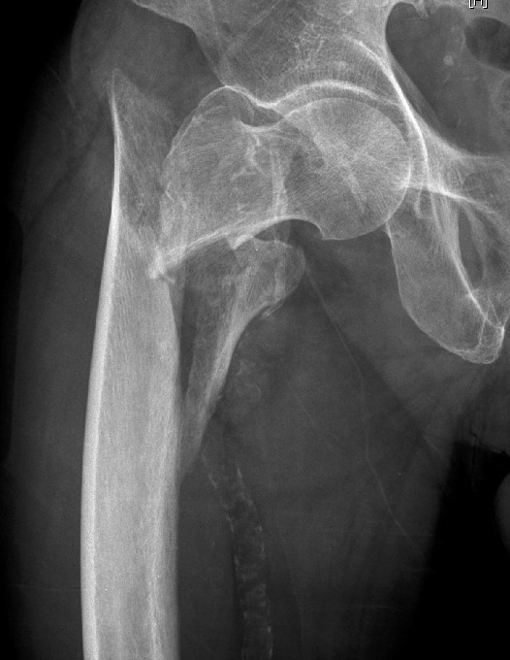
Fractura incuneata
Notes:
Toto by snáď mohlo byť ok?

Slide 11
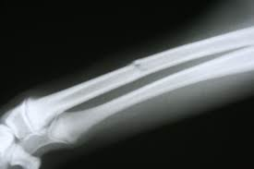
Infractio = f. partialis = f. incompleta

Slide 12
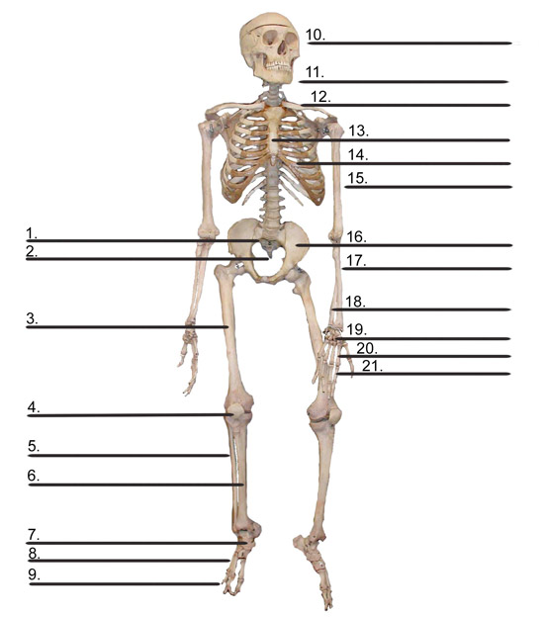
Choose a bone and break it. Try to write as much detailed diagnosis as possible.
Notes:
Cvičení primárně slouží jako opakování názvú kostí lidského těla, (kosti pojmenovat, zařadit do deklinace, určit gen. základ slova, případně odvodit adj.
Sekundárně jej možno použít jako cvičení pro zopakování typu zlomenin, student si vybere, kterou kost a jak “zlomí” a pokusí se to zapsat

Slide 13
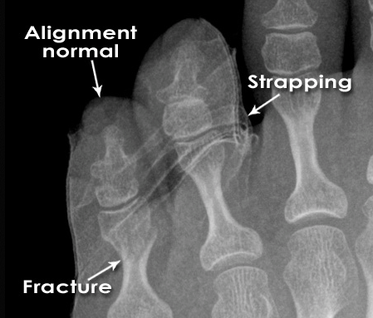
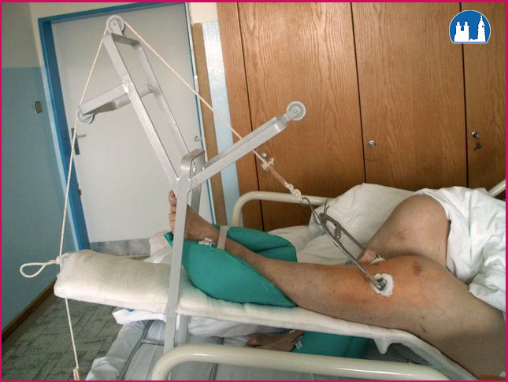
Fracture Healing:
1: REPOSITIO = REDUCTIO fragmentorum
  CLOSED (short /long term)
Notes:
is a medical procedure to restore fracture or dislocation to the correct alignment. This sense of the term "reduction" does not imply any sort of removal or quantitative decrease but rather implies a restoration: re ("back [to normal]") + ducere ("lead"/"bring"), i.e., "bringing back to normal."
Use of plates, screws, and wires was first documented in the 1880s and 1890s. Early surgical fixation initially was complicated by many obstacles, such as infection, poorly conceived implants and techniques, metal allergy, and a limited understanding of the biology and mechanics of fracture healing.[1] During the 1950s, Danis and Muller began to define the principles and techniques of internal fixation.

Slide 14
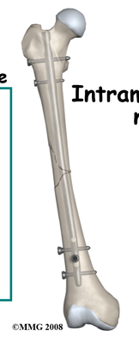
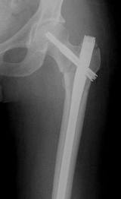
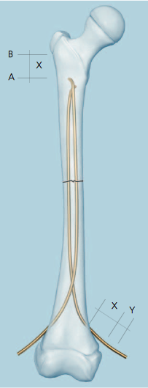
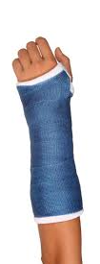
Fracture Healing:
2: FIXATIO = STABILISATIO fragmentorum
  PLASTER CAST
  INTERNAL FIXATION
Notes:
(mechanical stability)
intramedullar rods/ Internal plates and screws
ESIN

Slide 15
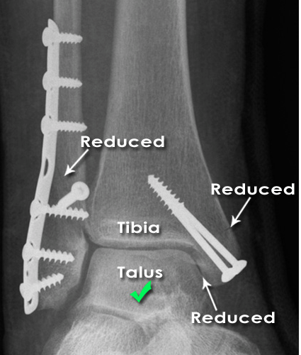
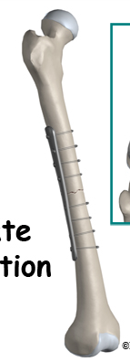
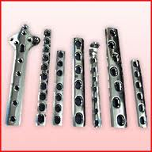
Fracture Healing:
2: FIXATIO = STABILISATIO fragmentorum
INTERNAL FIXATION

Slide 16
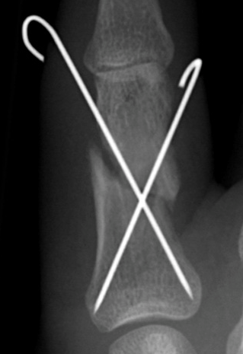
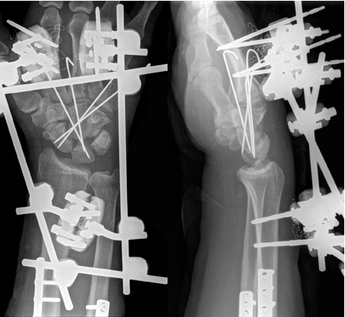
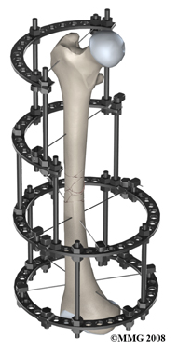
Fracture Healing:
2: FIXATIO = STABILISATIO fragmentorum
Notes:
Kirschner

Slide 17
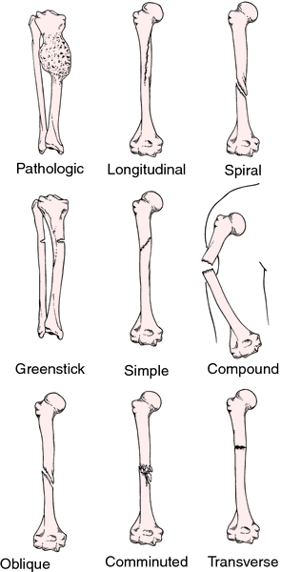
Name the type of fracture
A
B
C
D
E
F
Notes:
A, pathologica
B, spiralis
C, infractio, incompleta
D, obliqua
E, aperta/complicata
F, comminutiva

Slide 18
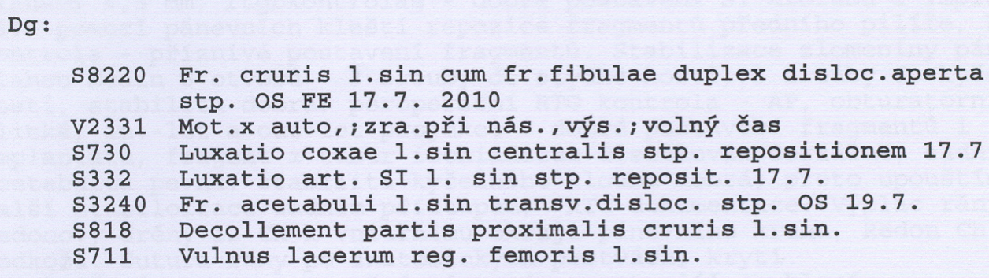
Authentic reports :1
Décollement = severe damage of soft tissues
Notes:
Toto je doplnková možnosť, diagnózy som stiahla z Katkinho Webu, Compact

Slide 19
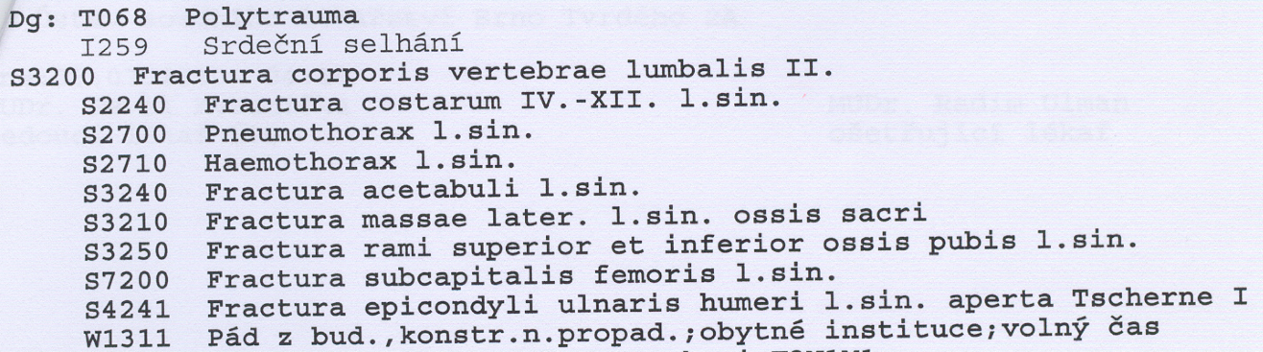

Authentic reports :2
Fr. aperta TSCHERNE I
- open fracture with small skin injury without its contusion
- negligible bacterial contamination
Profesor Dr. Harald Tscherne (1933), Traumatology Clinic, Hannover: Classification of fractures published in 1982, T. divides fracture into open and closed. The most important for him is the degree of the soft tissues damage.

Slide 20
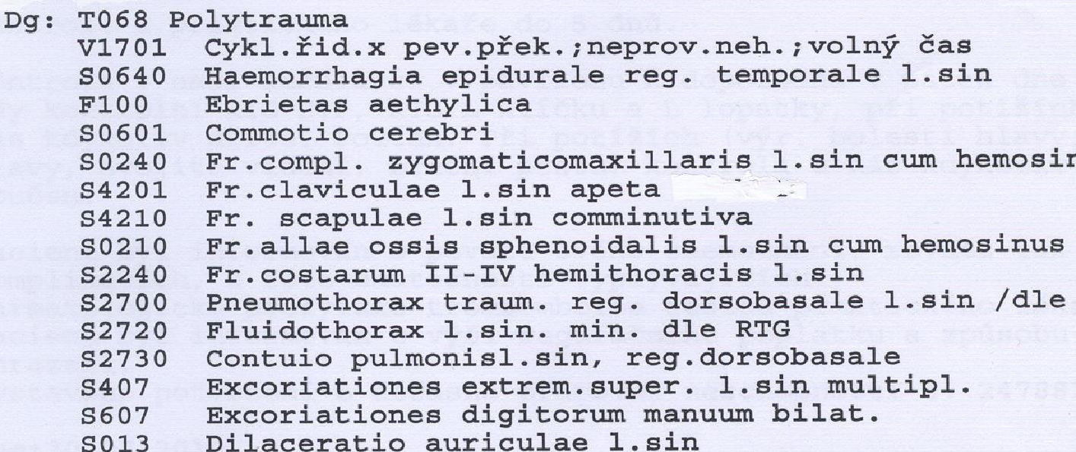
Authentic reports :3
Notes:
Toto je doplnková možnosť, diagnózy som stiahla z Katkinho Webu, Compact

Slide 21
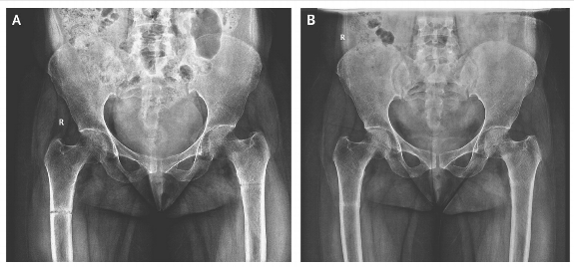
1
A 45-year-old woman presented with a 3-month history of generalized body pains nonresponsive to analgesic agents. Along with low back pain, she had progressive difficulty in getting up from sitting and supine positions and in walking. There was no history of trauma or any medication intake. She is an orthodox believer who wears a black veil outdoors and is completely covered, with little exposure to the sun. An anteroposterior radio-graph of the pelvis showed an undisplaced transverse fracture of the shaft of both femurs. The patient was treated with therapeutic doses of calcium and vitamin D supplements.

Slide 22
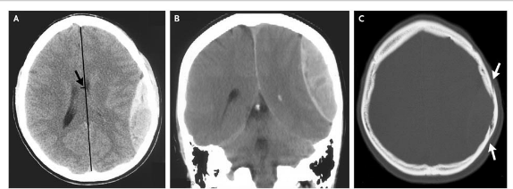
2
An 18-year-old slightly intoxicated man was assaulted with a glass bottle on the left parietal region of his head and had a 5-minute loss of consciousness. Two hours after the injury he was presented to a local emergency with severe headache, nausea, and repeated vomiting. Computed tomography of the head revealed a 2.5-cm epidural hematoma in the left parietal region (Panels A and B) underlying a linear nondisplaced skull fracture (Panel C, arrows).

Slide 23
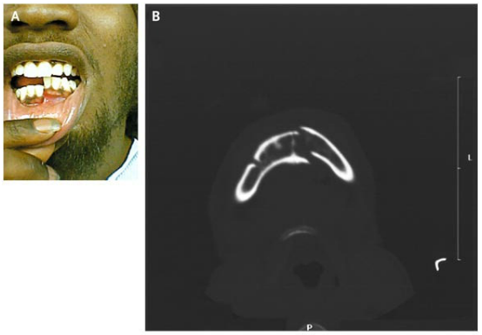
3
A 21-year-old man
presented after being
struck with a gun on
his right lower jaw.
Examination revealed
displacement of the
left half of his mandible with malocclusion on biting (Panel A). Computed tomography showed a fracture of the left mandible and a fracture of the right mandibular body and angle (Panel B). Given the U shape of the mandible, it is common for contralateral fractures to result from major injury. Intravenous analgesics and antibiotics were given; the patient underwent open reduction with internal fixation of his fractures.

Slide 24
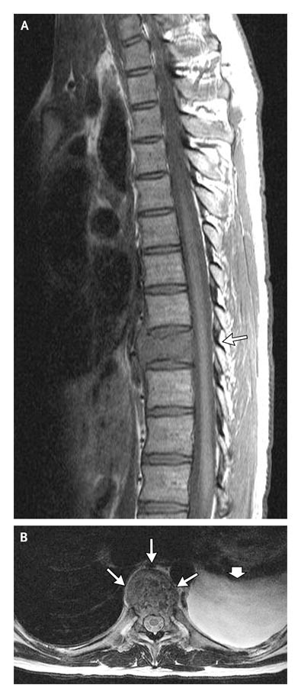
4
A 26-year-old man was admitted to this hospital because of back pain and a mass in the lung. He had been well until 17 days before admission, when he bent down to lift something and felt a sudden snap in his back, followed by pain that was associated with profuse diaphoresis and muscle spasms that extended from the left shoulder to the buttocks but did not radiate to the legs. He was unable to stand up straight and had difficulty breathing and sleeping because of the pain. The next day, magnetic resonance imaging (MRI) of the spine at that facility revealed a pathologic T9 vertebral fracture with soft-tissue extension beyond the vertebral body, a chronic anterior wedge-compression fracture of the L1 vertebra, degenerative changes in the L5–S1 intervertebral joint, and a large pleural effusion on the left side.

Slide 25
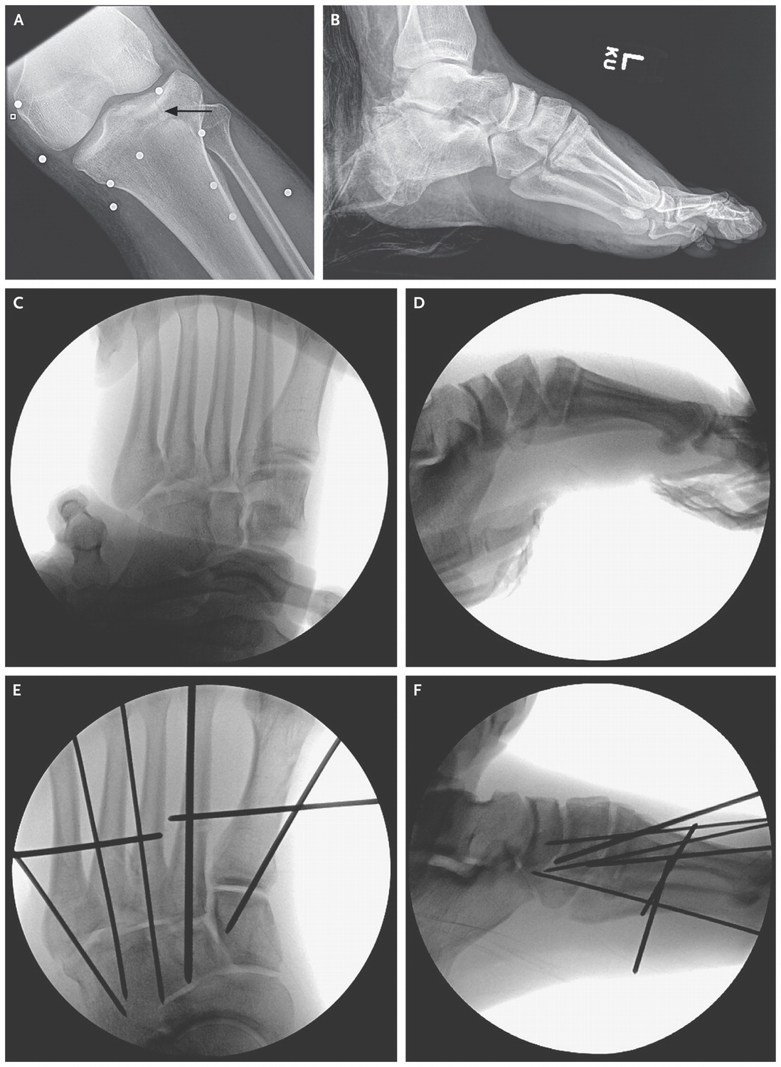
5
A 34-year-old man was brought to the emergency department at the hospital because of multiple traumatic injuries that he sustained when a bomb exploded while he was watching the 2013 Boston Marathon. At the scene, the patient reportedly lost consciousness, had a complete amputation of his right leg directly below the knee, and had copious blood loss. A plain radiograph of the left tibia and fibula (Figure 3A Radiographs of the Injuries of the Left Leg.) revealed multiple metallic foreign bodies around the knee and a nondisplaced fracture of the lateral tibial plateau. Plain radiographs of the left foot and ankle revealed a comminuted fracture of the calcaneus (Figure 3B), minimally displaced cuboid and cuneiform fractures, and subluxation of multiple tarsometatarsal joints, evidence of a ligamentous Lisfranc injury (dislocation of the tarsometatarsal joints due to midfoot trauma; named after the military surgeon in Napoleon's army) (Figure 3C).

Slide 26
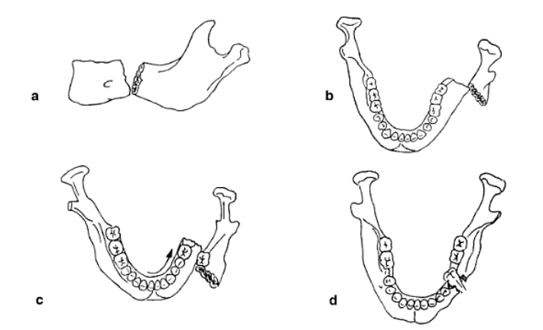
Fractura cum dislocatione
ad axim
ad latus
ad longitudinem cum contractione
ad longitudinem cum distractione

Slide 27
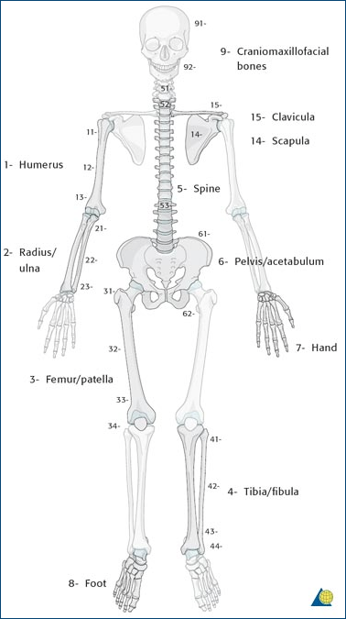
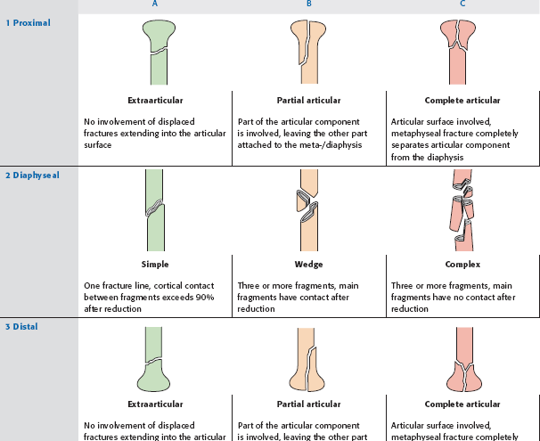
Authentic reports : 2
AO Classification of fractures
S 4220 Fractura colli chirurgici humeri l. dx. comminutiva AO 11-C3
Notes:
první číslo – vyjadřuje postiženou kost (1 humerus, 2 předloketní kosti, 3 femur, 4 bérec, 5 páteř, 6 pánev, 7 ruka 8 noha)
druhý údaj – určuje segment kosti (u dlouhých kostí – 1 prox.epimetafýza, 2 diafýza, 3 distální epimetafýza)
- třetí údaj ukazuje typ zlomeniny – A-C, u každé části je konkrétní

Slide 28
Literature
Mazánek, J.: Traumatologie orofaciální oblasti. Praha : Grada, p. 24
http://radiologymasterclass.co.uk
http://anthropology.si.edu
http://nejm.org (The New England Journal of Medicine)

