Slide 1
Ajectives and nouns

Slide 2
Adjectives and nouns
When we connect the noun with the adjective, we have to know the GENDER of the noun.
According to the gender of the noun we choose the right form of the adjective.
morbus, i, m.
periculosus, a, um
periculosus
masculine form of the adjective
feminine form of the adjective
neutral form of the adjective
morbus
periculosa
periculosum

Slide 3
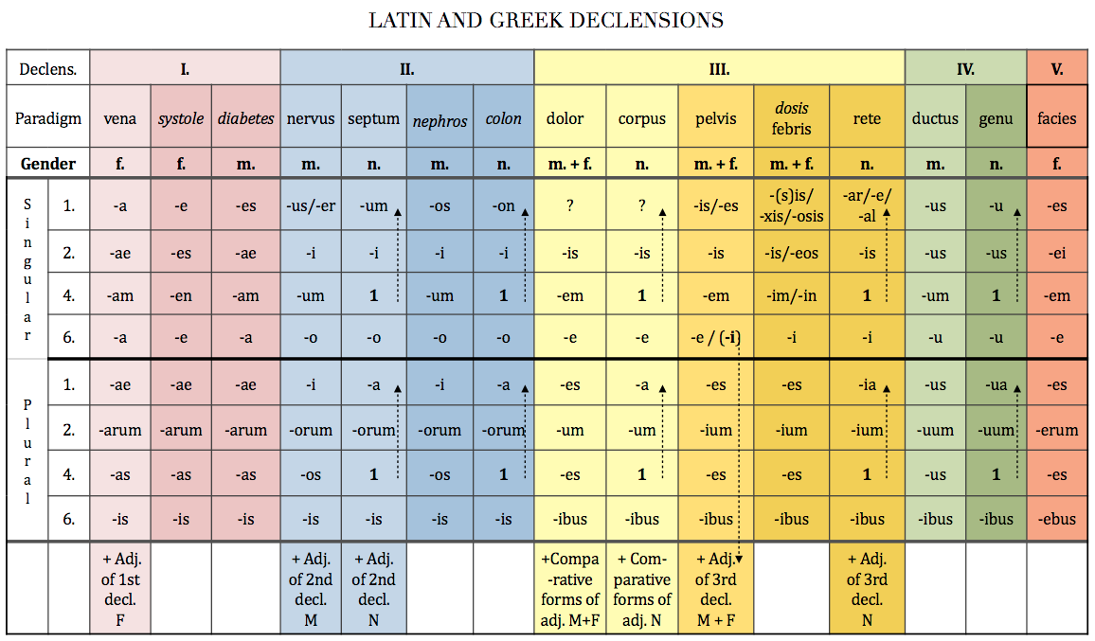
periculosa
periculosus
periculosum
When you know what gender of the adjective you should use, you decline it according to the paradigm for that adjective.

Slide 4
Adjectives and nouns
The adjective always have to be of the same GENDER, CASE and NUMBER as the noun with which it is connected
dangerous disease -> morbus periculosus
cause of dangerous disease ->causa morbi periculosi
after dangerous disease -> post morbum periculosum
with dangerous disease -> cum morbo periculoso

Slide 5
Adjectives and nouns
!The adjective does not have to have the same endings as the noun, it has to be of the same GENDER, CASE and NUMBER!
periodus, i, f.
->periodus longa
after a long period
post periodum longam
longus
periodus
longa
longum
The noun and the adjective are BOTH of feminine GENDER, accusative CASE and singular NUMBER, although they do not have the same endings

Slide 6
Connect nouns
cranii
carpi
radii
ulnae
humeri
digiti
calcanei
malleoli
ovarii
uteri
ventriculi
cerebri
linguae
recti
intestini caeci
cerebri
organi
ventriculi
bronchi
arteriae
oculi
uteri
mandibulae
oesophagi

Slide 7
Decide on declension and paradigm
Chole
Medulla
Nephros
Ascites
Methodus
Tarsus
Diabetes
Collum
Colon
Palatum
Oculus
Therapia
Diameter
Cancer
Puer
Tibia

Slide 8
Connect the nouns with adjectives
oculus + niger, gra, grum
chole + purus, a, um
palatum + durus, a, um
tibia + dexter, tra, trum
methodus + novus, a, um
diabetes + mellitus, a, um
therapia + chirurgicus, a, um
nephros + sinister, tra, trum
oculus niger
chole pura
palatum durum
tibia dextra
methodus nova
diabetes mellitus
therapia chirurgica
nephros sinister

Slide 9
Connect given terms with the prepositions (or nouns)
sine + nephros sinister
sine nephro sinistro
ad + chole pura
ad cholen puram
in + palatum durum (position)
in palato duro
fractura + tibia dextra
fractura tibiae dextrae -> fracture of left shinbone
cum + methodus nova
cum methodo nova
propter + diabetes mellitus
propter diabetam mellitum

Slide 10
What is the gender, number and case of the following nouns?
palata
angulis
oculos
ovariorum
nephron
alvo
icterum
olecranon
methodi
palatum, i, n., nominative pl. or accusative pl.
angulus, i, m./ ablative pl.
oculus, i, m./ accusative pl.
ovarium, ii, n./ genitive pl.
nephros, i, m./ accusative sg.
alvus, i, f./ ablative sg.
icterus, i, m./ accusative sg.
olecranon, i, n./ nominative or accusative sg.
methodus, i, f./ genitive sg. or nominative pl.

Slide 11
Translate into Latin
big muscle
musculus magnus
muscle of back
musculus dorsi – state of dependency -> genitive case
big muscle of back
musculus magnus dorsi – state of dependency -> genitive case
big muscles of back
musculi magni dorsi – state of dependency -> genitive case
-> noun and adjective in plural
muscle of finger
musculus digiti – state of dependency -> genitive case
muscles of fingers
musculi digitorum – state of dependency -> plural genitive case

Slide 12
Decide what is correct
The cause of deadly anaemia
A causa anaemia perniciosa B causa anaemiae perniciosae
Insufficiency of the valve of the aorta
A insufficientia valvulae aortae B insufficientia aortae valvulae
Because of acute dyspnoea
A propter dyspnoen acutam B propter dyspnoen acuten
Fracture of the right collar bone
A fractura dextra clavicula B fractura claviculae dextrae

Slide 13
Fill in missing endings:
i
um
ae
i
a
us
i
i
i
i
i
i

Slide 14
Form phrases from words in boxes and translate them into English
uterus
ligamentum
latus, a, um
ligamentum latum uteri
wide ligament of uterus
cerebrum
transversus, a, um
fissura
fissura transversa cerebri
transverse fissure of brain
antebrachium membrana
interosseus, a, um
membrana interossea antebrachii
interosseous membrane of forearm
anomalia bulbus
congenitus, a, um
oculus
anomalia bulbi oculi congenita
hereditary anomaly of the eye bulb

Slide 15
Form phrases from words in boxes
tunica vesica
mucosus, a, um
felleus, a, um
tunica mucosa vesicae felleae
mucous membrane of gall blader
plica (pl.)
transversus, a, um
rectum
plicae transversae recti
transverse folds of rectum
apertura ventriculus
quartus, a, um
medianus, a, um
apertura ventriculi quarti mediana
median opening of the fourth ventricle
sinister, a, um
thyroideus, a, um
lobus glandula
lobus glandulae thyroideae sinister
left lobe of thyroid gland

Slide 16
Translate the legend to the image:

Slide 17
Translate the legend to the image:

