Slide 1
Basic medical terminology 4

Slide 2
Questions
What case is the noun in the state of dependency in? And how is it usually translated into English?
genitive case
eg. fractura costae = fracture of a rib
What is called “prepositional phrase”?
phrase following a preposition
eg. post fracturam costae
Based on what should the adjective be connected to the noun?
based on the gender of the noun

Slide 3
What is the correct adjective for the noun in the triangle?
dextra
dextrum
dexter
dextrum
radius
pollex
crus
dexter
dextrum
dextra
dextra
dexter

Slide 4
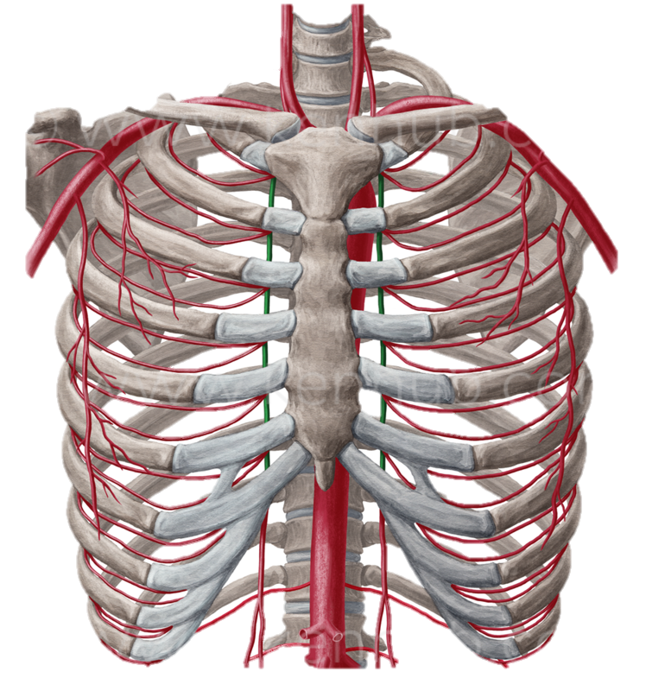
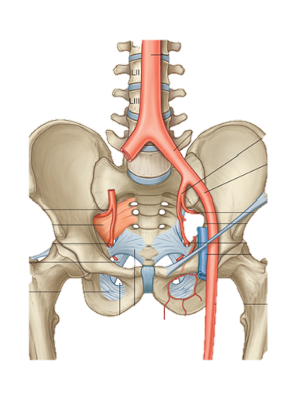
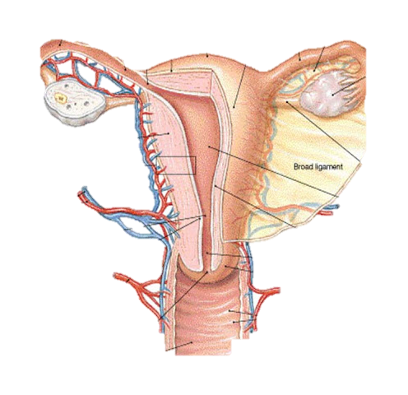
Arteriae
Notes:
Artheria thoracica interna

Slide 5
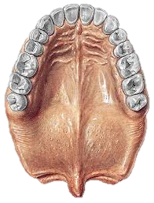
Rhaphe

Slide 6
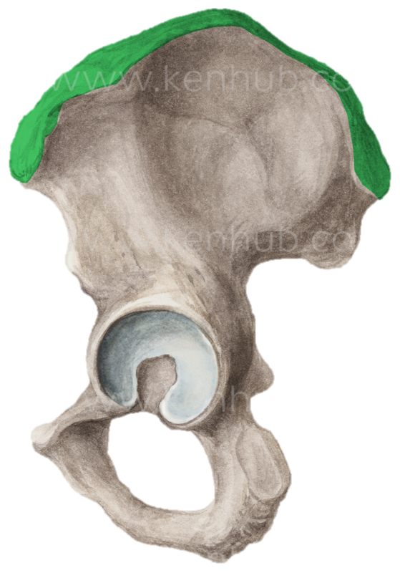
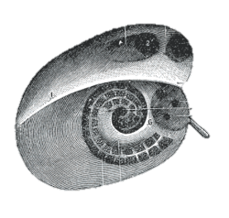
Cristae

Slide 7
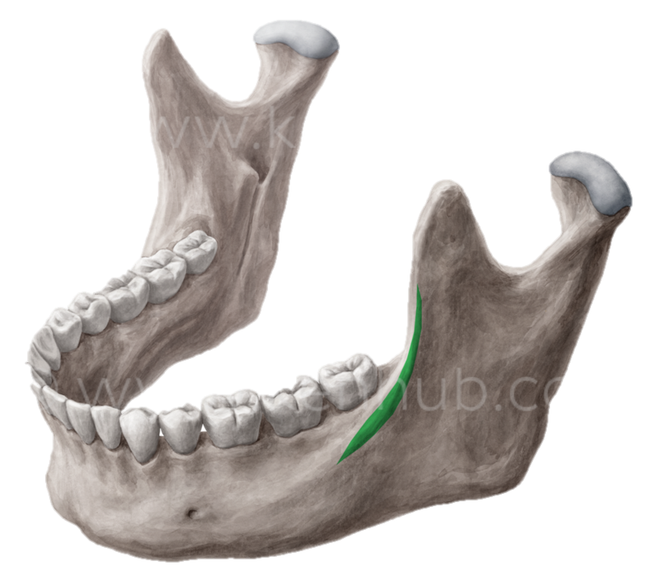
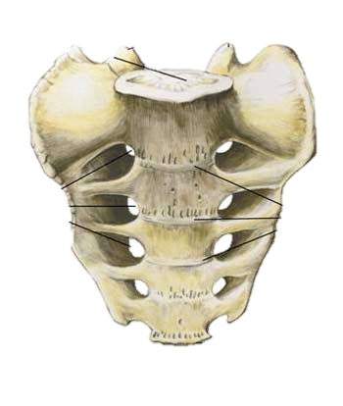
Lineae

Slide 8
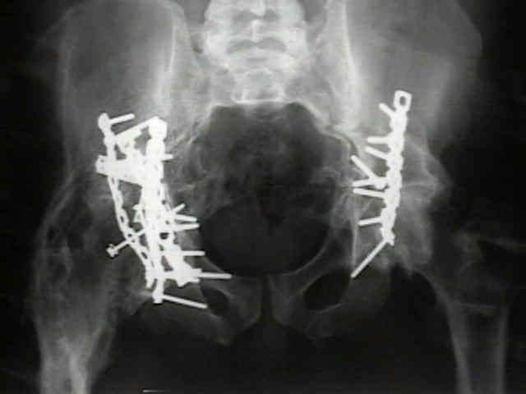
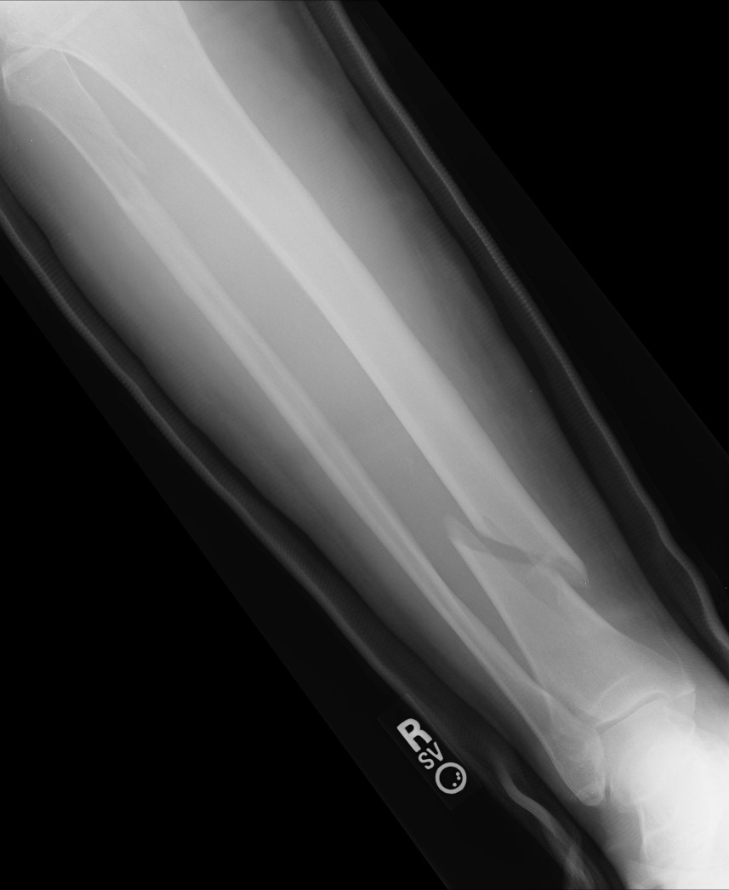
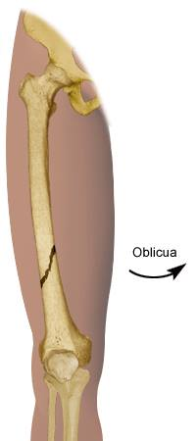
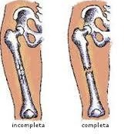
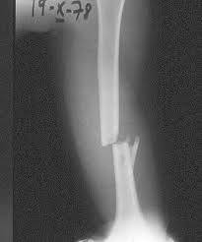
Fracturae

Slide 9
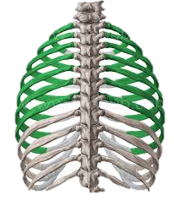
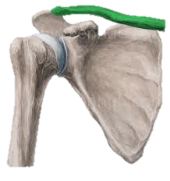
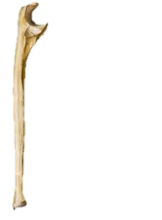
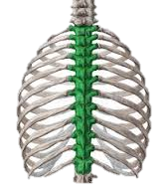
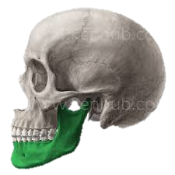
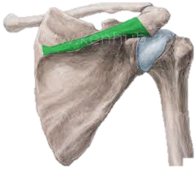
Name structures in Latin
1
2
3
4
5
6
7
8
Notes:
1. Tibia dextra, 2. Costae verae, 3. clavicula dextra, 4. ulna dextra, 5. mandibula sinistra, 6. fibula dextra, 7. spina scapulae dextrae, 8. vertebrae thoracicae

Slide 10
Ordinal numerals 1-12
Primus, a, um
Secundus, a, um
Tertius, a, um
Quartus, a, um
Quintus, a, um
Sextus, a, um
Septimus, a, um
Octavus, a, um
Nonus, a, um
Decimus, a, um
Undecimus, a, um
Duodecimus, a, um
costa spuria prima
vertebra thoracica secunda
costa vera tertia
vertebra coccygea quarta
costa vera quinta
vertebra thoracica sexta
costa vera septima
vertebra thoracica duodecima

Slide 11
Costae
Costa vera sinistra
Costa prima
Costa secunda
Costa tertia
Costa quarta
Costae verae
Incisurae costarum
Costa spuria sinistra
Costae spuriae

Slide 12
2nd declension - overview
Gen. sg. –I
Gender M (F)/N
Nouns of the female gender in this declension are exceptions
Nom. sg. –US/-ER/-OS
Gender M (F)
Nom. sg. –UM/-ON
Gender N

Slide 13
Nephros
The paradigm nephros is for masculine words of Greek origin.
The only difference is the ending -os in nom. sg. and -on in acc. sg.
-os
-on

Slide 14
Neuter gender nouns
There are some rules which apply for all Latin nouns of the neuter gender.
They have the same ending in the nominative and accusative cases.
In nom. pl. their endings end in –a
Since rule n. 1 can be applied, they end in -a even in acc. pl.
-um
-on
-um
-on
-a
-a
-a
-a

Slide 15
fractura + radius, ii, m; nasus, i, m.; sternum, i, n.
post + morbus, i, m. =disease
in (where) + oculus, i, m.; organum, i, n.

Slide 16
Homework
Finish handout 4 and bring it to the lecture
Learn the vocabulary in handout 4
Print handout five and bring it to the lecture
Bring the textbook

