Slide 1
Revision

Slide 2
Revision
What is the genitive ending of 3rd declension nouns?
-is
What are the example words of the 3rd declension?
dolor, corpus, pelvis, rete, dosis
What is the difference between paradigm dolor and pelvis?
genitive plural: dolor-um / pelv-ium
What is the difference between paradigm corpus and rete?
ablative singular: corpor-e / ret-i
nominative and accusative plural: corpor-a / ret-ia
genitive plural: corpor–um / ret-ium

Slide 3
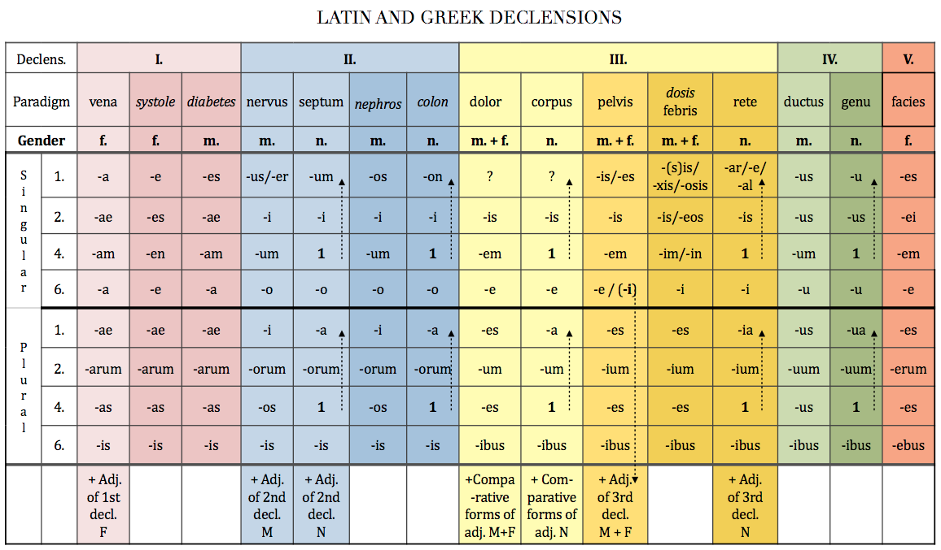
The difference between consonant stems and i-stems

Slide 4
Revision
How do we decide, whether the noun is declined according to pelvis?
it is of masculine / feminine gender
AND
it has the same number of syllables in the nominative and genitive of singular (e.g. auris, auris, f. )
OR its genitive stem ends in 2 consonants (e.g. dens, dentis, m. )
How do we decide, whether the noun is declined according to rete?
it is of neuter gender
and in nomitative singular it ends in -e, -al, -ar
(animal, alis, n., calcar, aris, n., cochlear, aris, n. )

Slide 5
Revision
How do we decide, whether the noun is declined according to dosis?
the nominativa singular ends in -sis, -xis, -osis
the genitive is the same
the dictionary entry has the genitive ending is / eos
What Latin nous are declined according to dosis?
febris, is, f.
tussis, is, f.
sitis, is, f.
pertussis, is, f.
tuberculosis, is, f.

Slide 6
DOSIS

Slide 7
Add the correct adjective and form the plural
Join the phrases with prepositions
auris (medius, a, um)
psychosis (organicus, a, um)
canalis (nutricius, a, um)
dens (incisivus, a, um)
febris (acutus, a, um)
sepsis (lentus, a, um)
metastasis (isolatus, a, um)
mors (clinicus, a, um)
rete (venosus, a, um)
In (abl.)
Ante
Sub (abl.)
In (acc.)
Propter
Post
Ex
Post
In (acc.)
Aure media
Psychosim organicam
Canale nutricio
Dentem incisivum
Febrim acutam
Sepsim lentam
Metastasi isolata
Mortem clinicam
Rete venosum

Slide 8
Match the nouns with the appropriate adjectives
foramen
mors
medulla
injectio
ulcus
mater
lobus
febris
tumor
symphisis
femur
prognosis
diameter
perforatus, a, um
fractus, a, um
continuus, a, um
clinicus, a, um
obliquus, a, um
nutricius, a, um
subcutaneus, a, um
flavus, a, um
pubicus, a, um
bonus, a, um
sinister, tra, trum
durus, a, um
benignus, a, um
1f, 2d, 3h, 4g, 5a, 6l, 7k, 8c, 9m, 10i, 11b, 12j, 13e

Slide 9
Fill in the missing suffixes
partes hypophys_
symptomata tuberculos_
resectio radic_ dent_
sub calcar_ avi_ (position)
amputatio ped_ dextr_ cum narcos_
febris cum tuss_
aether pro anaesthes_
fractura pelv_ cum haemorrhagi_ in cavitat_ abdmin_
cochlear plen_ mell_ contra tuss_ chronic_

Slide 10
Fill in the missing suffixes
partes hypophysis
symptomata tuberculosis
resectio radicis dentis
sub calcari avis (position)
amputatio pedis dextri cum narcosi
febris cum tussi
aether pro anaesthesia
fractura pelvis cum haemorrhagia in cavitate abdminis
cochlear plenum mellis contra tussim chronicam

Slide 11
Join the terms to form the expressions
rete + canalis + nervus + hypoglossus, a, um
stratum + corneus, a, um + ungues
pars + thoracicus, a, um + systema + autonomicus, a, um
stenosis + ostium + venosus, a, um + sinister, tra, trum

Slide 12
Translate
internal ear
symptoms of tuberculosis
lobes and parts of the hypophysis
network of carpus
in acute fever
canine teeth
venous network of the eyeball
symptoms of organic psychosis
antibiotics against the whooping cough
symptoms of synarthrosis
auris interna
symptomata tuberculosis
lobi et partes hypophysis
rete carpi
in febri acuta
dentes canini
rete venosum bulbi
symptomata psychosis /eos organicae
antibiotica contra pertussim
symptomata synarthrosis / eos

Slide 13
Form phrases with different types of injuries
Vulnus + sclopetarius, a, um + dorsum
Sutura + vulnus + lacer, a, um + caput
Oedema + propter + vulnus + contusus, a, um + femur
Infectio + in + vulnus + scissus, a, um + digitus + II
Vulnus (pl.) + sectus, a, um + antebrachium
Sepsis + post + vulnus (pl.) + morsus, a, um + caput
Corpus (pl.) + alienus, a, um + in + vulnus (pl.) + punctus, a, um + abdomen
Vulnus sclopetarium dorsi
Sutura vulneris laceri capitis
Oedema propter vulnus contusum femoris
Infectio in vulnere scisso digiti secundi
Vulnera secta antebrachii
Sepsis post vulnera morsa capitis
Corpora aliena in vulneribus punctis abdominis

Slide 14
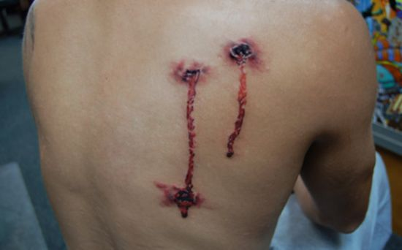
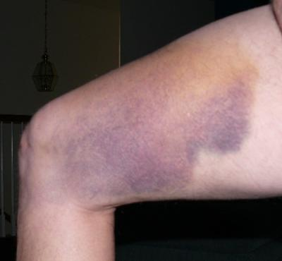
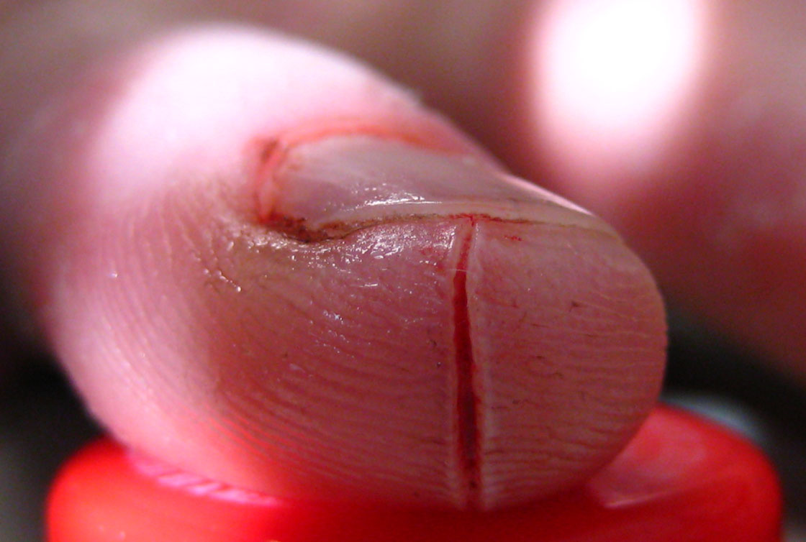
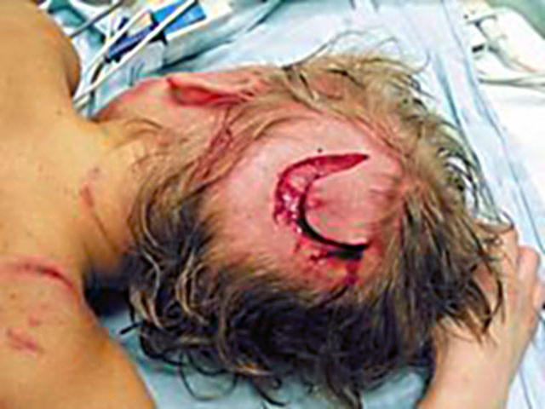
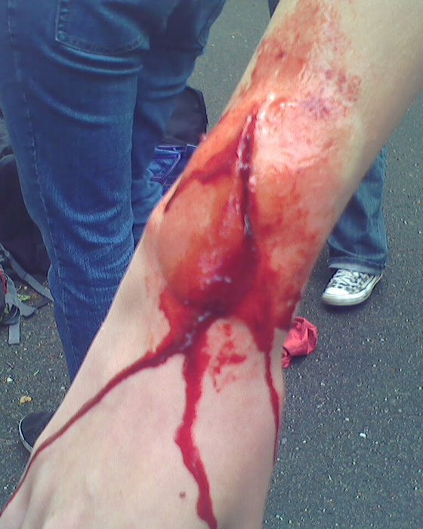
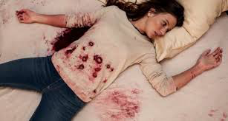
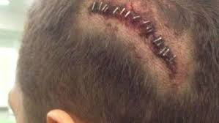
A
C
F
B
D
G
E
Notes:
A vulnus sclopetarium dorsi/ B vulnera secta antebrachii, (vidno len jednu ranu!)/ C oedema propter vulnus contusum femoris/ D corpora aliena in vulneribus punctis abdominis (často sa dostanu do rany kúsky látky z odevu) /E sutura vulneris laceri capitis / F Infectio in vulnere scisso digiti secundi / G sepsis post vulnera morsa capitis (vidno len jednu ranu!)

Slide 15
Decide what is correct
✗
Patient 1 has shot wound in his left lower leg
Patient 2 tore her upper lip
Patient 2 suffered brain concussion
Patient 3 has open fracture of his left forearm with contusion and tear wound on the lower leg
Patient 4 broke her heel bone
Patient 4 had simple fracture of the third thoracic vertebra
Patient 4 has cut wound in the region of the left elbow bone
✔
✗
✗
✔
✗
✗
Notes:
K tomuto cvičeniu majú extra Handout (7a), pracuje sa v skupine

Slide 16
Name the action performed by the given muscle
Musculus abductor pollicis longus >> abductio, onis, f.
Adductio, onis, f.
Musculus adductor hallucis longus
Musculus compressor urethrae
Musculus constrictor pharyngis medius
Musculus depressor anguli oris
Musculus dilatator pupillae
Musculus extensor carpi
Musculus flexor digitorum profundus
Musculus levator glandulae thyr(e)oideae
Musculi rotatores thoracis
Musculus tensor fasciae latae
Compressio, onis, f.
Constrictio, onis, f.
Depressio, onis, f.
Dilatatio, onis, f.
Extensio, onis, f.
Flexio, onis, f.
Levatio, onis, f.
Rotatio, onis, f.
Tensio, onis, f.

Slide 17
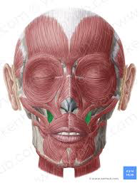
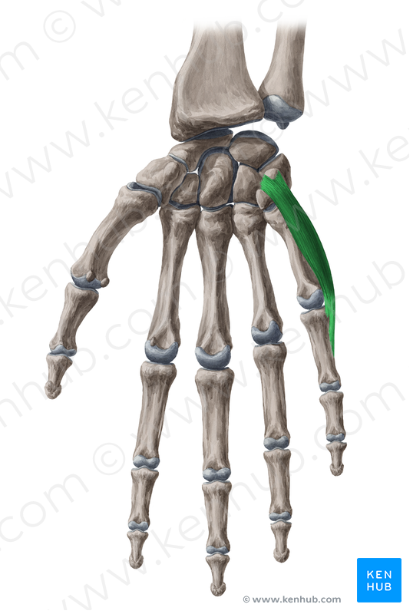
The muscle(s) that…
…moves the little finger away from other fingers is…
…helps the face to form a smile because it elevates the angles of the mouth at each corner is…
…stretches the wide band that encloses the thigh muscles is…
Notes:
Musculus abductor digiti minimi
Musculus levator anguli oris
Musculus tensor fasciae latae

Slide 18
Translate /TASK 6a HANDOUT 6-7
function of the digestive organs
functio organorum digestoriorum (organS -> plural)
thorn wounds in the trunk of the body
vulnera lacera in trunco corporis (woundS->plural; in (position) +abl.)
foreign body in the oral cavity
corpus alienum in cavitate oris (in (position) +abl.)
function of the salivary glands
functio glandularum salivariarum (glandS -> plural)
serous tunic of the gullet
tunica serosa oesophagi
walls of the stomach
parietes stomachi (don`t confuse pars, partis, f. with paries, etis, m.)
the body of the stomach
corpus stomachi
ulcers in the body of the stomach
ulcera in corpore stomachi / ventriculi (ulcerS->plural, ulcus is neuter-> ulcera)

Slide 19
Translate /TASK 6a HANDOUT 6-7
perforated intestines
intestina perforata (intestineS->plural, intestinum is neuter-> intestina)
sugical therapy of perforated intestines
therapia chirurgica intestinorum perforatorum (intestineS->plural)
symptoms of the intestine perforation
symptomata perforationis intestini (perforation is a noun; there is no adjecive meaning intestine -> perforation of the intestine)
cancer of the sigmoid colon
cancer coli sigmoidei
right and left lobe of the liver
lobus hepatis dexter et sinister
tumor of the head of the pancreas
tumor capitis pancreatis
body and neck of pancreas
corpus et cervix pancreatis

Slide 20
Find opposites/TASK 8 UNIT 4
Dura mater encephali
Tumor malignus
Pes dexter
Medulla ossium flava
Vitium congenitum
Regio parva
Sanatio per primam intentionem
Auris externa
Prognosis bona
Nephrosis chronica
pia
benignus
sinister
rubra
acquisitum
magna
secundam
interna
mala
acuta

