Slide 1
Revision

Slide 2
Identify the case; add the correct form of adjective
in genibus
dolor genus
in genua
dolor genuum
in genu
genua
sanatio decubitus
prope decubitus
sub decubitu
sanatio decubituum
sub decubitibus
prope decubitum
propter cariem
therapia carierum
sub carie
therapia cariei
sub cariebus
propter caries
valgus, a, um dolorosus, a, um profundus, a, um

Slide 3
Form phrases from words in boxes and translate them into English
medicamentum (pl.) infectiosus, a, um morbus
contra
medicamenta contra morbum infectiosum
medicaments against infectious disease
acutus, a, um
pulmo
dolor
dextrer, tra trum
dolor acutus pulmonis dextri
acute pain of right lung
symptoma (pl.)
hepatitis
acutus, a, um
symptomata hepatitidis acutae
symptoms of acute inflammation of the liver
vulnus
pus in
lacer, a, um
pus in vulnere lacero
pus in a torn wound

Slide 4
Form phrases from words in boxes and translate them into English
decubitus dexter, tra, trum
regio in
scapula dolorosus, a, um
decubitus dolorusus in regione scapulae dextrae
painful bedsore in region of right shoulder blade
dens
profundus, a, um
caries
caninus, a, um
caries profunda dentis canini
deep dental decay of canine tooth
exisio lacteus, a, um
caries
dens propter
excisio dentis lactei propter cariem
excision of a milk tooth because of dental decay
operatio status
femur
fractura post
sinister, tra, trum
status post operationem fracturae femoris sinistri
state after operation of left femur
excisio, onis, f. - excision

Slide 5
Fill in correct endings
unguentum contra decubit...
dosis medicament... pro di...
exitus post infarct... myocardi... acut...
dolores chronic... dent... incisiv... propter cari... profund...
mors post part... praematur...
fractura apert... genus... sinistr...
vulner... punct... thorac...
abscessus meat... acustic... extern...
Unit 6, task 9

Slide 6
ADJECTIVES of 3RD DECLENSION /DICTIONARY ENTRY
ADJECTIVES OF 1st and 2nd DECLENSION
albus, a, um// niger, a, um
ADJECTIVES OF 3rd DECLENSION
acer, is, e// brevis, e// simplex, cis
3 : –ER (M), -IS (F), -E (N): very rare in med. terminology
2 : -IS (M+F), -E (N): extremely frequent
1 : -X, -NS (M+F+N): some types are frequent

Slide 7
ADJECTIVES of 3RD DECLENSION
3 terminations in nominative sg. which are always:
-ER (M), -IS (F), -E (N)
e. g.:
biventer, is, e having two bellies

Slide 8
ADJECTIVES of 3RD DECLENSION
2 terminations in nominative sg. which are always:
-IS (M+F), -E (N) :
Underived adjectives like:
brevis, e short; gravis, e heavy, difficult
levis, e light; tenuis, e thin, slender
Derived adjectives ending on -alis, e/-aris, e
cranialis, e; muscularis, e
(means relation, pertaining to or belonging to)
Derived adjectives ending on -bilis, e
operabilis, e; mobilis, e
(means capable or susceptible of a specified action)
Derived adjectives ending on -formis, e
pisiformis, e; vermiformis, e
(means shaped like, similar to, Latin equivalent to Greek
ending -oideus, a, um)

Slide 9
ADJECTIVES of 3RD DECLENSION
1 termination in nominative sg. which usually is:
-X, -NS (M+F+N)
always accompanied with the genitive ending
Underived adjectives like:
recens, recentis recent, new;
latens, latentis latent, not manifested
Derived adjectives ending -plex, plicis (refers to number, multiplicity)
simplex, cis; duplex, cis
Derived adjectives ending on -ceps, cipitis (refers to head-like strucutres)
biceps, bicipitis
Originally participles having meaning of action ending on -ans, antis and -ens, entis
migrans, antis; ascendes, entis

Slide 10
ENDINGS OF ADJECTIVES OF THE 3rd DECLENSION
 | SG |  | PL
 | M + F | N | M + F | N
1 | -x, -ns -is -er/-is | -x, -ns -e -e | -es | -ia
2 | -is |  | -ium
4 | -em | = 1. | -es | = 1.
6 | -i |  | -ibus

Slide 11
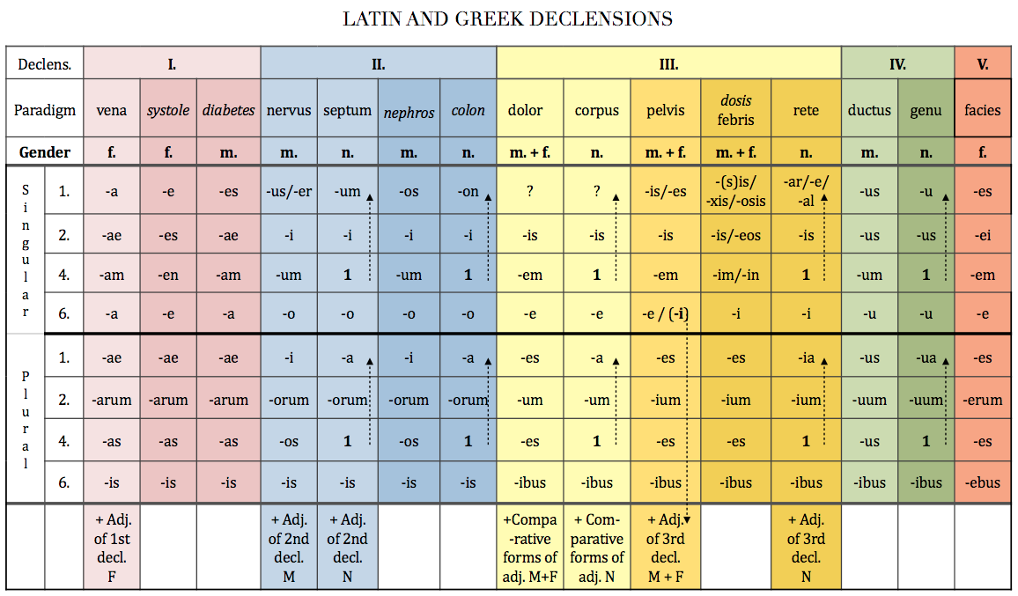

Slide 12
FORM CLOSE ATTRIBUTE
musculus+ biventer, is, e
!fossa + biventer, is, e
!ganglion + biventer, is, e
musculus + communis, e
arteria + communis, e
crus + communis, e
lobulus + simplex, cis
articulatio + simplex, cis
crus + simplex, cis
3-forms
2-forms
1-form
Number of forms in nom. sg.

Slide 13
Derive adjectives using endings -alis, e or -aris, e
costa/ cost- + alis ⇢ costalis, e
femur / femor- + alis, e ⇢ femoralis, e
musculus/ muscul- + aris, e ⇢ muscularis, e
dorsum intestinum cervix labium
facies nasus pulmo viscera
apex digitus margo medulla
rectum orbita maxilla pectus
ren patella vagina tonsilla
sternum abdomen frons paries
superficies vestibulum spina bronchus
pars os, oris cranium dens

