Slide 1
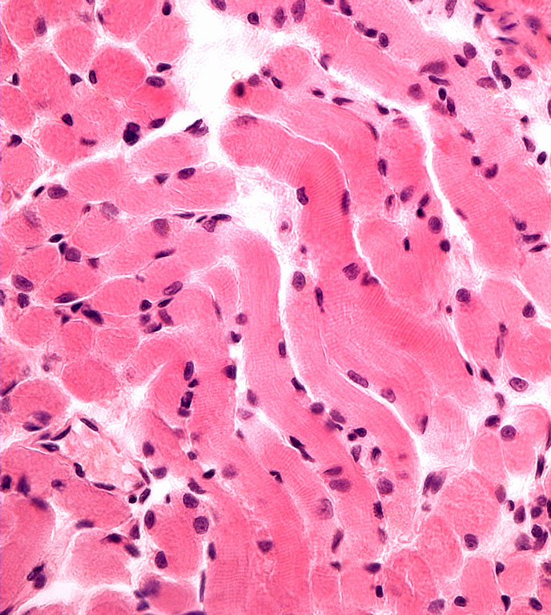
Muscle tissue
Petr Vaňhara, PhD
Dept. Histology & Embryology
Faculty of Medicine MU
pvanhara@med.muni.cz

Slide 2
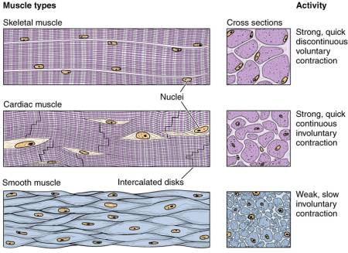
General characteristic of muscle tissue
Hallmarks
Unique cell architecture
Excitability and contraction
Mesodermal origin
Muscle tissue
Skeletal
Cardiac
Smooth

Slide 3
Histology of skeletal muscle tissue
Composition: muscle cells + connective tissue, blood vessels
Unique cell architecture – long multinuclear cells – muscle fibers (rhabdomyocytes)
Long axis of cells is oriented parallel with direction of contraction
Specific terminology:
  cell membrane = sarcolemma
  cytoplasm = sarcoplasm
  sER = sarcoplasmic reticulum
  Muscle fiber – microscopic unit of skeletal muscle
  Myofibril – LM unit – myofilaments – unit of muscle fibers
  Myofilaments – filaments of actin and myosin (EM)

Slide 4
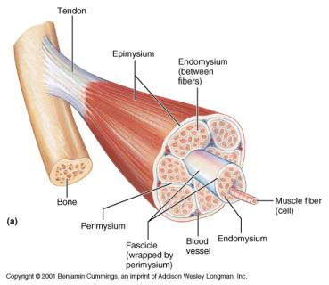
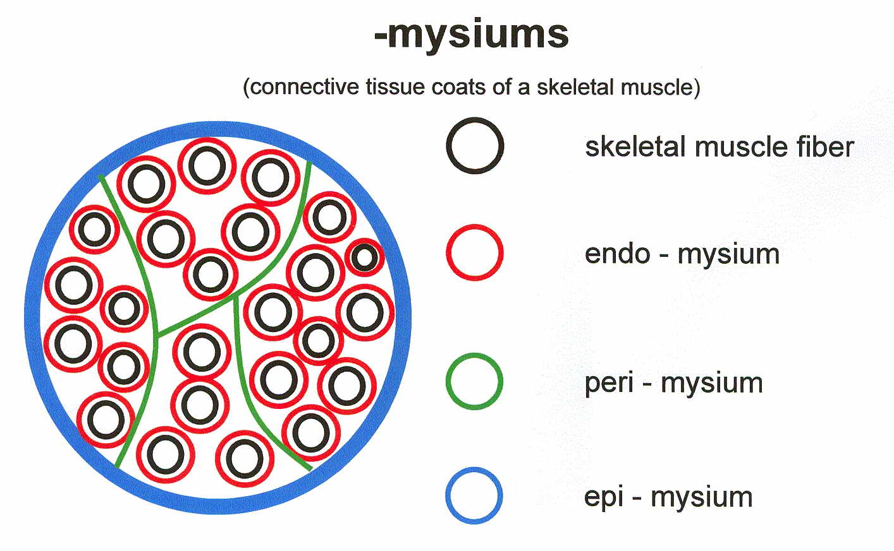
Connective tissue of skeletal muscle
Containment
Limit of expansion of the muscle
Transmission of muscular forces
Endomysium – around each muscle cell (fiber)
Perimysium – around and among the primary bundles of muscle cells
Epimysium – dense irregular collagen c.t., continuous with tendons and fascia
Fascia – dense regular collagen c.t.

Slide 5
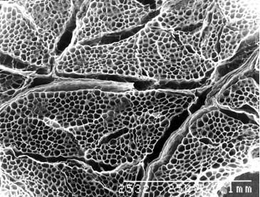
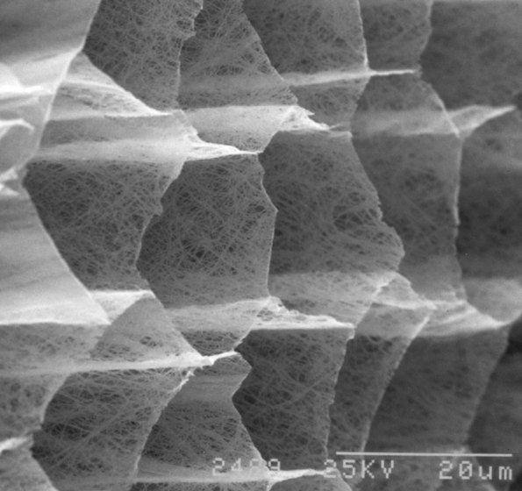
Connective tissue of skeletal muscle

Slide 6
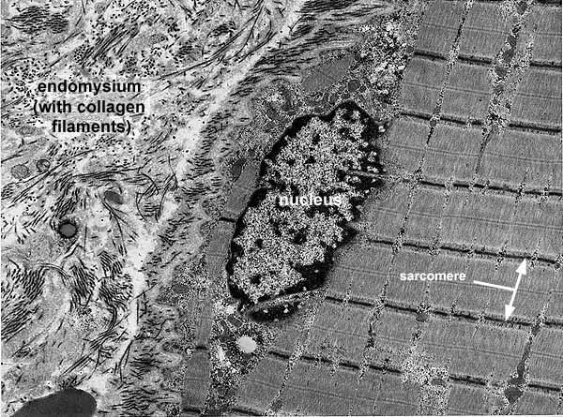
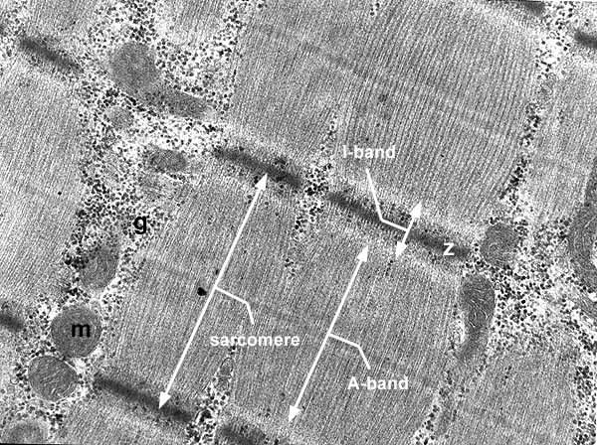
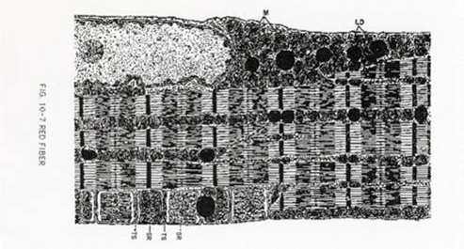

Slide 7
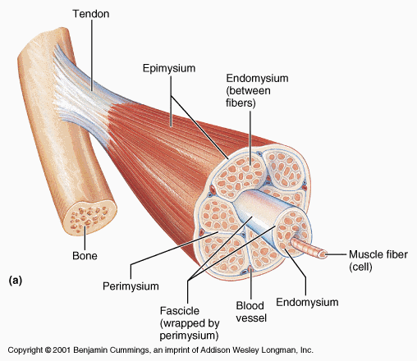
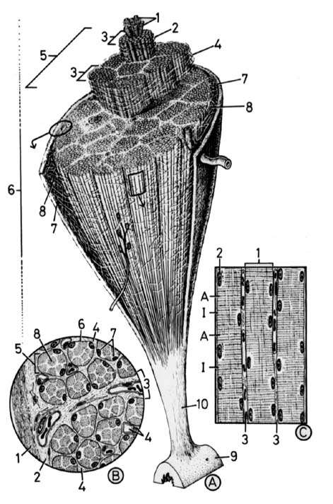
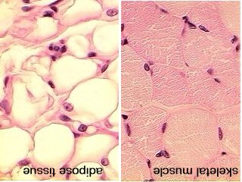
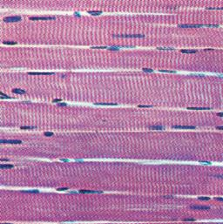
Structure of skeletal muscle

Slide 8
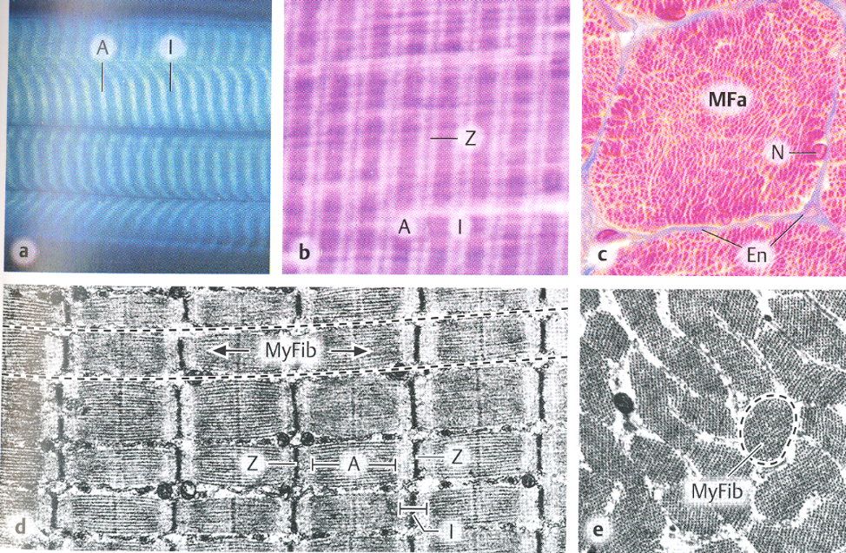
Structure of skeletal muscle
morphological and functional unit: muscle fiber (rhabdomyocyte) – elongated, cylindrical-shaped, multinucleated cell (syncytium)
nuclei are located at the periphery (under sarcolemma)
myofibrils show cross striation
diameter of muscle fiber: 25-100 μm
length: millimeters - centimeters (up to 15)

Slide 9
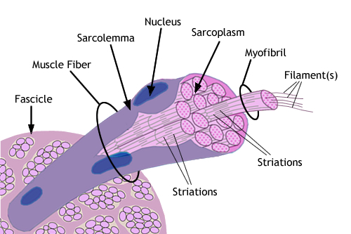
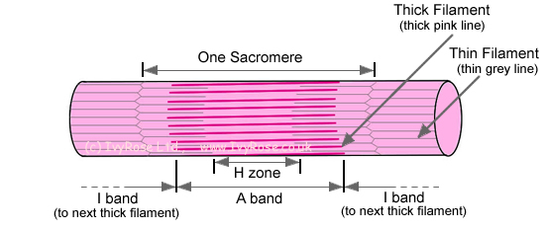
Ultrastructure of rhabdomyocyte
Muscle fiber = myofiber = syncitium = rhabdomyocyte
Muscle fiber – morphological and functional unit of skeletal muscle [Ø 25 – 100 μm]
Myofibrils – compartment of fiber sarcoplasm [Ø 0.5 – 1.5 μm]
Sarcomere – the smallest contractile unit [2.5 μm], serial arrangement in myofibrils
Myofilaments – actin and myosin, are organized into sarcomeres [Ø 8 and 15 nm]

Slide 10
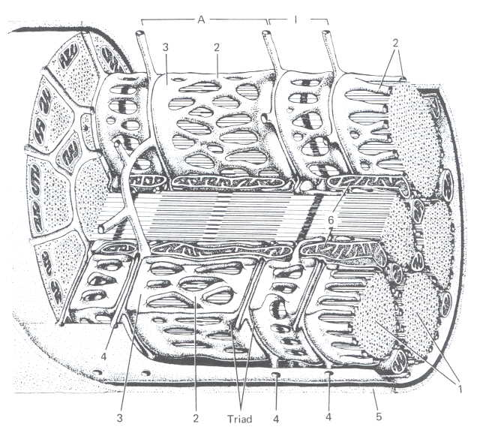
Ultrastructure of rhabdomyocyte
Sarcolemme + t-tubules,
Sarcoplasm:
Nuclei,
Mitochondria,
Golgi apparatus,
Glycogen (β granules)
Sarcoplasmic reticulum
(smooth ER) – reservoir of Ca²⁺
Myofibrils (parallel to the
length of the muscle fiber)
T-tubule
terminal cisterna
mitochondria
sarcolemma
myofibrils
tubules + cisternae of sER

Slide 11
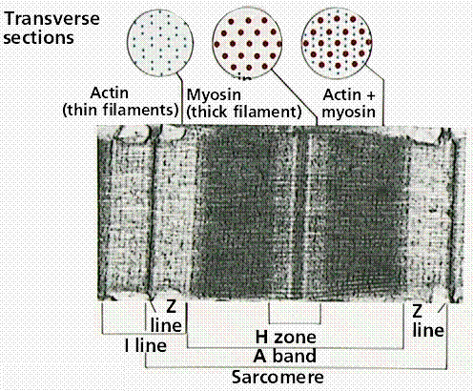
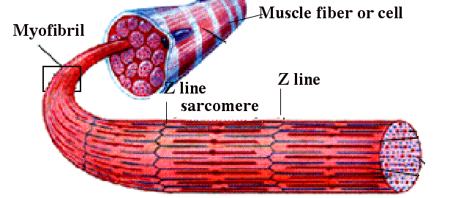
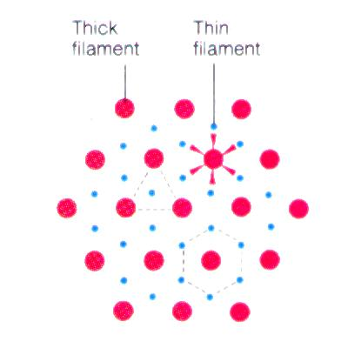
Myofibrils
elongated structures [Ø 0.5 – 1.5 μ] in sarcoplasm of muscle fiber oriented in parallel to the length of the fiber,
Actin + myosin myofilaments
Sarcomere
Z-line
M-line and H-zone
I-band, A-band

Slide 12
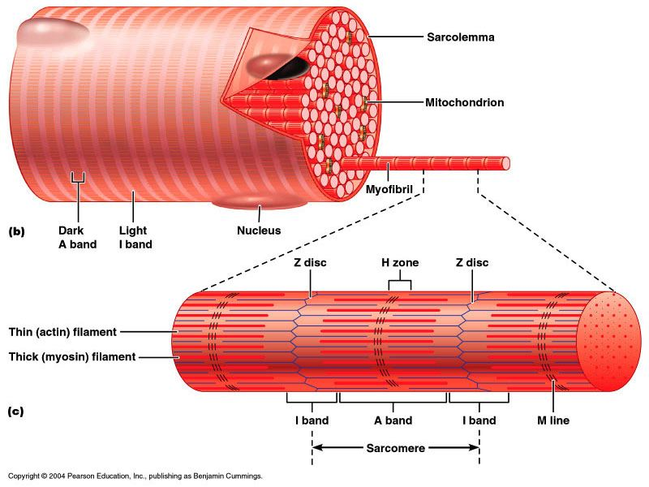
Sarcomere

Slide 13
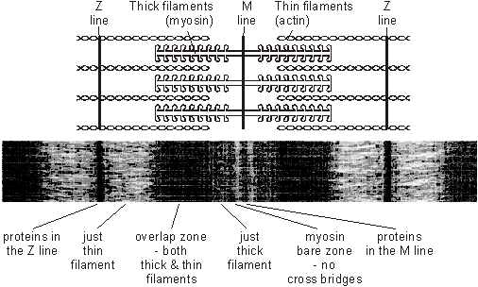
Sarcomere
H-zone
½ I-band
I–band
A–band

Slide 14
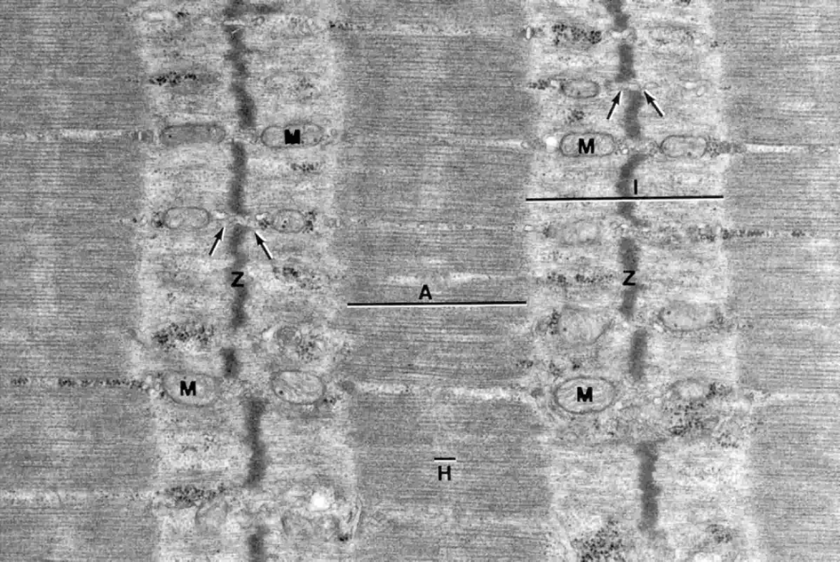
Sarcomere

Slide 15
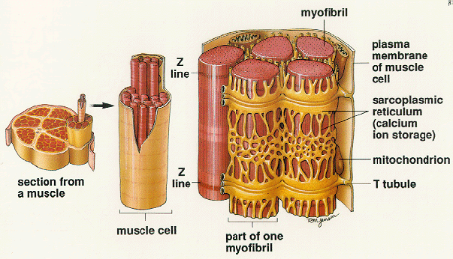
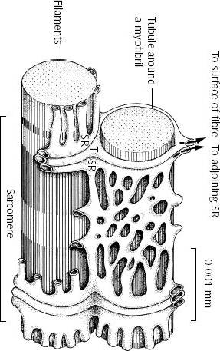
Sarcoplasmic reticulum, t-tubule
Terminal cisterna
T-tubule
Terminal cisterna
TRIAD
communicating intracellular cavities around myofibrils, separated from cytosol
terminal cisternae (“junction”) and longitudinal tubules (“L” system).
reservoir of Ca ions
T-tubules (“T” system ) are invaginations of sarcoplasm and bring action potential to terminal cisternae change permeability of membrane for Ca ions

Slide 16
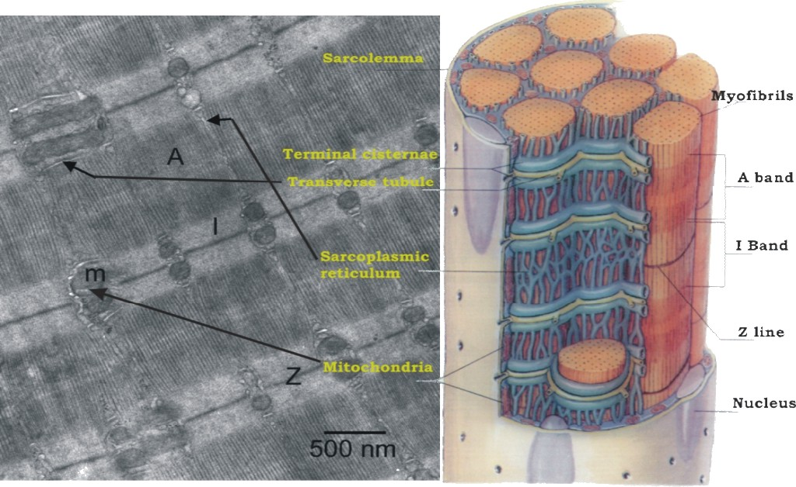
Sarcoplasmic reticulum, t-tubule

Slide 17
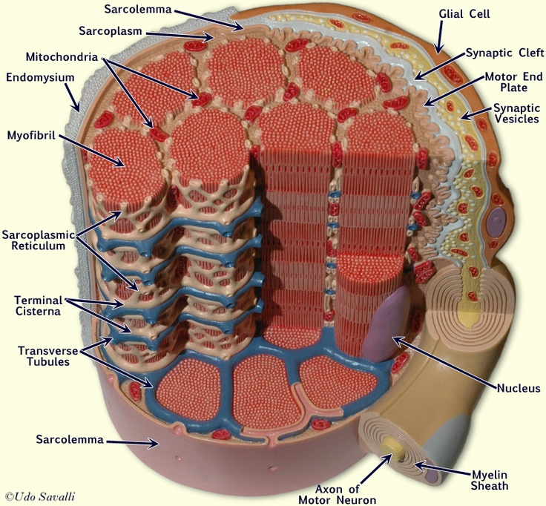

Slide 18
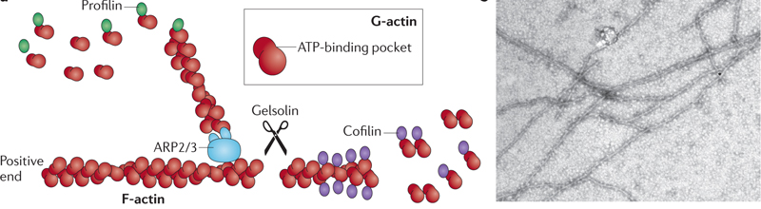
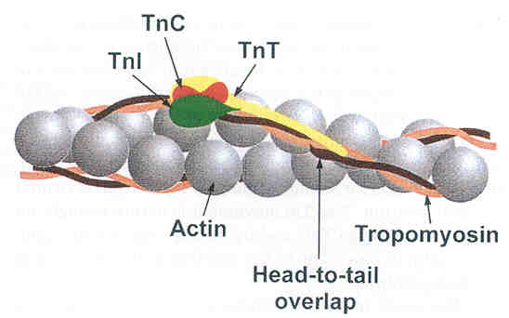
Thin myofilaments
Fibrilar actin (F-actin), (∅ 7 nm, ↔1 μm)
Tropomyosin – thin double helix in groove of actin double helix, spans 7 monomers of G-actin
Troponin – complex of 3 globular proteins
  TnT (Troponin T) – binds tropomyosin
  TnC (Troponin C) – binds calcium
  TnI (Troponin I) inhibits interaction between thick
  and thin filaments

Slide 19
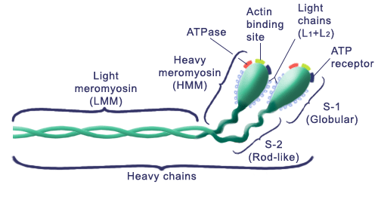
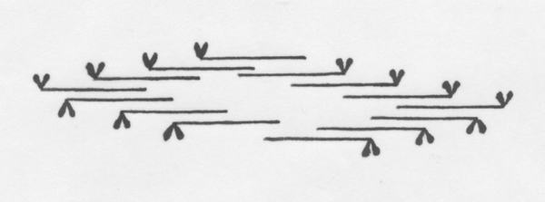
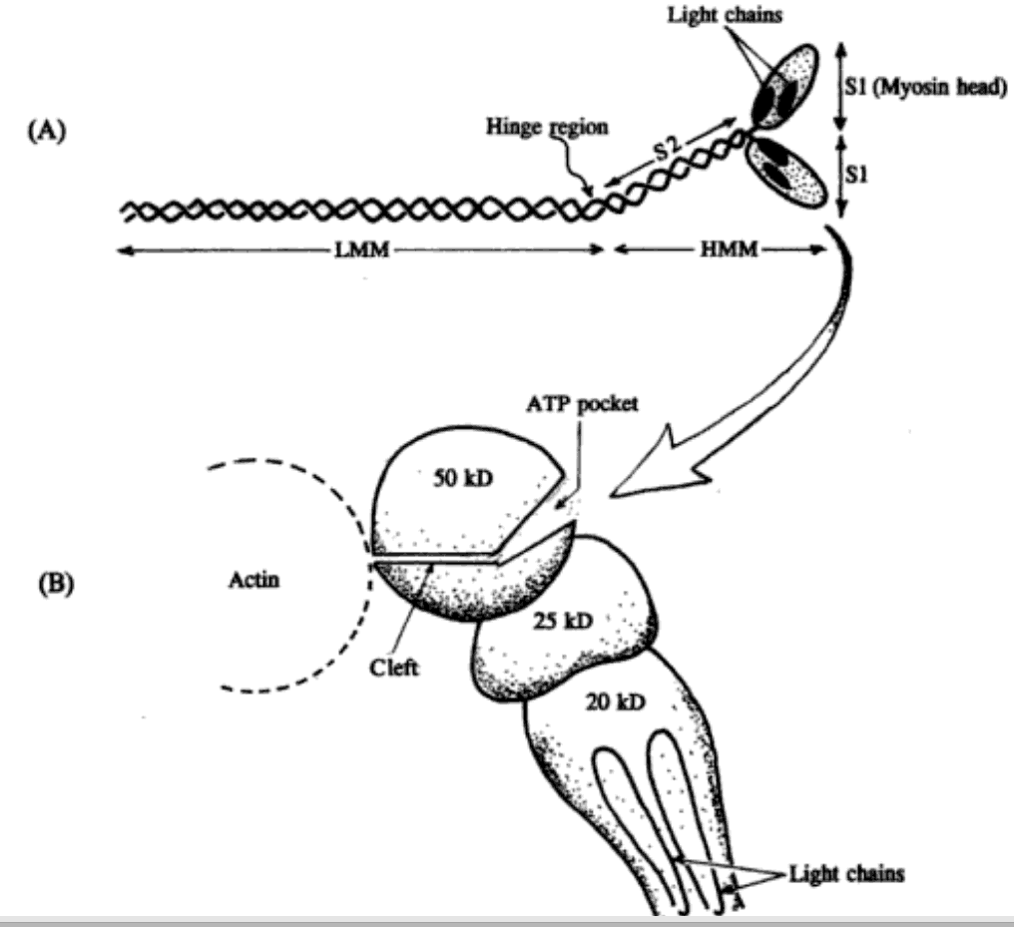
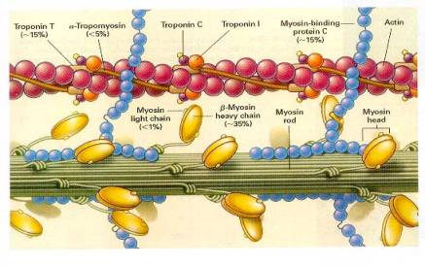
Thick myofilaments
Myosin
Large polypeptide, golf stick shape, (∅ 15 nm, ↔1,5 μm)
Bundles of myosin molecules form thick myofilament

Slide 20
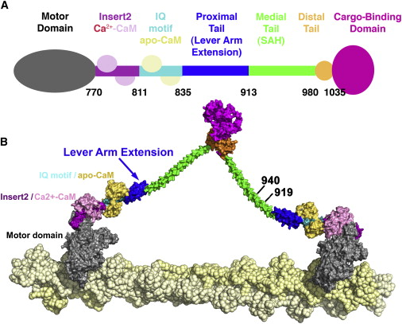
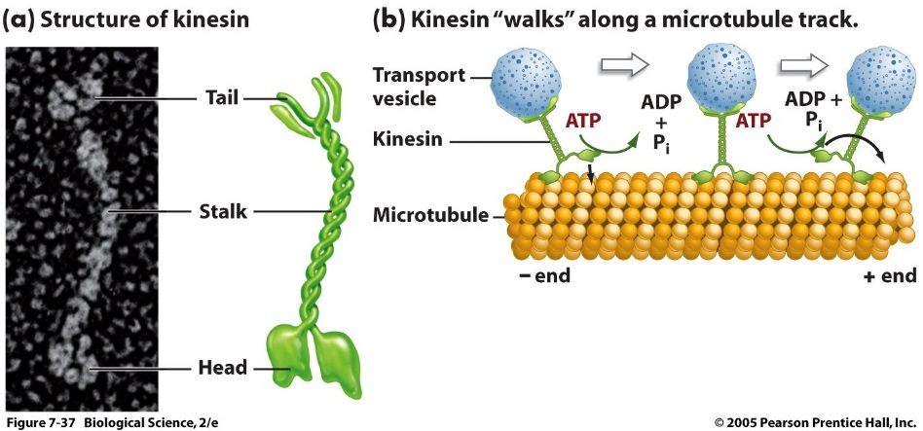
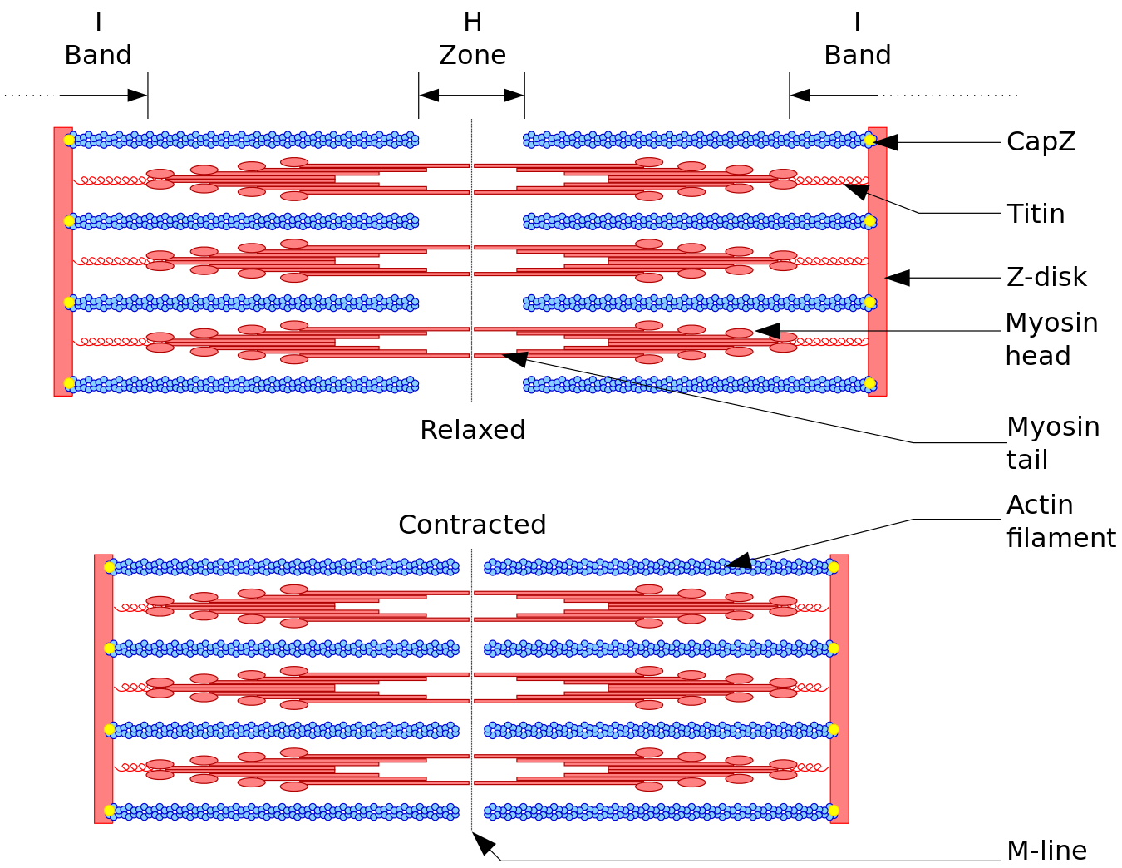

Slide 21
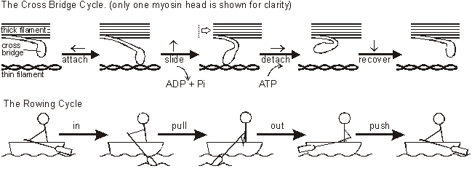
Contraction
Propagation of action potential (depolarization) via T-tubule (= invagination of sarcolemma)
Change of terminal cisternae permeability – releasing of Ca⁺ ions increases their concentration in sarcoplasm
Myosin binds actin - sarcomera then shortens by sliding movement – contraction
Relaxation: repolarization, decreasing of Ca²⁺ ions concentration, inactivation of binding sites of actin for myosin
myosin
actin

Slide 22
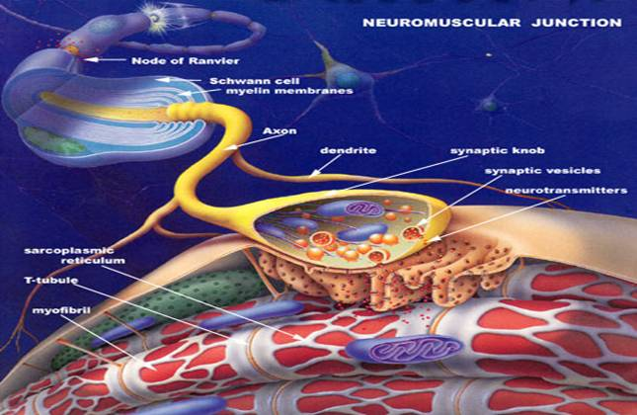
Contraction
Impulse along motor neuron axon
Depolarization of presynpatic membrane (Na⁺ influx)
Synaptic vesicles fuse with presynaptic membrane
Acetylcholine exocyted to synaptic cleft
Acetylcholine diffuses over synaptic cleft
Acetylcholine binds to receptors in postsynaptic membrane
Depolarization of presynaptic membrane and sarcolemma (Na⁺ influx)
T-tubules depolarization
Depolarization of terminal cisternae of sER
Depolarization of complete sER
Release of Ca^{II+} from sER to sarcoplasm
Ca^{II+} binds TnC
Troponin complex changes configuration
TnI removed from actin-myosin binding sites
Globular parts of myosin bind to actin
ATPase in globular parts of myosin activated
Energy generated from ATP→ADP + Pi
Movement of globular parts of myosin
Actin myofilament drag to the center of sarcomere
Sarcomeres contract (H-zone, I-band shorten)
Myofibrils contracted
Muscle fiber contracted

Slide 23
http://highered.mheducation.com/sites/0072495855/student_view0/chapter10/animation__breakdown_of_atp_and_cross-bridge_movement_during_muscle_contraction.html

Slide 24
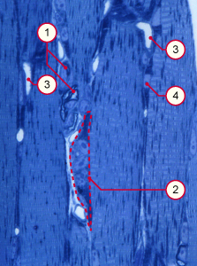
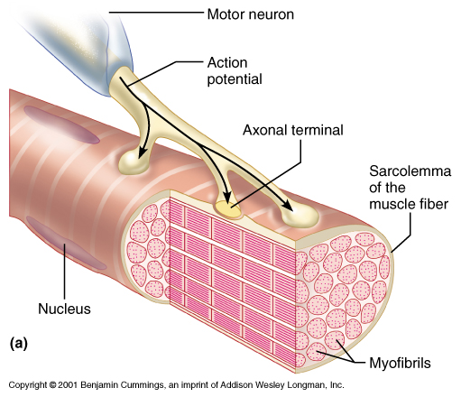
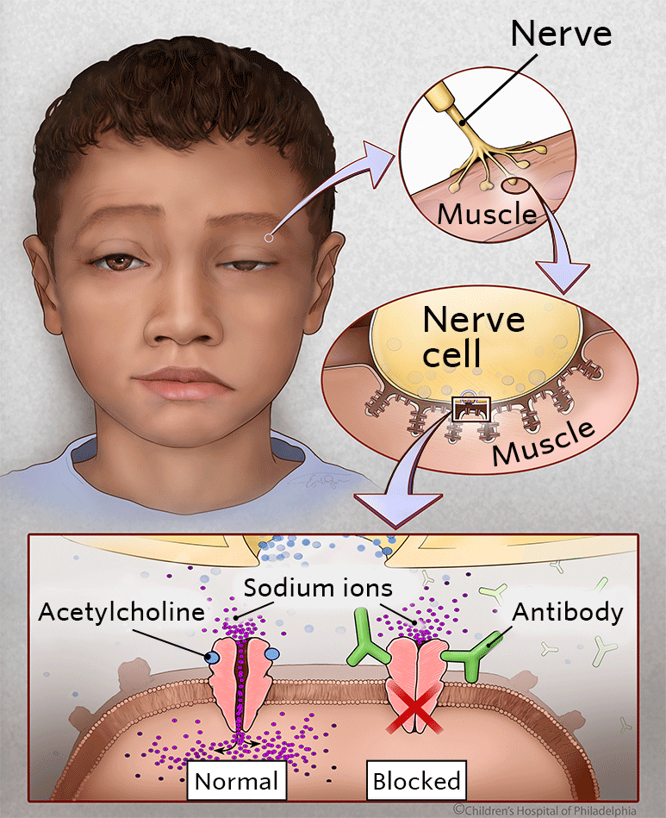
Neuromuscular junction
1 2 3 4 | Myelinated axons Neuromuscular junction Capillaries Muscle fiber nucleus
Myasthenia gravis

Slide 25
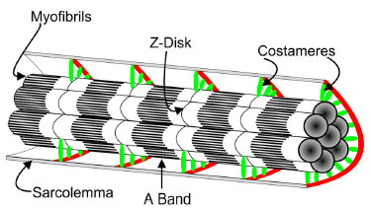
Costameres
Structural components linking myofibrils to sarcolemma
Circumferential alignment
dystrophin-associated glycoprotein (DAG) complex
  links internal cytoskelet to ECM
  Integrity of muscle fiber

Slide 26
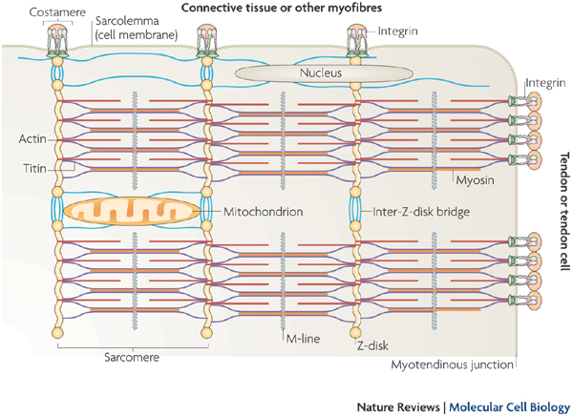
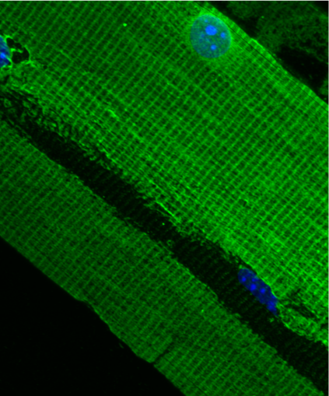
Costameres

Slide 27
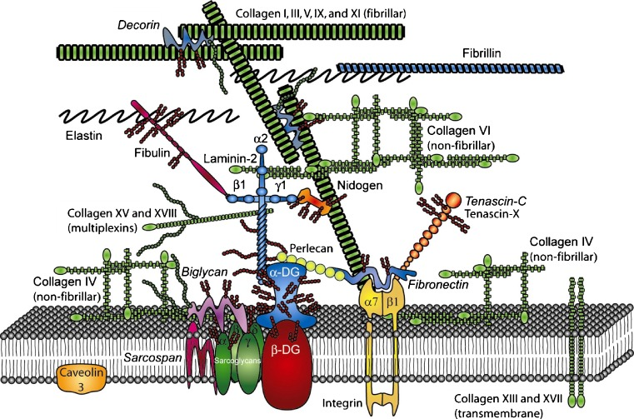
Costameres

Slide 28
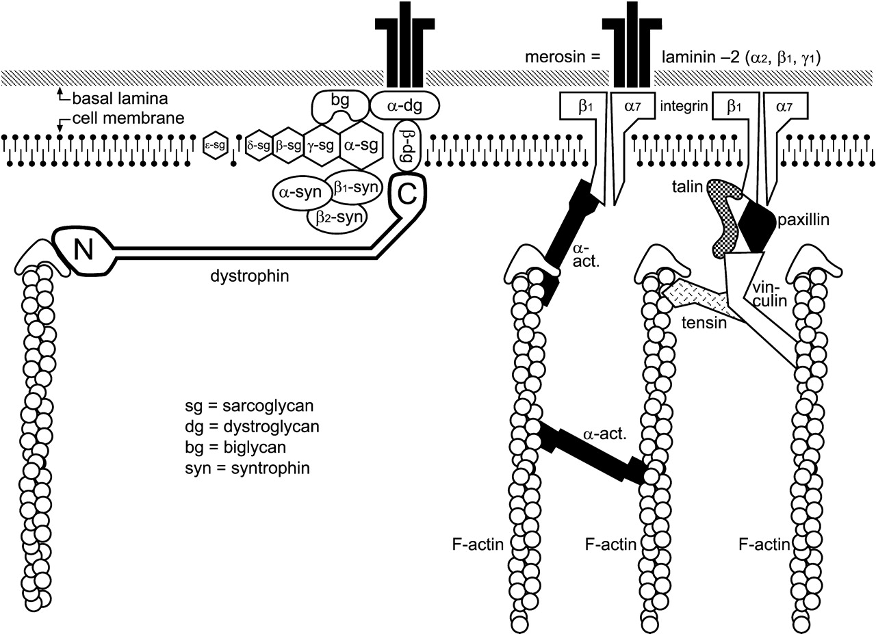

Slide 29
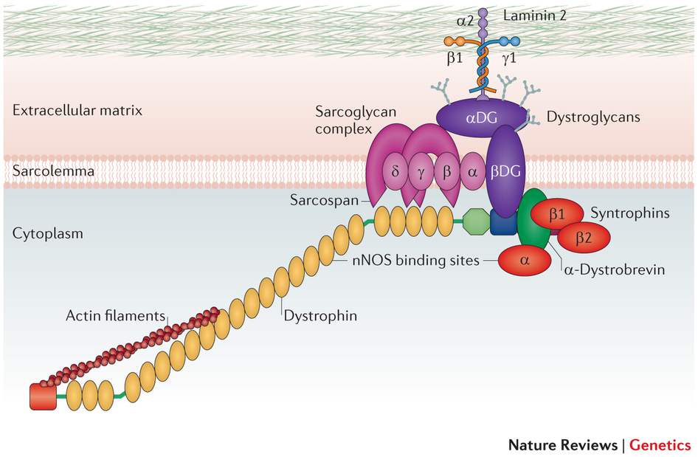

Slide 30
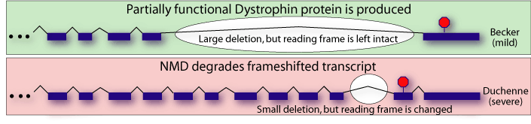
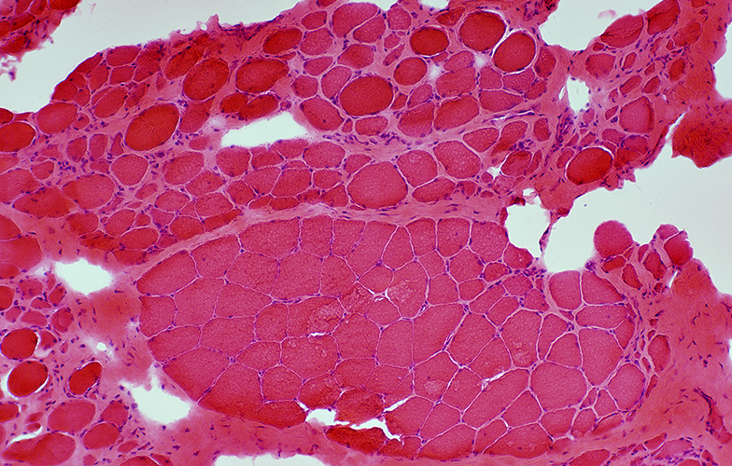
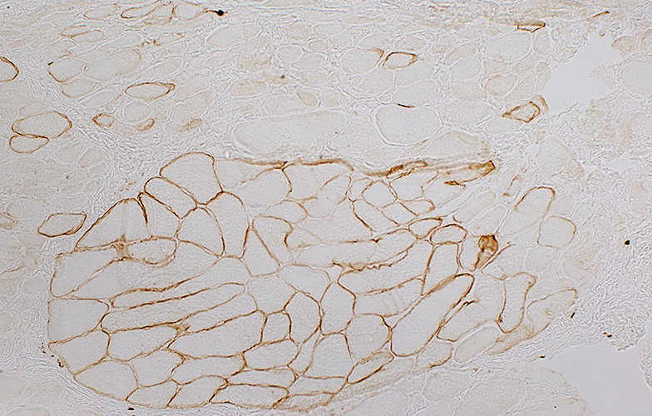

Duchenne muscular dystrophy
Lane 1: Becker dystrophy; Dystrophin has reduced abundance but normal size.
Lane 2: Becker dystrophy; Dystrophin has reduced size and abundance.
Lane 3: Normal; Dystrophin has normal size and amount.
Lane 4: Duchenne dystrophy; Almost no protein is present.
http://neuromuscular.wustl.edu/pathol/dmdpath.htm

Slide 31



Duchennoe muscular dystrophy

Slide 32
HISTOLOGY OF CARDIAC MUSCLE TISSUE
made up of long branched fiber (cells) – cardiomyocytes,
cardiomyocytes are cylindrical cells, branched on one or both ends (Y, X shaped cells),
Sarcoplasm: single nucleus in the center of cell, striated myofibrils, numerous mitochondria,
cells are attached to one another by end-to-end junctions – intercalated discs.

Slide 33
chains of cardiomyocytes blood capillary with erythrocytes
Intercalated disc

Slide 34




Slide 35



Slide 36


CARDIAC MUSCLE TISSUE COMPARED TO SKELETAL
no triads, but diads: 1 t-tubule + 1 cisterna
t-tubules around the sarcomeres at the Z lines rather than at the zone of overlap
sarcoplasmic reticulum via its tubules contact sarcolemma as well as the t-tubules
cardiac muscle cells are totally dependent on aerobic metabolism to obtain the energy
large numbers of mitochondria in sarcoplasm and abundant reserves of myoglobin (to store oxygen)
abundant glycogen and lipid inclusions

Slide 37



Intercalated disc
„scalariform“ shape of cell ends
fasciae adherentes (adhesion of cells)
Nexus (quick intercellular communication – transport of ions, electric impulses, information)

Slide 38


Intercalated disc:
nexus
fascia adherens

Slide 39

Myofibril of cardiomyocyte
Actin + myosin myofilaments
Sarcomere
Z-line
M-line and H-zone
I-band, A-band
T-tubule + 1 cisterna = diad (around Z-line)

Slide 40


Slide 41


Purkinje fibers
are located in the inner layer of heart ventricle wall
are specialized cells fibers that conduct an electrical stimuli or impulses that enables the heart to contract in a coordinated fashion
numerous sodium ion channels and mitochondria, fewer myofibrils

Slide 42

SMOOTH MUSCLE TISSUE

Slide 43

SMOOTH MUSCLE TISSUE
spindle shaped cells (leiomyocytes) with myofilaments not arranged into myofibrils (no striation), 1 nucleus in the centre of the cell
myofilaments form bands throughout the cell
actin filaments attach to the sarcolemma by focal adhesions or to the dense bodies substituting Z-lines in sarcoplasm
sarcoplasmic reticulum forms only tubules, Ca ions are transported to the cell via pinocytic vesicles
zonulae occludentes and nexuses connect cells
calmodulin

Slide 44


SMOOTH MUSCLE TISSUE
Caveolae are equivalent to t-tubule
and in their membrane ions channel
are present to bring Ca needed fo
Contraction.
Caveolae are in contact with
sarcoplasmic reticulum.

Slide 45


Slide 46


SMOOTH MUSCLE TISSUE
+
nexuses

Slide 47



Leiomyocytes are arranged into layers in walls of hollow (usually tubular) organs
Cross section
Longitudinal section

Slide 48




Slide 49
Summary
Hallmark | Skeletal muscle | Cardiac muscle | Smooth muscle
Cells | Thick, long, cylindrical, non-branched | Branched, cylindrical | Small, spindle-shaped
Nuclei | Abundant, peripherally | 1-2, centrally | 1, centrally
Filaments ratio (thin:thick) | 6:1 | 6:1 | 12:1
sER and myofibrils | Regular sER around myofibrils | Less regular sER, myofibrils less apparent | Less regular sER, myofibrils not developed
T tubules | Between A-I band, triads | Z lines, diads | Not developed
Motor end plate | Present | Not present | Not present
Motor regulation | Voluntary control | No voluntary control | No voluntary control
Other | Bundles, c.t. | Intercalated discs | Caveoli, overlapping cells

Slide 50

Embryonic development

Slide 51


Slide 52


Regeneration

Slide 53

https://www.youtube.com/watch?v=b1WD564sjWw

Slide 54


Thank you for attention
pvanhara@med.muni.cz
http://www.med.muni.cz/histology

