Slide 1
How do I decide to what declension the word belongs to?
What are the genitive endings of Latin declensions?
What is stem?
How can we identify the stem of a Latin noun?

Slide 2
When do we use:
Nominative?
Genitive?
Accusative?
Ablative?

Slide 3
Use the chart with endings to change the following words into plural
coxa cervix
Gen _ _ _ _ _ _ _ _ _ _ _ _ _ _ _ _
stem _ _ _ _ _ _ _ _ _ _ _ _ _ _ _ _
Nom. pl. _ _ _ _ _ _ _ _ _ _ _ _ _ _ _ _
mentum arcus
_ _ _ _ _ _ _ _ _ _ _ _ _ _ _
_ _ _ _ _ _ _ _ _ _ _ _ _ _ _
_ _ _ _ _ _ _ _ _ _ _ _ _ _ _

Slide 4
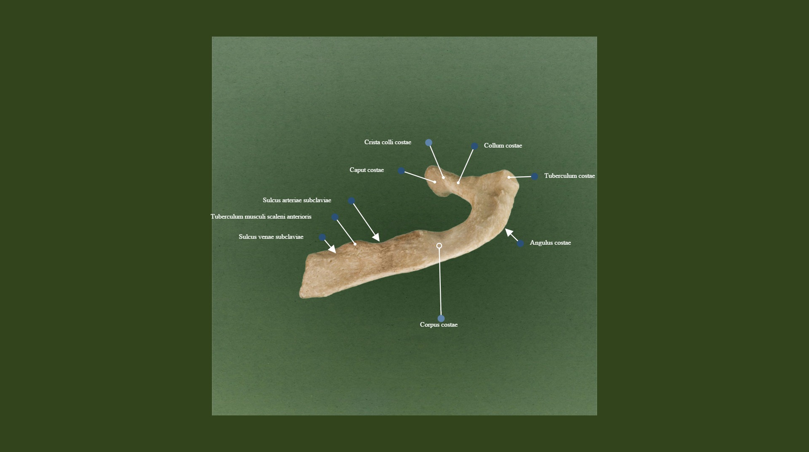
Creating anatomical terms
http://terminologia-anatomica.org/cs/ImageSet/ViewSet/2085?imageId=496

Slide 5
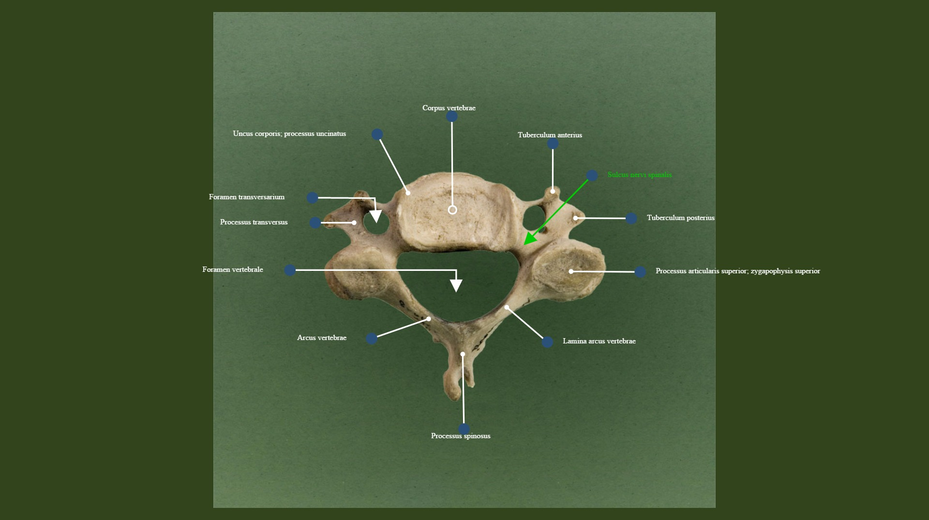
Compare anatomical terms using adjectives with those using Genitive
http://terminologia-anatomica.org/cs/ImageSet/ViewSet/2002?imageId=420

Slide 6
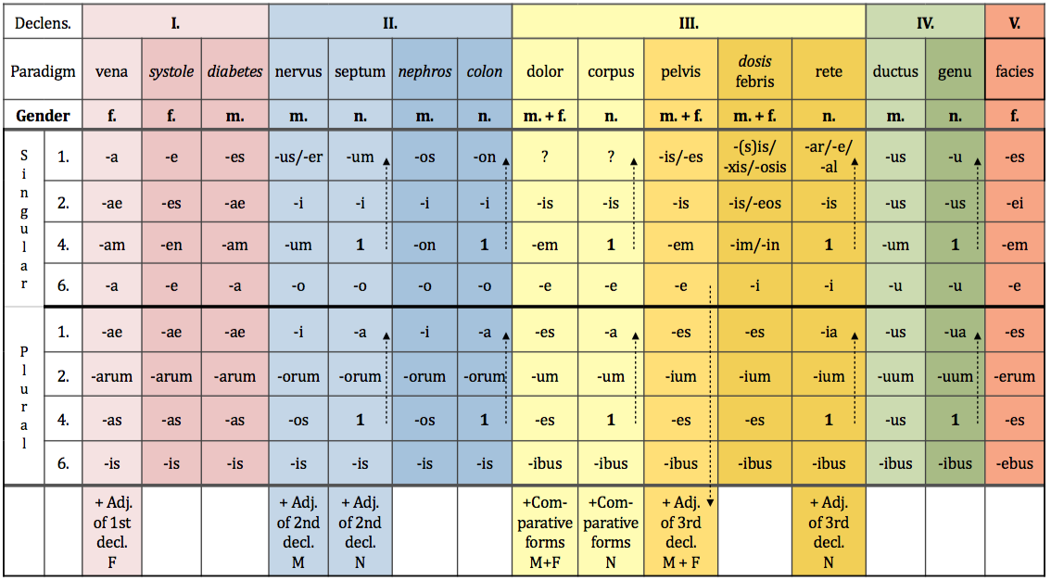
Genitive singular and plural

Slide 7
Introduction to syntax NOUN IN APPOSITION 1.
noun + noun < GENITIVE
Translated: using of
Meaning: state of dependency, possession
EX: Fractura costae //fractura costarum
Fracture of rib Fracture of ribs
! = rib fracture = rib fractures

Slide 8
Connect two nouns
ex: caput + costa > caput costae head of rib
caput + femur >
caput + fibula >
caput + humerus >
caput + phalanx >
caput + radius >
caput + talus >
caput + ulna >

Slide 9
Prepositions and prepositional phrases
Denote:
spatial relations sub, infra, post, ante, supra, a/ab, ad
temporal relations post, ante, intra
causal relations propter, e/ex
other cum, sine
Can be connected with:
Accusative case
Ablative case
Both Accusative and Ablative cases

Slide 10
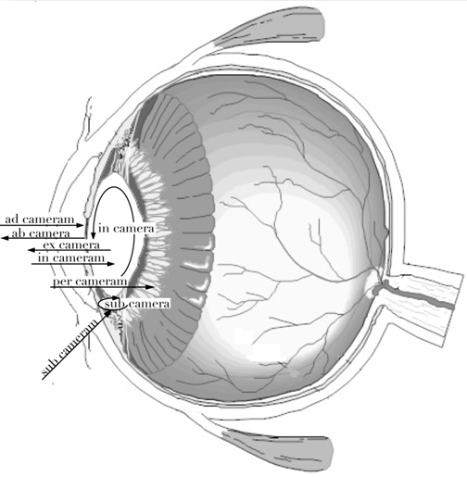

Slide 11
Connect nouns with prepositions

Slide 12
1st LATIN declension
In the 1st declension we decline nouns that have:
Genitive sg. ending | -AE
Nominative sg. ending | -A
Gender | Mostly F Never N Exceptions M
EXCEPTIONS!!!
NOUNS OF THE 1st Declension that are of masculine gender are:
Names of specialists – dentista, ae, m.
Names of muscles – agonista, ae, m.

Slide 13
1st GREEK declension
In the first declension we decline nouns that have:
Genitive sg. ending | -E | -ES
Nominative sg. ending | -ES | -AE
Gender | F | M

Slide 14
Latin and Greek Declensions
Latin Greek

