Slide 1
Social Networks and Interpersonal Relationships as Risk Factors for Obesity
BY pablo Guerrero and julia pender

Slide 2
Introduction
The current epidemic of obesity is caused largely by an environment that promotes excessive food intake and discourages physical activity.
Increase in obesity
Cannot be explained just by genetics
All socioeconomic groups
Social and environmental explanations
Whereas obesity has been stigmatized in the past, attitudes may be changing.
People are embedded in social networks and influenced by the appearance and behaviors of those around them.
It is plausible that areas of the brain that correspond to actions such as eating may be stimulated if these actions are observed in others.

Slide 3
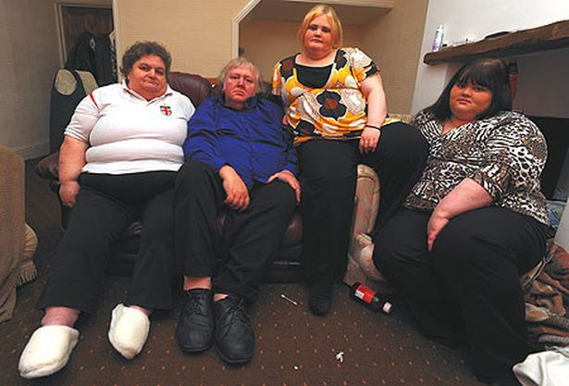
Obesity and Family History
70% of adiposity in 10-year-olds is due to genetic factors, and approximately 20% is due to socioenvironmental contributions.
Eating disinhibition, susceptibility to hunger, and eating in the absence of hunger all appear to be biologically heritable traits.
Thus, a child's family health history, along with shared behaviors and familial environments, must be considered in efforts to prevent and treat obesity.

Slide 4
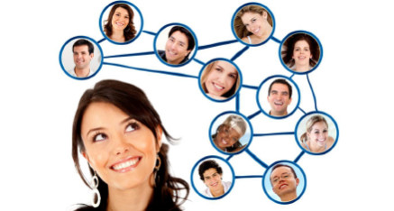
Overweight and social networks
Social network: structure of “reciprocally oriented and dependent people”
Many studies have explored the risk of becoming overweight or obese according to the size and density of people’s social networks.
Characteristics of people within a particular social group.
Risk of overweight or obesity among network members.
Obesity might cluster within particular interpersonal relationships.
Limited understanding about the ways in which such networks might shape the development of overweight and obesity.

Slide 5
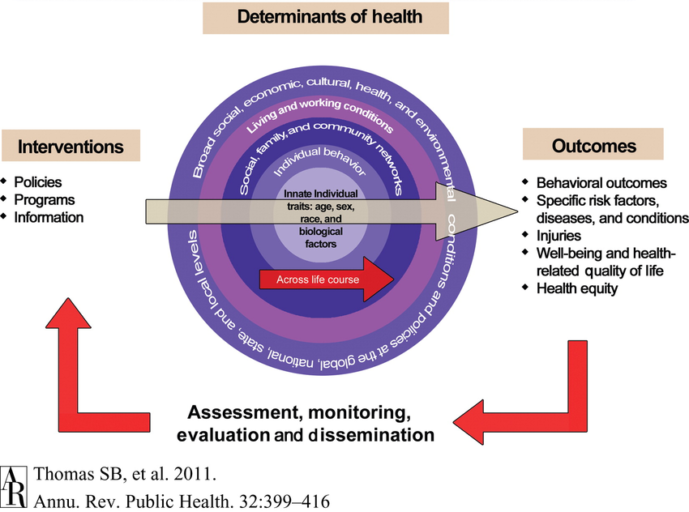
Overweight and social networks
Public health: range of different forms of social capital that might influence health within particular networks:
People’s sense of belonging
Practical and emotional support
Behavioural norms
Trust and co-operation
Social networking sites can influence weight by exposing people in the same social network to the same information.
Encouraging participation in health enhancing activities might also be more successful when more homogenous groups are targeted as opposed to unconnected individuals.

Slide 6
Communal coping
Process in which interpersonal relationships are the conduit to behavior change among multiple members within a particular social network.
Individuals define themselves in terms of their interconnectedness and relationships with their family, friends, neighbors, and community.
When faced with a shared health problem, a cooperative approach may be particularly effective.
Health interventions can target 3 interpersonal pathways:
Communication about a health problem, such as shared risk factors
Shared appraisals of the problem
Development of cooperative strategies to reduce negative impact

Slide 8
Social Contagion Social Capital
Aspiring to the body size of others in one’s social network
Krones et al. found that being around people that are thinner than average increased body weight dissatisfaction amongst young American women.
Hruschka found evidence to indicate that friends’ body size has an influence on an individual’s body weight ideals.
Blanchflower et al. found that perceptions about overweight among Europeans were influenced by comparisons with others and that educated individuals were more likely to rate themselves as overweight, indicating that this group aspires to a thinner ideal.
Sense of belonging
Involvement in community organisations and public affairs, volunteerism, informal sociability, and social trust were protective factors.
One of the ways in which sense of belonging might influence obesity is through a greater sense of the value in protecting one’s health. Similarly, a sense of being part of one’s community has been associated with greater interest in physical activity.

Slide 9
Social Network Approaches to Strengthen Obesity Prevention
Recommendation 1: Intervene with the family system, rather than with the individual
Recommendation 2: Design support mechanisms for parents and adult family members on the basis of their social ties within the community
Recommendation 3: Use peer networks to encourage increased physical activity

Slide 10
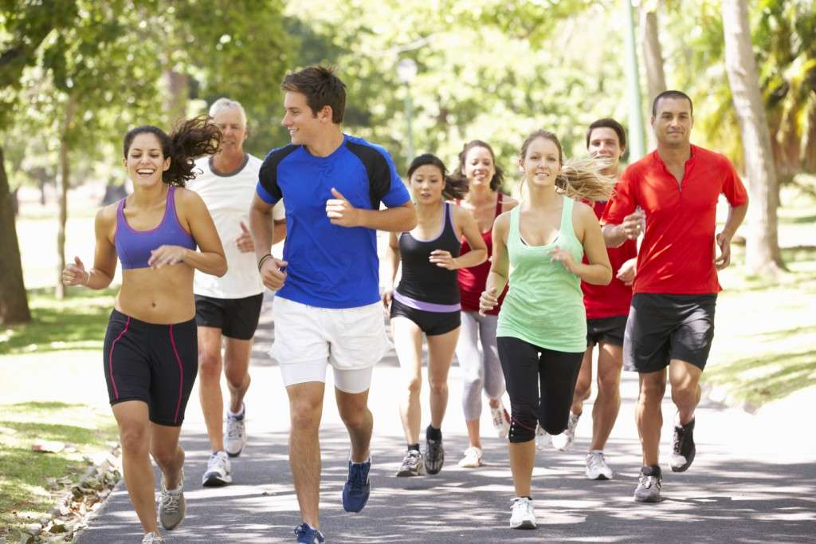
Social Network Approaches to Strengthen Obesity Prevention
1) Intervene with the family system, rather than with the individual
2) Design support mechanisms on the basis of social ties within the community
3) Use peer networks to encourage increased physical activity

Slide 11
Multinational companies and their influence in Social Networks
Who rules global food systems? “Big Food”
Multinational food and beverage companies with huge and concentrated market power.
More than half of global soft drinks are produced by large multinational companies, mainly Coca-Cola and PepsiCo.
The world's food system is an oligopoly. What people eat is increasingly driven by a few multinational food companies.

Slide 12
Multinational companies and their influence in Social Networks
Action requires tackling vested interests, especially the powerful Big Food companies with strong ties to and influence over national governments.
The influence of these Big Food companies can affect also Social Networks and interpersonal relationships.
Contemporary advertising play an important role in promoting and sustaining consumer culture, and if the product advertised is an unhealthy meal, it affects directly the epidemic spread of obesity.
Advertising functions as propaganda for consumption, especially in younger people.

Slide 13
Conclussion
Social networks are important to our understanding of obesity, but there has been limited understanding about the ways.
Three inter-related social processes appear to explain the role of social networks in the development of overweight and obesity:
Social contagion (whereby the network in which people are embedded influences their weight over time).
Social capital, (whereby sense of belonging and social support influence weight and weight influencing behaviours).
Social selection (whereby a person’s network might develop according to his or her weight).
Sense of belonging and Social support operate to influence behaviours within friends and family networks and regional networks.

Slide 14
Bibiography
Smith KP, Christakis NA. Social networks and health. Annu Rev Sociol. 2008;34:405–29. doi: 10.1146/annurev.soc.34.040507.134601
Christakis NA, Fowler JH, Christakis NA, Fowler JH. The spread of obesity in a large social network over 32 years. N Engl J Med. 2007;357(4):370–9. doi: 10.1056/NEJMsa066082.
Obesity: preventing and managing the global epidemic. Geneva (CH): World Health Organization; 2000.
Koehly LM, Shivy VA. Social environments and social contexts: social network applications in person environment psychology. Mahwah (NJ): Lawrence Erlbaum; 2000.

