Slide 1
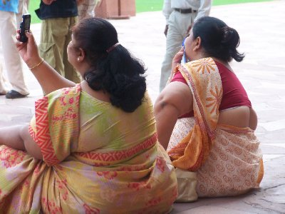
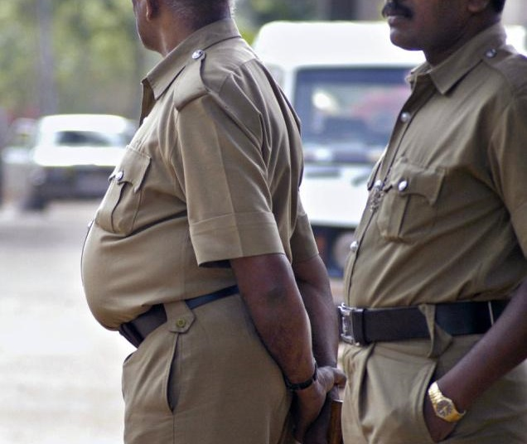
Prevalence of Obesity In India

Slide 2
WHO view on obesity
WHO describes obesity as today's one of the most neglected health problems, affecting every region of the globe
Even affecting lower class people these days.
India is one of the most populated countries in the world ( 2nd behind china).
Its unique as it presents both sides of nutritional status ( overweight and underweight)

Slide 3
Both sides of nutritional status varies from region to region
Took some time to overcome severe food shortages until the early 1960s known as Green revolution where better methods were adopted and showed mindboggling results

Slide 4
Still areas with BMI <18.5kg/m2 (mainly rural areas )
Regions with BMI>25kg/m2 (Obese/underweight)
Interesting thing here is that studies were done by National Family Health Survey, they saw the % of married women (aged 15-49), who are overweight and obese has increased from 11% (NFHS-2) to 15% (NFHS-3)

Slide 5
Obesity is 3 times higher in urban regions than rural.
This is double edge sword thing. Here health status ( disease) play role, but cultural and society issues play major role.
Women with 12 or more years of schooling are 3 times higher.

Slide 6
Percentage of obese women were high in rich urban states such as Punjab (30%), Kerela (28%), Delhi (26%)
Prevalence is also affected by wealth index, age, education .
India is one the fastest growing economies in the world ( it is estimated to have one of the highest GDP (7.1%)
Source: https://www.statista.com/statistics/263617/gross-domestic-product-gdp-growth-rate-in-india/

Slide 7
Table showing states ranking in Obesity

Slide 10
Socioeconomic factors
Studies were done in South India and it has shown, the prevalence of obesity has increased 1.7 fold.
Also affecting rural areas
Reasons? Transport facilities, inc family income, better health facilities, easy access to tv, gadgets.
BMI studies done now compared to 1989. The prevalence rose from 2% to 17.1%

Slide 11
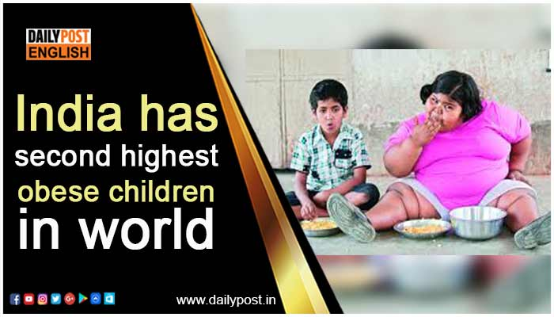

Slide 12
Childhood obesity
Various health risks: CVD, Diab, Arthrits, Inc in mortality.
India: prevalence of obesity is between 10-30%
Ludhiana ( Punjab aka: called Louisiana of Punjab). Age group age 11-17 : 11.6% as compared to rural counterpart (4.7%)
Low levels of physical activity, junk food, home delivery is massive problem.

Slide 13
How to solve this
Tough to accomplish these days as food is everywhere around
Inc in physical activity, atelast 20 mins brisk walking, yoga, more veggies and less fried food.
Government needs to take charge ( impose tough norms on food companies which is probably a long shot)

Slide 14
References
https://en.wikipedia.org/wiki/Green_Revolution_in_India
http://www.jmnn.org/article.asp?issn=2278-1870;year=2012;volume=1;issue=1;spage=37;epage=41;aulast=Kalra#ft1
Obesity in India: The weight of the nation Kalra S ... (n.d.). Retrieved December 13, 2017, from http://www.bing.com/cr?IG=94E544FC244F48BB9E65C2C1E762CD3C&CID=0DC9FD87722A6FDA1E1DF6D073856EE3&rd=1&h=h_VCwfP-9cKiCMSbANvFsHa6J_A5USx0hVL6yqAczsE&v=1&r=http%3a%2f%2fwww.jmnn.org%2farticle.asp%3fissn%3d2278-1870%3byear%3d2012%3bvolume%3d1%3bissue%3d1%3bspage%3d37%3bepage%3d41%3baulast%3dKalra&p=DevEx,5067.1

