Slide 1

Socioeconomic Status and prevalence of obesity
Jeyvin Kumar
Ismael Rueda
Group 34

Slide 2

Socioeconomic status (SES)
Education + income + occupation
Higher SES correlated with :
→ Access to more resources
→ better psychological wellbeing

Slide 3
Obesity statistic UK - 2015
58% of women and 68% of men were overweight or obese.
There were 525 000 admissions in NHS hospitals where obesity was recorded as a factor.
26% of adults were classified as inactive (fewer than 30 minutes physical activity a week).
26% of adults ate the recommended 5 or more portions of fruit and vegetables a day

Slide 4
Education Level
Evidence for Policy and Practice Information and Co-ordinating Centre
(EPPI-Centre) conducted research to find relationship between obesity and education attainment
Pat studies, specialist websites, contacted experts, independent consultations with teachers and students
Weak correlation found
Individuals with lower education levels are more likely to be obese
Reasons :
1. Not understanding benefits of exercise
2. Not understanding components of a balanced diet
3. Not understanding the harmful effects of being overweight

Slide 5
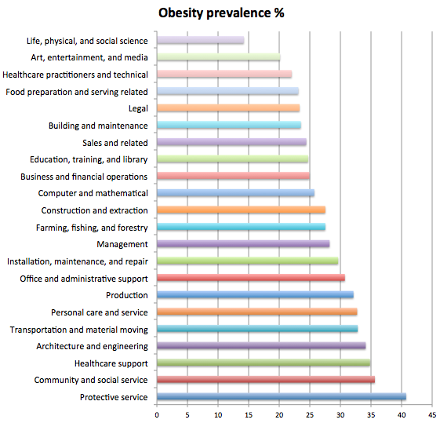
Occupation
Study by American journal of preventive medicine

Slide 6
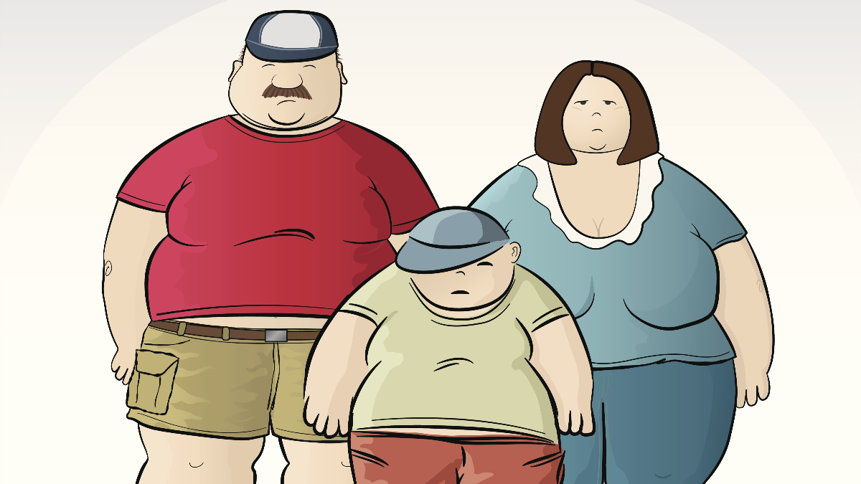
Occupation
American Journal of Preventive Medicine
More than 40 hours per week + hostile work environment → significantly more likely to be obese
Highest obesity rates – healthcare professionals, engineering, protective services

Slide 7

Income
Prevalence of obesity was considerably
higher among families in the poorest quintile
compared with those in the top income quintile
For children – there was no correlation
until the age of 11 by the time differences
between children from poorer compared with
richer families had emerged (20.2 vs. 16.5%)
Potential explanations
Junk/fast good – inexpensive
More stress /money concerns → increased food intake
Less money available for physical activity – gym membership, organising sport activities

Slide 8
Conclusion
Overall there was a inverse correlation between SES and obesity
However at times correlation between a single component of SES related to obesity was weak and could have been classified as statistically insignificant
In some studies parameters were not so well defined. For example healthcare workers encompassed all those who worked in the hospital – doctors, nurses, secretaries, admin despite all of them having different job descriptions, income, responsibilities ect

Slide 9
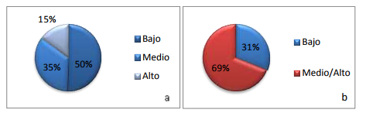
Socioeconomic Status and prevalence of obesity
Example in Spanish population
Socioeconomic status (a) and Level of studies (b) CODIES 2011.

Slide 10
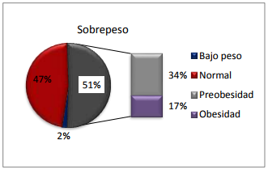
Prevalence of obesity
57% of the people from the lower socioeconomic status had over weight
35% of the people from the highest socioeconomic status had over weight
Obesity levels in high, medium and low status were 9%, 13% and 22% respectively
BMI levels on the studied sample

Slide 11
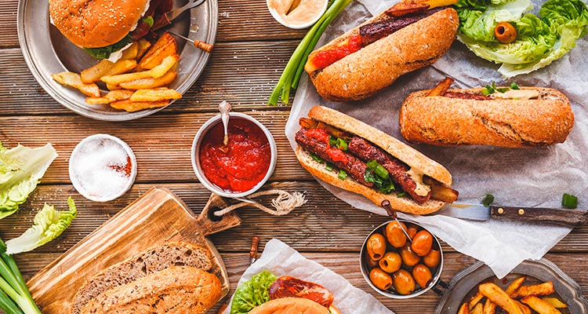
Obesity and level of studies
66% of people with over weight had lower level of studies
44% of people with over weight had higher level of studies
Furthermore, the prevalence of pre obesity and obesity was higher in married people (41% and 21%) compared to prevalence of pre obesity and obesity in single people (27% and 13%).

Slide 12
References
https://www.gov.uk/government/uploads/system/uploads/attachment_data/file/613532/obes-phys-acti-diet-eng-2017-rep.pdf
https://academic.oup.com/eurpub/article/26/1/7/2467515
https://rdu.unc.edu.ar/bitstream/handle/11086/714/ABALLAY.pdf?sequence=1

Slide 13
THANK YOU

