Slide 1
Ajectives and nouns

Slide 2
Decide on declension and paradigm
Chole
Medulla
Nephros
Ascites
Methodus
Tarsus
Diabetes
Collum
Colon
Palatum
Oculus
Therapia
Diameter
Cancer
Puer
Tibia

Slide 3
What is the gender, number and case of the following nouns?
palata
angulis
oculos
ovariorum
nephron
alvo
icterum
olecranon
methodi
palatum, i, n., nominative pl. or accusative pl.
angulus, i, m./ ablative pl.
oculus, i, m./ accusative pl.
ovarium, ii, n./ genitive pl.
nephros, i, m./ accusative sg.
alvus, i, f./ ablative sg.
icterus, i, m./ accusative sg.
olecranon, i, n./ nominative or accusative sg.
methodus, i, f./ genitive sg. or nominative pl.

Slide 4
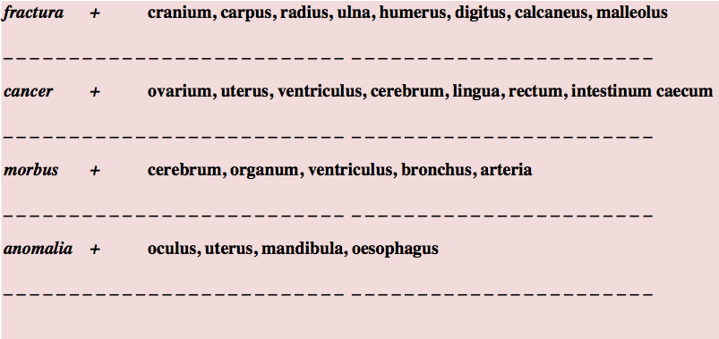
Connect nouns
cranii
carpi
radii
ulnae
humeri
digiti
calcanei
malleoli
ovarii
uteri
ventriculi
cerebri
linguae
recti
intestini caeci
cerebri
organi
ventriculi
bronchi
arteriae
oculi
uteri
mandibulae
oesophagi

Slide 5
Adjectives and nouns
When we connect the noun with the adjective, we have to know the GENDER of the noun.
According to the gender of the noun we choose the right form of the adjective.
morbus, i, m.
periculosus, a, um
periculosus
masculine form of the adjective
feminine form of the adjective
neutral form of the adjective
morbus
periculosa
periculosum

Slide 6
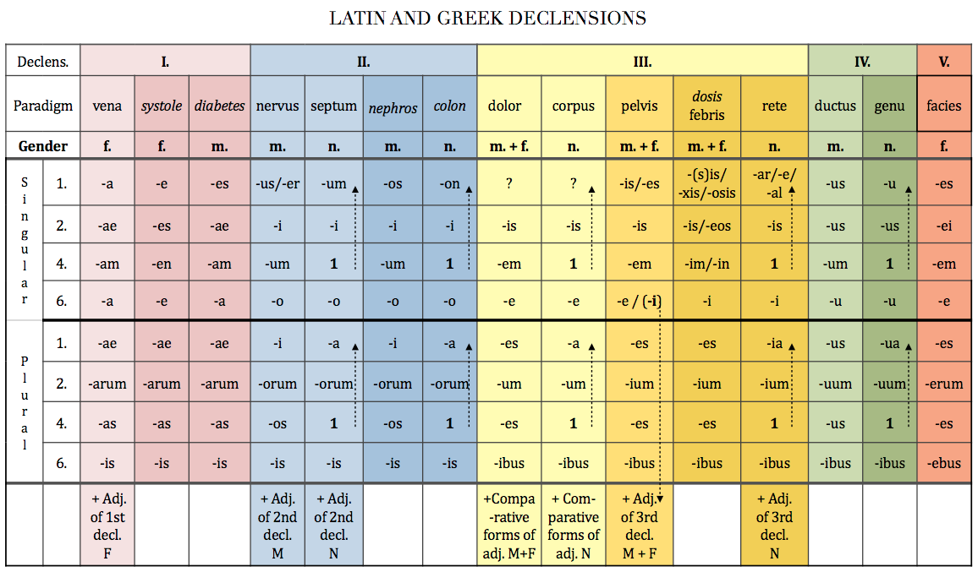
periculosa
periculosus
periculosum
When you know what gender of the adjective you should use, you decline it according to the paradigm for that adjective.

Slide 7
Adjectives and nouns
The adjective always have to be of the same GENDER, CASE and NUMBER as the noun with which it is connected
dangerous disease -> morbus periculosus
cause of dangerous disease ->causa morbi periculosi
after dangerous disease -> post morbum periculosum
with dangerous disease -> cum morbo periculoso

Slide 8
Adjectives and nouns
!The adjective does not have to have the same endings as the noun, it has to be of the same GENDER, CASE and NUMBER!
periodus, i, f.
->periodus longa
after a long period
post periodum longam
longus
periodus
longa
longum
The noun and the adjective are BOTH of feminine GENDER, accusative CASE and singular NUMBER, although they do not have the same endings

Slide 9
What is the correct adjective for the noun in the triangle?
transversus
transversa
diameter
anatomicus
accessorius
collum
nervus
transversum
anatomica
anatomicum
accessoria
accessorium

Slide 10
What is the correct adjective for the noun in the triangle?
dexter
dextra
ovarium
palatina
lymphaticum
fissura
nodus
dextrum
lymphatica
lymphaticus
palatinum
palatinus

Slide 11
What is the correct adjective for the noun in the triangle?
sinistra
sinister
periculosus
brachium
longus
periodus
morbus
sinistrum
periculosa
periculosum
longa
longus

Slide 12
What is the correct adjective for the noun in the triangle?
anatomica
anatomicus
durus
pharyngeum
ostium
palatum
anatomicum
tuberculum
dura
durum
pharyngeus
pharyngea

Slide 13
Muscles of…
Musculi +
antebrachium
digitus minimus
digiti
brachium dextrum
carpus sinister
membra

Slide 14
Find adjectives. Which adjective is dependent on which noun?
Tunica serosa vesicae felleae
Plica venae cavae sinistrae
Therapia chirurgica tonsillae
Fractura fibulae complicata
Colica periculosa complicata

Slide 15
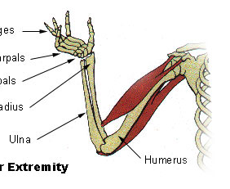
Ossa membri superioris et allia:
Right shoulder blade
Complicated fracture of the left collar bone
The small head of humerus
True and false ribs
The neck of Radius
Fracture of Fingers
Open fracture of the right ulna and radius
Ligaments of wrist
Muscles of metacarpus
C
A
B
F
G
H
I
E
D

Slide 16
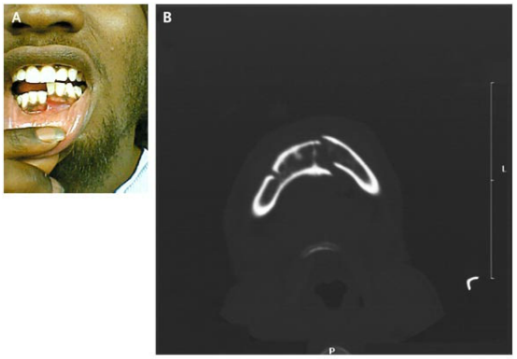
2
A 21-year-old man
presented after being
struck with a gun on
his right lower jaw.
Examination revealed
displacement of the
left half of his mandible with malocclusion on biting (Panel A). Computed tomography showed a fracture of the left side of mandible and a fracture of the right mandibular body and angle (Panel B). Given the U shape of the mandible, it is common for contralateral fractures to result from major injury. Intravenous analgesics and antibiotics were given; the patient underwent open reduction with internal fixation of his fractures.

Slide 17
Connect the nouns with adjectives
oculus + niger, gra, grum
chole + purus, a, um
palatum + durus, a, um
tibia + dexter, tra, trum
methodus + novus, a, um
diabetes + mellitus, a, um
therapia + chirurgicus, a, um
nephros + sinister, tra, trum
oculus niger
chole pura
palatum durum
tibia dextra
methodus nova
diabetes mellitus
therapia chirurgica
nephros sinister

Slide 18
Connect given terms with the prepositions (or nouns)
sine + nephros sinister
sine nephro sinistro
ad + chole pura
ad cholen puram
in + palatum durum (position)
in palato duro
fractura + tibia dextra
fractura tibiae dextrae -> fracture of left shinbone
cum + methodus nova
cum methodo nova
propter + diabetes mellitus
propter diabetam mellitum

Slide 19
Translate into Latin
big muscle
musculus magnus
muscle of back
musculus dorsi – state of dependency -> genitive case
big muscle of back
musculus magnus dorsi – state of dependency -> genitive case
big muscles of back
musculi magni dorsi – state of dependency -> genitive case
-> noun and adjective in plural
muscle of finger
musculus digiti – state of dependency -> genitive case
muscles of fingers
musculi digitorum – state of dependency -> plural genitive case

Slide 20
Decide what is correct
The cause of deadly anaemia
A causa anaemia perniciosa B causa anaemiae perniciosae
Insufficiency of the valve of the aorta
A insufficientia valvulae aortae B insufficientia aortae valvulae
Because of acute dyspnoea
A propter dyspnoen acutam B propter dyspnoen acuten
Fracture of the right collar bone
A fractura dextra clavicula B fractura claviculae dextrae

Slide 21
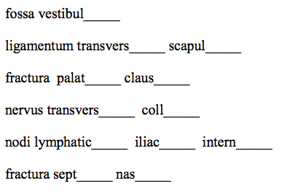
Fill in missing endings:
i
um
ae
i
a
us
i
i
i
i
i
i
Exercise 5, handout 5

Slide 22
Fill in missing endings and change to plural
apertura extern__
costa liber __
ruptura ven __ cav __
nucleus rub __
tunica mucos __
bronchus sinist __
costa spuri __
nasus extern __
a
pl.
aperturae externae
a
pl.
costae liberae
ae
ae
pl.
rupturae venarum cavarum
er
pl.
nuclei rubri
pl.
tunicae mucosae
a
er
pl.
bronchi sinistri
a
pl.
costae spuriae
us
pl.
nasi externi
Exercise 6, handout 5

Slide 23
Form phrases from words in boxes and translate them into English
uterus
ligamentum
latus, a, um
ligamentum latum uteri
wide ligament of uterus
cerebrum
transversus, a, um
fissura
fissura transversa cerebri
transverse fissure of brain
antebrachium membrana
interosseus, a, um
membrana interossea antebrachii
interosseous membrane of forearm
anomalia bulbus
congenitus, a, um
oculus
anomalia bulbi oculi congenita
hereditary anomaly of the eye bulb
Exercise 4, handout 5

Slide 24
Form phrases from words in boxes
tunica vesica
mucosus, a, um
felleus, a, um
tunica mucosa vesicae felleae
mucous membrane of gall blader
plica (pl.)
transversus, a, um
rectum
plicae transversae recti
transverse folds of rectum
apertura ventriculus
quartus, a, um
medianus, a, um
apertura ventriculi quarti mediana
median opening of the fourth ventricle
sinister, a, um
thyroideus, a, um
lobus glandula
lobus glandulae thyroideae sinister
left lobe of thyroid gland
Exercise 4, handout 5

Slide 25
Form phrases from words in boxes and translate them into English
collum
vesica
felleus, a, um
collum vesicae felleae
neck of the gall bladder
musculus
transversus, a, um
dorsum
musculus transversus dorsi
transverse muscle of back
truncus
accessorius, a, um
nervus
truncus nervi accessorii
trunk of accessory nerve
durus, a, um palatum
congenitus, a, um
fissura
fissura palati duri congenita
hereditary fissure of hard palate
Exercise 4, handout 5

Slide 26
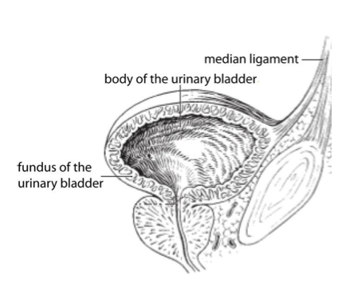
Translate the legend to the image:
Ligamentum medianum
Corpus vesicae urinariae
Fundus vesicae urinariae
Exercise 8, handout 5

Slide 27
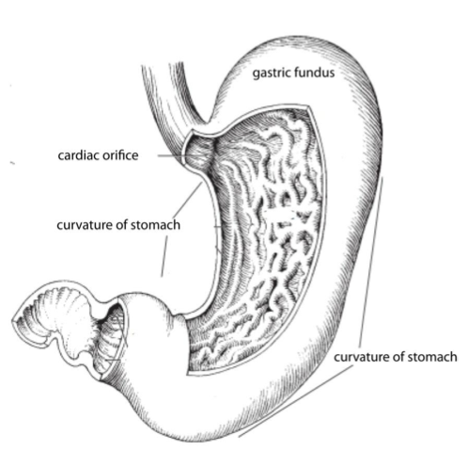
Translate the legend to the image:
Fundus ventriculi
cardia
Curvatura ventriculi
Curvatura ventriculi
Exercise 8, handout 5

