Slide 1
Latin and greek prefixes + suffixes
Based on presentation by E. Dávidová

Slide 2
Decide whether the following statements are true or false:
Statement | answer
1) Dis- is used for “a disorder”, and dys- for “division”, “removal/loss” and “negation”. | T/F
2) The Latin equivalent to the prefix endo- is extra-. | T/F
3) The prefix ana- has two meanings: “division” and “again” (e.g. anatomia, anamnesis). | T/F
4) The prefix af- is a variety of the prefix ab- (e.g. vasa afferentia). | T/F
5) The prefixes ante- and anti- have the same meanings. | T/F
6) The prefix hyper- means “deficient” or “decreased”. | T/F
7) The prefix dia- has three meanings: “division”, “through” and “between” (e.g. diagnosis, diameter, diaphragma). | T/F

Slide 3
Decide whether the following statements are true or false:
Statement | answer
1) It is possible to distinguish noun and adjective suffixes (e.g. obesitas, tonsillaris). | T/F
2) The ending of the suffix determines the declension (e.g. arthrosis, flexura, ligamentum). | T/F
3) The diminutive is a word which relates to an object of the bigger size. | T/F
4) The diminutive always keeps the gender of the word which it comes from (e.g. canalis – canaliculus). | T/F
5) It does not matter whether the suffix –alis or –aris is used to express relation to the noun. | T/F
6) The suffix –or has the meaning of an “agent” and is usually used to name bones. | T/F

Slide 4
MATCH THE PREFIXES WITH THEIR MEANING:
a/an-
peri-
epi-/ep-
post-
super-
para-/par-
cata-
at, near to
from up to down
after, behind
around
at, on, over
negation

Slide 5
MATCH THE SUFFIXES WITH THEIR MEANING:
disease full of
relation (a Latin suffix)
equipped with
Inflammation state
disease/pathological state
relation (a Greek suffix)
tumour
-iasis
-alis
-icus
-atus
-itas
-ia
-oma
-itis
-osus

Slide 6
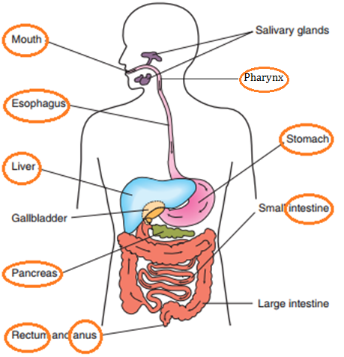
USE THE SUFFIXES TO DERIVE ADJECTIVES FROM NOUNS:
-alis -aris -inus -eus -aneus -icus -arius
oralis
pharyngeus
oesophagealis
gastricus
hepaticus
intestinalis
pancreaticus
Rectalis, analis

Slide 7
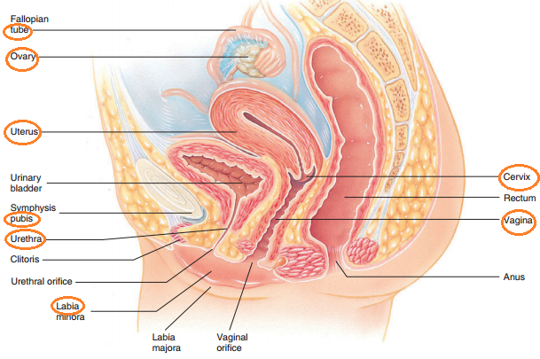
-alis -aris -inus -eus -aneus -icus -arius
salivarius
ovaricus
uterinus
cervicalis
pubicus
vaginalis
urethralis
labialis

Slide 8
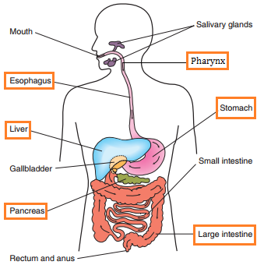
DERIVE TERMS FOR INFLAMMATIONS OF THE FOLLOWING ORGANS:
pharyngitis
oesophagitis
gastritis
hepatitis
pancreatitis
colitis

Slide 9
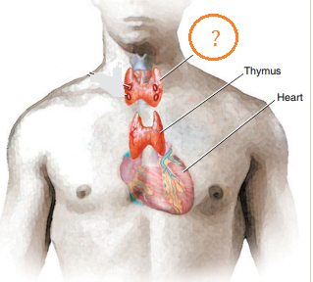
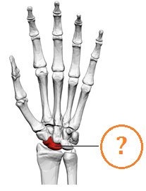
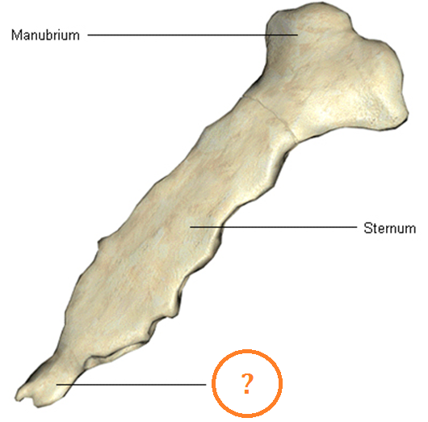
FORM ADJECTIVES WITH MEANING “SIMILAR TO”:
Thyreos (shield):
Glandula thyroidea
Skafe (boat):
Os scaphoideum
Xifos (sword):
Processus xiphoideus

Slide 10
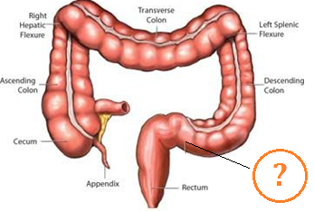
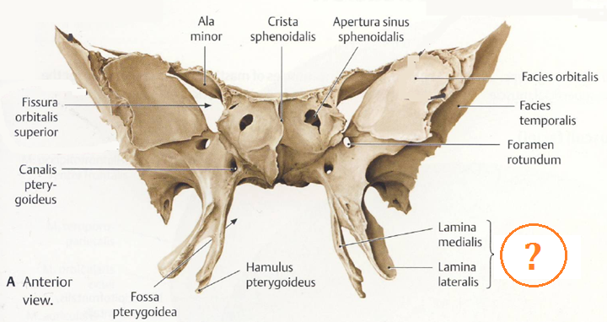
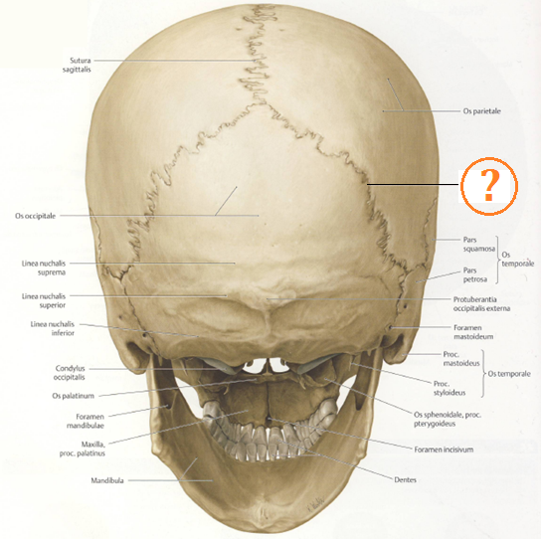
Sigma (Greek letter Σ):
Colon sigmoideum
Pteryx, gen. pterygos (wing):
Processus pterygoideus
Lambda (Greek letter Λ):
Sutura lambdoidea

Slide 11
Divide each term into its components. Write these components into boxes in the table. You may not need all of the boxes provided:
terms | prefix | root 1 | root 2 | suffix | meaning
periorbitalis
graviditas
cholelithiasis
posttraumaticus
superficialis
parotis
catarrhalis
epigastricus
anaemia

Slide 12
Divide each term into its components. Write these components into boxes in the table. You may not need all of the boxes provided:
terms | prefix | root 1 | root 2 | suffix | meaning
periorbitalis | peri | orbit |  | alis | pertaining to the area surrounding the socket of the eye.
graviditas |  | gravid |  | itas | Pragnancy
cholelithiasis |  | chole | lith | iasis | presence of stones in the gallbladde
posttraumaticus | post | traumat |  | icus | Following injury or resulting from it
superficialis | super | fici |  | alis | situated on or near the surface
parotis | par | otis |  |  | a parotid gland
catarrhalis | cata | rrh |  | alis | relating to a catarrh
epigastricus | epi | gastr |  | icus | Relating to the upper middle region of the abdomen.
anaemia | an | aem |  | ia | a deficiency in the number of red blood cells

Slide 13
FORM FIVE TERMS BY COMBINING THE FOLLOWING PREFIXES/ROOTS/SUFFIXES:
IM-
-NEPHR-
DYS-
-MUN-
-CAPIT-
-IA
-CELL-
-ITIS
-ITAS
INTRA-
-ALIS
-PEPS-
-ARIS
PERI-
-UL-
SUB-
Im-mun-itas, dys-peps-ia, intra-cell-ul-aris, peri-nephr-itis, sub-capit-alis

