Slide 1
Basic medical terminology 3

Slide 2
Read and explain your pronunciation
Musculus latissimus dorsi
Pars respiratoria tunicae mucosae nasi
Vena aquaeductus cochleae
Hiatus oesophageus
Protuberantia occipitalis externa
Myometrium
Nucleus rhapes medianus

Slide 3
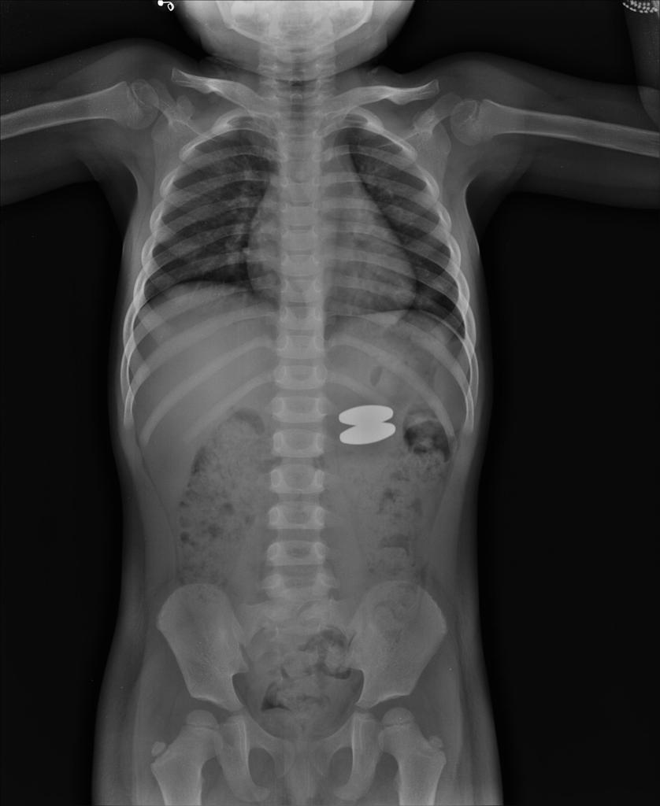
Read and guess the meaning:
Dg.:
Corpus alienum trac. GI l.dx. sine compl, sine inflam.
Corpus alienum tractus gastrointestinalis lateris dextri sine complicationibus, sine inflammatione
Notes:
Preč’tať, pokúsiť sa preložiť, ako zaujímavosť možno uviesť, že na r. snímke je dieťa, ktoré prehltlo 2 kovové magnetky

Slide 4
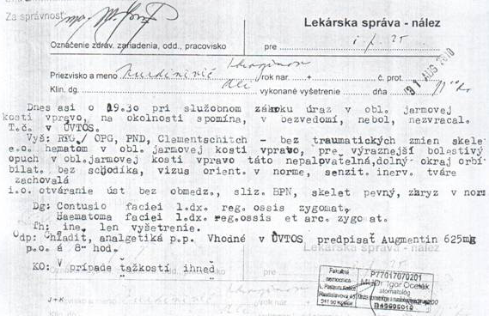
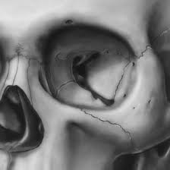
Contusio faciei l.dx. reg. ossis zygomat.
Contusio faciei lateris dextri regionis ossis zygomatici
Haematoma faciei l. dx. reg. ossis et arc. zygomat.
Haematoma faciei lateris dextri regionis ossis et arcus zygomatici
Notes:
Prečítať a pokúsiť sa preložiť, demonštrovať skratky, záznam je z väzenského zariadenia, poukazuje pravdepodobne na silný úder do tváre a neprimeraný zákrok väzenskej polície (táto inf. Je pre zaujímavoať, nemusí byť uvedené)

Slide 5
Questions
What case expresses the state of dependency?
genetive case
How is it usually translated into English?
using ‟of”
What cases are used with prepositions in medical terminology?
accusative and ablative case
Are there any prepositions connected with two cases?
In, sub
Which prepositions are connected with the ablative case?
a/ab, cum, sine, de, e/ex, pro

Slide 6
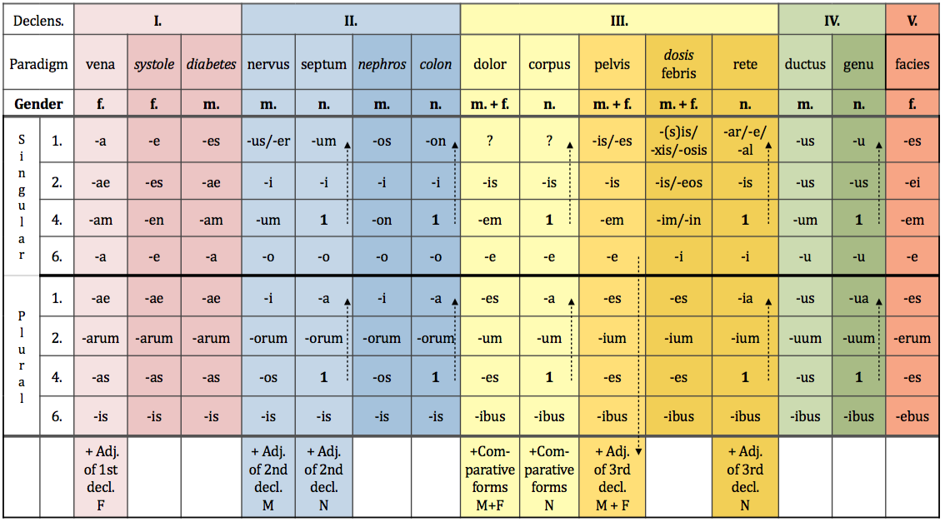
Non-Agreed Attribute

Slide 7
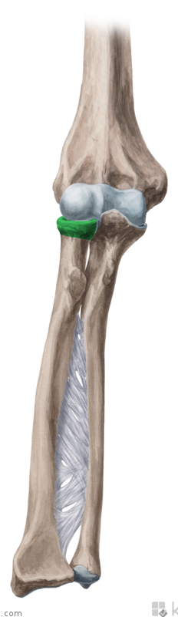
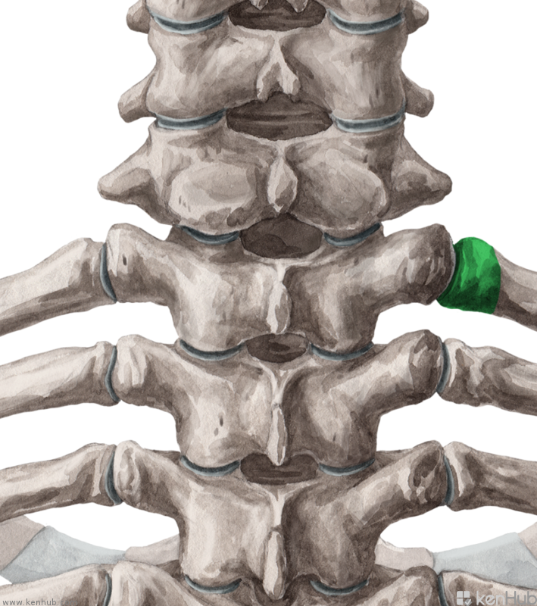
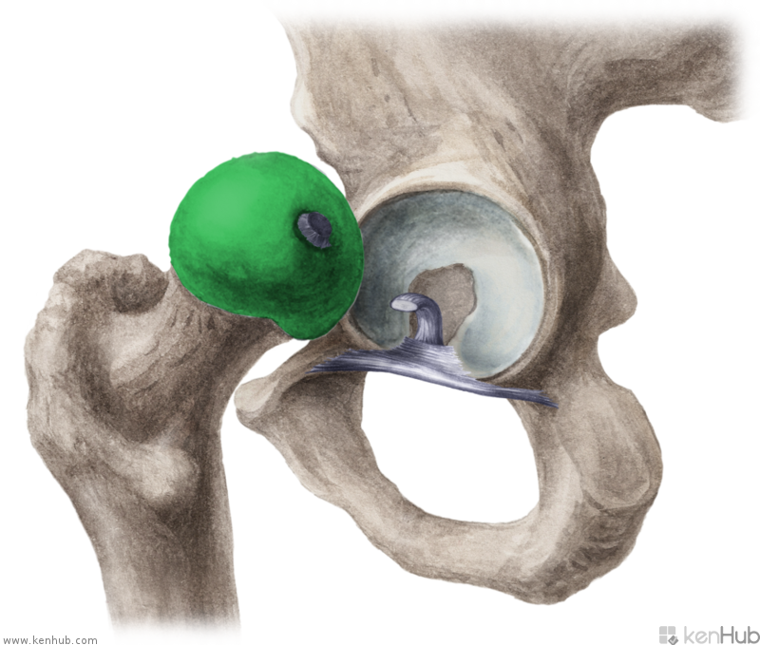
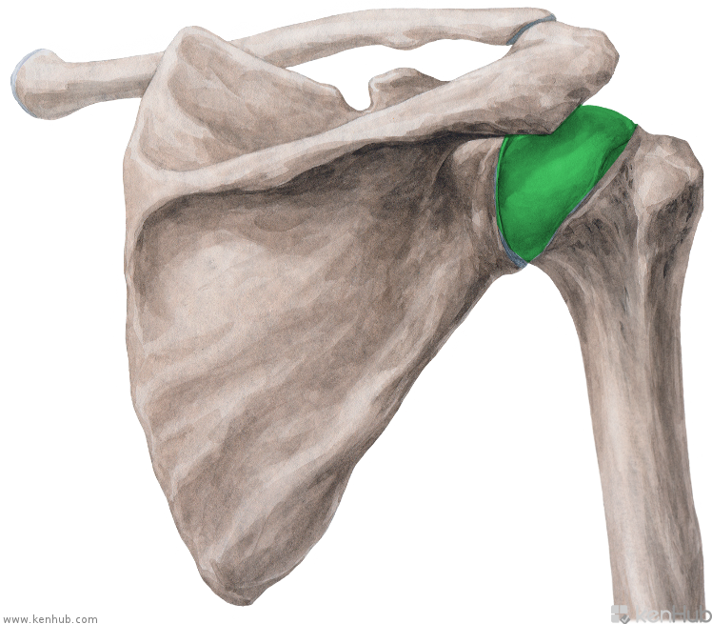
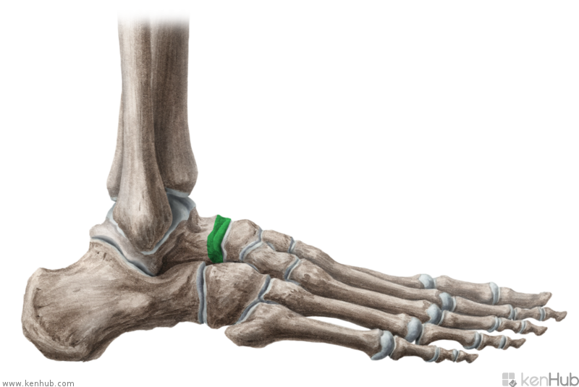
C
D
A
E
F
B
Notes:
Na všetkých obrázkoch je hlavica nejakej kosti: úlohou študentov je preložiť anat. termíny do latinčiny.
A. Caput costae, B. Caput humeri, C. caput fibulae, D. caput radii, E. caput femoris, F. caput tali

Slide 8
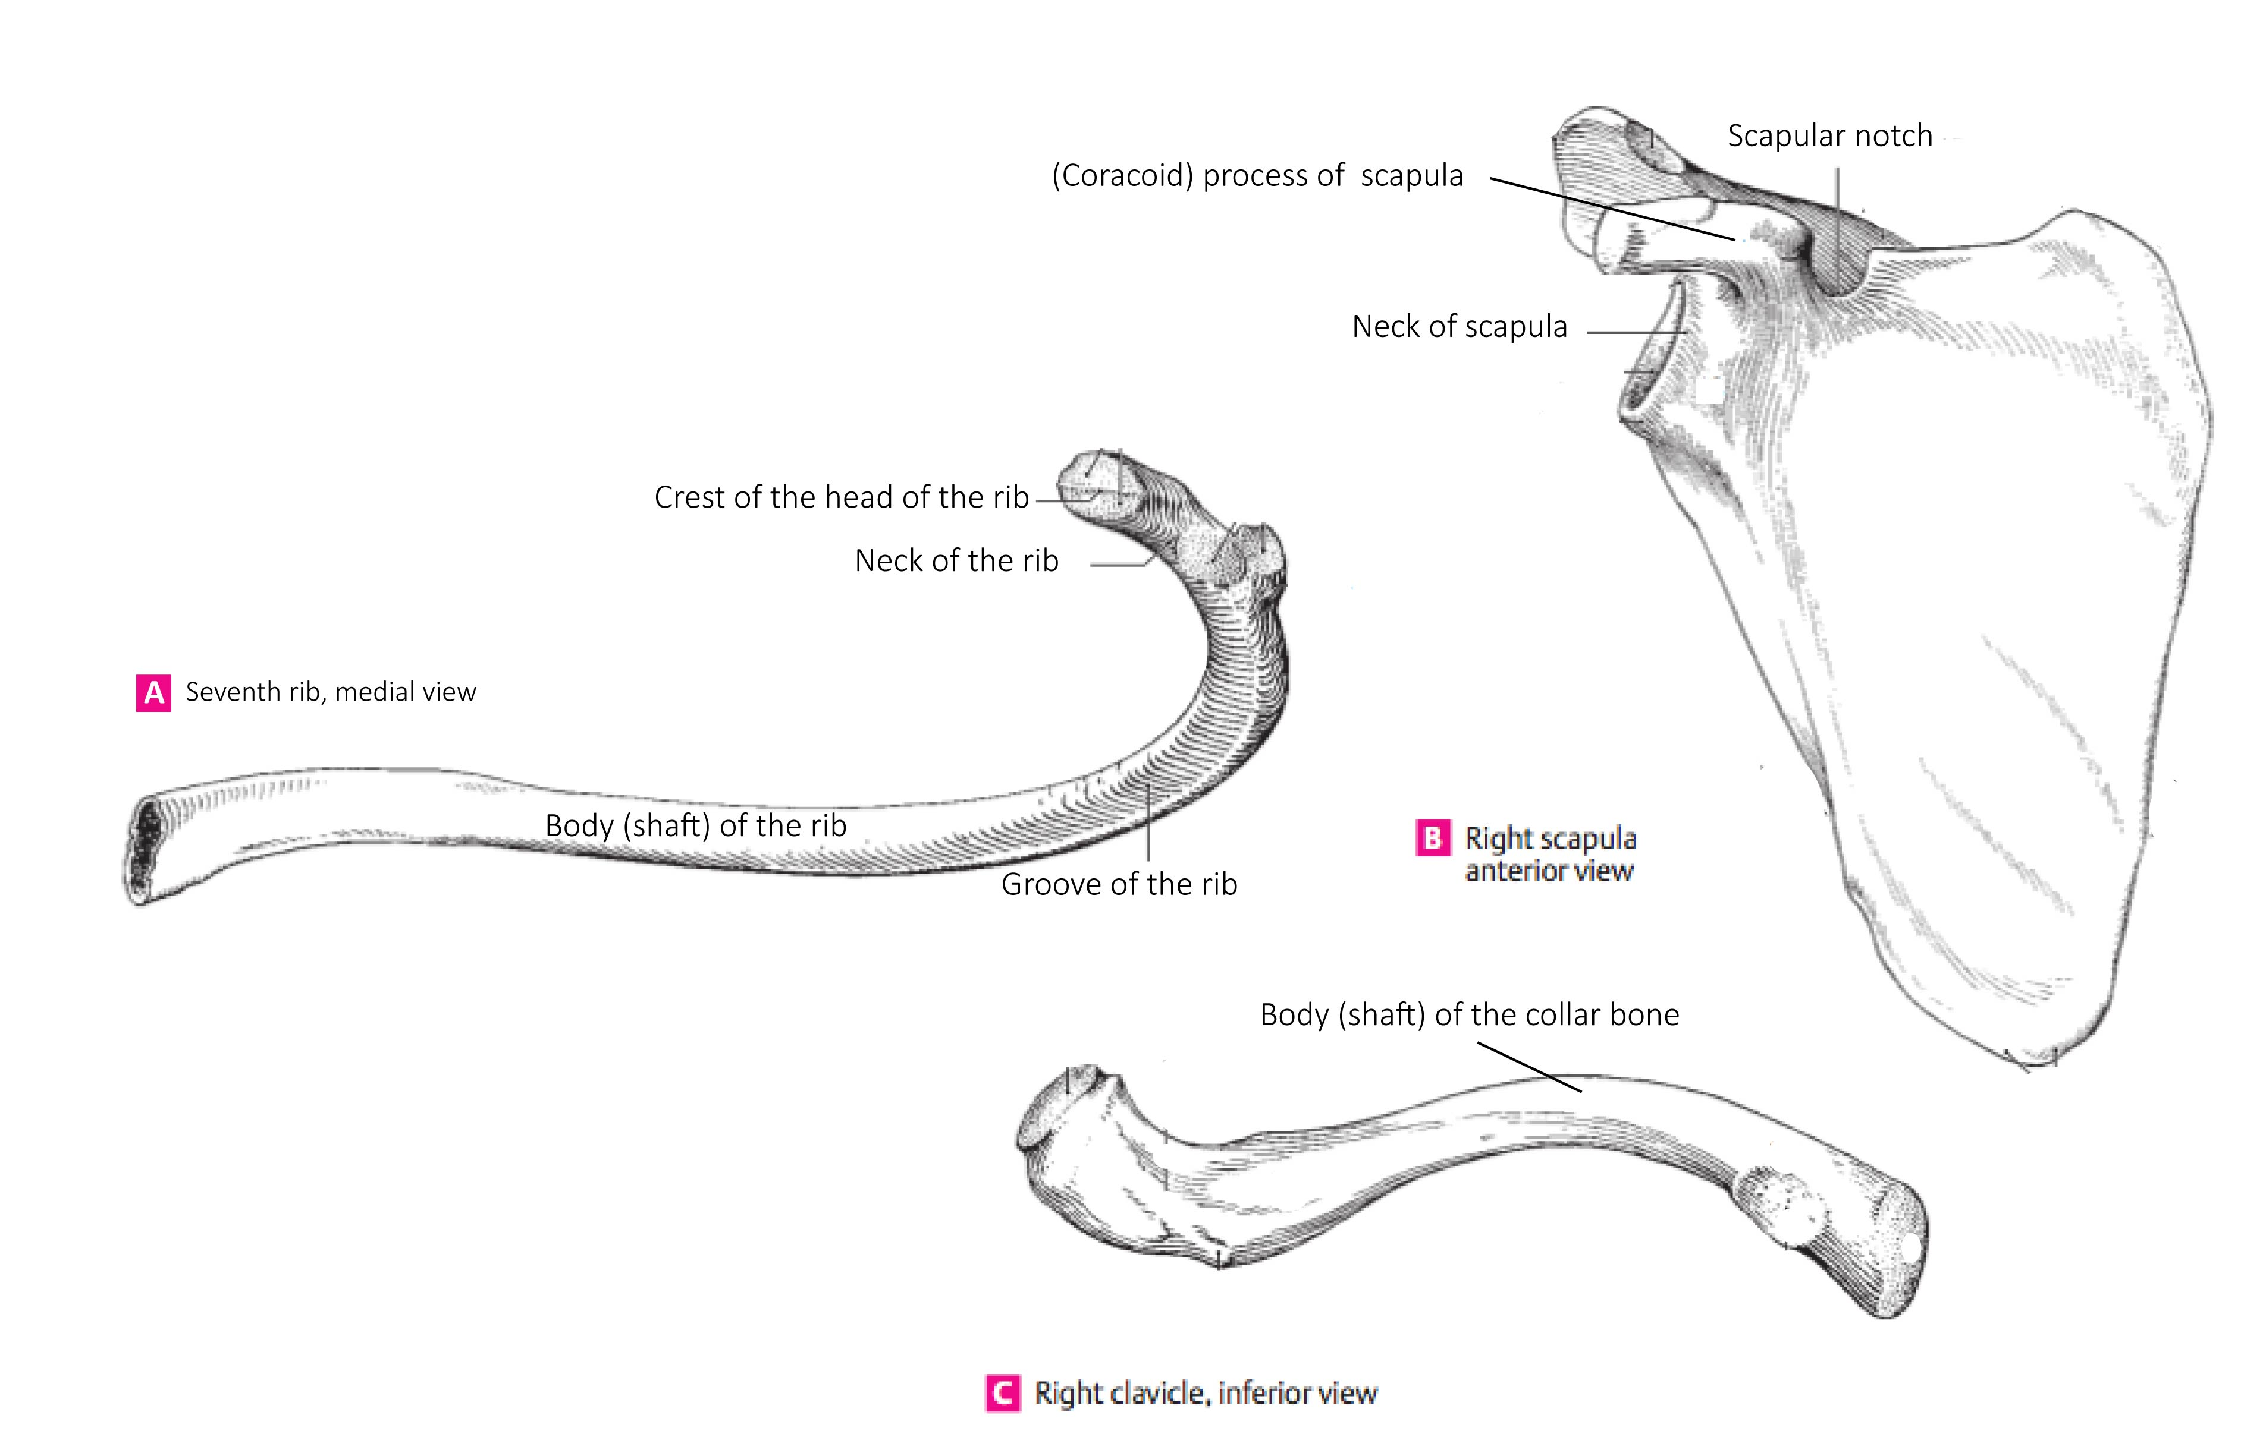

Slide 9
Prepositions/prepositional phrases

Slide 10
Read, guess the meaning
Corpus humanum e capite, collo, trunco, membris constat. Corpus hominis quattuor membra habet: duo membra superiora et duo membra inferiora. Membrum superius ex brachio, cubito, antebrachio, manu et digitis manus constat. Membrum inferius ex femore, genu, crure et pede constat. Collum caput cum trunco corporis iungit, ubi viscera locata sunt. Truncus ex thorace, abdomine et pelve constat. In cavitate thoracis cor et pulmones sunt.
Medicamenta in organismum humanum viis variis introducuntur: per os, per rectum, sub linguam, sub cutem, intra musculos.
Notes:
Čítať, úlohou študentov je identifikovať tučne zvýraznené slová a uviesť ich slovníkovú podobu. Cvičenie možno použiť aj ako malú písomku, preto som neuviedla do zadania uveďte slovníkuvú podobu slov.

Slide 11
Adjectives
Function : to qualify a noun
Forms : Alternate to reflect the gender, number and case of the noun
Gender > Male (m.) > Female (f.) > Neuter (n.)

Slide 12
Adjectives of the 1st and 2nd declension, dictionary entry
Magnus, a, um
Magnus magna magnum
m. f. n.
coxa cervix
oculus sulcus
crus arcus
bucca metatarsus
fibula hallux
Dexter, a, um
Dexter dextra dextrum
m. f. n.
coxa cervix
oculus sulcus
crus arcus
bucca metatarsus
fibula hallux

Slide 13
Agreed-attribute What is the correct adjective for the noun in the triangle?
dextra
dextrum
dexter
dextrum
genu
orbita
pes
dexter
dextrum
dextra
dextra
dexter

