Slide 1
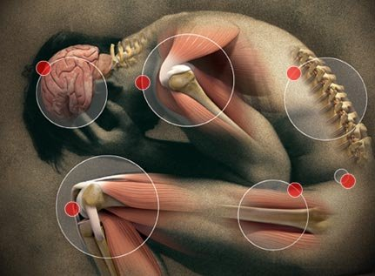
Pharmacotherapy of Pain

Slide 2
The Pain Pathway
1.) Peripheral nociceptors
bradykinin, substance P, histamine, acetylcholine, serotonin, ↓ pH (H⁺), prostaglandins (inflammatory mediators)
2.) Primary afferent fibres → dorsal horn of spinal cord
substance P, neurokinin A, glutamate
Inhibition of pain transmission on spinal level = descending pathways from midbrain and medulla to dorsal horn (serotonine, noradrenaline, GABA, enkefalins…)
3.) Spinothalamic and spinorecticular tract (spine → thalamus/brainstem reticular formation)
Localisation a emotional aspects of pain
4.) Thalamocortical pathway (thalamus → cortex)
Localisation, cause of pain + coordination of a response

Slide 3
NSAIDs
Non-steroidal antiinflammatory drugs
Inhibition of cyclooxygenase = ↓ prostaglandins
Treatment of „common“ pain, inflammatory diseases (gout, rheumatoid arthritis etc.), reduction of fever, combination of analgesics in stronger pain
Administration – p.o., rectal, topical, parenteral
Binding to plasma proteins – possible interactions
Good GIT absorption, passage into the synovial fluid, through BBB, placenta…
Classification: 1.) NON-SELECTIVE (COX1 ~ COX2)
2.) PREFERENTIAL (COX1 < COX2)
3.) SELECTIVE (COX1 <<< COX2)

Slide 4
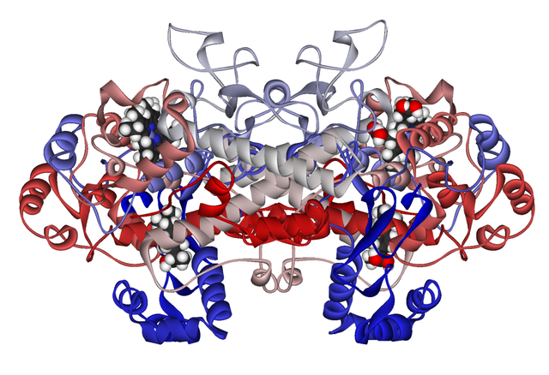
Cyclooxygenase
Isoenzymes: physiological, inducible, (CNS?)
COX1 – protection of gastric mucosa, kidney vasodilation, aggregation of thrombocytes
COX2 – site of inflammation, expressed due to ILs and TNF-α
COX3 – CNS?

Slide 5
Phospholipids
Essential FA
+ NOXIOUS STIMULI – LIPOCORTIN (ANNEXIN)
Phospholipase A2
NSAIDs –
Arachidonic acid
Glucocorticoids
COX
Cyclic endoperoxides
LOX
LEUKOTRIENS
PROSTAGLANDINS
PROSTACYCLIN
pain, inflammation, ↓ HCl, ↑ gastric mucus, uterus contractions, ↑ kidney perfusion, ↑ excretion of Na⁺ and water
allergy, leucotaxis
TROMBOXANS
vasodilation, inhibition of thrombocytes aggregation
vasoconstriction, ↑ thrombocytes aggregation

Slide 6
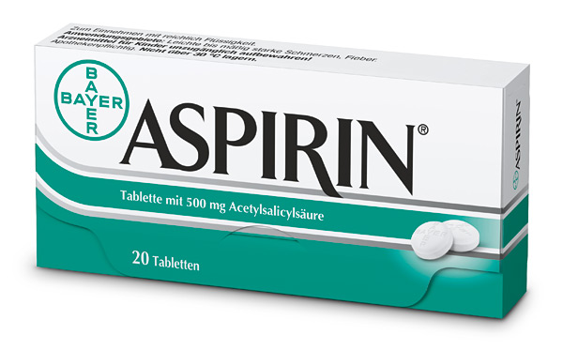
Acetylsalicylic acid
non-selective, irreversible COX inhibitor
plasmatic esterases: ASA → SA + AA
30-100 mg antiaggregant, 500 mg analgesic-antipyretic, over 1000 mg antiphlogistic
gastric absorption, possible irritation and ulceration of GIT (MoA + acidity), renal excretion
contraindications: children up to 12 years old – Reye‘s syndrome gastric ulcers, asthma before surgery
elderly – more susceptible to AE
„aspirin asthma“ = leucotriens predominance
other salicylates: choline salicylate, sulfasalazine…

Slide 7
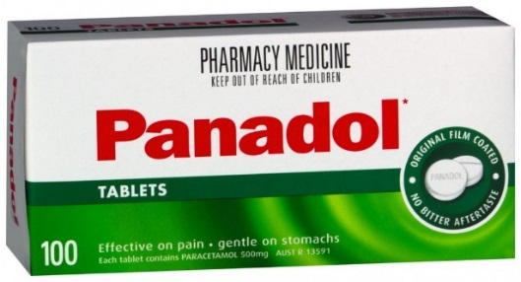
Paracetamol (Acetaminophen)
analgesic-antipyretic = without antiphlogistic and antiaggregant activity, no gastrotoxicity
mechanism of action unclear:
COX3? serotonin? TRPV ion channels?
dose: 10-15 mg/kg – frequently underdosed!
max. dose 4000 mg (8 tablets à 500 mg)
hepatotoxicity = NAPQI, detoxification by glutathione
overdosing – N-acetylcysteine therapy
combinations with tramadol, codein, propyphenazone, antispasmodics
suitable for children, elderly

Slide 8
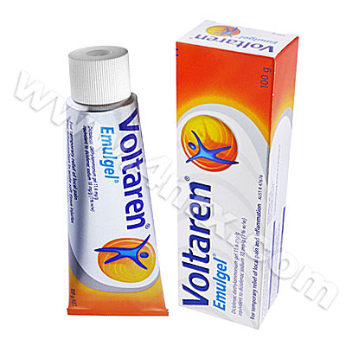
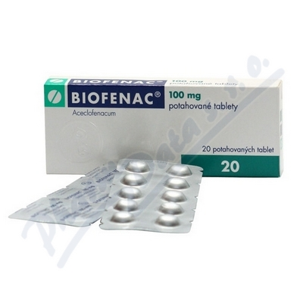
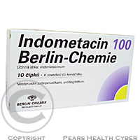
Acetic Acid Derivatives
Diclophenac
joint diseases → passage into synovial fluid
shorter half-life, capsules with prolonged release
cardiotoxicity – higher doses, contraindication
Aceclofenac
oral use only in the treatment of joint diseases
relatively low gastrotoxicity
also contraindicated for patients with CVD
Indomethacin
strong effect, only for short-term treatment
uricosuric effect = ↑ excretion of uric acid in the urine
used in acute gout attack
↑ gastrotoxicity, changes in blood count, headache and CNS disorders (all of them very frequent)
contraindicated for children

Slide 9
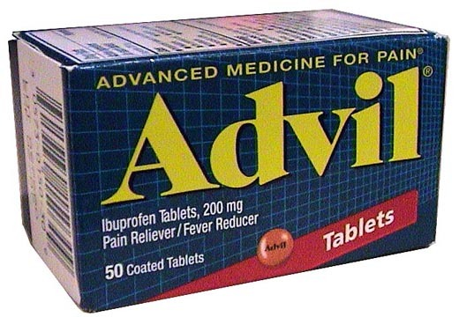
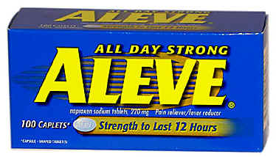
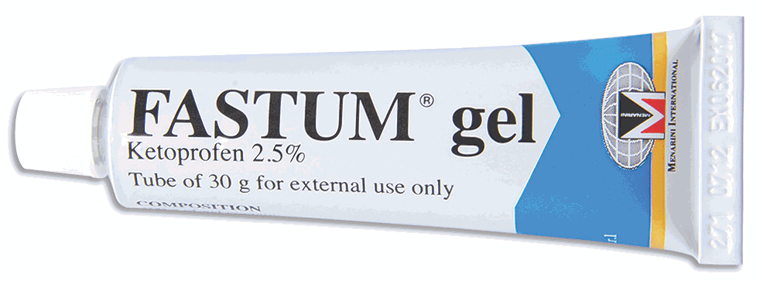
Propionic Acid Derivatives
Ibuprofen – good tolerability, safe
200-400 mg analgesic, antipyretic
1400-1600 mg antiphlogistic
max. dose 2400 mg
suitable for children
Ketoprofen – topical use (skin phototoxicity!)
Dexketoprofen – oral use
Flurbiprofen – topical oral use (lozenges/pastilles)
Naproxen – relatively low gastrotoxicity, longer half-life, good for headache and toothache

Slide 10
Other Important Analgesics
Propyphenazone – with paracetamol and caffeine
Metamizole
analgesic-antipyretic with mild antispasmodic effect
no antiphlogistic effect
myelotoxicity (changes in BC) → only for short-term use
combinations with antispasmodics (e.g. pitofenone, fenpiverinium)
Oxicams – long biological half-life:
Piroxicam – topical use, very long half-life (high risk of accumulation if taken orally)
Meloxicam – preferential effect on COX2
joint diseases – good passage into synovial fluid
reduction of GIT adverse effects
Lornoxicam – non-selective effect on COX

Slide 11
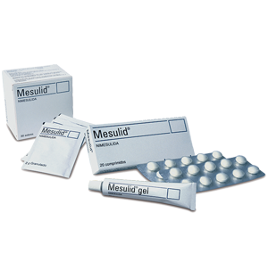
Preferential COX2 Inhibitors
COX1 < COX2
reduction of GIT adverse effects
analgesic, antiphlogistic and antiaggregant effect
Nimesulide
inhibits also collagenases and elastases degrading cartilages + ROS scavenger
hepatotoxicity → only for short-term use (15 days)
Meloxicam

Slide 12
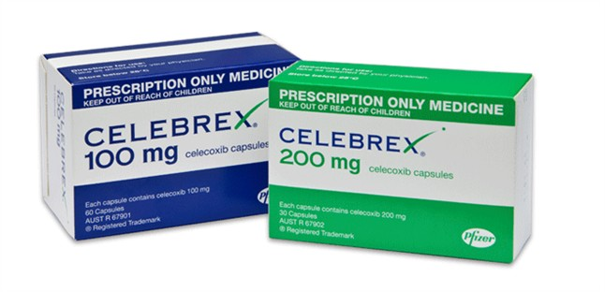
Selective COX2 Inhibitors = Coxibs
COX1 <<< COX2
minimal GIT adverse effects
joint diseases
cardiovascular AE – thrombotic diseases (due to inhibition of prostacyclin in endothelia)
contraindicated for patients with CVD
some of them withdrawn and lost market authorisation for severe CV and skin AE (rofecoxib)
celecoxib, parecoxib, etoricoxib

Slide 13
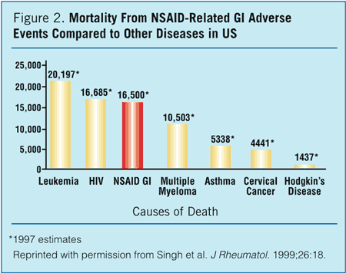
Protection against NSAIDs toxicity
use of safe dosage
fight against overuse, misuse, „dependence“
protection of gastric and intestinal mucosa (PPI – omeprazole)
education of both patients and health professionals
avoidance of drug-drug interactions

Slide 14
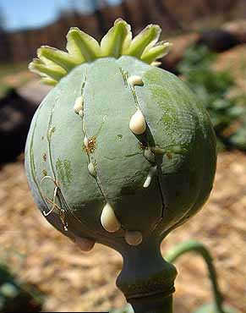
Opioid analgesics

Slide 15
Opiod analgesics = anodynes
OPIUM – Papaver somniferum, Papaveraceae
Bind to opiod receptors – changes in ion homeostasis of neurons → hyperpolarization, inability to conduct electrical impulses + changes in GABA signalling in specific parts of the brain
OPIOID RECEPTORS:
μ [mu] – supraspinal and spinal analgesia
κ [kappa] – spinal and peripheral analgesia
δ [delta] – spinal analgesia
σ [sigma] – dysphoria, hallucinations, changes in perception (not an opioid receptor, bud some opioids have affinity for it)

Slide 16
Classification of Opioids
According to their receptor effects:
1.) Agonists: a) strong effect (morphine, pethidine, methadone, fentanyl) b) medium and mild effect (codeine, dextropropoxyphene)
2.) Partial agonists (buprenorphine) and agonists-antagonists (butorphanol)
3.) Atypical opioids (tramadol, tilidine, tapentadol)
4.) Antagonists (naloxone, naltrexone)
According to their origin: a) endogenous (enkephalins, endorphins, dynorphins) b) natural (morphine, codeine…) c) semisynthetic (oxycodon, dihydrocodeine…) d) synthetic (pethidine, butorphanol, methadone, fentanyl...)

Slide 17
Opioid Agonists: Effects
mostly originate from activation of μ receptors
Central effects:
depression of CNS: sedation → somnolence → coma
depression of breathing – ↓ sensitivity of respiratory center
antitussive effect – ↓ sensitivity of cough center
emesis, nausea – first doses, irritation of area postrema
miosis – via n. oculomotorius
changes in hormonal levels: cortisol, ADH, GnRH → FSH, LH, testosteron…)
Peripheral effects:
↑ smooth muscle tone – constipation, urine retention, spasm of sphincters in GIT and GUT (contraindicated for colics!)
CVS – histamine liberation, vazodilation, postural hypotension
RESP – possible bronchoconstriction (histamine)

Slide 18
Opioid Agonists
Pharmacokinetics:
good absorption from GIT, but frequently high first pass effect (= not suitable for oral use)
pharmacologically active metabolites (e.g. codeine)
Addictive potential
dependency producing substances
tolerance – need for higher doses
craving for another dose
abstinence syndrome
Act No. 167/1998 Coll. on Dependency Producing Substances
instructions for prescription and use
methadone – substitution therapy for the addicted

Slide 19
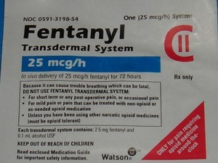
Opioid Agonists with Strong Effect
MORPHINE – 10 mg i.m., s.c., p.o., lasts 4-5 h
METHADONE – longer half-life, substitution therapy
OXYCODON, HYDROCODON
with paracetamol (acetaminophen)
PETHIDINE
Fentanils
the most effective opioids
lipophilic → good absorption
shorter effect → infusions, TTS
anesthesiology, algesiology
FENTANYL or FENTANIL
SUFENTANIL – 500 times more effective than morphine

Slide 20
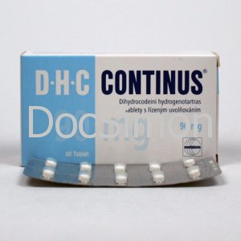
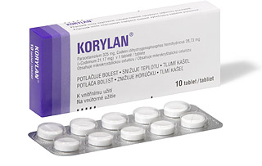
Opioid Agonists with Medium and Mild Effect
CODEINE
metabolised to morphine
analgesic – combined therapy (paracetamol)
antitussive: 10-30 mg
decreases secretion in bronchi and bronchioles
contraindicated for children
DIHYDROCODEINE
cancer pain
tablets with prolonged release

Slide 21
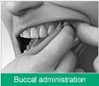
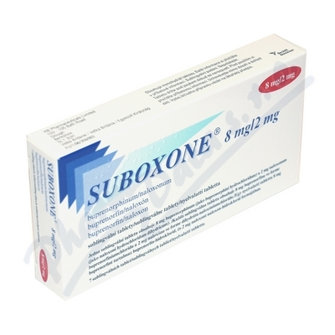
Partial agonists and Agonists-Antagonists
BUPRENORPHINE
partial agonist of μ opioid receptors
strong FP effect – parenteral administration (buccal tablets)
RMP Suboxone – combination therapy with naloxone (opioid addiction)
↓ AE, ↓ dependency
mild analgesic effect
BUTORPHANOL
PENTAZOCINE
κ a δ agonist
μ antagonist
mild analgesic effect
σ and κ activation = hallucinations, euforia, dysforia, abnormal dreams

Slide 22
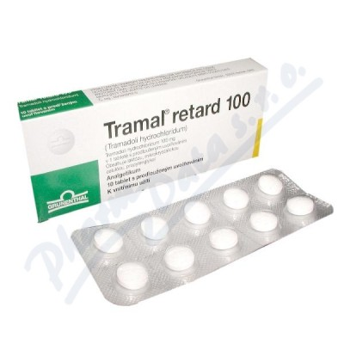
Atypical Opioids
TRAMADOL
low affinity for μ receptors + blockade of 5-HT and NA re-uptake (neurotransmitters of pain pathway)
max. dose 600 mg
frequently causes nausea and emesis
oral drops, tablets, modified release
advantages: no attenuation of respiratory center
no constipation
TILIDIN, TAPENTADOL

Slide 23
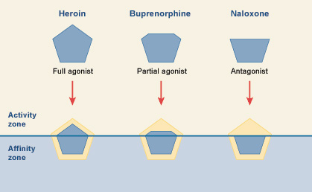
Opioid Antagonists
treatment of acute opioid intoxication and overdosing
treatment of addiction to opioids, heroin
treatment of alcohol addiction (nalmefene)
quick effect (in minutes), lasts 2-3 h
parenteral use, oral use (nalmefene)
NALOXONE
NALTREXONE
NALMEFENE

Slide 24
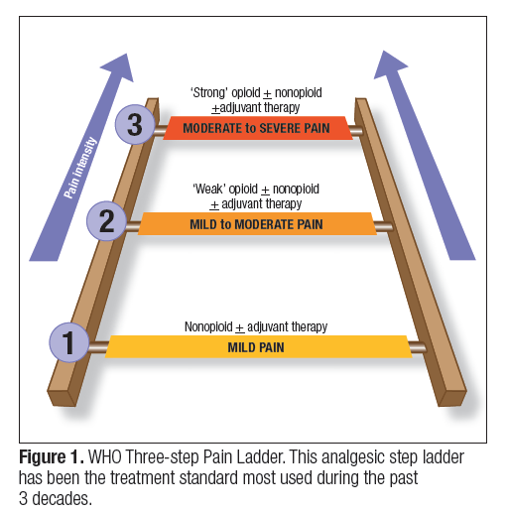
Strategy in the Treatment of Pain
WHO PAIN LADDER
1. CAUSAL TREATMENT
cause of pain
2. SYMPTOMATIC TREATMENT
pain itself

Slide 25
Anti-rheumatics – Therapy of RA
DMARDs – disease-modifying antirheumatic drugs
SULFASALAZINE
bowel microflora decomposition → 5-aminosalicylic acid and sulfapyridine
GOLD COMPOUNDS
e.g. sodium aurothiomalate
inhibition of phagocytosis
CHOLOROQUIN
originally for treatment and prevention of malaria
inhibition of chemotaxis of leukocytes
METHOTREXATE
immunosupressive therapy
folic acid antimetabolite
used in high dosis as cytostatic drug (cancer therapy)
highly effective
effect starts after 3-4 weeks

Slide 26
Anti-rheumatics
Targeted therapy:
Targeted interference with immune cells and mediators
Monoclonal antibodies, genetically engineered proteins…
Expensive, prescribed only when conventional treatment fails
Mechanisms of action:
anti-TNF-α drugs: ADALIMUMAB, infliximab, etanercept, certolizumab, golimumab
blockade of IL-6 receptor: tocilizumab
blockade of IL-1 receptor: anakinra
interference with T and B lymphocytes: abatacept, rituximab
NSAIDs:
Alleviation of morning joint stiffness
Analgesic and antiinflammatory effect
DICLOFENAC, IBUPROFEN; MELOXICAM, CELECOXIB and the others…

Slide 27
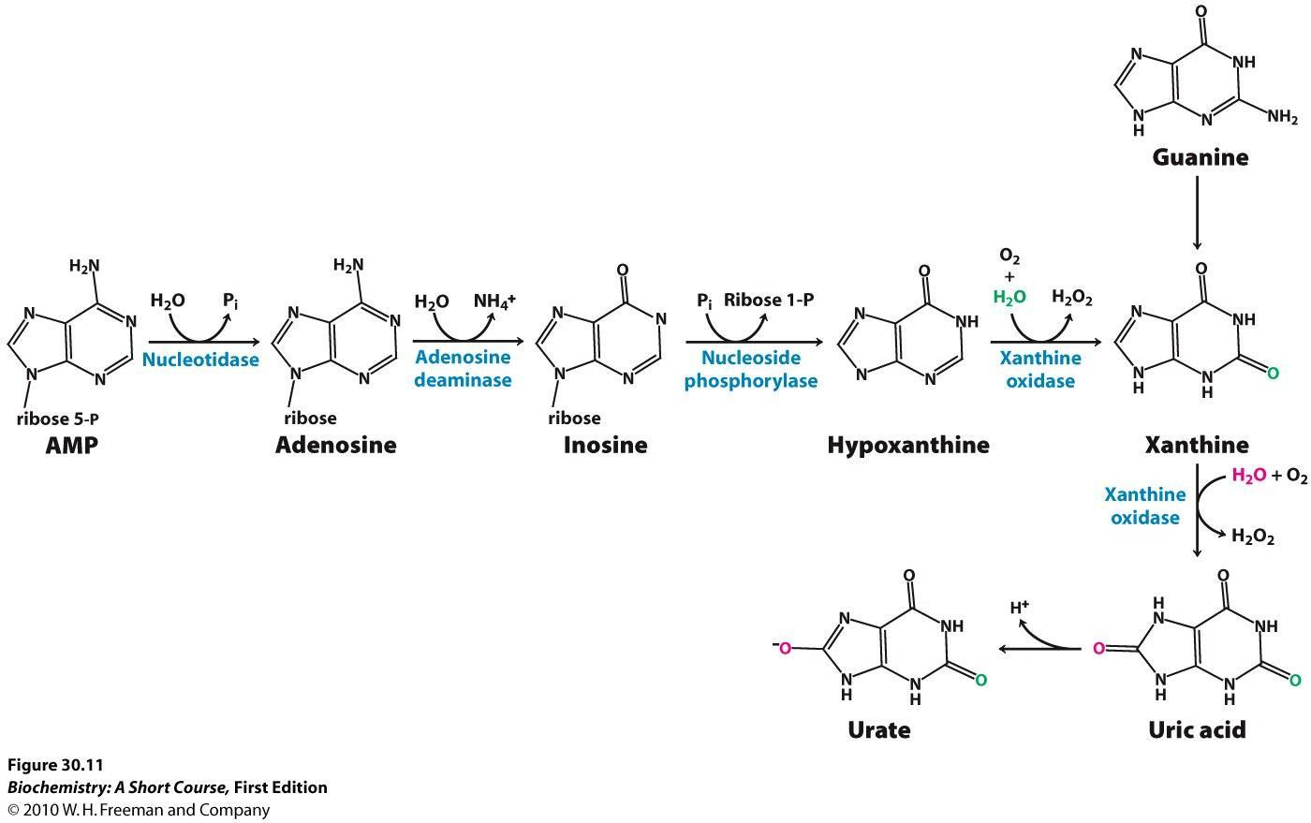
Antiuratics – Therapy of Gout
Chronic therapy:
inhibition of uric acid synthesis – inhibition of xanthinoxidase (ALLOPURINOL, FEBUXOSTAT)
diet – low proteins, low salt, low caffeine
treatment of pain – NSAIDs
Acute gout attack:
infection, dehydration, consumation of alcohol, meat…
strong pain, hyperesthesia, inability to move…
COLCHICINE
binds to tubulin of phygocytes → inhibition of their migration → inhibition of inflammation in the joint
influences other cells (epithelia) – AE: diarrhea
GLUCOCORTICOIDs inj. intraarticularly
NSAIDs (e.g. indomethacin – uricosuric effect)

