Slide 1
RESPIRATORY SYSTEM

Slide 2
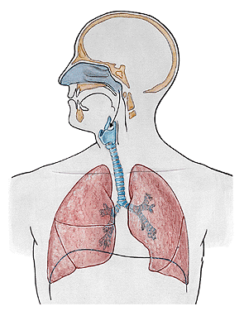

Slide 3
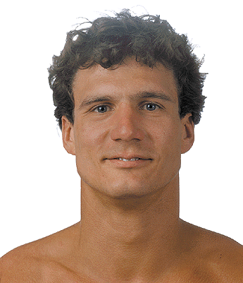
NASUS EXTERNUS
Radix nasi
Dorsum nasi
Apex nasi
Nares
Alae nasi

Slide 4
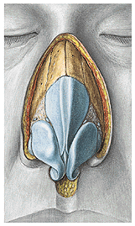
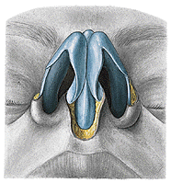
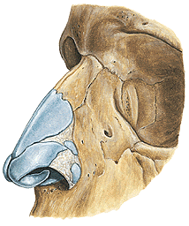
Cartilago nasi lateralis
Cartilago alaris major
- crus laterale
- crus mediale
Cartilagines alares minores
Cartilagines nasales accessoriae

Slide 5
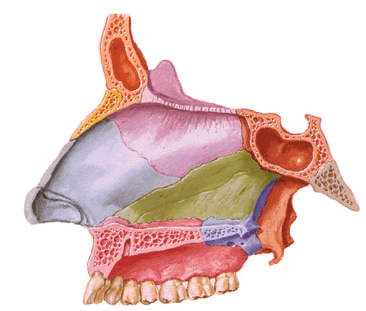
SEPTUM NASI
Cartilago alaris major – crus mediale
Cartilago septi nasi
Lamina perpendicularis ossis ethmoidalis
Vomer

Slide 6
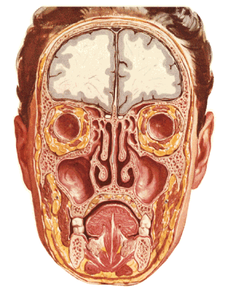
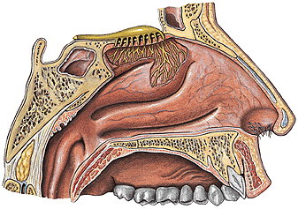
CAVITAS NASI
- vestibulum – limen, vibrisae, recessus apicis nasi
- cavitas nasi propria – meatus nasi sup., medius, inf.
meatus nasi communis, meatus nasopharyngeus, choanae

Slide 7
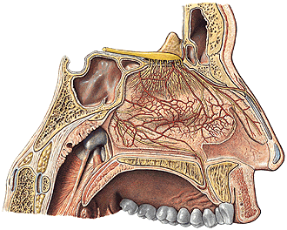
SEPTUM NASI
- pars membranacea
- pars cartilaginea
- pars ossea

Slide 8
Superior wall: cartilago nasi lateralis, os nasale,
pars nasalis ossis frontalis, lamina cribrosa
ossis ethmoidalis, corpus ossis sphenoidalis
Inferior wall:
processus palatinus
maxillae, lamina
horizontalis ossis
palatini
canalis incisivus

Slide 9
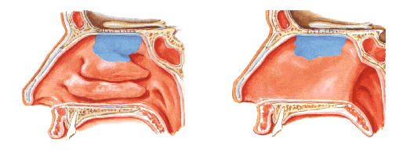
NASAL MUCOSA
Regio respiratoria
plexus cavernosi - epistaxis
Regio olfactoria

Slide 10
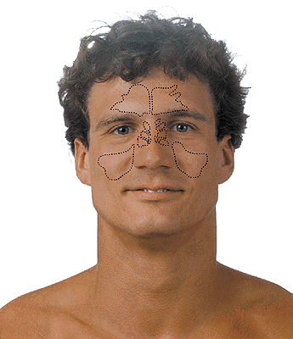
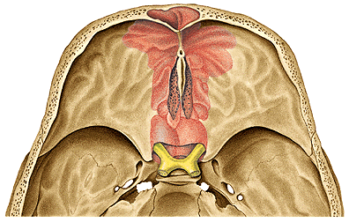
SINUS PARANASALES
Sinus maxillaris
Sinus frontalis
Sinus ethmoidales
Sinus sphenoidalis

Slide 11
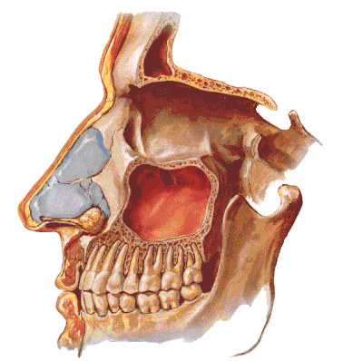
SINUS MAXILLARIS
(Antrum of Highmore)

Slide 12
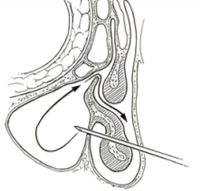
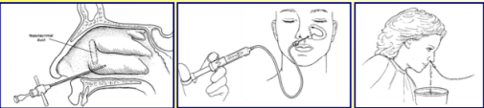
Maxillary sinus puncture (Antral washout)

Slide 13
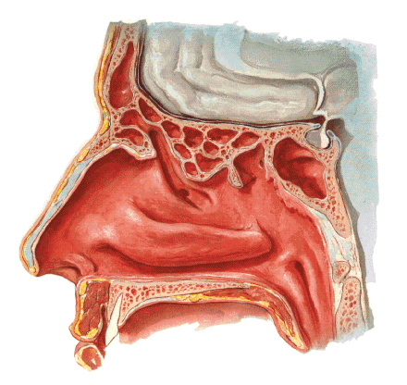
SINUS FRONTALIS
septum sinuum frontalium
Hiatus semilunaris

Slide 14
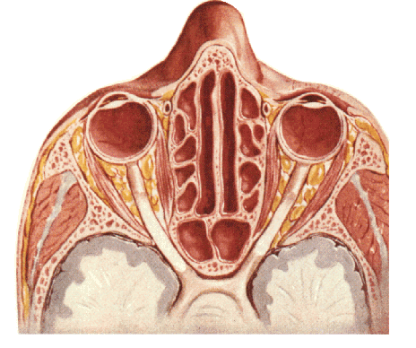
Hiatus semilunaris
SINUS ETHMOIDALES
(CELLULAE ETHMOIDALES)
SINUS SPHENOIDALIS
septum sinuum sphenoidalium
apertura sinus sphenoidalis

Slide 15
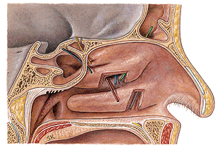
Meatus nasi inf. – ductus nasolacrimalis
Meatus nasi medius – hiatus semilunaris – sinus maxillaris,
sinus frontalis, cellulae ethmoidales anteriores
Meatus nasi sup. – cellulae ethmoidales posteriores, sinus
sphenoidalis

Slide 16
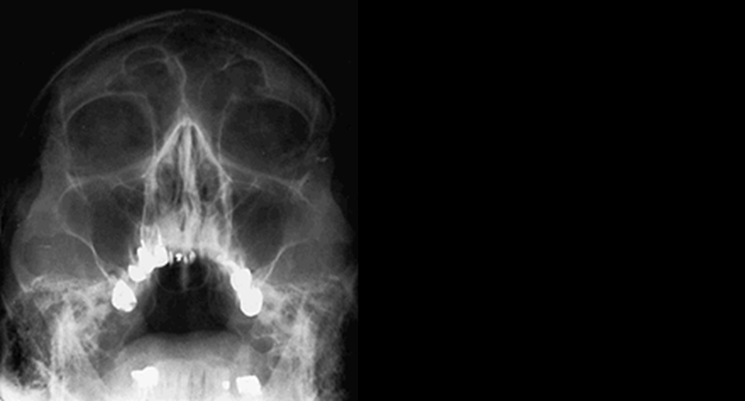
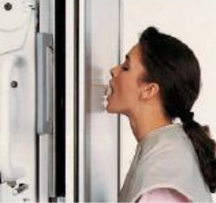
Waters' (Occipitomental) view

Slide 17
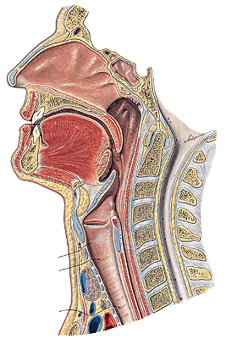
PHARYNX

Slide 18
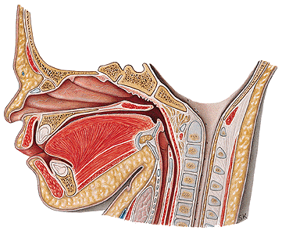
LARYNX
NEONATE
ADULT

Slide 19
Prominentia laryngis

Slide 20
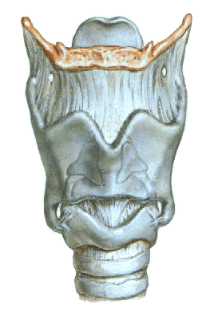
CARTILAGINES LARYNGIS:
Cartilago thyroidea
Cartilago cricoidea
Cartilago epiglotica
Cartilago arytenoidea
Cartilago corniculata
Cartilago cuneiformis

Slide 21
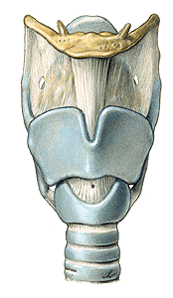
LARYNX
Membrana thyrohyoidea
Cartilago thyroidea
lamina dextra
lamina sinistra
incisura thyroidea sup.
incisura thyroidea inf.
cornua superiora
cornua inferiora
facies art. cricoidea
linea obliqua

Slide 22
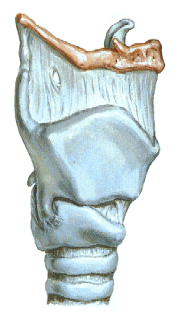
- linea obliqua

Slide 23
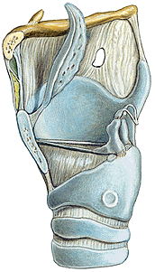
CARTILAGO CRICOIDEA
-arcus
-lamina
-facies articularis
arytenoidea
-facies articularis
thyroidea

Slide 24
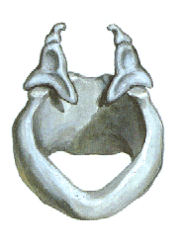
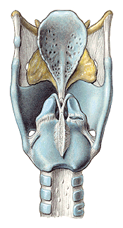
CARTILAGO ARYTENOIDEA
- apex
- basis
- facies art. cricoidea
- processus vocalis
- processus muscularis
- facies medialis
- facies posterior
- facies anterolateralis

Slide 25
CARTILAGO EPIGLOTTICA
petiolus epiglottidis
lamina
CARTILAGO CORNICULATA
CARTILAGO CUNEIFORMIS

Slide 26
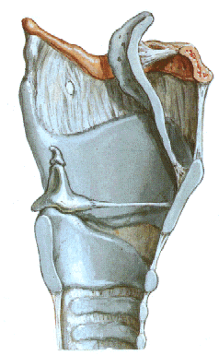

Slide 27
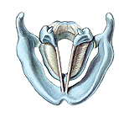
CONUS ELASTICUS
lig. cricothyroideum- coniotomy
lig. vocale – plica vocalis
Lig. cricotracheale

Slide 28
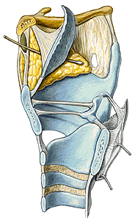
Lig thyroepiglotticum
Lig. hyoepiglotticum
Spatium praeepiglotticum
MEMBRANA QUADRANGULARIS
lig. ventriculare – plica vestibularis
MEMBRANA FIBROELASTICA
LARYNGIS = conus elasticus +
membrana quadrangularis

Slide 29
ARTICULATIO CRICOARYTENOIDEA
ARTICULATIO CRICOTHYROIDEA

Slide 30
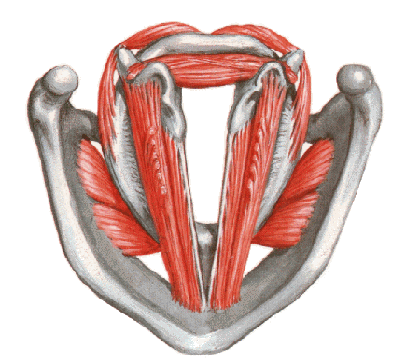
MUSCULI LARYNGIS
Rima glottidis – pars intermembranacea
– pars intercartilaginea

Slide 31
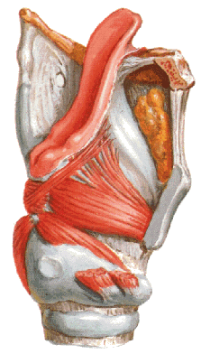
M. thyroarytenoideus - m. vocalis
(m. thyroepiglotticus)

Slide 32
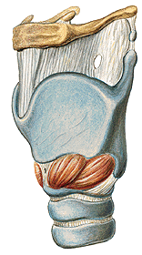
M. cricothyroideus

Slide 33
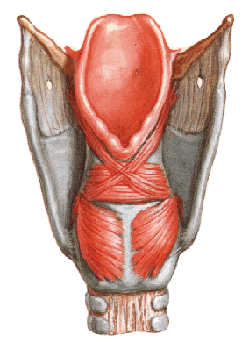
M. cricoarytenoideus post.
(posticus) - respiration

Slide 34
M. cricoarytenoideus lateralis
M. arytenoideus transversus et obliquus
– phonation
(m. aryepiglotticus)

Slide 35
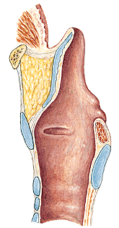
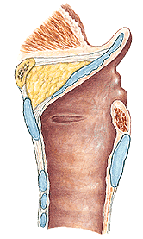
M. thyroepiglotticus M. aryepiglotticus

Slide 36
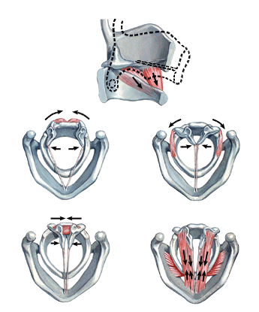
M. cricothyroideus
M. cricoarytenoideus
lateralis
M. cricoarytenoideus
post.
M. arytenoideus
- transversus
- obliquus
M. thyroarytenoideus

Slide 37
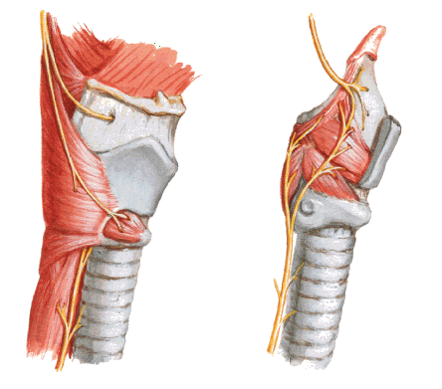
N. laryngeus sup.
N. laryngeus inf. – N. laryngeus recurrens

Slide 38
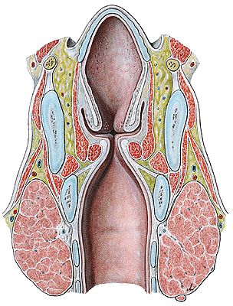
CAVITAS LARYNGIS
vestibulum laryngis
plicae vestibulares
rima vestibuli
-ventriculus laryngis
sacculus laryngis
plicae vocales
rima glottidis (glottis)
-cavum infraglotticum

Slide 39
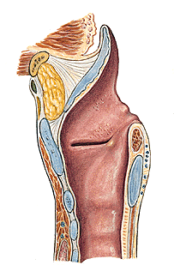
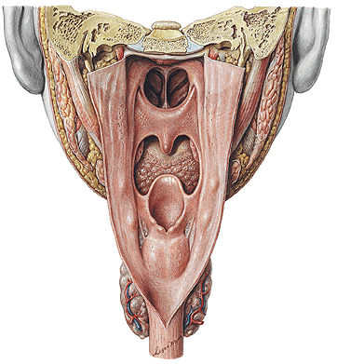
CAVITAS LARYNGIS
aditus laryngis-plicae aryepiglotticae (tuberculum cuneiforme
et corniculatum), plica interarytenoidea, (incisura inter-
arytenoidea)

Slide 40
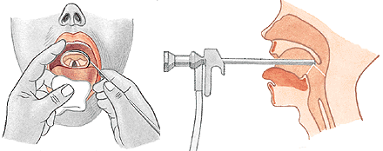
LARYNGOSCOPY
indirect
direct

Slide 41
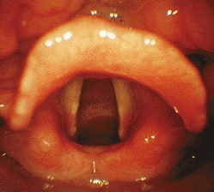
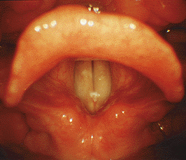
RESPIRATION
PHONATION

Slide 42
Vocal Cords up close while singing
http://www.youtube.com/watch?v=-XGds2GAvGQ

Slide 43
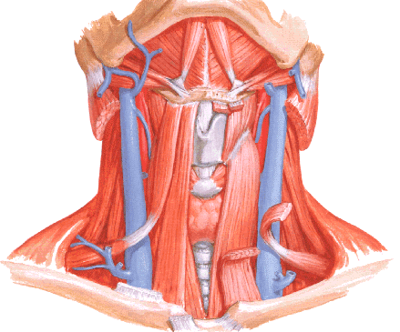

Slide 44
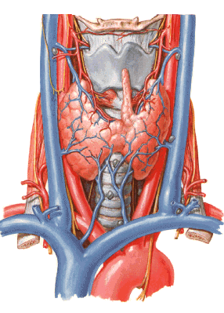

Slide 45
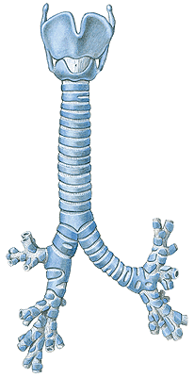
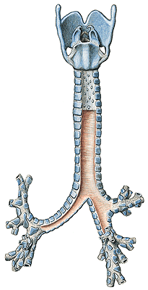
TRACHEA
pars cervicalis
pars thoracica
bifurcatio tracheae
- carina tracheae
15-20 cartilagines tracheales
ligg. anularia
paries membranaceus
(m. trachealis)
- glandulae tracheales

Slide 46
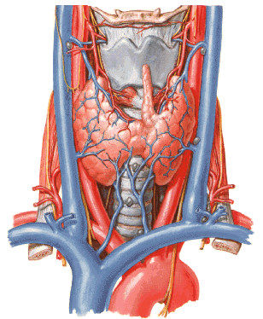
TOPOGRAPHY OF THE TRACHEA
isthmus glandulae thyroideae
vv. thyroideae inferiores
a. carotis communis
v. jugularis int.
n. vagus
oesophagus
n. laryngeus recurrens
truncus brachiocephalicus
v. cava sup.
v. brachiocephalica sinistra
arcus aortae

Slide 47



Slide 48

CONIOTOMIA (CRICOTHYROTOMIA)
TRACHEOTOMIA SUPERIOR
TRACHEOTOMIA INFERIOR
TRACHEOSTOMIA

Slide 49



Slide 50


GLANDULA THYROIDEA – lobus dexter
- lobus sinister
- isthmus
- lobus
pyramidalis
- thyroid hormone
- calcitonin

Slide 51


Slide 52

GLANDULAE PARATHYROIDEAE –sup. et inf.
Parathormone (parathyroid hormone; PTH)

Slide 53

Arbor bronchialis
BRONCHI
-principales
-lobares
-segmentales

Slide 54


PULMO DEXTER
lobus superior
medius
inferior
fissura obliqua
fissura horizontalis
PULMO SINISTER
lobus superior
inferior
fissura obliqua
incisura cardiaca
lingula pulmonis sinistri
apex pulmonis
basis pulmonis
(facies diaphragmatica)
facies costalis
margo anterior
inferior
posterior

Slide 55


FACIES MEDIALIS
hillum pulmonis
radix pulmonis
lig. pulmonale
sulcus a. subclaviae
sulcus costae primae
sulcus oesophageus
impressio cardiaca
sulcus v. cavae sup.
sulcus v. azygos
sulcus aorticus

Slide 56


SEGMENTA BRONCHOPULMONALIA DEXTRA
s. apicale 4. s. laterale 6. s. apicale
s. posterius 5. s. mediale 7. s. basale mediale
s. anterius 8. s. basale anterius
9. s. basale laterale
10. s. basale posterius

Slide 57


SEGMENTA BRONCHOPULMONALIA SINISTRA
1+2. s. apicoposterius 6. s. apicale
3. s. anterius (7. s. basale mediale)
4. s. lingulare superius 8. s. basale anterius
5. s. lingulare inferius 9. s. basale laterale
10. s. basale posterius

Slide 58

Bronchioli terminales
Bronchioli respiratorii
Ductuli alveolares
Sacculi alveolares
Alveoli pulmonis
Asthma bronchiale

Slide 59


Truncus pulmonalis → a. pulmonalis dx. et sin.
Vv. pulmonales → atrium sinistrum
Aorta thoracica → aa. bronchiales
Vv. bronchiales → v. azygos, v. hemiazygos accessoria

Slide 60


PLEURA - visceralis
- parietalis - costalis
- diaphragmatica
- mediastinalis
Cavitas pleuralis
Cupula pleurae – lig. scaleno-,vertebro-, costopleurale

Slide 61

Recessus pleurae:
r. costodiaphragmaticus
r. costomediastinalis
r. phrenicomediastinalis
Pneumothorax
Area interpleuralis sup. (thymica)
Area interpleuralis inf. (pericardiaca)

Slide 62



MEDIASTINUM
- superius
- inferius - anterius
- medium
- posterius

Slide 64


Slide 65
MUSCULI THORACIS

Slide 66

EXTRINSIC MUSCLES
M. pectoralis major
M.pectoralis minor
M. subclavius
M. serratus ant.

Slide 67


Slide 68

M. sternalis

Slide 69

INTRINSIC MUSCLES
M. intercostales externi
M. intercostales interni
M. intercostales intimi

Slide 70
Membrana intercostalis externa

Slide 71

M. transversus thoracis

Slide 72

DIAPHRAGM
Centrum tendineum
- foramen VCI
Pars sternalis
Pars costalis
Pars lumbalis
- crus dextrum
- crus sinistrum
- lig. arcuatum medianum
- lig. arcuatum mediale
- lig. arcuatum lat.

Slide 73

Hiatus esophageus
Hiatus aorticus

Slide 74


Slide 75

EXPIRATION
INSPIRATION

Slide 76
Illustrations and photographs were copied from:
Atlas der Anatomie des Menschen/Sobotta.
Putz,R., und Pabst,R. 20. Auflage. München:
Urban & Schwarzenberg, 1993
Netter: Interactive Atlas of Human Anatomy.
Windows Version 2.0

