Slide 1
Higher cognitive functions - reading
Kamil Ďuriš, M.D.-Ph.D
Matyáš Jelínek

Slide 2
Please, let us use your anonymous results. They will be used for improving the quality of teaching and in a scientific study measuring reading capability of students of the Medical Faculty.

Slide 3
Introduction
Reading and working with a text is one of the highest cognitive functions
Understanding and working with longer and more difficult texts, however, gradually declines
It may be in correlation with the development of audiovisual systems and social networks
The environment and other stimuli play a key role (disturbing vs. peaceful environment)

Slide 4
Project
This project serves as a pilot study, according to its results it will be considered to be included in the following years as a regular lesson
If it would be successful, this information would be a valuable resource for improving teaching
The purpose of this project is to highlight the issues of reading as one of the highest cognitive functions and to monitor reading development over time

Slide 5
Practicum
This exercise will consist of a battery of three tests that you will perform once with ambient music and once with a disturbing stimulus
Based on these tests, your reading speed, word processing, working memory, knowledge integration and text comprehension will be measured
It will be measured and integrated using a CC-R model (Cognitive Componets and Resource)

Slide 6
Speed reading task
Reading speed is based on the number of words read in a period of time
At the end of the task there will be five questions, the questions are used to verify whether the student actually reads the text or just skipped the text without remembering the key information
Instructions will be available before the task begins
Working one version should not take more than 20 minutes

Slide 7
CPT (Component Processes Task)
It measures individual differences in different written text components
It consists of three short paragraphs that describe the relationship between two real and three unrealistic objects (made up words)
Working one version should not exceed 15 minutes

Slide 8
Working memory task
A series of two sentences will be read to you out loud. One of them will make sense, the other will not
Your task will be to determine which sentence makes sense and write the last word of each sentence
Duration of one version should be within 15 minutes

Slide 9
Conclusion
This presentation will be available in the IS system
Please do not disturb others at work, to make the results as objective as possible

Slide 10
When you’re done with these tasks you can leave

Slide 12
Reading
Reading is an understanding of a written form of a language
It is a complex cognitive process decoding symbols to create meaning
It is the means of communication, language and communication

Slide 13
Genetic bases of reading
While linguistic influence on forming speech and reading ability is undeniable, it has been very convincingly proven that language learning (both written and spoken) is subject to significant genetic influences
For example, developmental dyslexia had little correlation with the home literacy environment, but instead is significantly impacted by gene transfer which increases a person's susceptibility

Slide 14
Genetic bases of reading
Thanks to the GWAS (Genome Wide Association Scan) project, several single nucleotide polymorphisms (SNPs) have been found in genes influencing reading and language skills
Namely, the linkage between the CCDC136, FLNC (Flamine C) genes on 7q32.1 and RBFOX2 to 22q12.3
In connection with the expression of the recessive allele in RBFOX2, gray matter reduction in connection with the expression of the recessive allele in RBFOX2, gray matter reduction in the left parietal gyrus, right gyrus temporalis medius and pars opercularis and triangularis on lower frontal gyrus

Slide 15
Genetic bases of reading
So far there is no study that correlates gene alleles, gray matter findings in the brain, and language and reading abilities

Slide 16
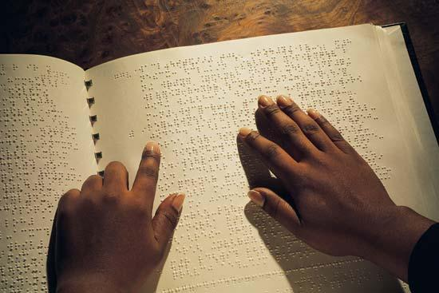
Sight and reading
Eye apparatus, eye tractus, primary and secondary vision centers, and other higher association areas are indispensable for reading ability
With a variation for Braille where the cerebral cortex receives a tactile stimulus

Slide 17
Mechanism of light signal transformation into an electric
Absorption of visible light photons and their transformation into an electrical signal in the photoreceptor is a key factor in the vision process
The impact of a certain amount of light of certain wavelength on the external segment membrane disk system causes a breakdown of the photopigments
The chemical process in the eye then leads to a voltage change - the generator potential - on the surface of the photoreceptor

Slide 18
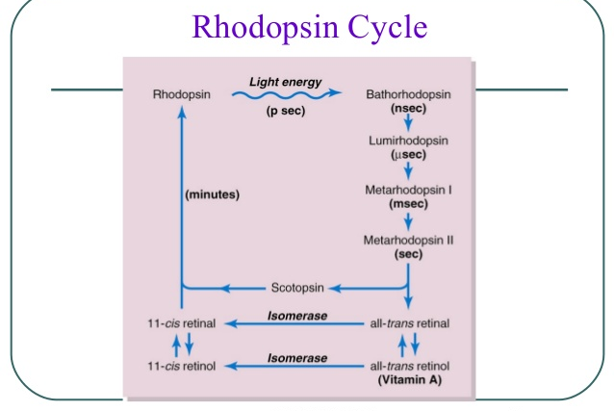

Slide 19
Mechanism of light signal transformation into an electric
The generator potential has a character of hyperpolarization
Light effect closes the Na + channels in the outer photoreceptor segment -> increases the negative membrane voltage (-70 mV) towards the equilibrium potential for the K +
Hyperpolarization occurs, voltage change spreads to the synaptic terminal where it mediates further local voltage changes on the membranes of bipolar and horizontal cells

Slide 20
Mechanism of light signal transformation into an electric
The link between the decay of photopigmentation and the generation of the generator potential is cGMP
Na + channels are kept open in the dark due to the presence of cGMP
Closure of Na + channels when enhancing the retina is linked to a decrease in cGMP

Slide 21
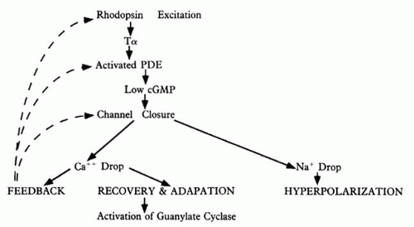

Slide 22
Visual pathway
It is a sum of neurons that transmit visual information from the eye into the corresponding cortical projection area of the CNS
The tract consists of four nerve cells
The first neurons are photoreceptors, the second bipolar cells, the third multipolar retina neurons
The neurits of the third neurons form the optic nerve that protrudes from the eyeball, some fibers cross in the chiasma opticum

Slide 23
Visual pathway
As tractus opticus it enters the CNS, where it ends on the fourth neurons in the nucleus corporis geniculati lateralis
Neuritis of this nucleus extends through the internal capsule as radiation optic into the visual cortical region near sulcus calcarinus in lobus occipitalis

Slide 24
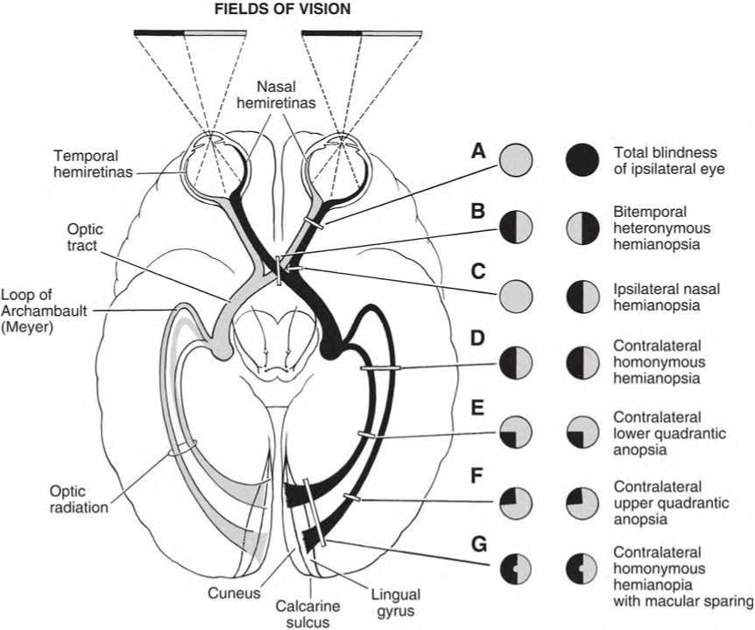

Slide 25
Secondary visual cortical regions
Parastrial cortical region - cortical stripe encircling the primary visual cortex
Mediotemporal visual cortical region - at the bottom and adjacent upper and lower quarter of sulcus temporalis superior
Inferotemporal visual cortical region - on lateral of the temporal lobe under the anterior two-thirds of sulcus temporalis superior
Rear parietal cortical region - localization roughly corresponds to the location of lobulus parietalis superior et inferior, the caudal part

Slide 26
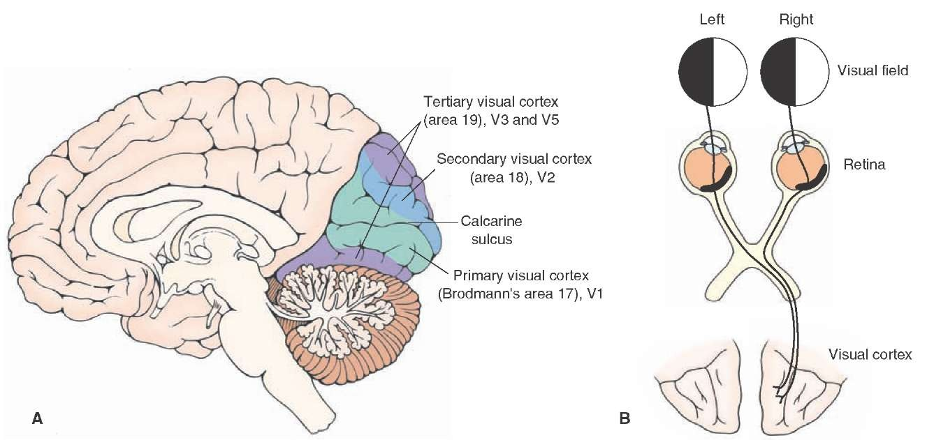

Slide 27
Reading and comprehension
A number of brain centers are involved in the process of reading and understanding written text
Temporal lobe, which is responsible for phonological awareness and decoding of different sounds
The Broca area in the frontal lobe, which controls speech production and language comprehension

Slide 28
Reading and comprehension
Gyrus angularis and supramarginalis, which connect different parts of the brain so that the letters can be combined into words
Also important is the white matter, specifically the nucleus arcuatus, which connects the speech centers of the brain, and the fasciculus longitudinalis inferior, which connects the speech centers with the visual cortex

Slide 29
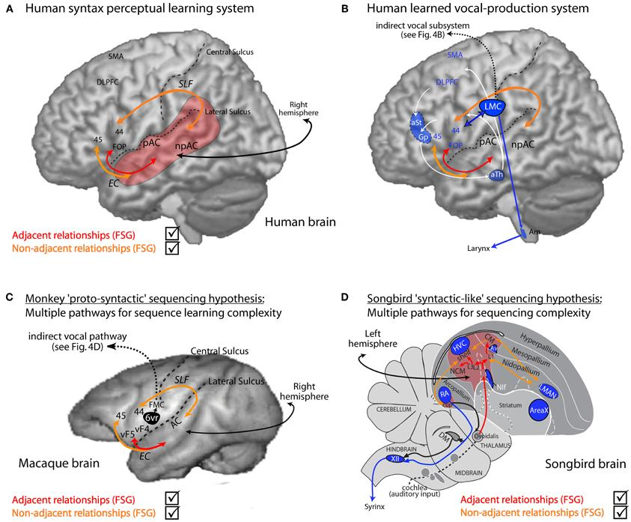

Slide 30
Theory of reading
There are two basic theories of reading learning in the brain, recently there has been a synthesis between these two
The first is a so-called lexical way, where the reader searches for words he/she sees in his/her mental dictionary and assigns a sound to them
The second so-called sublexical way, says the reader analyzes the word letter by letter, assigns them a sound and reads the word

Slide 31
Theory of reading
The lexical way works in the case of proficient readers in most words because they are very likely to have seen them before and are able to quickly recall them
The sublexical path works primarily in children who learn to read, or in adults with new or made up words

Slide 32
Cognitive functions
Higher cognitive functions are the highest degree of cognitive (conscious) processes that are necessary to control thought and behavior
They include, for example: thinking, attention, caution, memory, ability to speak, learn, read, plan, solve problems
Cognitive functions are reduced with addiction, attention deficit deficiency (hyperactivity disorder) and a number of other CNS disorders

Slide 33
Cognitive functions
From the neuroanatomical point of view, on the basis of modern neuroimaging methods and lesion studies, centers related to cognitive functions were identified primarily in the prefrontal cortex
Dorsolateral prefrontal cortex processes information for planning, organizational skills, working memory, abstract thinking, etc.
Cortex of the front cingulate is responsible for decision making, motivation-related behavior, inhibition of inappropriate behavior, etc.

Slide 34
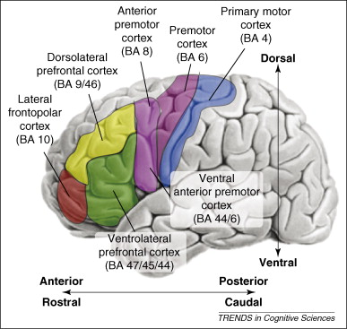
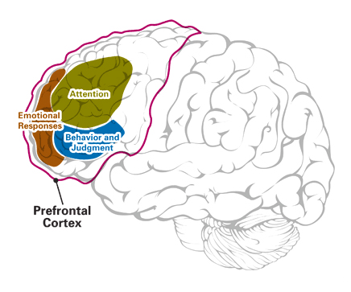
Cognitive functions
Orbitofrontal cortex monitors ongoing behavior, socially appropriate behavior, pulse control, etc.

Slide 35
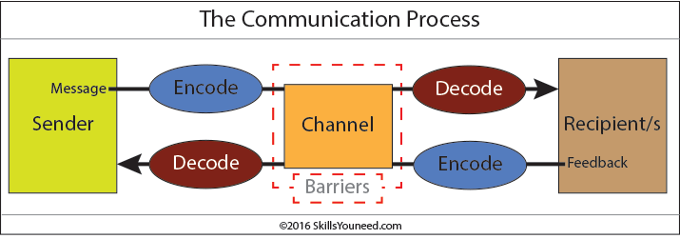
Communication
Communication can take place in different ways, such as odor, visual, sound, tactile
It is based on a pattern: source - encoding - channel - decoding - recipient
In human society, communication can be non-verbal, which is difficult to control because it is under the influence of the limbic system
Verbal communication is very manageable because it is under the control of the brain cortex

Slide 36
Speech
Speech is an articulated manifestation of a person’s thoughts serving for mutual understanding
There is no human community that does not have a speech system
Speaking, unlike reading, does not have to be taught
Its acquisition is a complex process involving both sensory (understanding) and motor system (production)

Slide 37
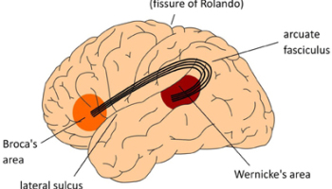
Speech
The main speech centers are Broca’s center, which links to the motor cortex, and Wernick’s center, which links to the hearing area and the fasciculus arcuatus
97% of people have Broca’s and Wernick’s areas located in the left hemisphere
The right hemisphere evaluates the nonverbal aspects of speech, the conveyed meaning (irony, metaphor), and the understanding of a more complexly organized speech

Slide 38
Reading disabilities
Developmental dyslexia is a congenital disorder characterized by difficulty in decoding written text and/or reading fluency
Alexia is a reading disorder that has very similar symptoms as developmental dyslexia
Hyperlexia is the ability to read much better than suggesting IQ or age, it is found in the spectrum of autism

Slide 40
Individual improvement of reading capabilities
Understanding the text is improved by increasing the reading range
Reading in a pleasant environment - for someone library, another cafe, for another a train station
Improve the speed of reading, for example, using rozectise.cz (also available in English)
David Gruber’ Speed Reading Courses - website
Speed reading helps not only by increasing the reading speed but also increases the angle that the given eye is able to accept

Slide 41
Thank you for paying attention and completing these tasks!

