Slide 1
Tate Murders Victim´s Wounds
Case Study

Slide 2
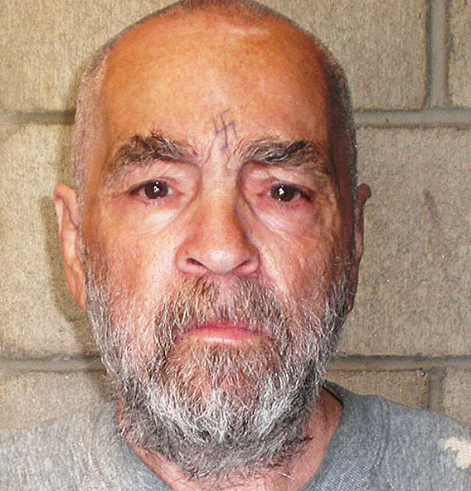
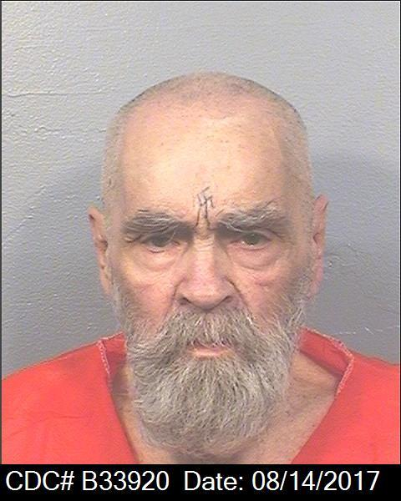
Charles Manson – Manson Family

Slide 3
Tate Murders

Slide 4
TATE FIRST HOMICIDE INVESTIGATION PROGRESS REPORT
DR 69-059 593
DECEASED : FOLGER, Abigail Anne, CC N o . 69-8794
FRYKOWSKI, Wojiciech, CC N o . 69-8793
PARENT, Steven Earl , CC N o . 69-8792
POLANSKI, Sharon Marie, CC No. 69-8796
SEBRING, Thomas John CC N o , 69-8795
DATE AND TIME OCCURRED: August 9 , 1969, 2400-0415 hours
LOCATION OF OCCURRENCE : 10050 Cielo Drive
DIVISION OF OCCURRENCE: West Los Angeles Division
TO: Lt . R. J. Helder, Supervisor of Investigations, Robbery-Homicide

Slide 5
Victims

Slide 6
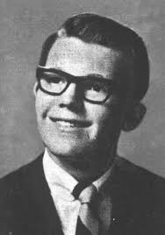
Steven Parent

Slide 7
Parent was wearing a red, white and blue plaid shirt, blue denim pants, white socks and black shoes. Parent's left wrist was bare; however, a wrist watch, later identified as his, was found in the left rear passenger seat. The band was severed. Parent had a laceration, indicative of a defense wound, on the palm of his left hand between the little and ring fingers. The wound runs vertical with his arm and the band on the wrist watch was undoubtedly severed when Parent received this wound. This was the only laceration that was apparent on Parent's body. It appeared that Parent had been shot (=shot wound) in the face, left arm and chest. At that time an extreme degree of rigor mortis was evident throughout all parts of the body. Post-mortem lividity was evident in the buttocks area of Parent's body, the back of his neck and the calves of his legs, which is consistent with the position that the body was discovered in .

Slide 8
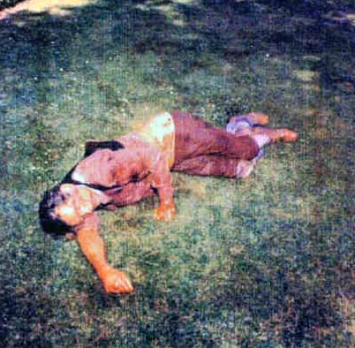
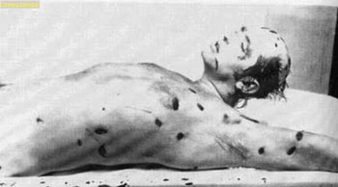
Wojiciech Frykowski

Slide 9
He was lying on his right side, his head resting on his right arm, his forearm and right hand running parallel with his body (=near the body). His left arm was at his side, with the left forearm running perpendicular with the ground and his left hand clutched the grass where he was lying. His body was in a north/south direction, the head to the southwest and the lower body to the northeast. Frykowski was attired in a purple shirt, multi-colored pants and brown high-top shoes and socks. Both his shirt and pants were drenched in blood. Numerous stab wounds were noted about his body with most of them on his left side. He also had stab wounds on his back and defense wounds to his right hand. Rigor mortis was evident in an extreme degree throughout all parts of the body. Post-mortem lividity was noted all along the right side of the victim, which is consistent with the position that he was found in.

Slide 10
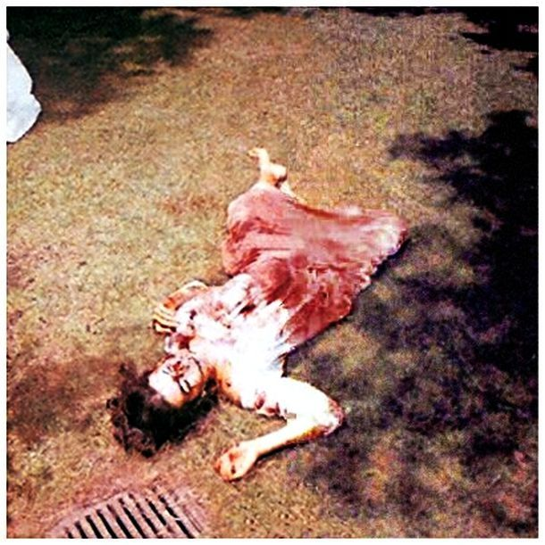
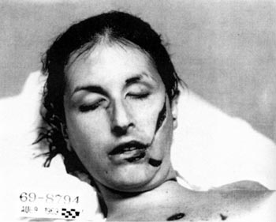
Abigail Folger

Slide 11
Abigail Folger was the next victim observed lying in the front yard in front of the Polanski home. She was lying in an east/west direction in a supine position. Her head was to the east and feet to the west. She was attired in a white, full-length nightgown which was completely drenched in blood from the breast area downward. Numerous stab wounds were noted in the upper anterior torso of Folger. She also had several severe lacerations to the left side of her face. Defense wounds were noted on both her right and left hands. Rigor mortis in an extreme degree was noted throughout the entire body. Post-mortem lividity was noted on the posterior of the deceased consistent with the position in which she was found.

Slide 12
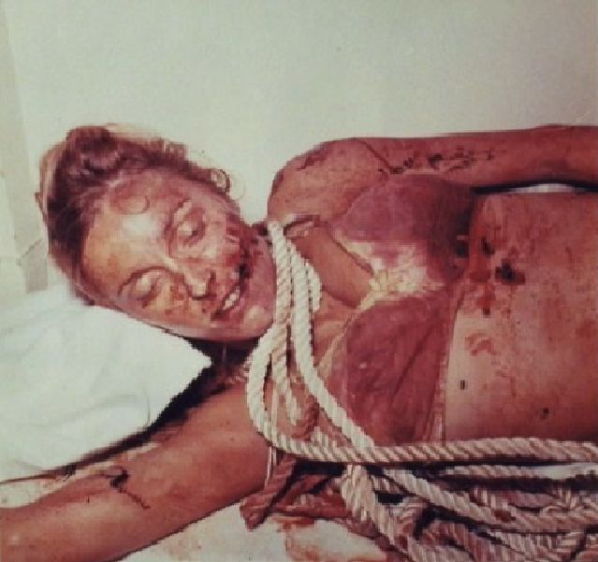
Sharon Tate

Slide 13
The next victim found was Sharon Polanski. She was inside the living room of the Polanski home, lying on her left side directly in front of a sofa which faces the fireplace. Her head was to the south and her legs, which were tucked up towards her body in a fetal position, were to the north. Numerous stab wounds were noted about her breasts, a wound in the upper abdominal region and one stab wound in the right leg. She was obviously several months pregnant. There was dried blood smeared over the entire body. It appeared to investigating officers that someone had handled the victim, as in moving her from one location to another and the blood from the stab wounds had been smeared over other parts of the body. A nylon rope, approximately 3/4 inches in diameter, was wrapped around Polanski's neck two turns. The two ends of the rope then went in a southerly direction, running parallel with Polanski's body. One end of this rope was wrapped around Sebring's neck, the remainder of this rope going underneath Sebring, parallel with the body. The remaining end which came from Sharon Polanski's body went up and over a ceiling beam, the loose end hanging on the other side of the beam,touching the floor. Polanski was attired in a bikini-type nightgown consisting of bra and pants. They were multi-colored and blood drenched. There was an extreme degree of rigor mortis evident in all parts of the body. Post-mortem lividity was noted in the posterior portion of the body consistent with the position in which the body was found .

Slide 14
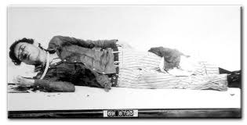
Jay Sebring

Slide 15
The fifth victim, Jay Sebring, was also located in the living room area of the Polanski home. Approximately 4 feet separated him from Sharon Polanski. He was on his right side in an east/west direction. His head was to the east and his lower upper torso was to the west. His legs went out at an angle perpendicular to the body, the feet in a northerly direction. A light colored towel, blood drenched, covered his head and face in a manner similar to that of a hood. The abovedescribed rope which was wound around Polanski's neck was also wrapped around Sebring. The one end of the rope which came from Polanski was wrapped around Sebring's neck 1 1/2 times. The loose end went underneath the body, running parallel with the upper torso and continuing toward the fire hearth in a westerly direction. Stab wounds were noted on Sebring's body and a large abrasion appeared on the left side of his face at the bridge of the nose. His left eye was bruised and swollen. His clothing was blood drenched and consisted of a blue shirt, white pants with black vertical stripes and black high-top boots.

Slide 16
Want to know more?

