Slide 1
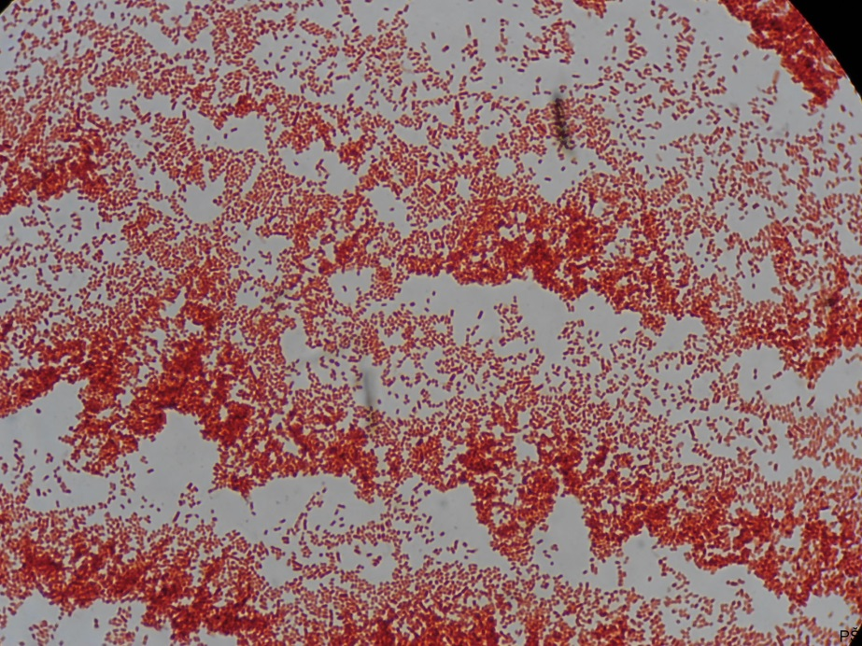
Gram-negative rods

