Slide 1
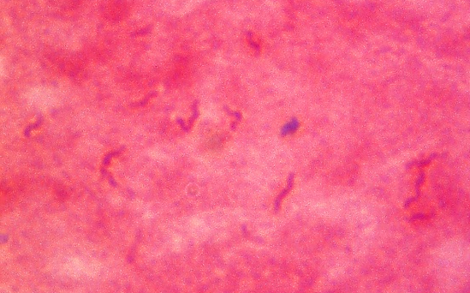
Helicobacter pylori

