Slide 1
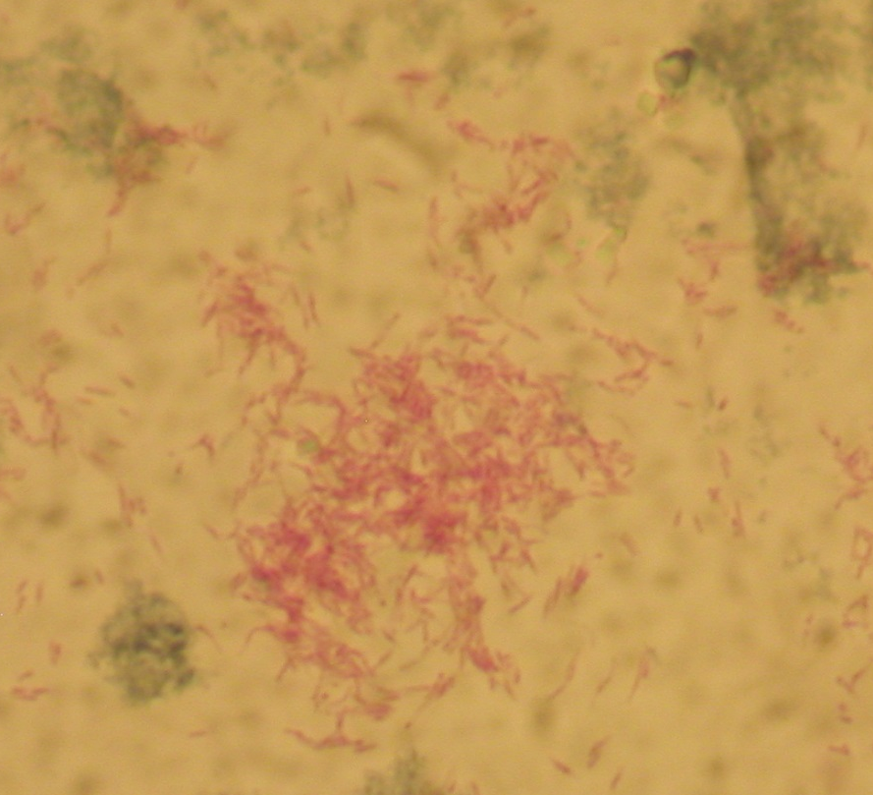
Mycobacterium turberculosis
Ziehl-Neelsen stain

