Slide 1
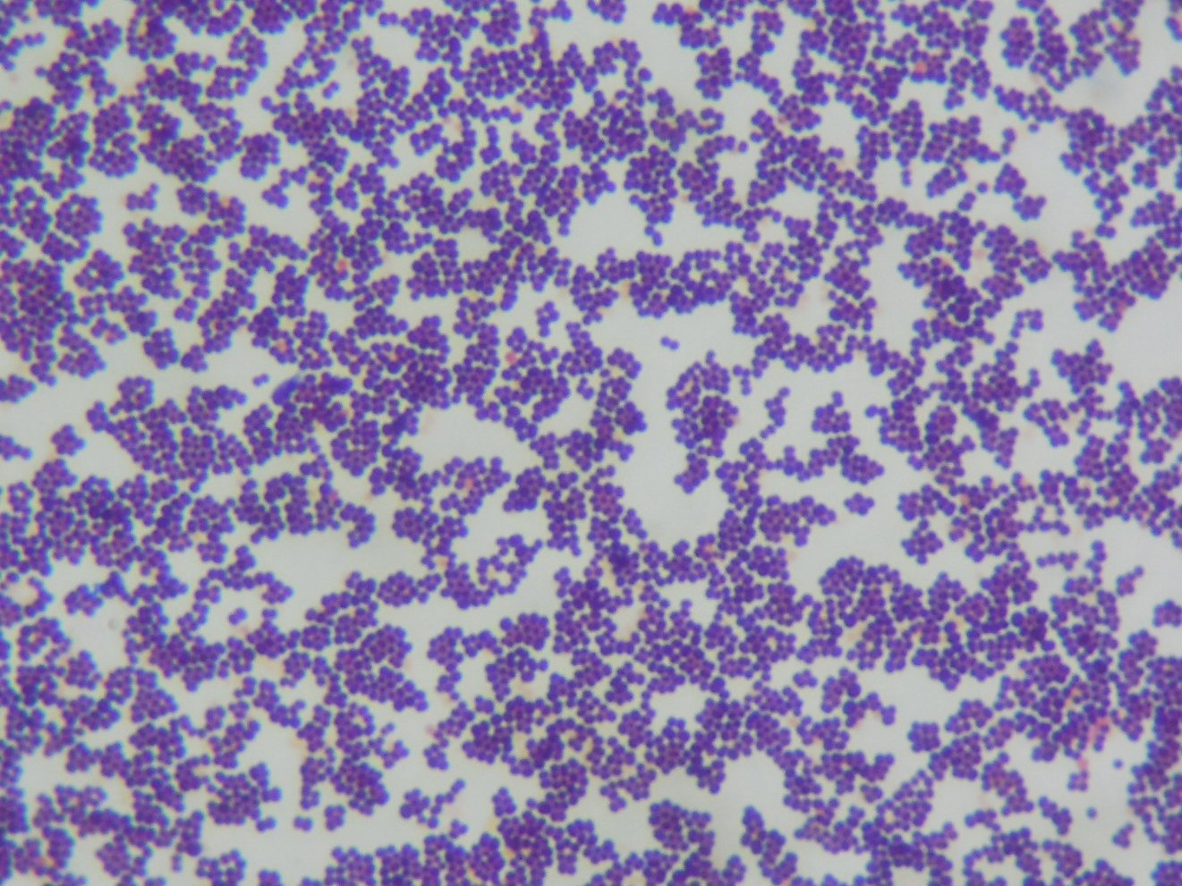
Staphylococcus sp.
Gram-positive cocci in grape-like clusters

