Slide 1
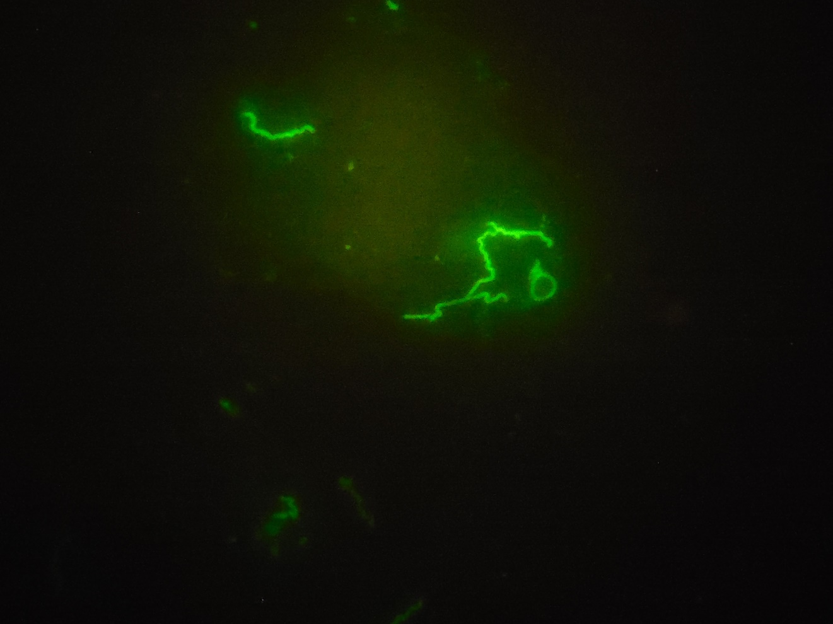
Treponema pallidum
Immunofluorescence

