Slide 1
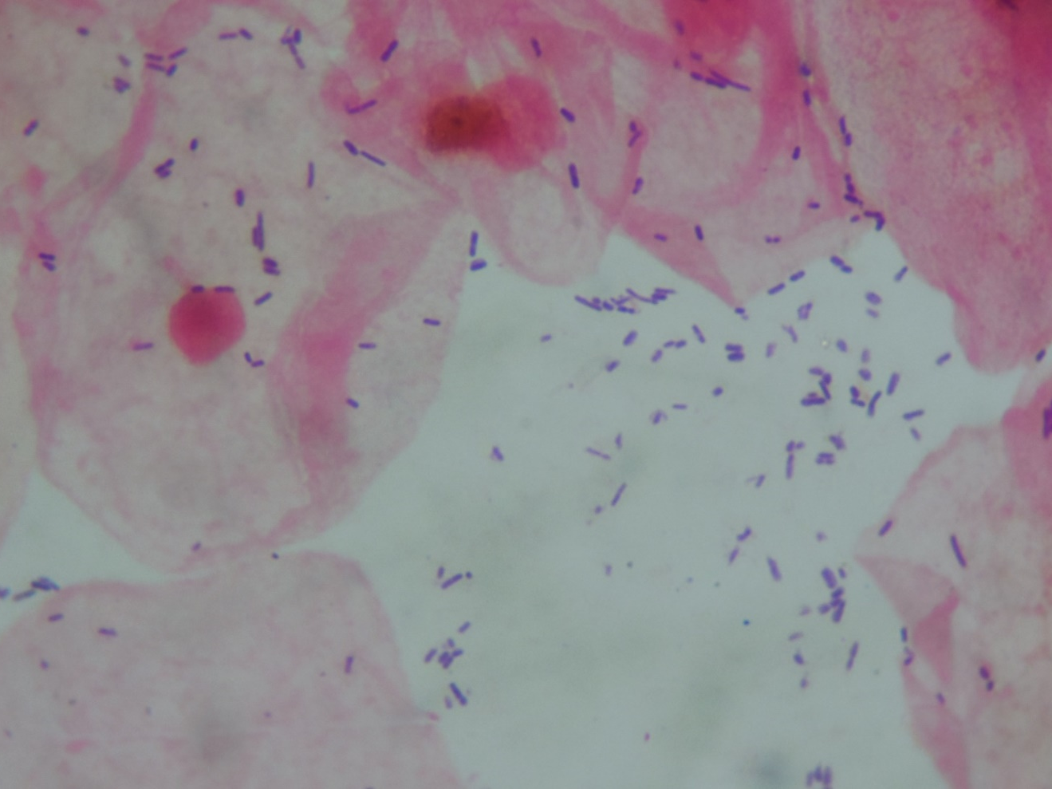
Vaginal swab
Lactobacillus sp. and epithelial cells

