Slide 1
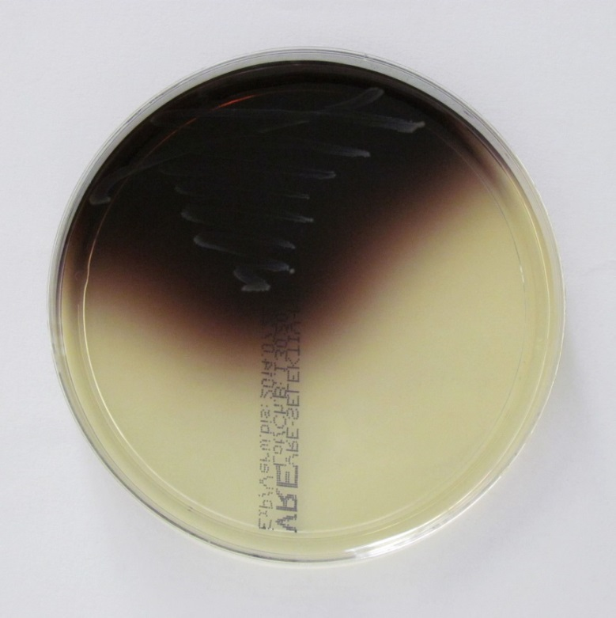
Vancomycin resistant enterococci (VRE)
Chromogenic Agar, where VRE growths as brown colonies

