Slide 1
Education in the Pediatric Intensive Care Unit at American Family Children’s Hospital
Claude Rochon MSN, RN, CPN
Edgewood College
American Family Children’s Hospital
Masaryk University Faculty of Nursing
March 15, 2016

Slide 2
EDGEWOOD COLLEGE
Madison, Wisconsin
U.S.A.

Slide 3
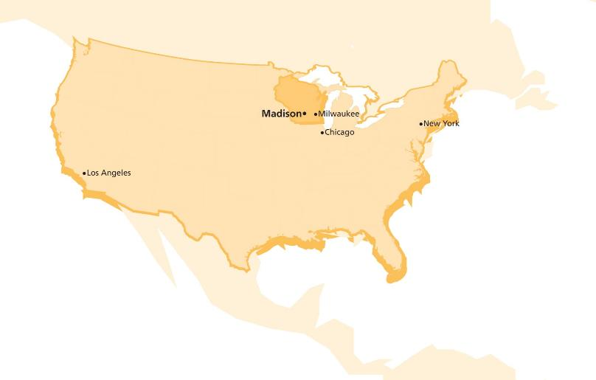


Slide 4


Slide 5

Edgewood College is a community of learners that affirms both its Catholic heritage and its respect for other religious traditions.

Slide 6
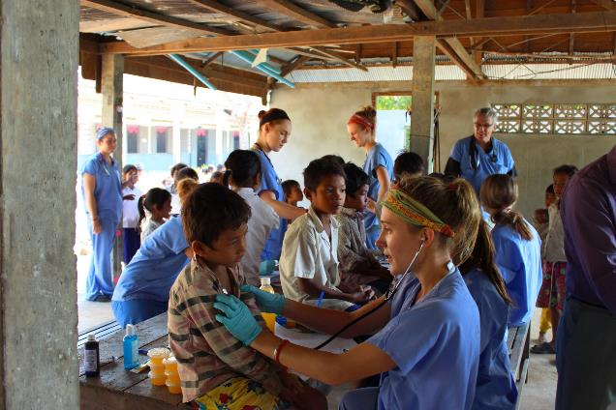
We foster open, caring, thoughtful engagement with one another and an enduring commitment to service.

Slide 7
Education in the Pediatric Intensive Care Unit
The Hospital
The Patient
The Family
The Medical Staff – All Disciplines
The Nursing Staff
The Transfer of Education to the Clinical Area

Slide 8
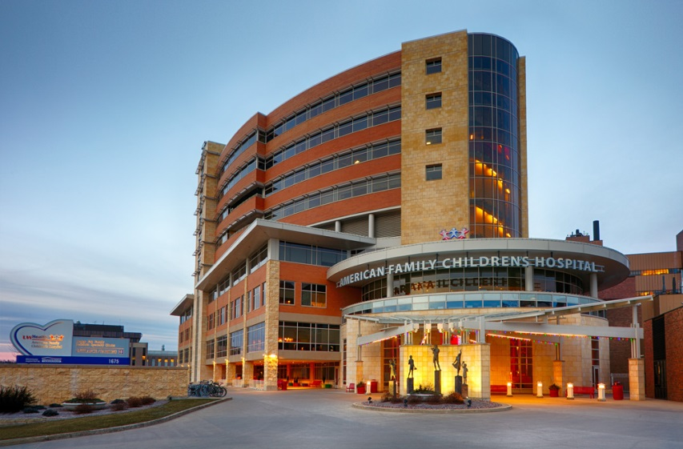

American Family
Children’s Hospital

Slide 9
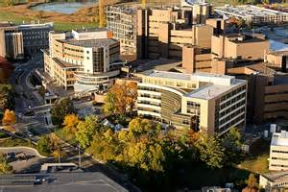
University of Wisconsin – Madison Hospital and Clinics

Slide 10
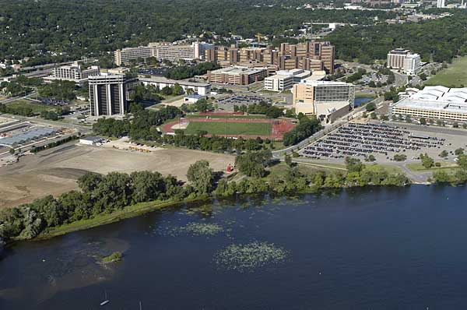
Research and Grant Spending
University of Wisconsin – Madison
American Family Children’s Hospital
We are rated from number two to number nine of rankings for the most money spent of research and development

Slide 11
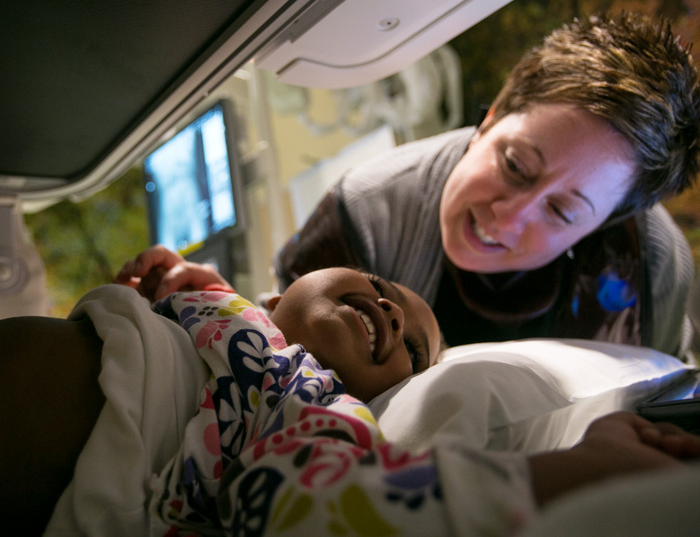
Facts and Figures – Fiscal Year 2015
Inpatient discharges: 4,200
Surgical procedures: 5,789
Clinic visits: 144,879
UW pediatric
specialists/surgeons: 235
Average hospital stay:
5.1 days
Case Mix Index: 1.6

Slide 12
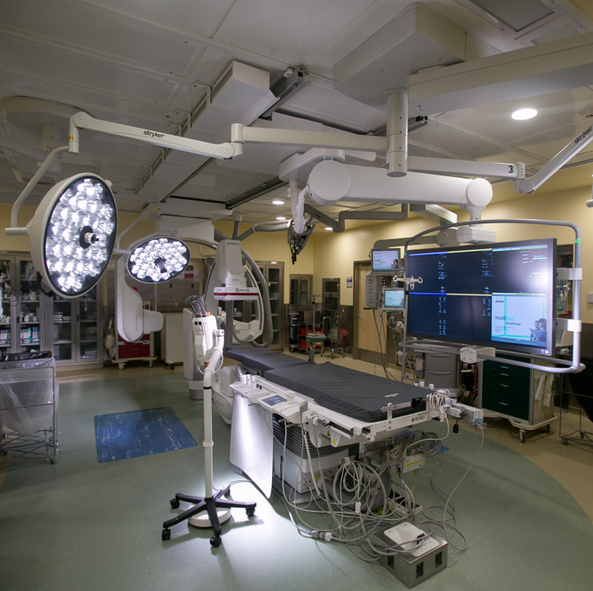
Pediatric Heart Program –
Ultra-safe Imaging
First in world with Artis Q.zen imaging equipment. Up to 60 percent less radiation exposure than conventional machines
Primary uses:
  Interventional cardiology
  Cardiac electrophysiology
  Interventional radiology
  Neuro-interventional radiology
  Complex surgery

Slide 13
Nursing / Medical Training
Graduate from High School 17-18 years old
Associate Degree Nurse
  2-21/2 years Technical College
4 year Baccalaureate Nursing Degree
Masters of Science – Nursing
  Education
  Administration
Doctor of Nursing Practice
  Administration
  Practical
Doctor of Philosophy
Graduate from High School 17-18 years old
  4 year Bachelor Degree
  4 Year Medical School
  3-8 Year Residency
  3-6 Year Fellowship
  Attending
  DNP Nurse functions at the same level as a Fellow on most units

Slide 14
Hospital
Where Does Education Begin?
  Planned Admission
    Clinical Nurse – Nurse Practitioner / Nurse Clinician
  Emergent / Unplanned Admission
    Emergency Department
      Child Life
      Nursing Staff in the Pediatric Intensive Care Unit
Open Policy at the Bedside!
  Parents Allowed
Discharge Planning Begins Upon Admission

Slide 15
Patient and Family Support Services
American Family Children's Hospital is a comprehensive pediatric medical and surgical center featuring nationally recognized pediatric specialists in fields from Cardiology to Cancer, including faculty from the University of Wisconsin School of Medicine and Public Health's Department of Pediatrics.
The Patient and Family Support Services section of the Children's Hospital Patient Guide includes the following information and resources:
Advance Directives
Child Health Advocacy and Safety
Child Life
Flad Family Chapel
Flashes of Hope
Hospital School and School Re-Entry
Interpreter Services
Kids as Partners (KAP) and Teen Advisory Board (TAB)
Kohl's Safety Center
Nutrition and Kids
Oral Health and Dental Care
Parent and Family Advisory Council
Patient Relations
Pediatric Palliative Care
Pet Therapy
Playrooms and Teen Lounges
Positive Image Center
SAFE KIDS Coalition
Social Work Staff
Special Events and Visitors
Spiritual Care Services
Support Groups
Tyler's Place and Sibling Services
Volunteering at the Children's Hospital

Slide 16
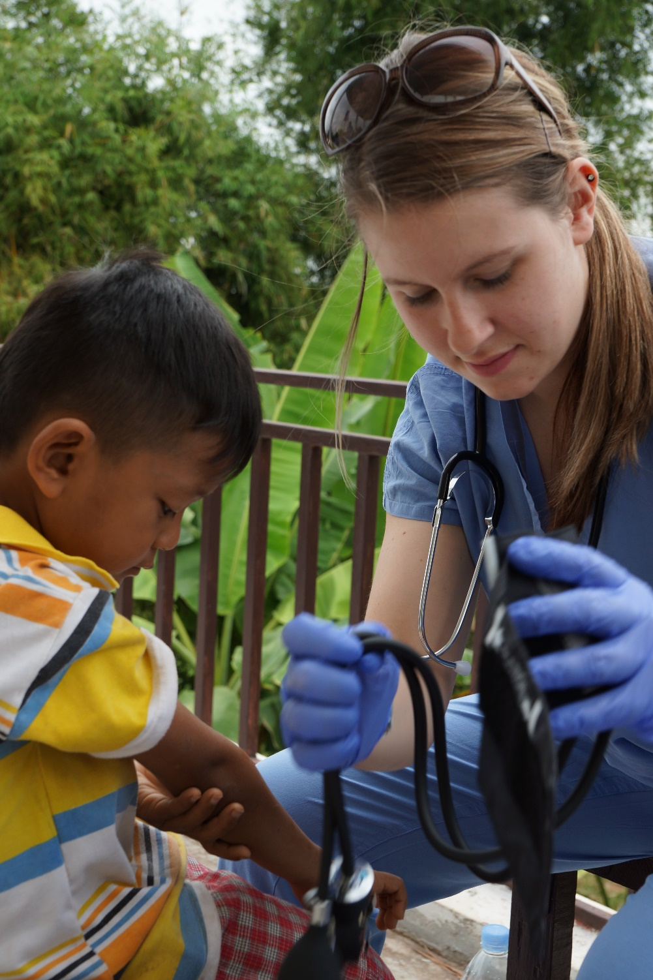
Education:
How do we educate?
  Written Material
  Videos
  Demonstration
  Teach Back
The effects of stress!
  When is appropriate to educate in the Pediatric Intensive Care Unit?

Slide 17
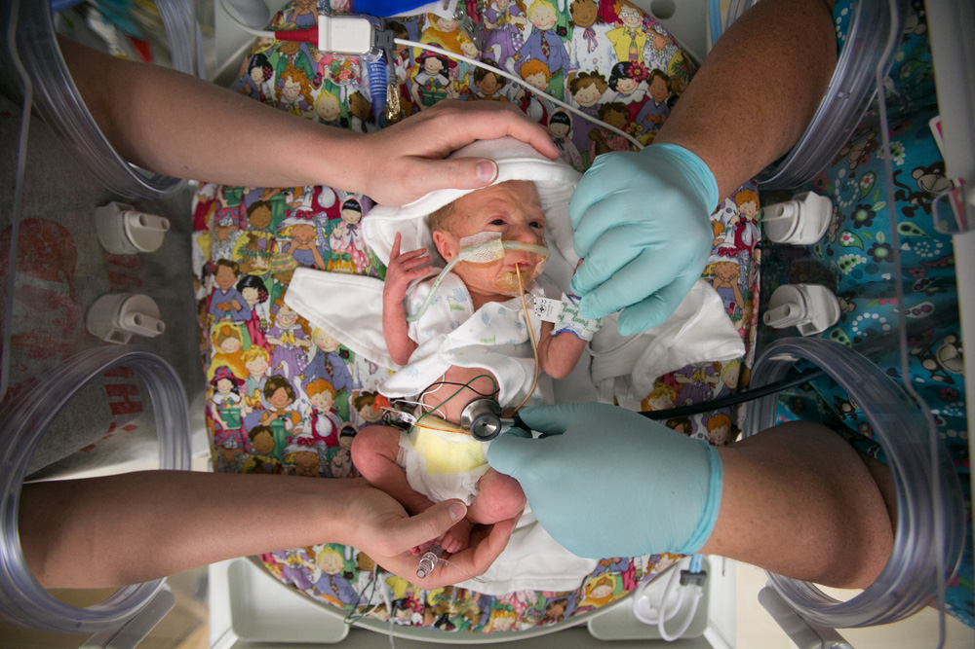
Retention of Education Provided!

Slide 18
Ability to Learn in a Stressful Environment
Nursing Students
Medical Students
Family
Patient

Slide 19
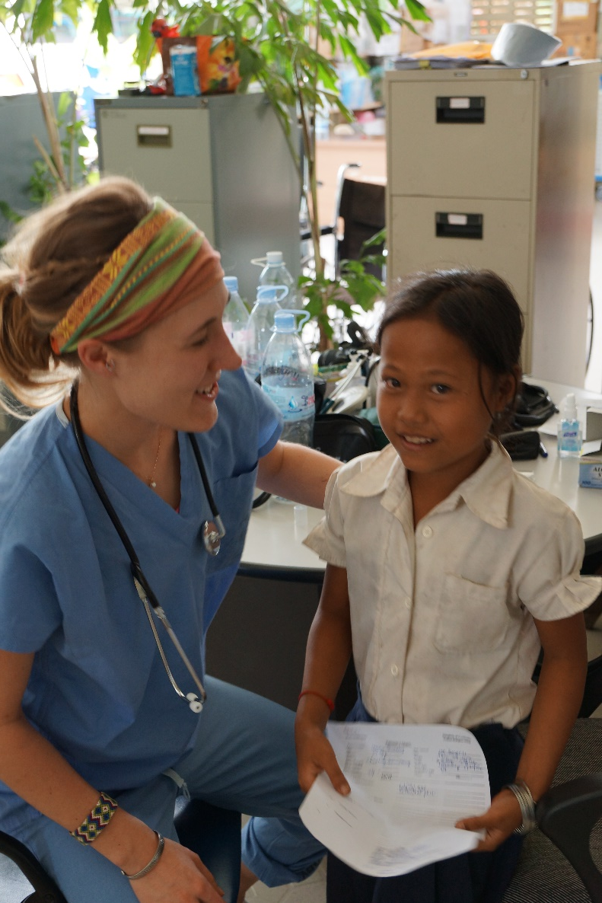
Patient
Age of the Patient
  Cognitive Ability of the Patient
  Laws Protecting the Patient
    Greater Than 10 Years old

Slide 20
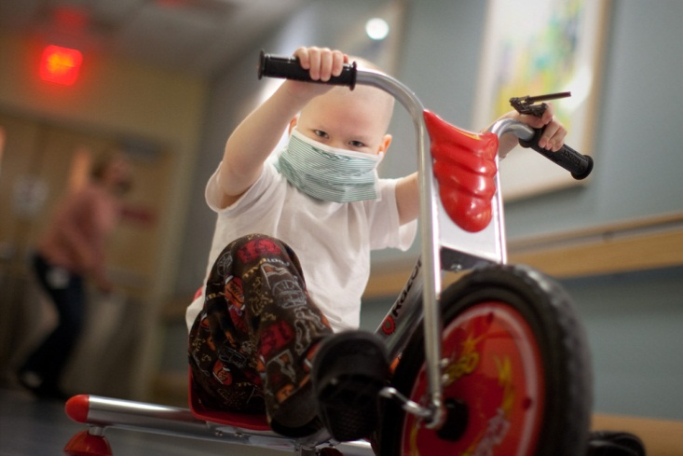
This is Austin
(Early 2013 – before bone marrow transplant)

Slide 21

So How do we Teach Austin and his Family?

Slide 22
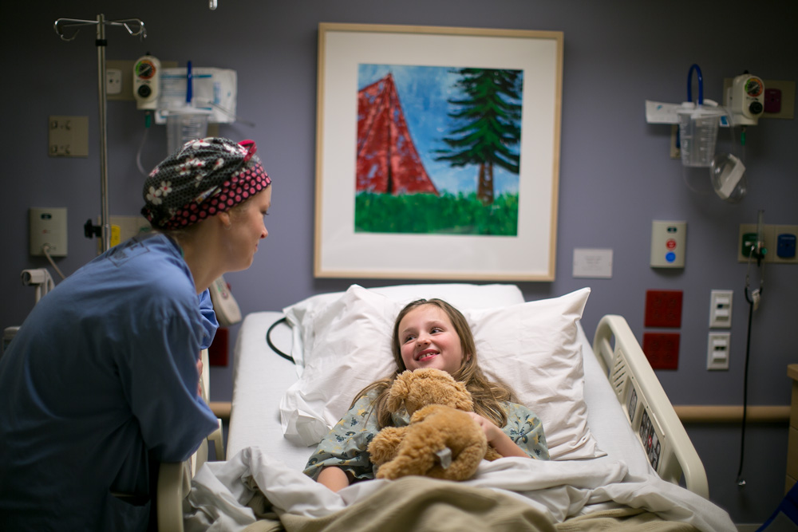
American Family Children’s Hospital:
A Clinical Innovator

Slide 23
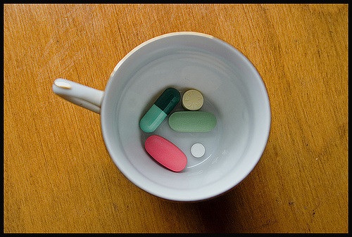
Case Study
New medications for a new acute medical diagnosis.
  Beata is 2 1/2 years old
    Do you teach mother and dad?
    Do you teach the siblings
    Do you teach Beata?
      3 volunteers – Role Play

Slide 24
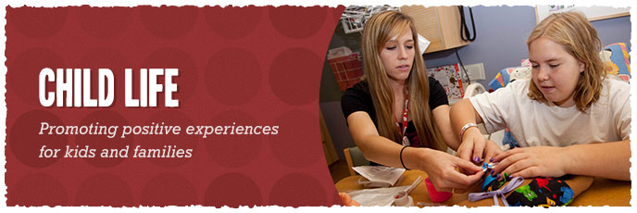
Child Life
The Child Life program at American Family Children's Hospital is made up of trained professionals with backgrounds in child development.
Certified Child Life Specialists help children, adolescents and families cope with the fear and anxiety associated with the medical environment and hospitalization. The goal of the Child Life program is to promote positive experiences for children and families throughout hospitalization.
Play with a Purpose: How Child Life Uses Play
Create a friendly, familiar environment
Teach about procedures, surgeries, or new diagnosis
Distraction during procedures or times of discomfort
Promote development
Allow children to master their healthcare experience
Encourage peer interactions
Support emotional and psychosocial needs
Provide opportunities for self-expression
Introduce medical supplies to encourage learning and reduce fears
Involve siblings throughout medical experience
https://youtu.be/Tvhttps://youtu.be/TvTReVA3ZTYTReVA3ZTY

Slide 25
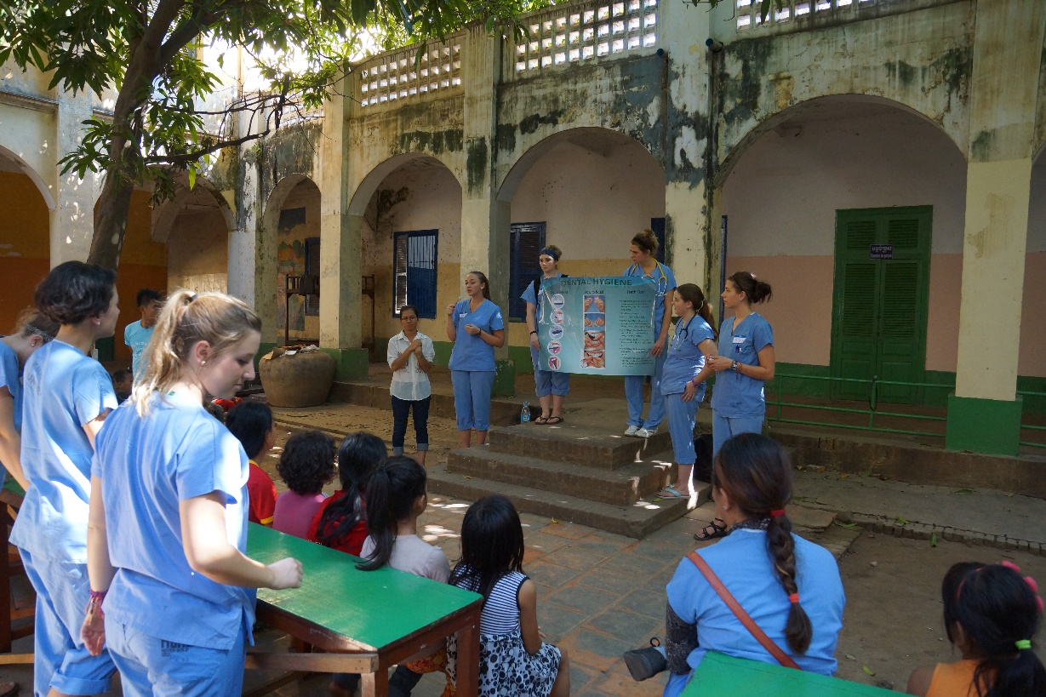
Family
Acute
Nurse dedicated to family
Open policy
Child Life

Slide 26
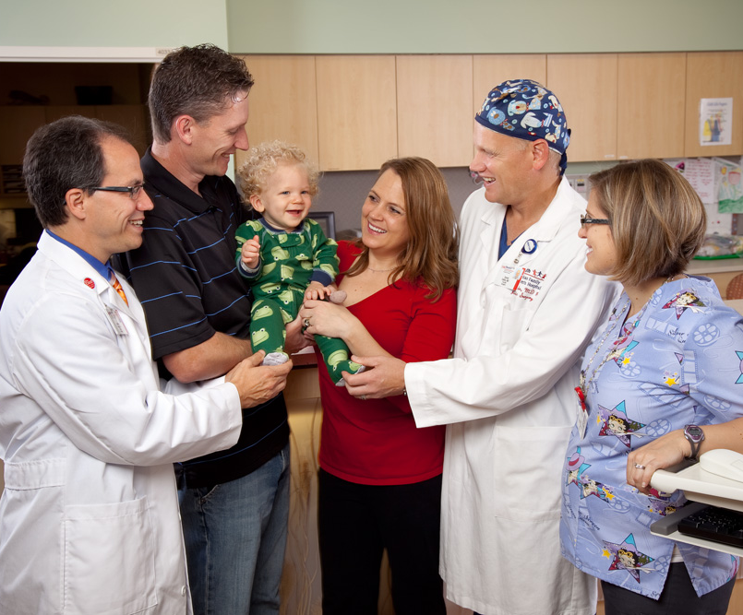
Patient and Family-Centered Care
We are a leader in making patient- and family-centered care a core principle
Rooted in the belief that family members know their child best

Slide 27
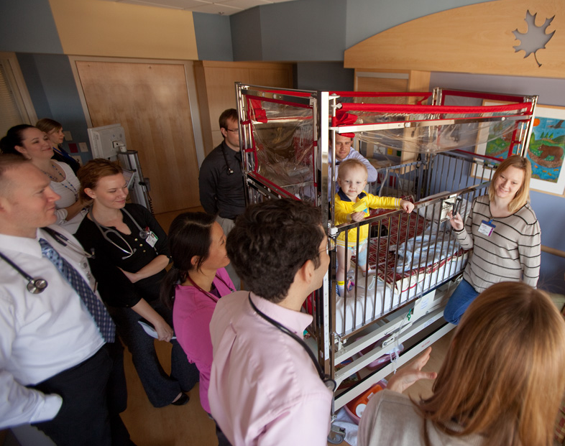
Family-Centered Rounds
Daily patient rounds include family members as part of health care team
Has increased patient and family satisfaction
Helps reduce length of stay in hospital
Increased safety

Slide 28
Advanced Pediatric Care –
It Takes a Village
Pediatric Intensivists
Surgeons
Subspecialists
Nurse Practitioners
Hospitalists
Pharmacists
PICU RN’s
Respiratory Therapists
Nutritionists
Families
Case Management
Social Work
Health Psychology
Child Life

Slide 29
Medical Faculty – All Disciplines
Who is Involved In Patient Education
Complexity of the Disease Process
Physicians
  Fellows / Nurse Practitioners
    Residents
      Medical Students
Pharmacy
  Pharmacy Students
Nutrition
Respiratory Therapists
Occupational Therapists
Physical Therapists
Speech
Mutual Respect
Collaboration

Slide 30
Nursing
How do I teach?
Little Children 2-3 years old
  Down on their level!
    Keep it simple
      Pill Case Study
Older Children
  Ask them how much they want to be involved?

Slide 31
Nurse Led Care Rounds:
Originated in our Neonatal Intensive care Unit
Pediatric Bone Marrow Transplant Unit
Pediatric Hematology / Oncology Unit

Slide 32
10 Elements of Competence for Using Teach-back Effectively
1. Use a caring tone of voice and attitude.
2. Display comfortable body language and make eye contact.
3. Use plain language.
4. Ask the patient to explain back, using their own words.
5. Use non-shaming, open-ended questions.
6. Avoid asking questions that can be answered with a simple yes or no.
7. Emphasize that the responsibility to explain clearly is on you, the provider.
8. If the patient is not able to teach back correctly, explain again and re-check.
9. Use reader-friendly print materials to support learning.
10. Document use of and patient response to teach-back.
What is Teach-back?
A way to make sure you—the health care provider—explained information clearly. It is not a test or quiz of patients.
Asking a patient (or family member) to explain in their own words what they need to know or do, in a caring way.
A way to check for understanding and, if needed, re-explain and check again.
A research-based health literacy intervention that improves patient-provider communication and patient health outcomes1 .

Slide 33

Diabetic Education
Diagram
Intensive Care Education
  Age of the child
  Previous Understanding of the Disease Process
  Bedside Nurse
    Initiating
    Re-enforcement
  Clinical Nurse Educator
    2 to 3 Short Education Sessions
Medical Floor Education
Clinical Nurse Educator
  Clinical Setting

Slide 34
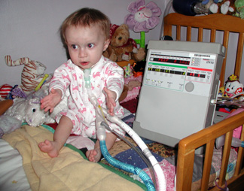
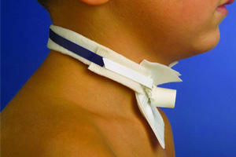
Tracheostomy Teaching

Slide 35
As a Nurse What Would you Teach?
Paper and write everything that you can think of to teach parents and Patient before Discharge.

Slide 36
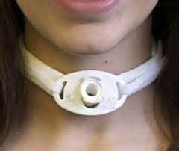
Education
1). Acknowledgement of the Tracheostomy / Anatomy
2) General Care
3) Suctioning
4) To Go Bag
5) Classroom with Nurse Educator
6) PICU Nurse
7) Support Staff- Family Members 2-4 people other than the parents
8 ) 24 Hour Cares
9) Day Trip
10) Overnight
11) Car Seat Test
12) Equipment

Slide 37
What Did We Forget?
School Nurse
Child Health Psych
Re-introduction into the classroom.
CPR Training
Nose
Speaking Valve
Cuff or Un-cuffed

Slide 38

Transfer to Other Units
Nurse – School Reintroduction
  Monkey in the Chair
  Pink Panther Diabetes
Nurse Clinical Nurse Specialist

Slide 39


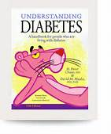



Slide 40
Nurse Education in the Pediatric Intensive Care Unit
Nurse Residency Programs
New Graduate
  3 to 6 month Orientation
  Residency to last 1 year
Over 1 year in Pediatrics in another hospital
  Short orientation period designed to meet the nurse
Springboard to Pediatrics
  Have nursing experience greater than one year in adult population
    Shadow
      Classroom Studies

Slide 41
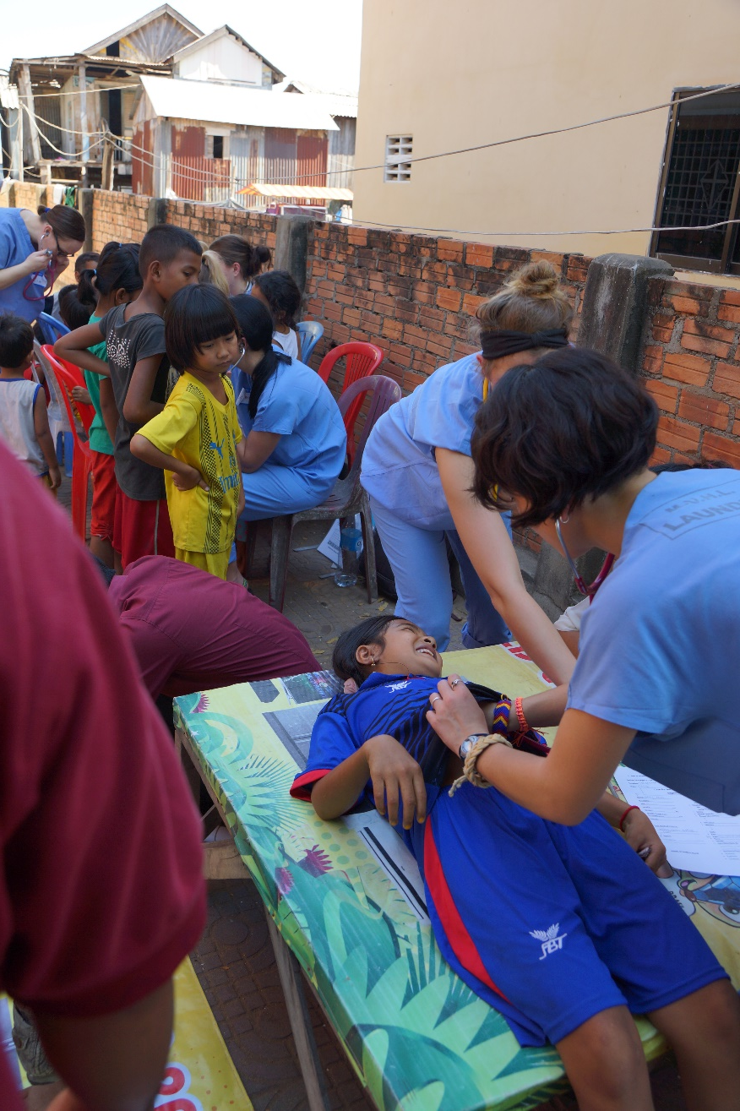
Residency Program
Staged Orientation
  1st Stage
    Orientation to unit
    Learn the dynamics
    Learn to communicate with other Disciplines
  2nd Stage
    Stable Patients
      pairs
    Sicker Patients
      singled
  3rd Stage
    Sickest Patient’s on the Unit
    Preceptor in control
      Resident learns what to expect
  4th Stage
    Returns to pairs and type of patient first to experience

Slide 42


Thank You!
Madison, Wisconsin
U.S.A.

