Slide 1
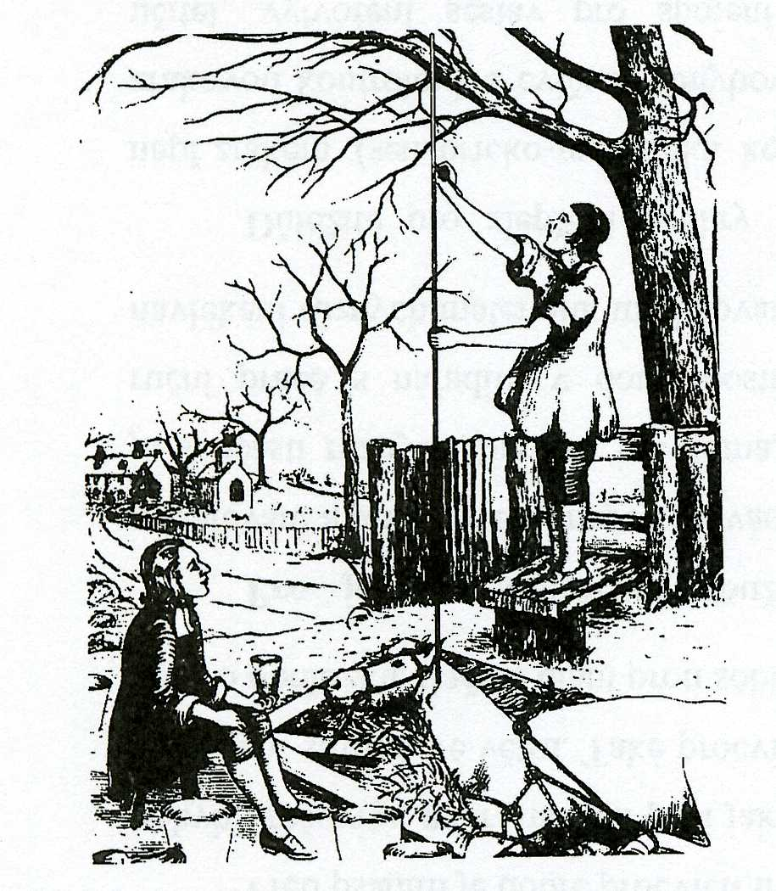

Slide 2
Blood pressure measurement
The system pressure values are, for technical reasons, dependent on:
Measuring method used
  Non-invasive methods:
    auscultatory
    oscillometry
    ultrasound
    photopletysmography
  Invasive methods
    indirect – Swan-Ganz´s catheter
    direct – catheter with a pressure sensor at the end
Methodology
  Clinical measurement – in ambulance - practitioner
  Home measurement
  24hour ambulatory blood pressure monitoring

Slide 3

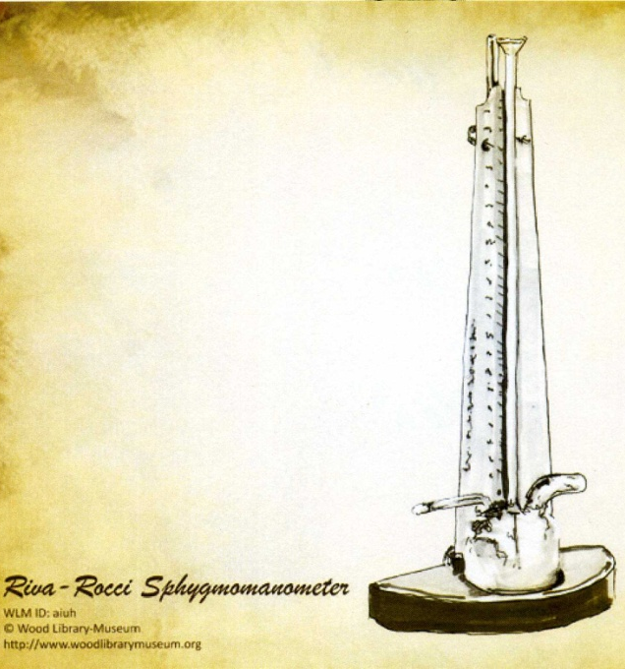
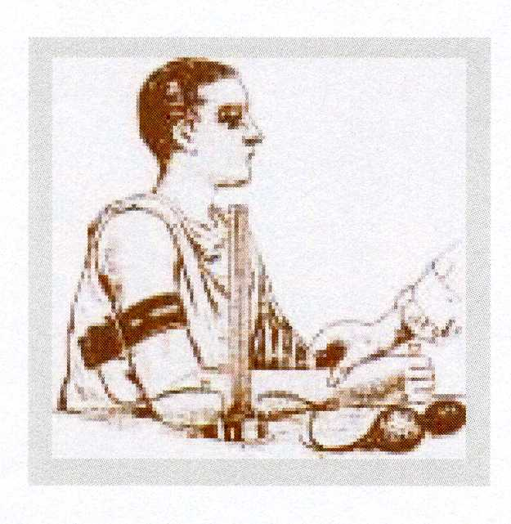
Palpatory method
Austrian Von Basch
„aneroid sfygmomanometr“
With baloon on wrist
1876
Italian physician
Riva Rocci
„mercury sfygmomanometr“
With cuff on the arm
1896

Slide 4
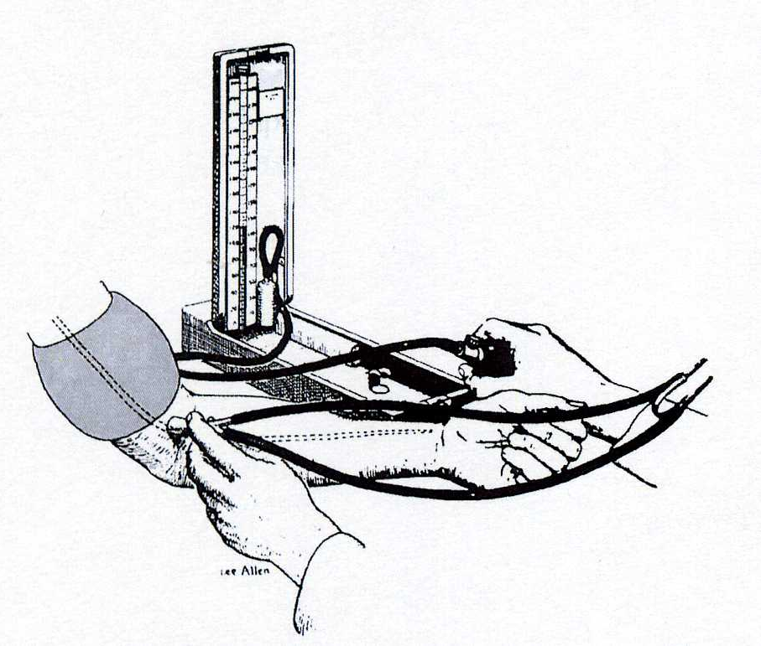
Auscultatory method
Russian army surgeon
Nikolaj Korotkoff
1904
„mercury sfygmomanometr“
The cuff on the arm,
stethoscope in the area of the elbow

Slide 5
Auscultatory methods
based on detection of Korotkoff phenomenons
„gold standard“
with comparison on intra-arterial measurement of blood pressure – we will find: lower values for SBP and higher values of DBP
/this is only technical systemic mistake – does not matter/
According a guidelines for diagnostic of arterial hypertension: we diagnose arterial hypertension: repeated blood pressure increase above 140/90mmHg, demonstrated at least in two out of three measurements using the auscultation method in the clinical setting

Slide 6
Oscillometric method
Author: Mr. Marey – the first describe on 1876
It has been repeatedly demonstrated that the oscillation of BP in the sphygmomanometric cuff is measured during its gradual discharge - the point of maximum oscillation corresponds to the mean arterial pressure measured invasively
Oscillations begin approximately around systolic pressure values and continue after deflation of the cuff = both systolic and diastolic pressure is estimated only indirectly based on empirical derived algorithms
  Advantage: Less susceptible to external noise
  Disadvantage: definitely unreliability in physical activity - distortion by motion artifacts + susceptible to low-frequency mechanical vibrations

Slide 7
Ultrasound method
The device includes an ultrasonic vibration generator and an ultrasonic sensor - placement via the brachial artery and under the sphygmomanometric cuff
When deflate the cuff, it induces a systolic movement of the arterial wall that causes the Doppler phase shift in the transmitted ultrasound signal; diastolic BP is calculated by a significant reduction in arterial wall motions
Other variant: systolic BP based on blood flow detection - in newborns and small children

Slide 8
Digital photoplethysmography
Continuously blood pressure measurement - „beat to beat“ – from digital artery
Profesor Jan Peňáz – Department of Physiology – Masaryk university in Brno - patent 1969
Disadvantage: can not be used in conditions with peripheral vasoconstriction (shock states, vasoneurosis, diabetic angiopathy)

Slide 9
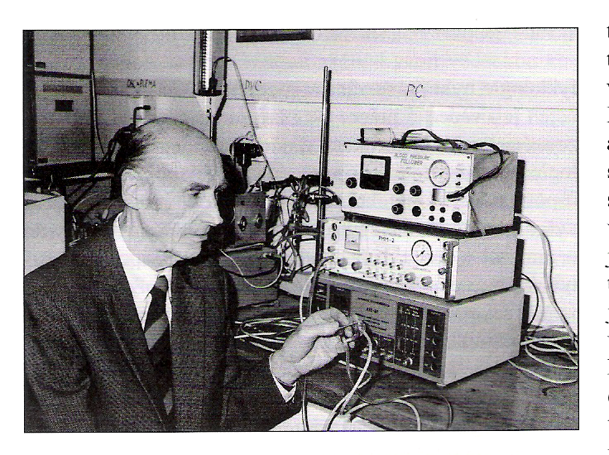

Slide 10
We need than pressure in the cuff corresponded to the pressure of the digital artery
Method: photopletysmography
Recorded photoelectric plethysmogram
The new term: Transmural pressure – Pt (the pressure across the wall of the artery)
BP, Pc (pressure in cuff), Pt
We estimated: BP=Pc - - - Pt=0 - - - photoplethysmogram registered the highest amplitude of oscilation --- we measure the MAP
Step by step increase of Pc, in the moment of the highest amplitude – feed-back loop started for obtained(keeping) the constant volume of the finger

Slide 11
Penaz patent
He used the signal from the photocell to control the external cuff pressure and that to keep the finger volume unchanged. This has achieved that pressure in the cuff monitors blood pressure in the artery.

Slide 12
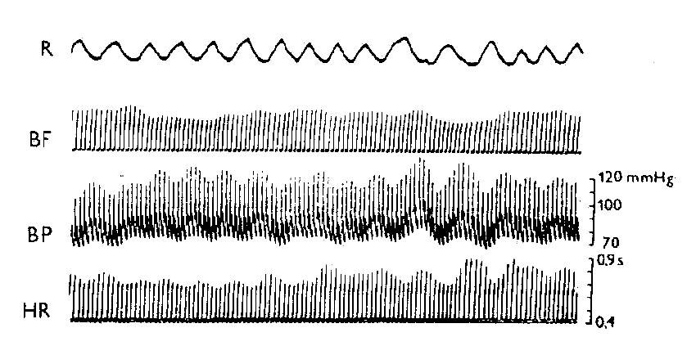
Record of breathing and waves in circulatory parameters
(Peňáz´s photoplethysmomanometr)

Slide 13
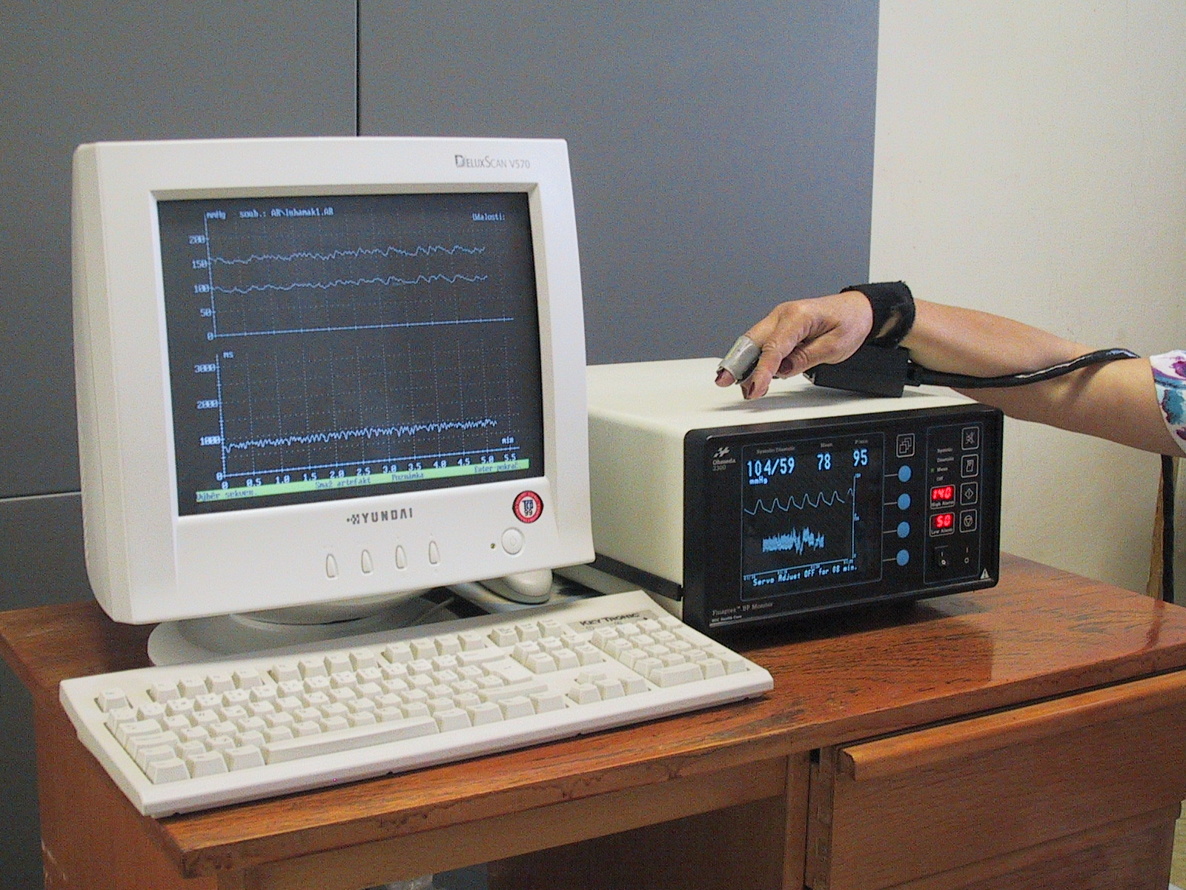
Finapres (Ohmeda, USA)

Slide 14
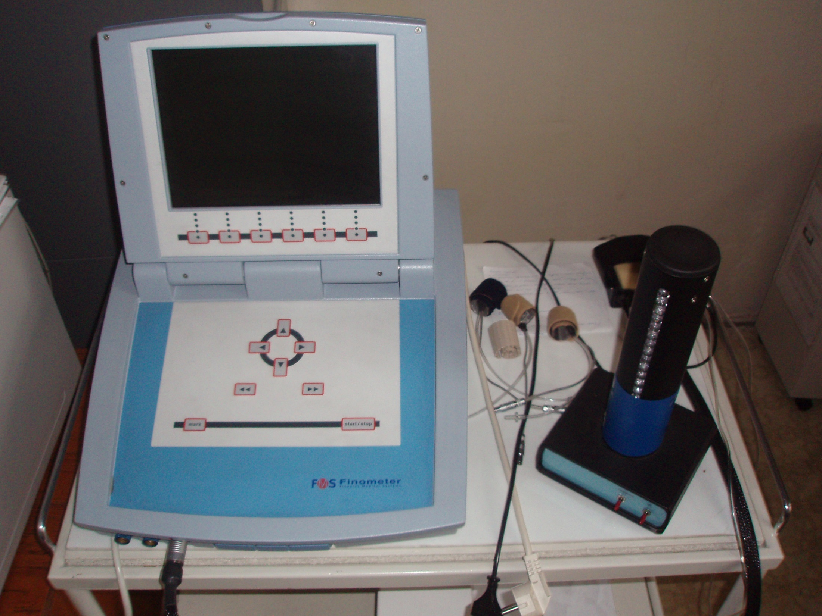

Slide 15
Invasive measurement of blood pressure
The most accurate measurement method of BP – BUT HIGH RISK:
- difficult accessibility, risk of infection diseases
Usage: BP monitoring in critical states (coronary units, intensive care units); in more complex therapeutic procedures
  Indirect - Swan-Ganze catheter - hollow tube, on the vessel side with a hole, the other side connected to the sensor - filled with physiological solution - transfer of pressure changes from the vessel's light towards the sensor – inaccurate
  Direct – special sensor – special microsensor on the vessel side - the blood pressure signal is transmitted from it
  up-to-date catheters - signal transmission via fiber optics
  Important for the diagnosis of all forms of pulmonary hypertension

Slide 16
Methodology
Clinical statement
In keeping with a good practice is still auscultation method able to report reliable results
We must rely on white-coat hypertension versus masked hypertension in some patients
There is always higher BP in the case of BP measurement by physician and lower values measured by nurse or technician

Slide 17
Methodology 2
„Home“ blood presure measurement
Advantage: measurement by patients, elimination of white-coat hypertension effect, measurement in long period
Disadvantage: technical problem, correct measurement by patient
Classic oscillometry method – cuff on the arm
  Attention on location of measurement on the wrist - in the vertical position - pressure above 15-20 mmHg higher than on the arm, even when in the heart position the SBP is higher by 2-3mmHg than on the arm
  Finger position cuff (non digital photoplethysmography) - Higher values of 4 mmHg than on the arm (another characteristic of the pulse curve in the finger artery)
  Values at home measurements are always lower than in the clinical setting – Hypertension society recommendation: BP higher than 135/85mmHg - are increased !

Slide 18
Methodology 3
24 hour ambulatory blood pressure monitoring
Advantage: an overview of absolute values and variability in time-defined periods (! but still intermittent measurement!)
Oscillometric method
Information: SBP, DBP, pulse pressure, mean arterial pressure - profile of absolute values at monitored intervals; average and standard deviation for the period under review; % of the blood pressure parameters above the specified upper limit; calculation of different indexis; determination of variability of blood pressure fluctuation
The number of BP increases in more than 40% of all values in either on night – or day-time interval – dg: arterial hypertension
ABPM values are lower than clinical values - recommendations:
normal: below 135/85 daily and night under 120/70; 24 hour diameters 130/80 mmHg

Slide 19
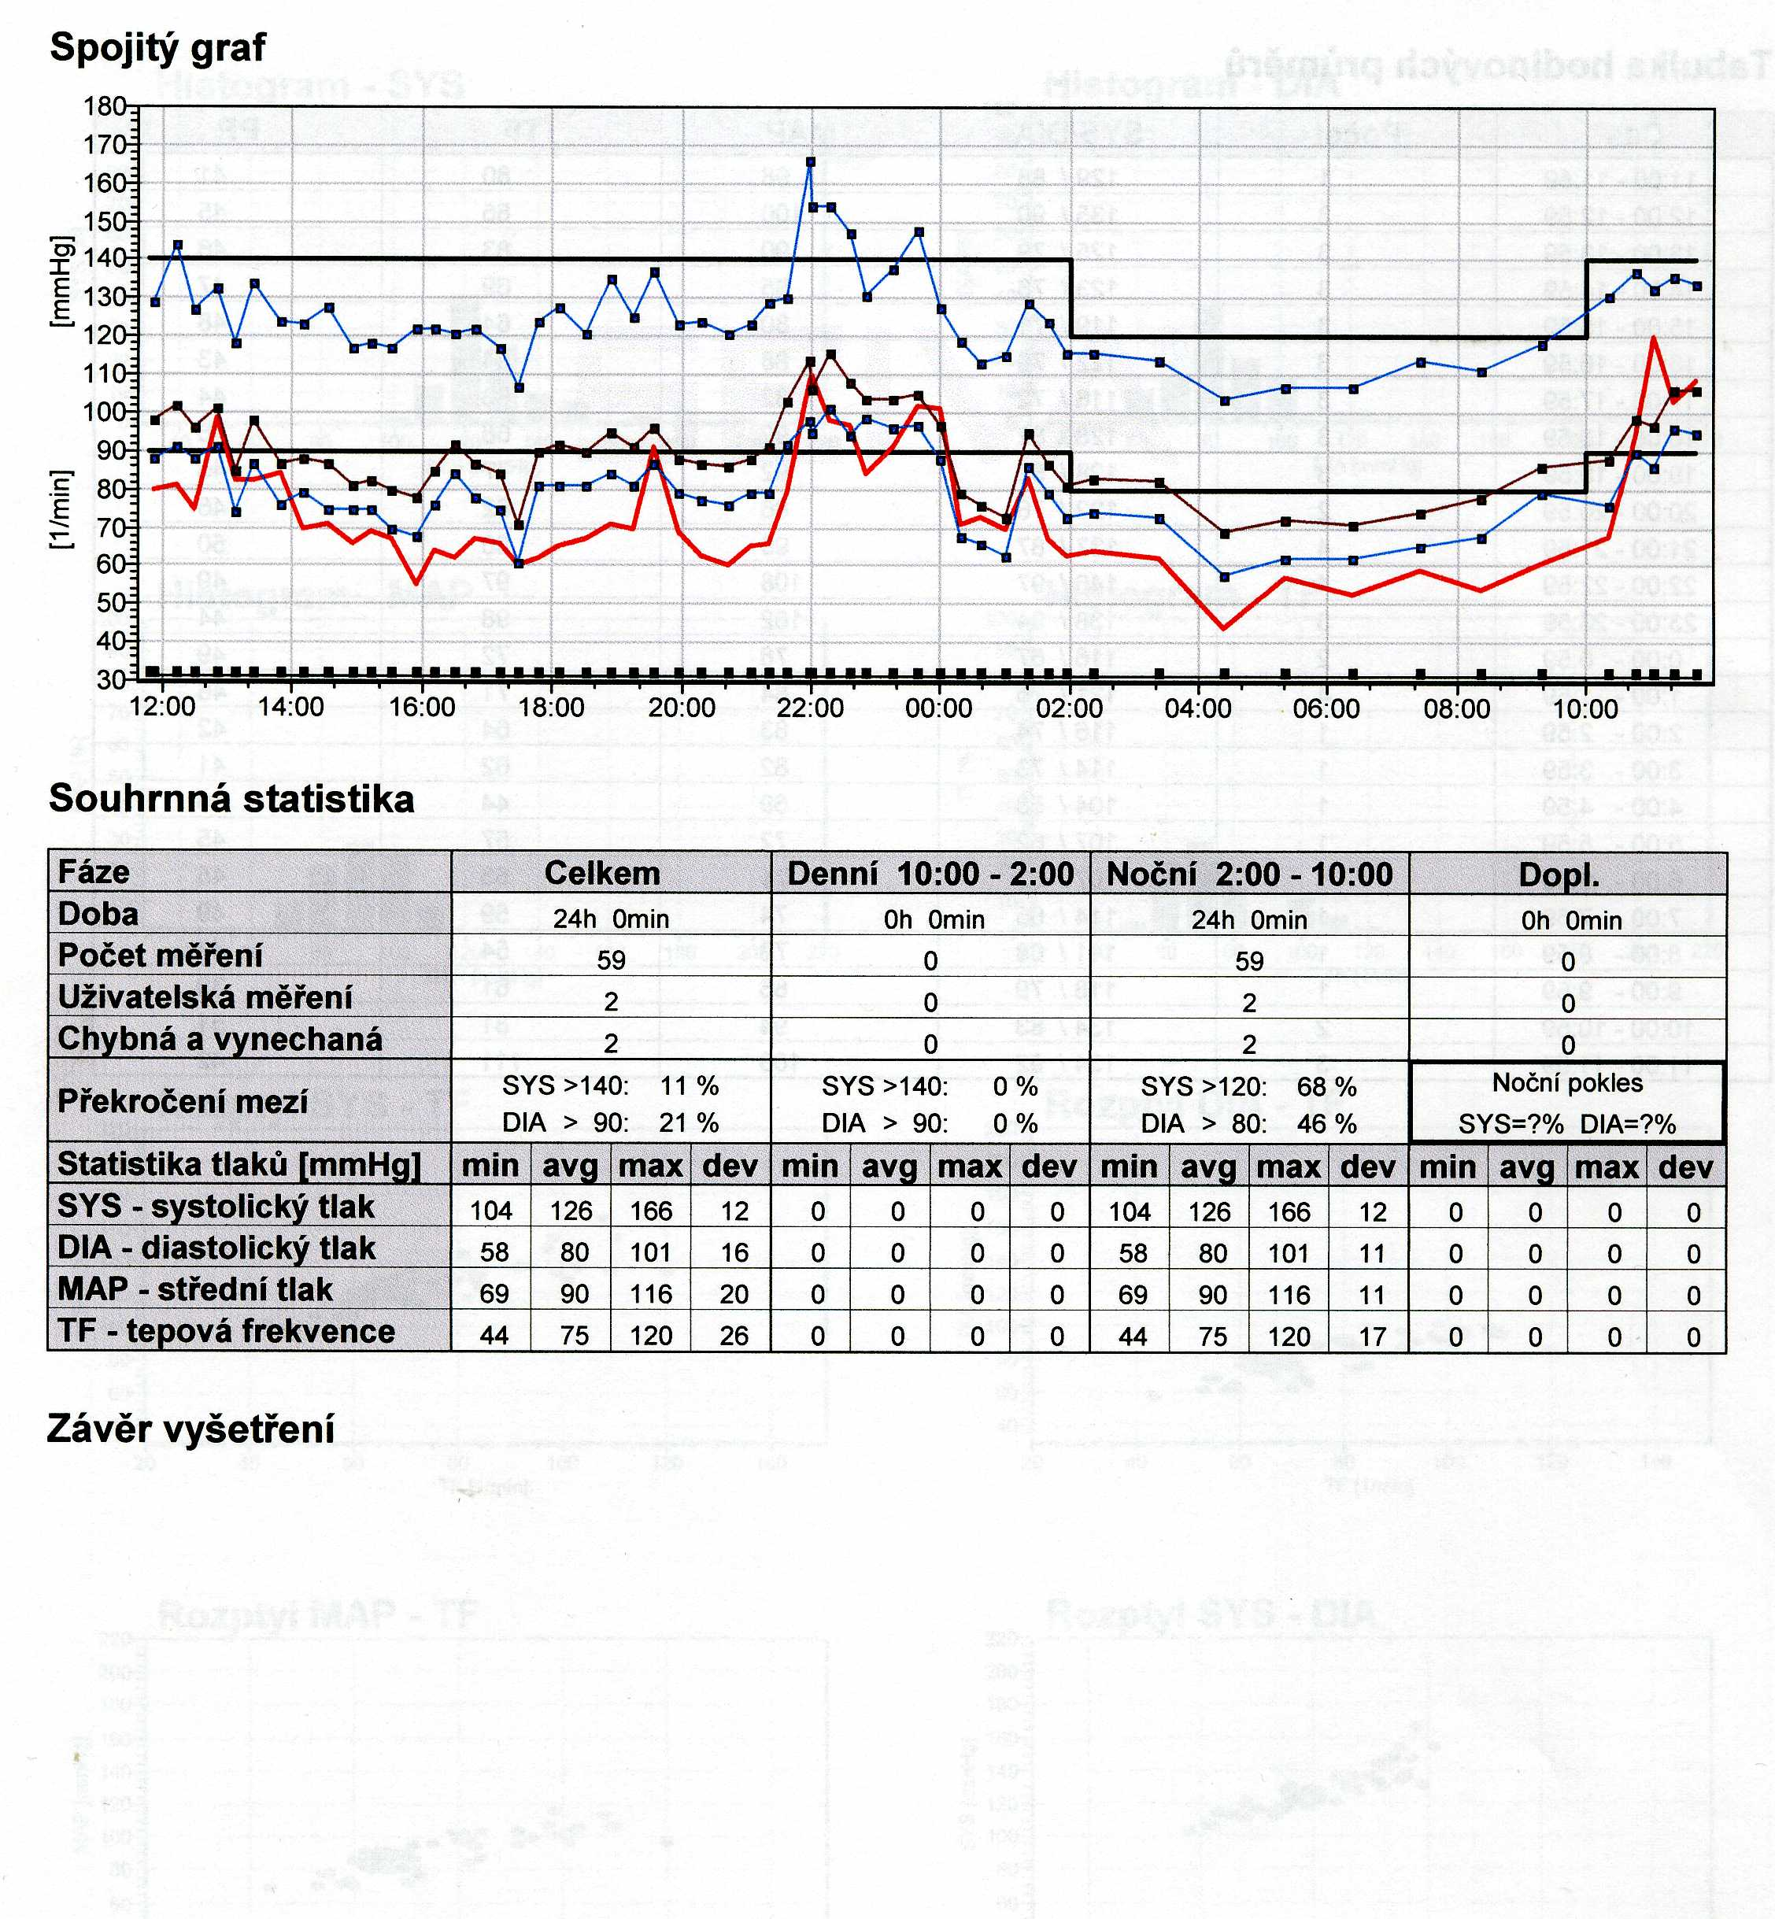

Slide 20


Slide 21
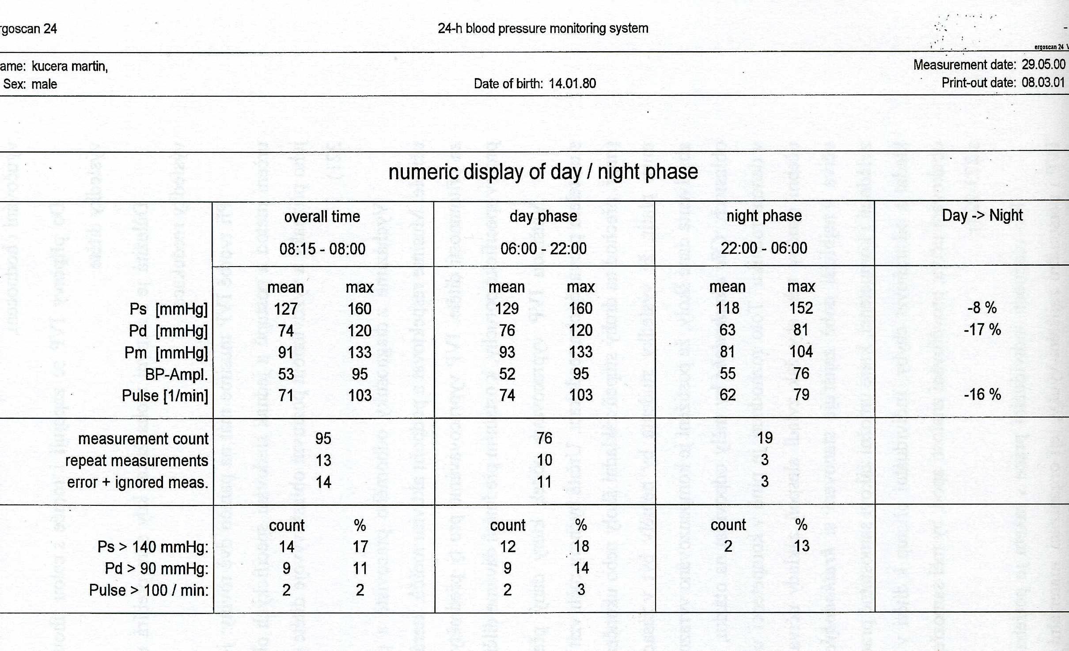

Slide 22
Methodology 4
Continuously blood pressure measurement
Beat to beat record by Penaz method
BP is dynamic parameter
  variability of fluctuation of heart rate and blood pressure – regulation by baroreflex – cooperation both parts of autonomic nervous system (symphathetic and parasymphathetic part)
  Necessary component in clinical tests - head up table test (on inclined plane) and BP dysregulation in young subjects - dif.dg syncope
  BP regulation research - maneuvers – Valsalva etc. ... ..
  BP measurement in extreme situations: supersonic airplane pilots – overload condition, the cosmic program – weightlessness condition etc.

Slide 23
Blood pressure
in children

Slide 24
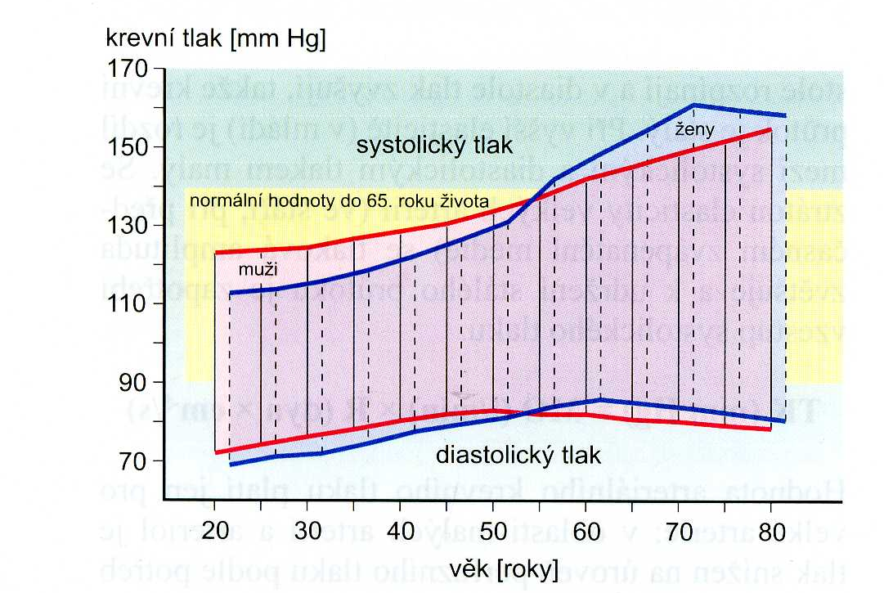
Age influence on blood pressure in man and female
Fölsch et al., Patologická fyziologie, Grada 2003

Slide 25
For children aged 1 to 13 years/aged ≥13 years
Normal BP: <90th percentile // <120/ <80 mmHg
Elevated BP: ≥ 90th percentile to <95th percentile//120/ <80 to 129/ <80 mmHg
  or 120/80 mmHg to <95th percentile (whichever is lower)
  Stage 1 HTN: : ≥ 95th percentile to <95th percentile+12 mmHg//130/80 to 139/89 mmHg
    Or 130/80 to 139/89 mmHg (whichever is lower)
  Stage 2 HTN: ≥ 95th percentile +12 mmHg// ≥140/90 mmHg
    Or ≥140/90 mmHg (whichever is lower)
    Flynn JT, Kaelber DC, Baker-Smith CM, Blowey D, Carroll AE, Daniels SR, et al., for the Subcommittee on Screening and Management of High Blood Pressure in Children. Clinical practice guideline for screening and management of high blood pressure in children and adolescents. Pediatrics. 2017;140(3):e20171904. https://doi.org/10.1542/peds.2017-1904.

Slide 26
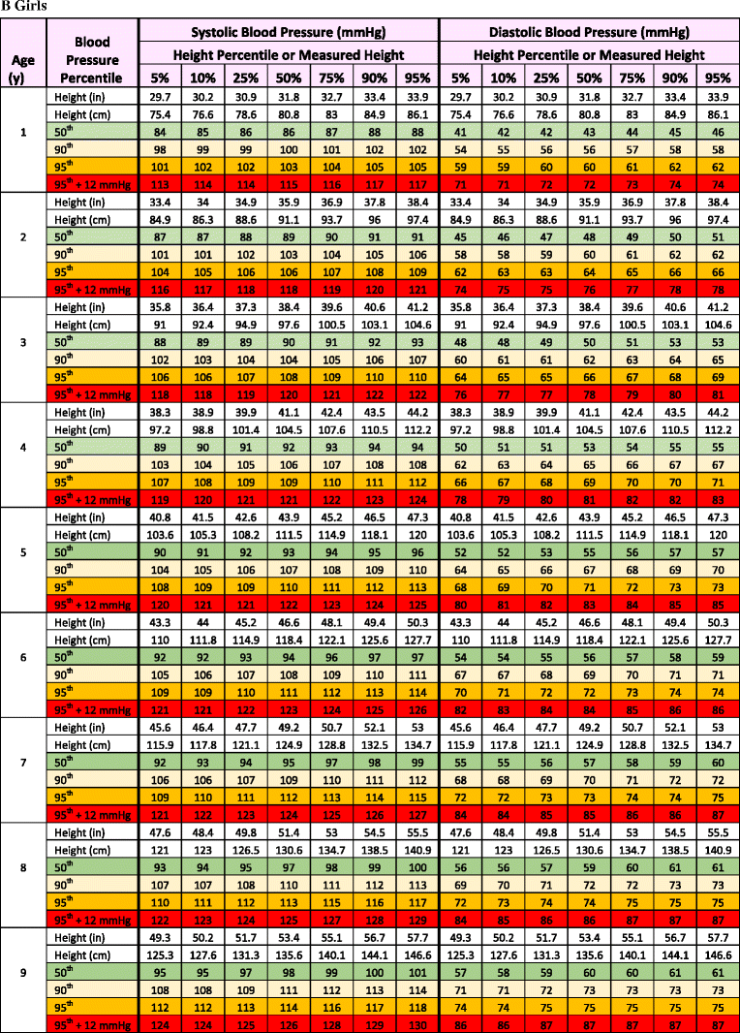
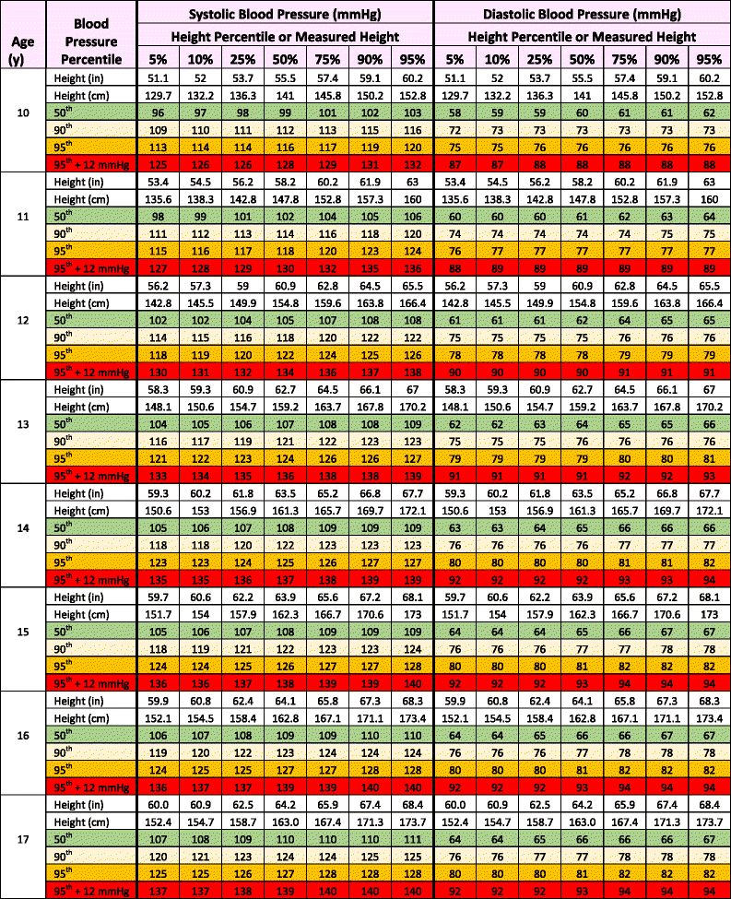

Slide 27
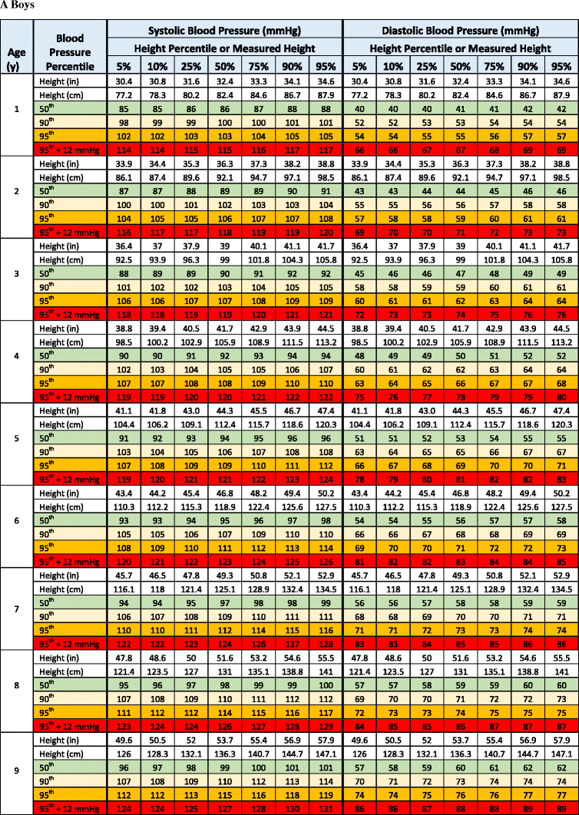
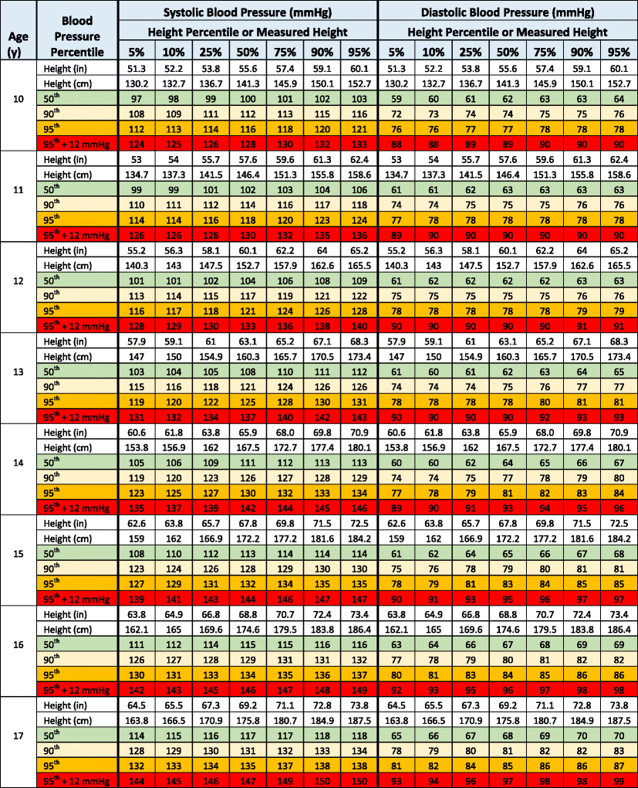

Slide 28
Blood pressure
Immediately after birth – high blood pressure:
  Stress after delivery, increase concentration of catecholamine and cortizol
After 1st day …….. 70/50 mmHg:
  Open of pulmonary and intestine circulation
During pubertas:
  Development of regulatory mechanism
  Stimulation of external world

Slide 29
Newborn 80/46 mmHg 10.6/6.1 kPa
3 years 100/67 13.3/8.9
10-11 years 111/58 14.8/7.7
13-14 years 118/60 15.7/8.0

Slide 30
Blood presure measurement in newborn and children
Korotkoff method – for children over 1 year – use a correct size of cuff
In the newborns, auscultation phenomena are poorly audible - there may be an underestimation of SBP
better use the ultrasound method of the blood flow detector

Slide 31
The size of cuff
Body weight age size of cuff
1 500 g newborn 2.5 cm
5 kg 3 month 4.5 cm
10 kg 15 month 6 cm
30 kg 9 year 7.5 cm
more than
30 kg 10 and more years 12 cm

Slide 32
Specific features measurement
Pregnant women
  Physiological profile of pregnancy - decrease of BP with increase in cardiac output and large decrease of peripheral resistance = special hyperkinetic conditions - Korotkoff phenomena we auscultated even after deflation of the cuff - diastolic BP we estimated in IV phase of Korotkoff phenomena
  Elderly people with atherosclerosis - poor compressibility of the artery wall by a compression cuff - we need to inflate more - so we measure falsely higher SBP values - pseudohypertension
  Obese persons – using the right size of the cuff !!!!! using a standard cuff – overstocking of SBP
  Dynamic physical exercise - auscultation method may underestimate SBP by 15 mmHg, during recovery phase - overstatement of up to 30mmHg SBP; DBP less frequently but falsely low - better use for DBP measurement reading from phase IV of Korotkoff sounds

Slide 33
Actual blood pressure values are dependent on:
factors that are conditioned by the organism
on the measurement method
in which conditions the measurements are performed (methodology)
even on accuracy and reliability of instruments (technical page - necessary tests and calibration of pressure device / 1 year)
THIS MUST BE ALLOWED TO CONSIDER AT THE MEASUREMENT IN CLINICAL PRACTICE

Slide 34
THANK YOU FOR YOUR ATTENTION

