Slide 1
REGULATION/DYSREGULATION in BLOOD PRESSURE

Slide 2


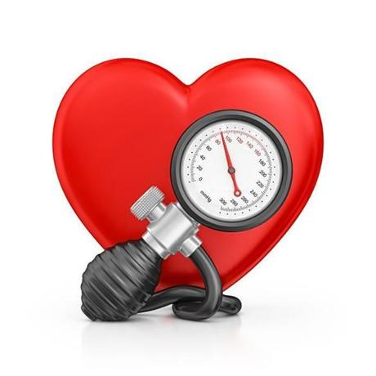

Blood pressure – the most important parameter in cardiovascular system – „high-profile“ parameter

Slide 3
Blood pressure (BP) – pressure of the blood to the wall of the vessels
Systolic BP, diastolic BP, pulse pressure, mean arterial pressure (MAP)
BP = CO x R CO – cardiac output, R – resistance
CO = SV x HR SV – stroke volume, HR – heart rate

Slide 4
ESH AND ESC GUIDELINES
2013 ESH/ESC Guidelines for the management of arterial
hypertension
The Task Force for the management of arterial hypertension of the European
Society of Hypertension (ESH) and of the European Society of Cardiology (ESC)
Authors/Task Force Members: Giuseppe Mancia (Chairperson) (Italy) * , Robert Fagard (Chairperson)

Slide 5
Classification BP values
category | Systolic BP | Diastolic BP
 | (mmHg) | (mmHg)
optimal | < 120 | < 80
normal | 120 – 129 | 80 – 84
high normal pressure | 130 – 139 | 85 – 89
Hypertension - mild | 140 – 159 | 90 – 99
Hypertension - moderate | 160 – 179 | 100 – 109
Hypertension - severe | ≥ 180 | ≥ 110
Isolated systolic hypertension | ≥ 140 | < 90
According the Guidelines of European Society of Cardiology 2013

Slide 6
2018 ESC/ESH Guidelines for the management
of arterial hypertension
The Task Force for the management of arterial hypertension of the
European Society of Cardiology (ESC) and the European Society of
Hypertension (ESH)
Authors/Task Force Members: Bryan Williams* (ESC Chairperson) (UK),
Giuseppe Mancia* (ESH Chairperson) (Italy), Wilko Spiering (The Netherlands),
Enrico Agabiti Rosei (Italy), Michel Azizi (France), Michel Burnier (Switzerland),
Denis L. Clement (Belgium), Antonio Coca (Spain), Giovanni de Simone (Italy),
Anna Dominiczak (UK), Thomas Kahan (Sweden), Felix Mahfoud (Germany),
Josep Redon (Spain), Luis Ruilope (Spain), Alberto Zanchetti† (Italy), Mary Kerins
(Ireland), Sverre E. Kjeldsen (Norway), Reinhold Kreutz (Germany),
Stephane Laurent (France), Gregory Y. H. Lip (UK), Richard McManus (UK),
Krzysztof Narkiewicz (Poland), Frank Ruschitzka (Switzerland),
Roland E. Schmieder (Germany), Evgeny Shlyakhto (Russia), Costas Tsioufis
(Greece), Victor Aboyans (France), and Ileana Desormais (France)
European Heart Journal (2018) 39, 3021–3104

Slide 7
Classification of BP
It is recommended that BP be classified as
optimal, normal, high–normal, or grades
1–3 hypertension, according to office BP.

Slide 8
Classification of office blood pressure and definitions of hypertension gradeb
Category Systolic (mmHg) Diastolic (mmHg)
Optimal <120 and <80
Normal 120–129 and/or 80–84
High normal 130–139 and/or 85–89
Grade 1 hypertension 140–159 and/or 90–99
Grade 2 hypertension 160–179 and/or 100–109
Grade 3 hypertension ≥180 and/or ≥ 110
Isolated systolic hypertensionb ≥ 140 and <90
BP = blood pressure; SBP = systolic blood pressure.
A) BP category is defined according to seated clinic BP and by the highest level of BP, whether systolic or diastolic.
B) Isolated systolic hypertension is graded 1, 2, or 3 according to SBP values in the ranges indicated.
The same classification is used for all ages from 16 years.

Slide 9
Changes in recommendations
2013
Diagnosis: Office BP is recommended for screening and diagnosis of hypertension.
2018
Diagnosis: It is recommended to base the diagnosis of hypertension on:
Repeated office BP measurements; or Out-of-office BP measurement with ABPM and/or HBPM if logistically and economically feasible.

Slide 10
Treatment thresholds
2013
Highnormal BP (130–139/85–89 mmHg): Unless the necessary
evidence is obtained, it is not recommended to initiate antihypertensive drug therapy at high–normal BP.
2018
Highnormal BP (130–139/85–89 mmHg): Drug treatment may be
considered when CV risk is very high due to established CVD, especially
CAD.

Slide 11
Definitions of hypertension according to
office, ambulatory, and home blood pressure levels
Category SBP(mmHg) DBP(mmHg)
Office BP ≥ 140 and/or ≥ 90
Ambulatory BP
Daytime (or awake) mean ≥ 135 and/or ≥ 85
Night-time (or asleep) mean ≥ 120 and/or ≥ 70
24 h mean ≥ 130 and/or ≥ 80
Home BP mean ≥ 135 and/or ≥ 85
BP = blood pressure; DBP = diastolic blood pressure; SBP = systolic blood pressure.
.

Slide 12
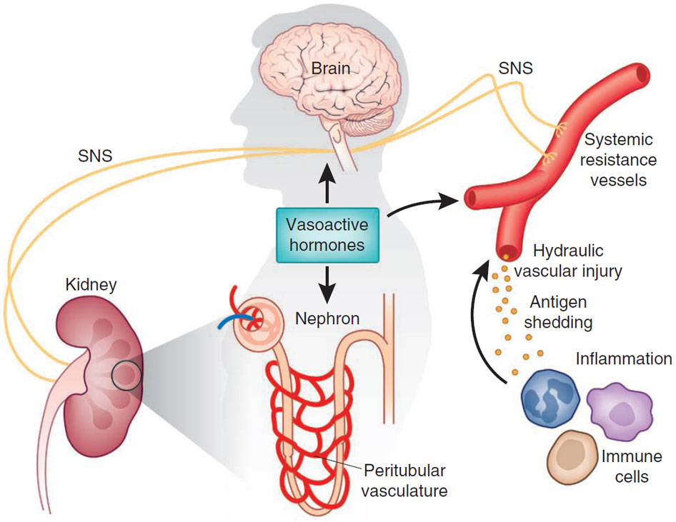
Regulation of blood pressure – complex process
compliance
Vasoconstriction: angiotensin II, vasopresin, epineprin (α₁), serotonin, PGF/TXA_{2,} endotelin, cofein, NPY
sympatikus parasympatikus
baroreflex
Vasodilatation:
NO, adrenalin (β₂), adenosin, acidosis, histamin, PGD₂/PGE₂/PGI₂, prostacyclins, VIP, bradykinin
RAAS
ANP/BNP
ADH
Thomas M Coffman, Under pressure: the search for the essential mechanisms of hypertension , Nature Medicine 17, 1402–1409 (2011)

Slide 13
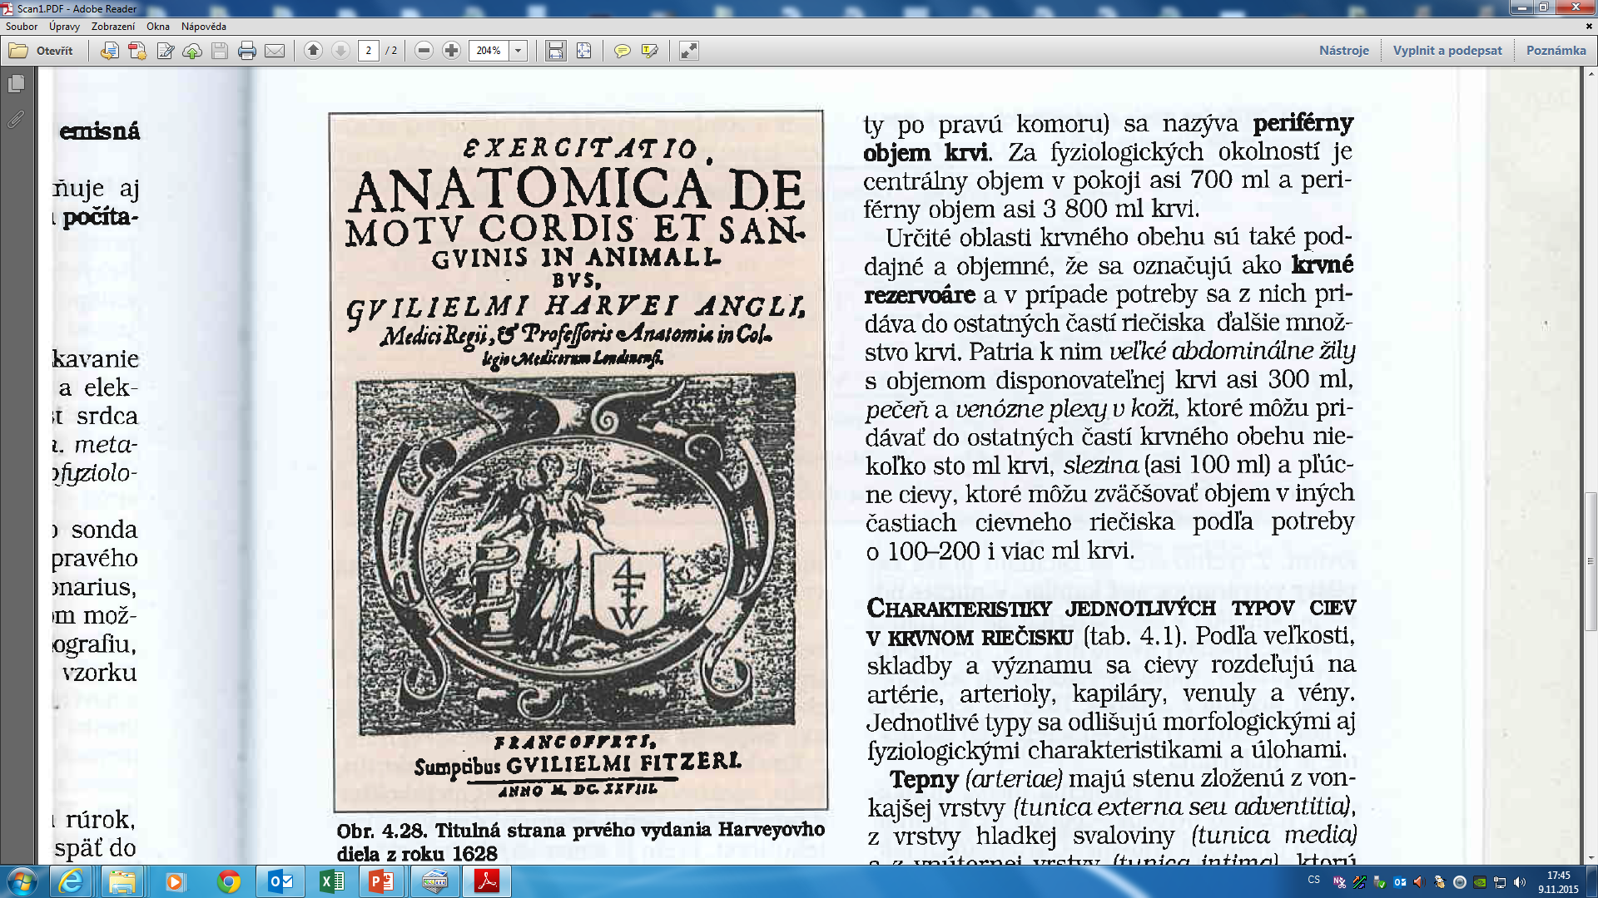
let me remark that 400 years ago

Slide 14
REGULATION IN CARDIOVASCULAR SYSTEM
Main function:
keep relatively constantaneous arterial blood pressure
keep perfusion of tissues

Slide 15
Regulation of vessels tone
Tone of the vessels = basic tension of the smooth muscle inside of the wall
(vasoconstriction x vasodilatation)
Regulation - local autoregulation
- system regulation

Slide 16
Autoregulation
Autoregulation – the capacity of tissues to regulate their own blood flow
Myogenic theory – Bayliss phenomenon (as the pressure rises, the blood vessels are distended and the vascular smooth muscle fibres that surround the vessels contract; the wall tension is proportional to the distending pressure times the radius of the vessels – law of Laplace)

Slide 17
Autoregulation
Metabolic theory – vasodilator substances tend to accumulate in active tissue, and these metabolites also contribute to autoregulation
  ending products of energetic metabolism – CO₂, lactate acid, K⁺
  effect of hypoxia (circulation: vasodilatation x pulmonary circulation: vasoconstriction)
  Adenosin – coronary circulation: vasodilatation

Slide 18
Autoregulation
by substances which releasing from:
  endothelium
  tissues

Slide 19
Substances secreted by the ENDOTHELIUM
Vasodilatation:
Nitric oxide (NO) from endothelial cells
(originally called: EDRF)
Prostacyclin is produced by endothelial cells
Vazoconstriction:
Endothelins (polypeptids – 21peptides)
three isopeptides: ET 1, ET 2 , ET 3

Slide 20
Substances secreted by the tissues:
Histamine – primarily tissue hormones.
General affect: vasodilatation - decrease periphery resistence, blood pressure
KININS: 2 related vasodilated peptides
Bradykinin + lysylbradykinin (kallidin).
Sweat glands, salivary glands
10x strongers than histamine
Relaxation of smooth muscle, decrease blood pressure

Slide 21
Systemic regulation
By hormones
Catecholamines – epinephrine, norepinephrine - effect as activation of sympathetic system
RAAS - stress situation
ADH - general vasoconstriction
Natriuretic hormones - vasodilatation

Slide 22
Neural regulatory mechanism
Autonomic nervous system
Sympathetic: vasoconstriction
All blood vessels except capillaries and venules contain smooth muscle and receive motor nerve fibers from sympathetic division of ANS (noradrenergic fibers)
Regulation of tissue blood flow
Regulation of blood pressure
Parasympathetic part: vasodilatation
Only sacral parasympathetic cholinergic fibres (Ach) inervated arteriols from external sex organs

Slide 23
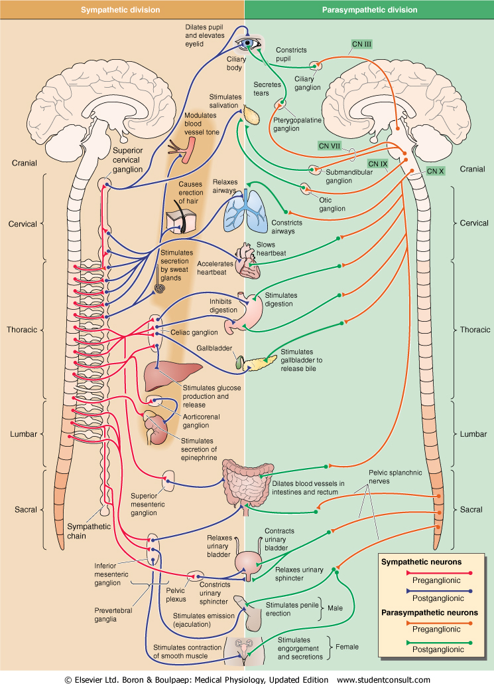
Sympathetic nervous system
Fight or flight response
Energy/store consumption
Preganglionic neuron
– Spinal cord
-Thoraco - lumbar system
Ganglia Paravertebral
Truncus sympathicus
Majority
Prevertebral
-Plexus aorticus
Mostly diffuse effect
Parasympathetic nervous system
Rest and digest response
Energy conservation/en. store production
Preganglionic neuron
– Brain stem and spinal cord
– cranio-sacral system
Ganglia
Close to target organs or intramurally
Mostly local effect

Slide 24
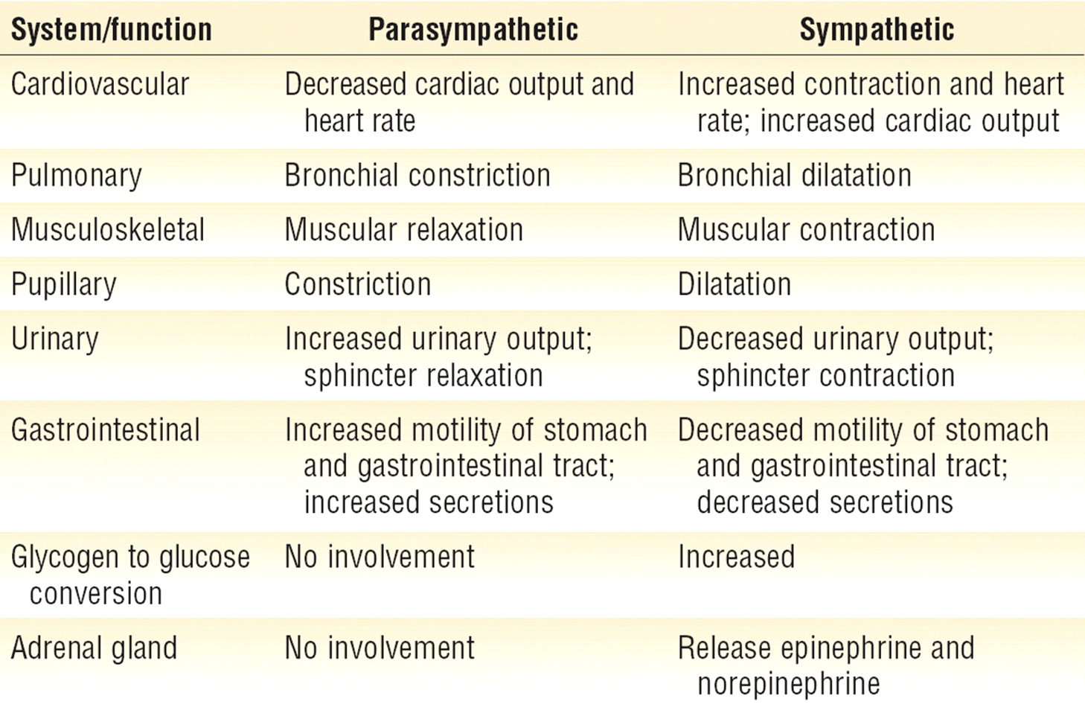
Sympathetic nervous system
Fight or flight response
Energy/store consumption
Preganglionic neuron
– Spinal cord
-Thoraco - lumbar system
Ganglia Paravertebral
Truncus sympathicus
Majority
Prevertebral
-Plexus aorticus
Mostly diffuse effect
Parasympathetic nervous system
Rest and digest response
Energy conservation/energy store production
Preganglionic neuron
– Brain stem and spinal cord
– cranio-sacral system
Ganglia
Close to target organs or intramurally
Mostly local effect

Slide 25
INTEGRATION of regulation in cardiovascular system
The regulation of the heart:
  Rami cardiaci n. vagi
Cardiac decelerator center - medula oblongata (ncl.dorsalis, ncl. ambiguus) – parasympathetic fibres of nervus vagus
: vagal tone (tonic vagal discharge)
Negative chronotropic effect (on heart rate)
Negative inotropic effect (on contractility)
Negative dromotropic effect (on conductive tissue)

Slide 26
INTEGRATION of regulation in cardiovascular system
The regulation of the heart:
  nn. cardiaci
Cardiac accelerator center – spinal cord, sympathetic ganglia – sympathetic NS
Positive chronotropic effect (on heart rate)
Positive inotropic effect (on contractility)
Positive dromotropic effect (on conductive tissue)

Slide 27
INTEGRATION of regulation in cardiovascular system
Vasomotor centre (regulation for function of vessels)
Medula oblongata
presoric area (rostral and lateral part –vasoconstriction – increase blood pressure
depresoric area (medio-caudalis part – vasodilatation, decrease of blood pressure)

Slide 28
INTEGRATION of regulation in cardiovascular system
Influence by central nervous system
  cerebral cortex
  limbic cortex
  hypothalamus

Slide 29
Regulation of blood pressure
Short - term regulation
- baroreflex
Middle - term regulation
- humorals regulation
sympathetic - catecholamines
RAAS (decrease perfusion pressure in kidney – secretion of renin)
ADH
Long – term regulation
- kidney regulation

Slide 30
Baroreflex – in every day life
Orthostatic – clinostatic reaction
Valsalva maneuvre

Slide 31
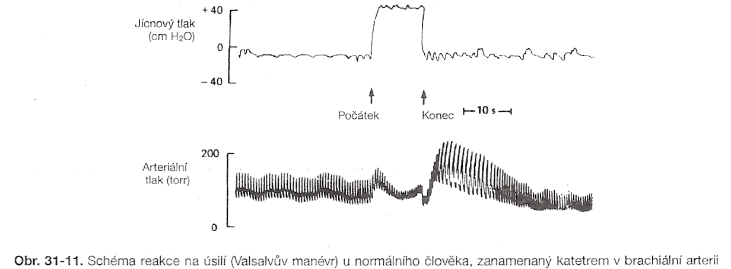

Slide 32
Resetting of baroreflex
During repeated raising of blood pressure - e.g. in chronic hypertension - the force of baroreflex reaction on systemic blood pressure is lower
??? Why???mechanical changes in baroreceptors – decrease sensitivity due to structure changes on the vessels wall OR dysfunction of endotelium OR down-regulation in the brain center due to their increasing frequency of stimulation
Resseting of baroreflex can regulate the changes in blood pressures, but the resseting is unable to go back on „normal“ level
Resetting is a partially reversible – during a short-term influence of raising blood pressure
Notice: in clinical practice:
  !start treatment of hypertension in time!

Slide 33
BAROREFLEX SENSITIVITY
A change of duration of pulse interval (in ms) due to a change of blood pressure by 1 mmHg
Laboratory methods:
- Phenylephrin aplication
- neck suction
- Valsalva manoever
Spontaneous methods:
in time-domain
- Sequence analysis
in frequency-domeain
- cross-spectral analysis
- α-index

Slide 34
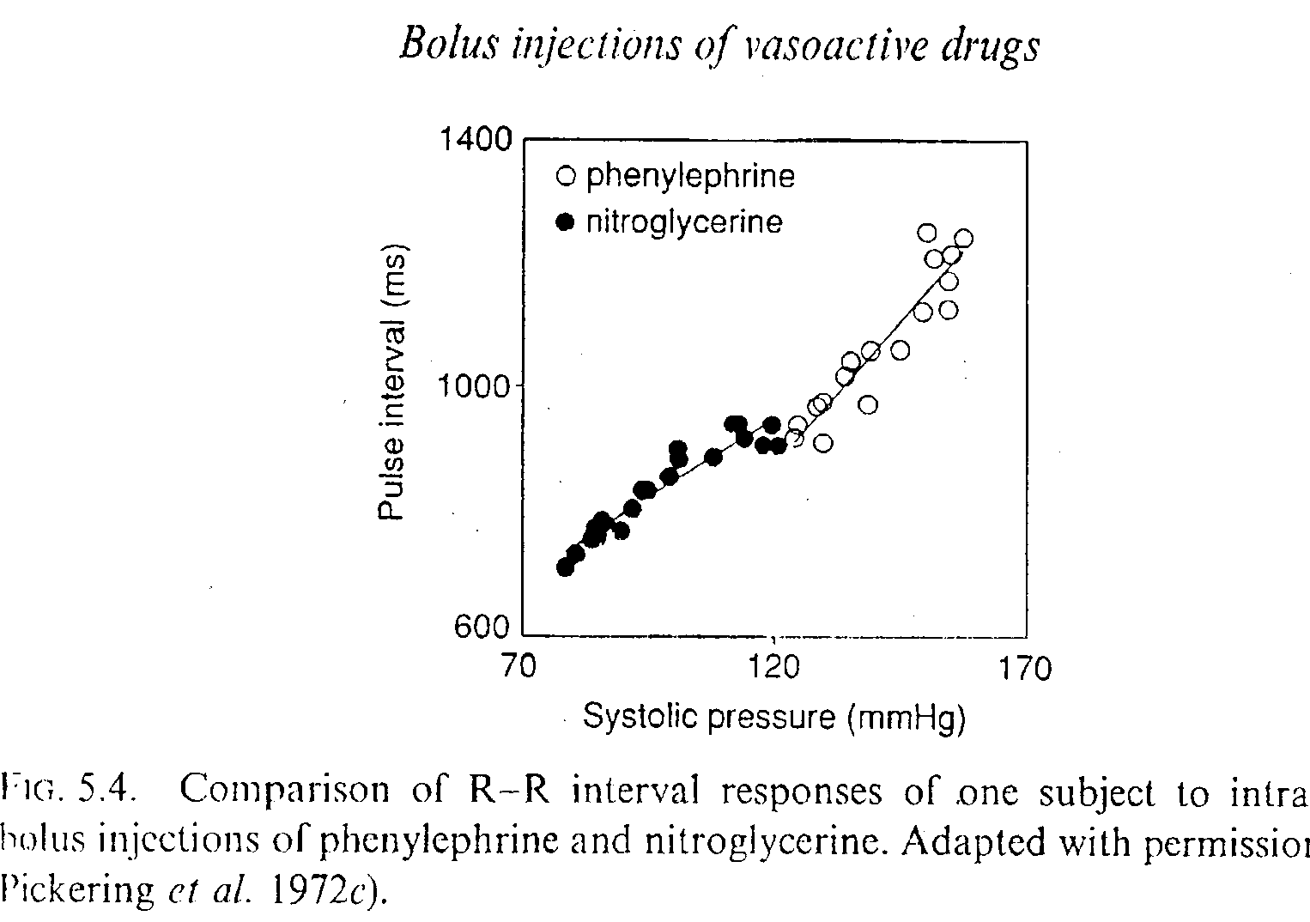
BAROREFLEX SENSITIVITY
- Phenylephrin aplication

Slide 35
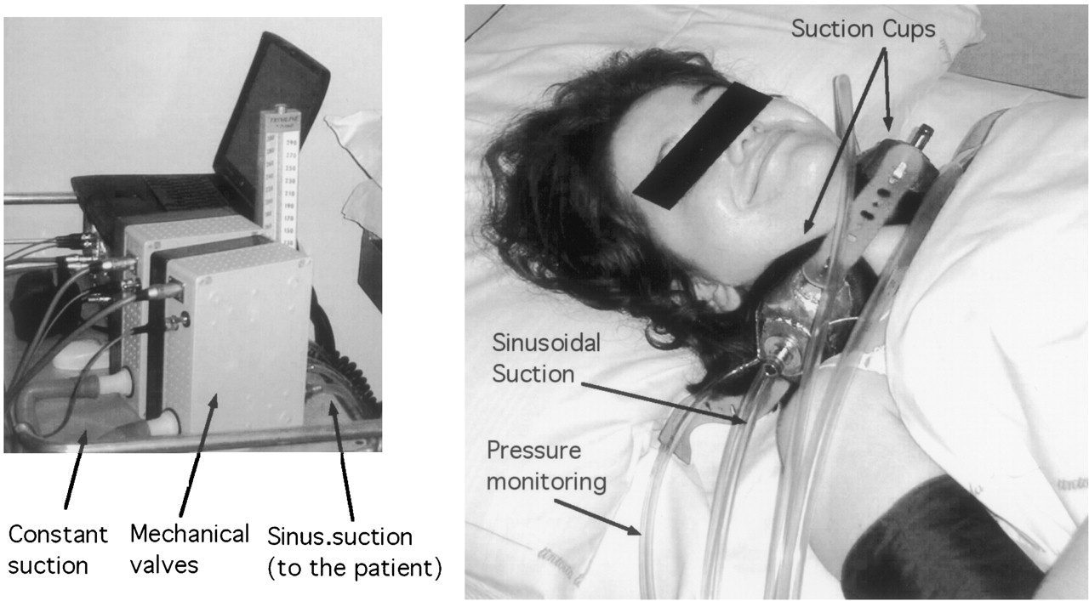

BAROREFLEX SENSITIVITY
- Neck suction
Furlan R et al. Circulation 2003;108:717-723

Slide 36
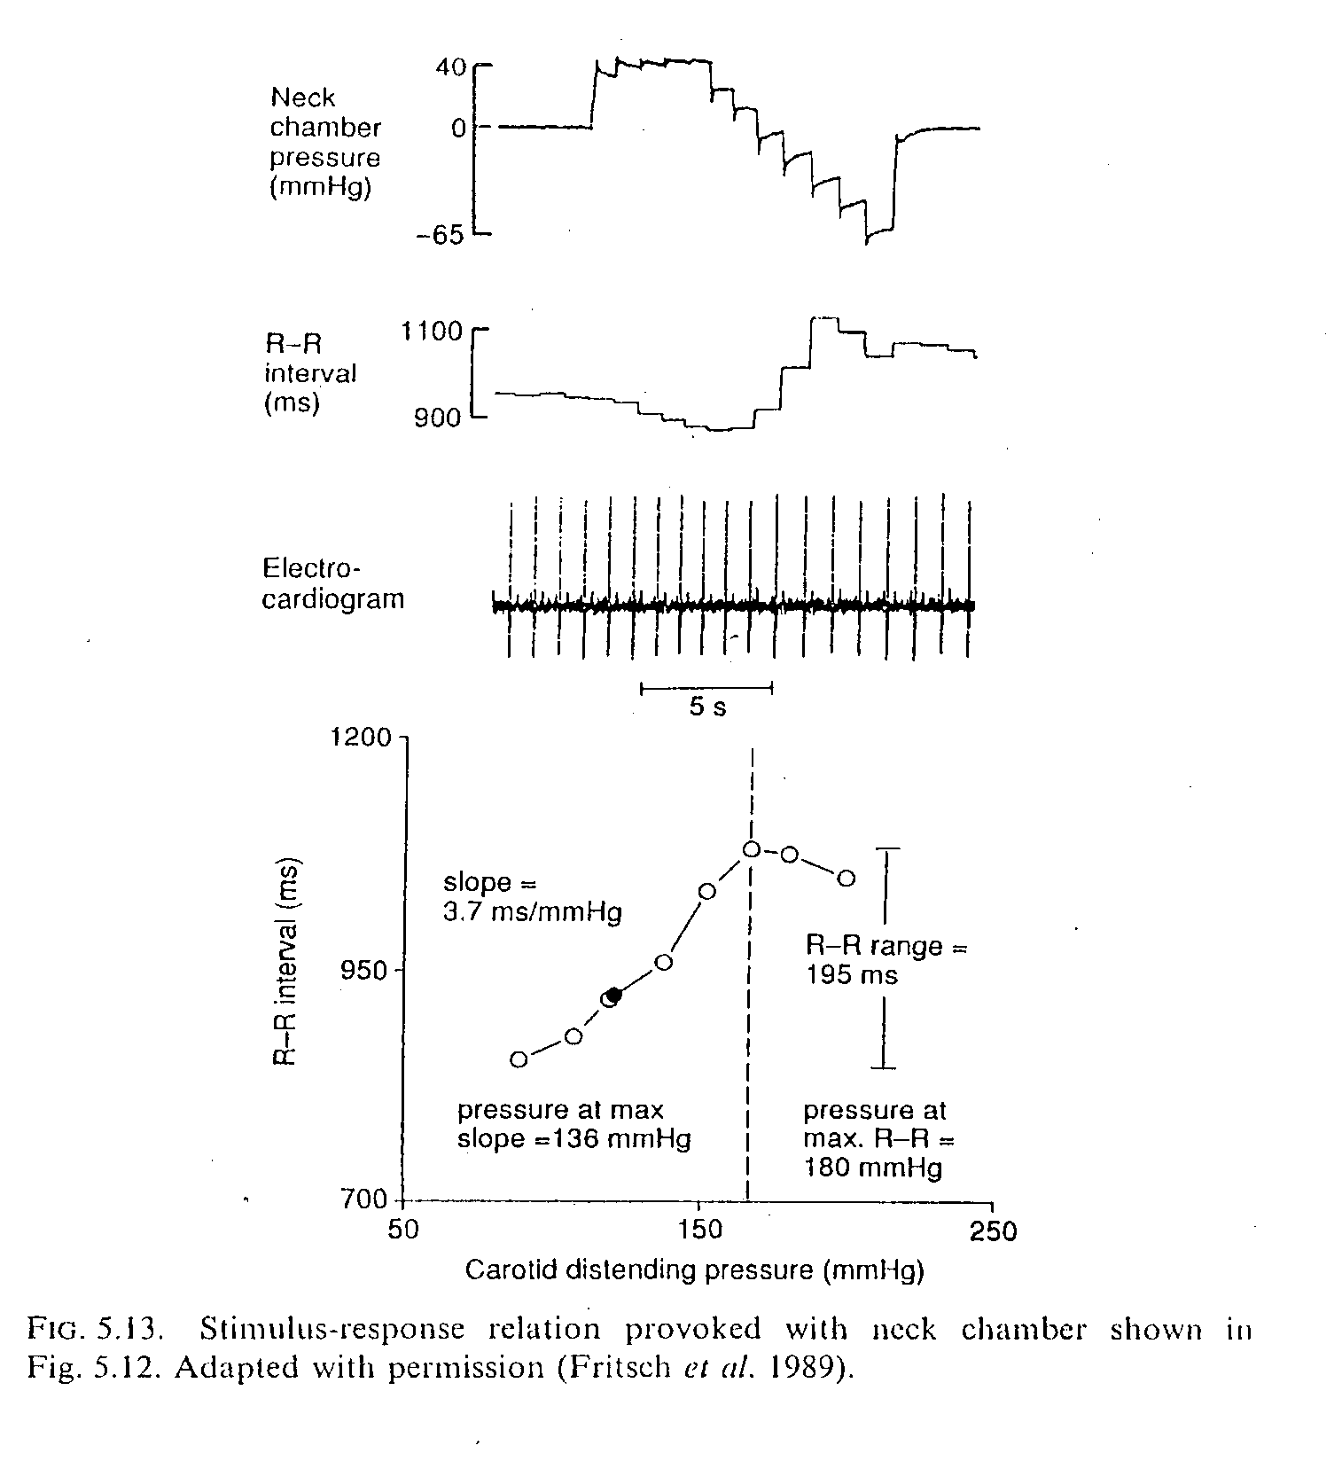
BAROREFLEX SENSITIVITY
- Neck suction

Slide 37
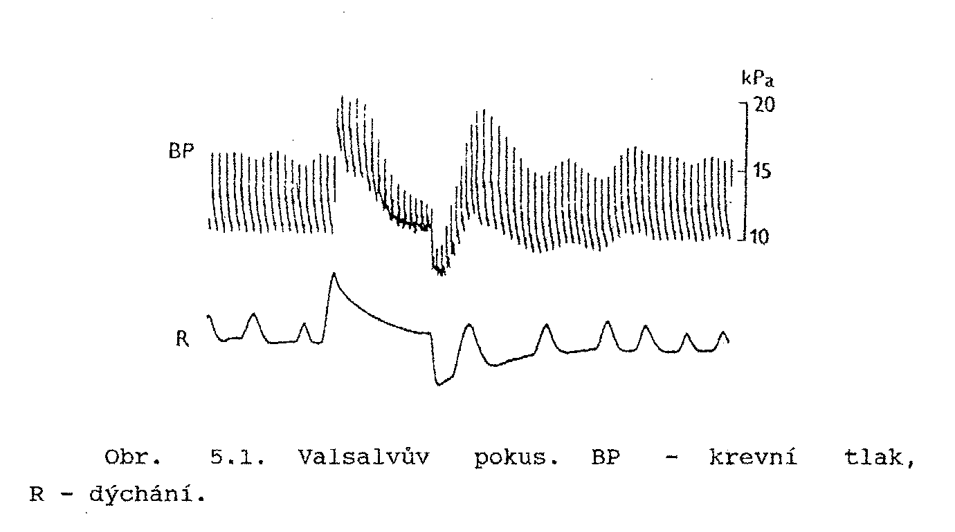
BAROREFLEX SENSITIVITY
- Valsalva manoever
(TK)VNSVPTStř TK

Slide 38
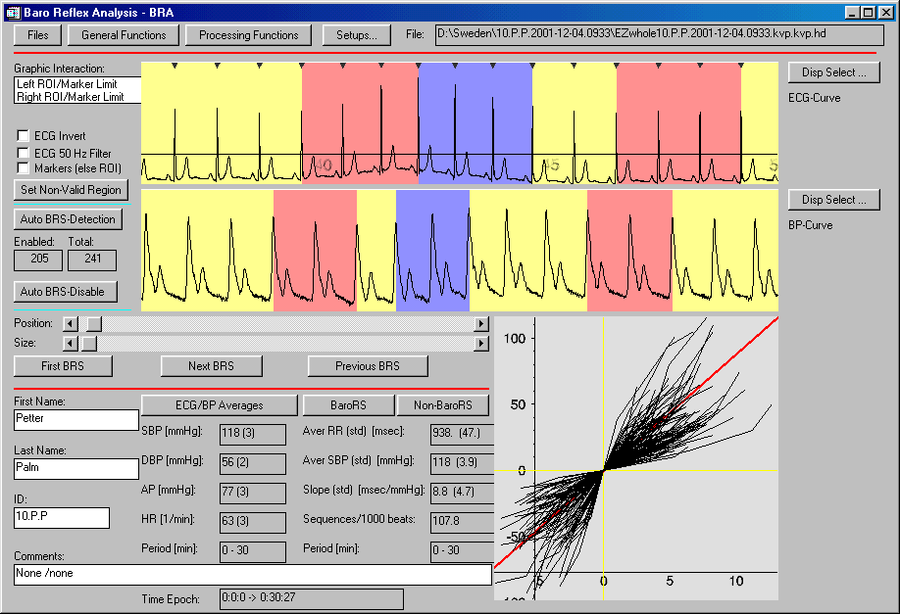
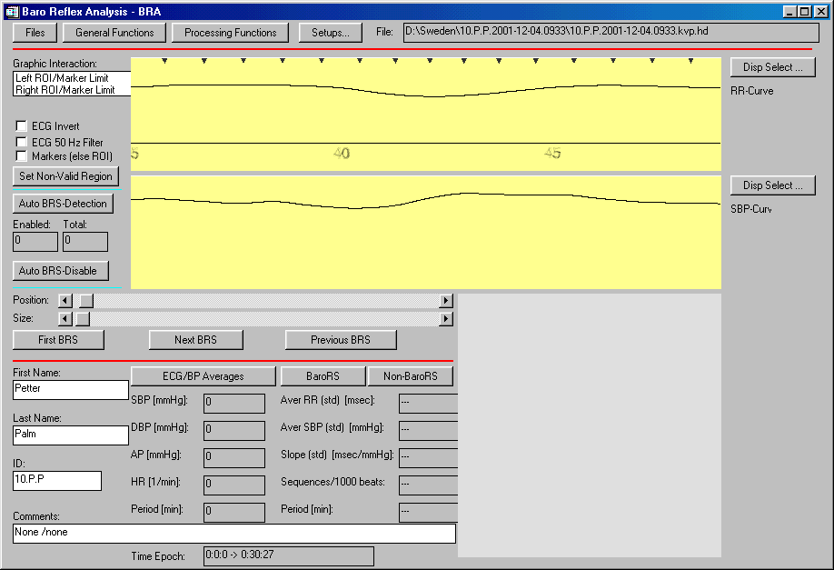
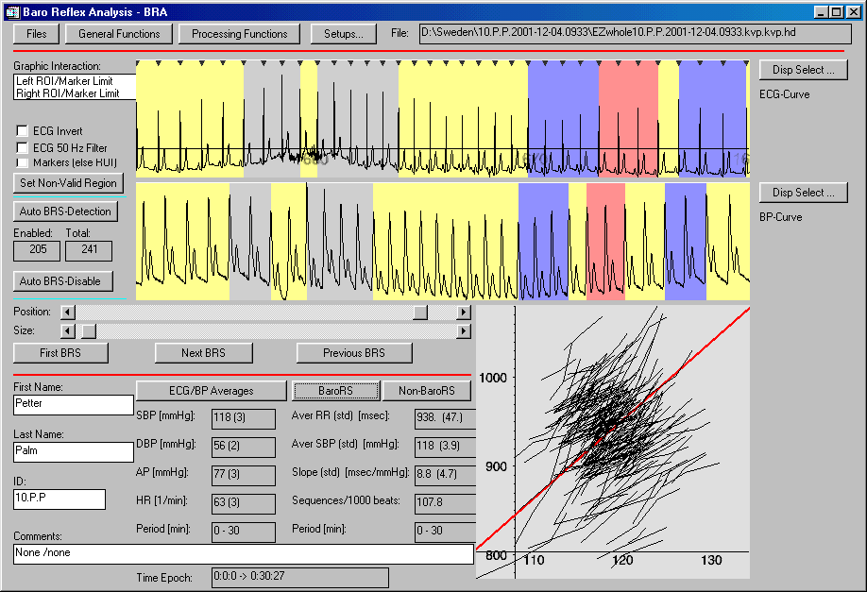
SI
[ms]
STK
[mmHg]
BAROREFLEX SENSITIVITY
- Sequence analysis

Slide 39
BAROREFLEX SENSITIVITY
- cross-spectral analysis

Slide 40
Middle – term regulation 1 catecholamines
Mediators of sympathetic nerves for baroreceptors and chemoreceptors
Sympathetic nervous system stimulates releasing of epinephrine and norepinephrine from adrenal medulla – main function: vasoconstriction – chronotropic effect – inotropic effect
Its function start during minutes or hours

Slide 41
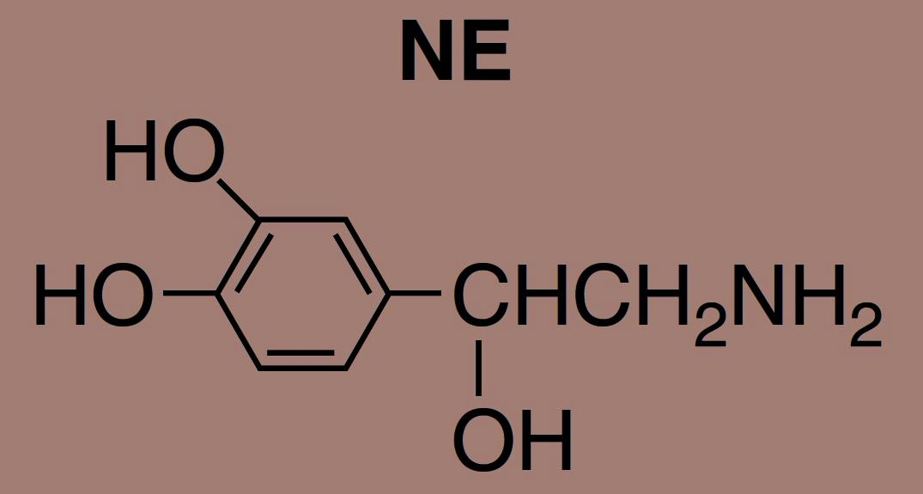
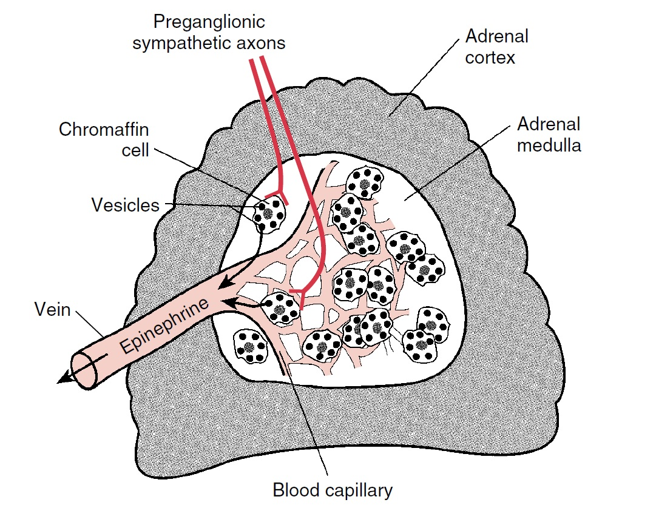
ANS
Adrenal medulla
– modified sympathetic ganglion
– release stress hormon to blood stream

Slide 42
Middle – term regulation 2
Renin - angiotensin - aldosteron
System in kidney
+
extrarenal system (in other tissues – brain, adrenal medulla, gonades, eyes)
+
Intermediate system – heart, smooth muscles
Renin – in juxtaglomerular cells in kidney
In liver – glycoprotein angiotensinogen – release angiotensin I (dekapeptid) – due to angiotensin converting ensyme to angiotensin II(oktapeptid) or angiotensin III (aminopeptidase)
Angiotensin II – other way – chymase – in th heart and arterioles
(it is reason why during treatment by ACE blocatores – the angiotensin level is not reduce)

Slide 43
Secretion of renin is modulated by
Sympathetic nervous system – beta 1 receptors activation – main mechanism of secretion of renin
Second way – by special mechanism due to sensitivity on sodium
  exists a special intrarenal mechanism – negative sodium billance increase the renin secretion
  ???? hypothesis – macula densa register of sodium concentration in renal tubular system – this information transports to juxtaglomerular cells where activated renin-angiotensin system (has an influence on secretion of renin – release angiotensin II );
  Increse level of sodium – decrease releasing of renin (mediator – Nitric Oxide)
???Arterial pressure – stretch receptors (baroreceptory) in vas afferens (juxtaglomerular cells) – influence on blood pressure in kidney or also in systemic circulation???

Slide 44
Angiotensin II - Effects (Owerview)
Vasoconstriction
Change in renal hemodynamics – decrease of blood flow in kidney and glomerular filtration
Influence on reabsorption of sodium in renal tubules
It invokes or enhances the presynaptic release of noradrenaline
Stimulates the release of ADH
Effect of ANGIOTENSIN III
Stimulation of aldosterone secretion from the adrenal cortex

Slide 45
Middle – term regulation 3
ADH - vasopressin
During a strong decline of blood pressure
from posterior pituitary – vasoconstriction
May be: slowly effect – retention of water in distal tubule and proximal part of collecting ducts

Slide 46
Long – term regulation
Little is known about how this occurs
Pressure diuresis regulates the volume in circulation and keep „pressure homeostasis“
Blood pressure increases longer than 2 hours (persistant increase)– started pressure diuresis, its time duration a lot of days (increase blood pressure – increase excretion of sodium - osmotic activity – increase excretion of water ---decrease extravascular volume and decrease blood pressure)
a single control system which is not subject to adaptation – the action takes as long as the pressure is returned to the original values (or if its action is not reversed by other mechanisms)
With persistent decrease of BP - the opposite effect

Slide 47
Long – term system of pressure natriuresis
It is a cascade of regulatory processes:
the mechanical effect of increased blood flow through the kidney ... increased blood flow in the kidney papilla - increased renal interstitial hydrostatic pressure - increased tight junction of epithelial cells of the renal tubules for sodium - increased sodium excretion - increased excretion water - decrease in volume of circulatory fluids - pressure drop in the systemic circulation
System of internal renal baroreceptors ... pressure increase in vas afferens ... restriction of renin production - attenuation of renal sympathetic stimulation - decrease in sodium reabsorption, reduction of fluid volume - pressure drop
Na⁺- K⁺ - ATPase inhibitory factor – released from adrenal medulla (steroid-like digitalis - possibly ouabain)
Increased AT₂ receptor expression for angiotensin II (may antagonize the effects of inadequate AT₁ receptor stimulation, in rat experiments demonstrated - increased sodium and water excretion)
Others: bradykinin, urodilatin, renal natriuretic peptides

