Slide 1
Moderní metody pro analýzu genomu: Bioinformatika I
Vojtěch Bystrý
29. October 2018
Notes:
Good morni

Slide 2
Goals of the presentation
Overview of NGS bioinformatics
  NGS bioinformatics < Sequence analysis < Bioinformatics
What to think about when you
  plan experiment
  discuss data analyses
  check results
Not to teach you how to do bioinformatics
2

Slide 3
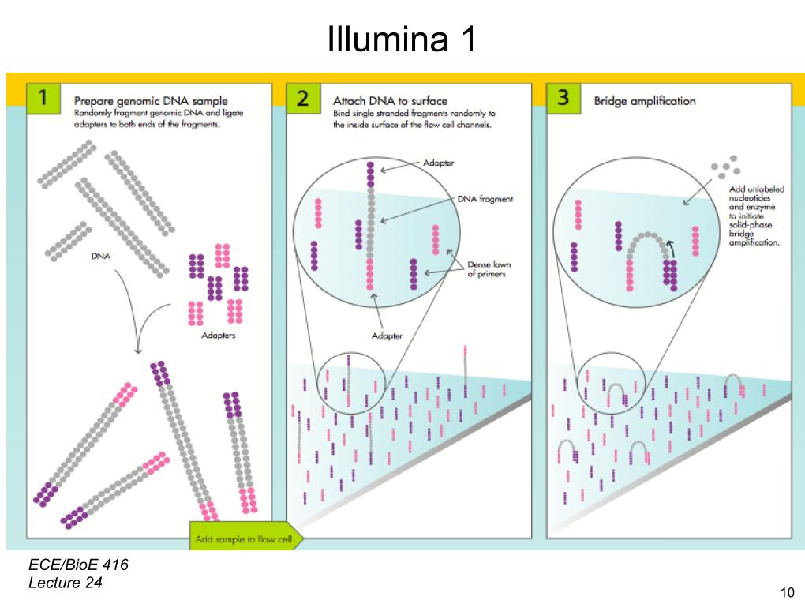
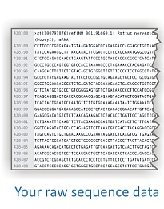
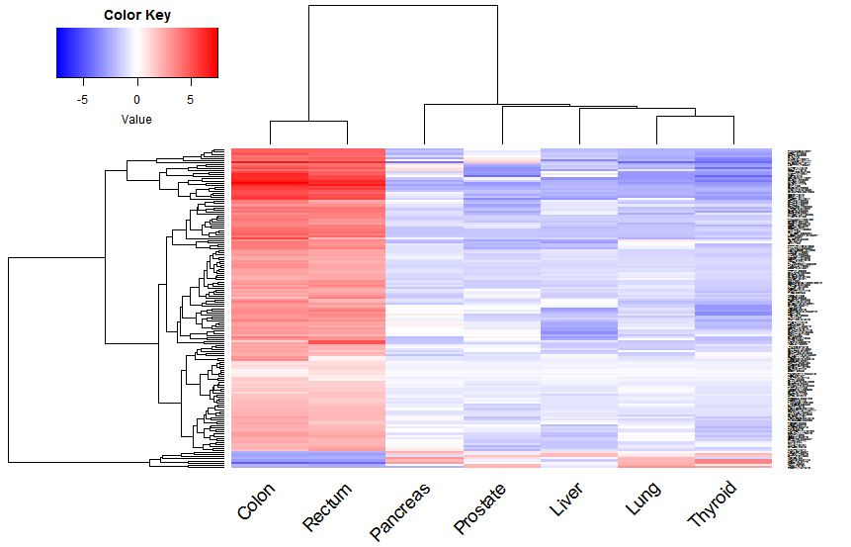
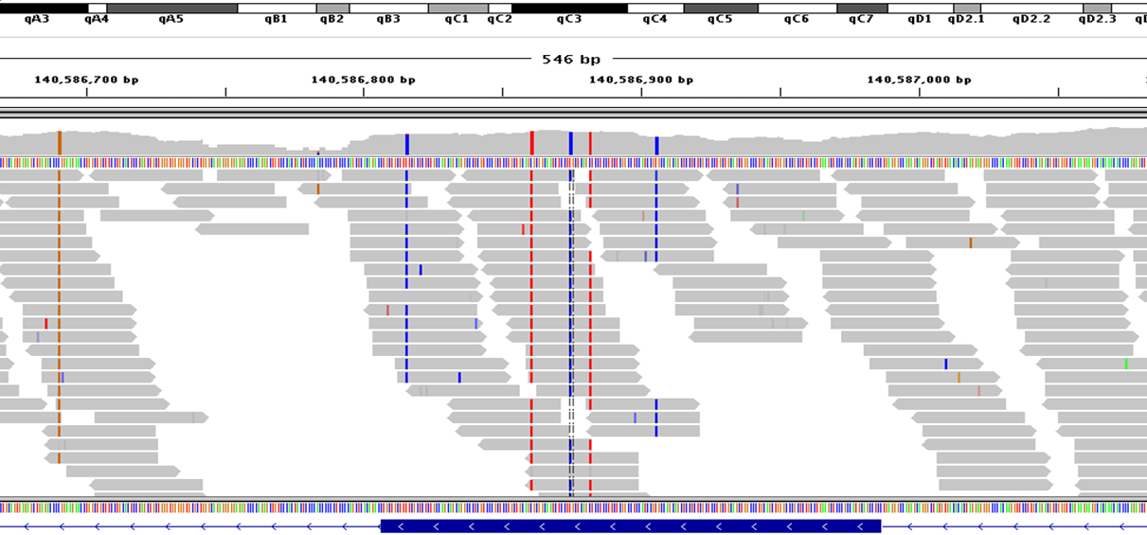
NGS Bioinformatics
3

Slide 4
NGS experiments
Cell Static
Next Generation Sequencing
Cell Dynamics
4

Slide 5
NGS experiments
Cell Static
DNA sequencing
Next Generation Sequencing
Cell Dynamics
RNAseq, Chip-seq, CLIP-seq..
5

Slide 6
NGS experiments
DNA sequencing
Recognize differences from “normal”
Next Generation Sequencing
RNAseq, Chip-seq, CLIP-seq..
Counting elements
6

Slide 7

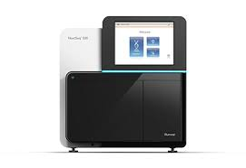
NGS data analysis workflow
Experiment design
de-multiplexing
Special cases
Raw data
.fastq
QC
Not known reference:
Non-standard species
Assembly
IG/TR receptors
Mapping
.bam
QC
Variant analysis
Expression analysis
Structural variants
…
7

Slide 8
NGS data analysis workflow
Experiment design
de-multiplexing
Special cases
Raw data
.fastq
QC
Mapping
.bam
QC
Variant analysis
Expression analysis
Structural variants
8

Slide 9
Experimental design
Have a hypotheses!
Consult with sequencing expert and bioinformatician
If experiment you have in mind can be done in a way you are planning to.
If the results you want can be obtained from the planned sequencing. (desired outcome)
If the bioinformatician knows how to perform specific types of analyses and how long it will probably take.
9

Slide 10
NGS data analysis
Experiment design
de-multiplexing
Special cases
Raw data
.fastq
QC
Mapping
.bam
QC
Variant analysis
Expression analysis
Structural variants
10

Slide 11
De-multiplexing
Not perfect
  In silico contamination – problem for MRD detection
Sample naming and organisation
Naming
  Unique names
  _ vs – vs .
  Special characters: $&|@+- …
  Really tricky: - vs −
Organization
  Should not be your worries
  For any longer ‘operation’ comprehensive database is necessary
  Currently working on it ourselves ☺
  Please fill the forms carefully and as much as possible
11

Slide 12
NGS data analysis
Experiment design
de-multiplexing
Special cases
Raw data
.fastq
QC
Mapping
.bam
QC
Variant analysis
Expression analysis
Structural variants
12

Slide 13
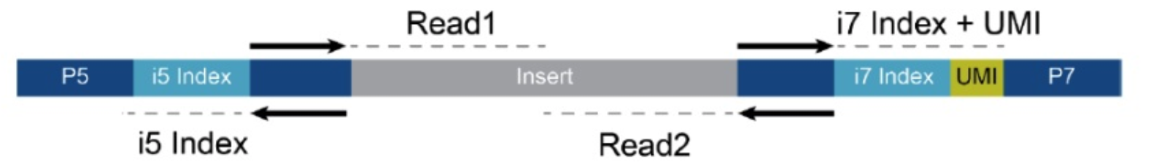
Data pre-processing
Primer (adaptor) trimming
  To cut adapter usually not necessary but good practice
  Primer removal is necessary
UMI extraction

Slide 14
UMI – unique molecular identifiers
Each molecular fragment gets unique n-base sequence (n ~ 8-12)
Usage:
  Mark duplicates
  Consensus sequence
    sequencing (PCR) error removal

Slide 15
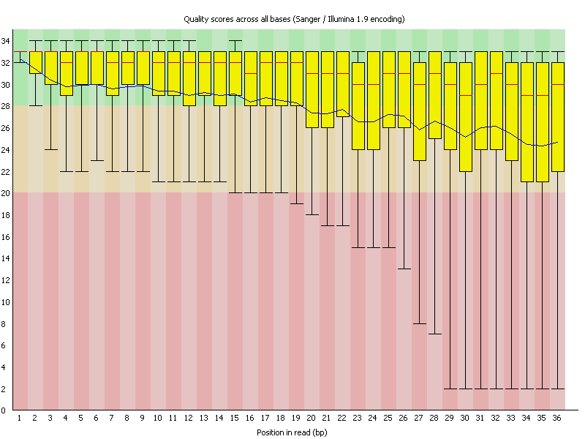
Raw data - QC
Fastq - q stands for quality – coded phred score
CFFFFEFFGCEEGECFGGGGAFF87@E:++6C<++3:,8,33,,:,,,:,,:,,,
Quality | Error probability
5 | 31%
10 | 10%
20 | 1%
30 | 0.1%
Very good for early problem detection
Reasonable for trimming and read filtering
  RNA seq - above phred score 5
Not good for individual variant analysis
15
Notes:
Most is

Slide 16
NGS data analysis
Experiment design
de-multiplexing
Special cases
Raw data
.fastq
QC
Mapping
.bam
QC
Variant analysis
Expression analysis
Structural variants
16

Slide 17
Alignment
Computationally most demanding
More or less standardized
Align to genome then select region of interest (ROI) <- .bed file
  Don’t force alignment
  Keep the information about wrongly aligned for QC
  Exception targeted SV detection
Our standard procedure:
  BWA - DNA
  STAR - RNA
  Chimira – sRNA
17

Slide 18
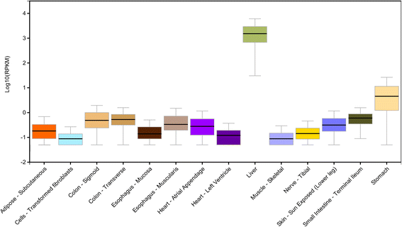
Alignment - QC
DNA
  Mean coverage and variance
  Percentage of covered with at least
    In WES we define good quality if at lest 90% of positions are covered at least 20x
  Per base coverage – in smaller experiments
RNA
  Per gene coverage
  Variability of per gene mapping
  Gene counts distribution
  rRNA content estimate
  Tissue expression check - gtex
18

Slide 19
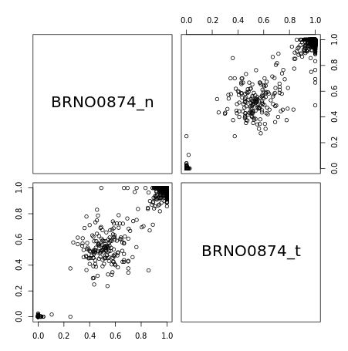
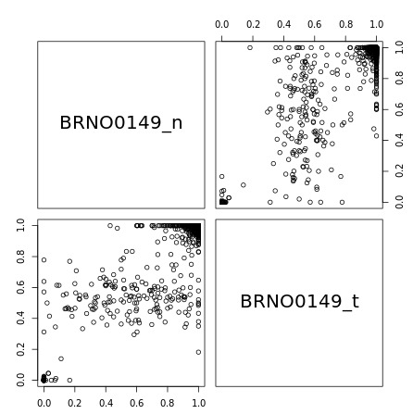
Alignment - QC
BAM cross-contamination
  verifyBamID
  FREEMIX - bellow 0.03 = OK
Cross-sample snp allele frequency correlation
  merge vcf tools
19

Slide 20
NGS data analysis
Experiment design
de-multiplexing
Special cases
Raw data
.fastq
QC
Mapping
.bam
QC
Variant analysis
Expression analysis
Structural variants
20

Slide 21
Variant Calling
21

Slide 22
Variant Calling
Type of comparison
  ermline – to reference genome
  Somatic – to other sample(s)
Expected variant heterogeneity
  Indirectly corelates to the necessary coverage

Slide 23
Variant Calling - planning
Scope
With fixed cost of bp-read it seems the price is linear
The “price” of the analysis must be considered
  Power of the results (sensitivity, specificity)
Scope | genes | ~bp | ~% of WG
WGS | ~22000 | 3 200 mil | 100%
WES | 22000 | 30 mil | 1%
PanCancer | 1049 | 1.2 mil | 0.04%
CZECANCA | 219 | 250 000 | 0.0083%
TP53 | 1 | 25772 | 0.000859%
23

Slide 24
Variant Calling - planning
Example
WES on a single healthy person with a question:
Are there any variants?
Answer is YES
Lets have an analysis with per base false positive error rate 0.0001.
Resulsts in:
2 false variants in TP53 gene
3000 false variants in WES!
24

Slide 25
Variant Calling - planning
Sample design
  Germline
  Somatic
  Tumor - Normal
  Family
Any relationship between samples for comparison improve specificity dramatically
  Not sensitivity
Somatic variant calling without normal needs high coverage
RNA
  Depends on gene expression levels
  Variant might not be there! – gtex, previous runs QC
25

Slide 26
Variant Calling
Specificity vs. Sensitivity
Tools
  varscan – no statististics = no assumptions
  vardict
  gatk haplotype caller
  mutect – only snp
  pindel – only indels
  freebayes
Callers combining – usual strategy
Variant Annotation
  Annovar – good database
  snpEff
  vep – variant effect predictor
26

Slide 27
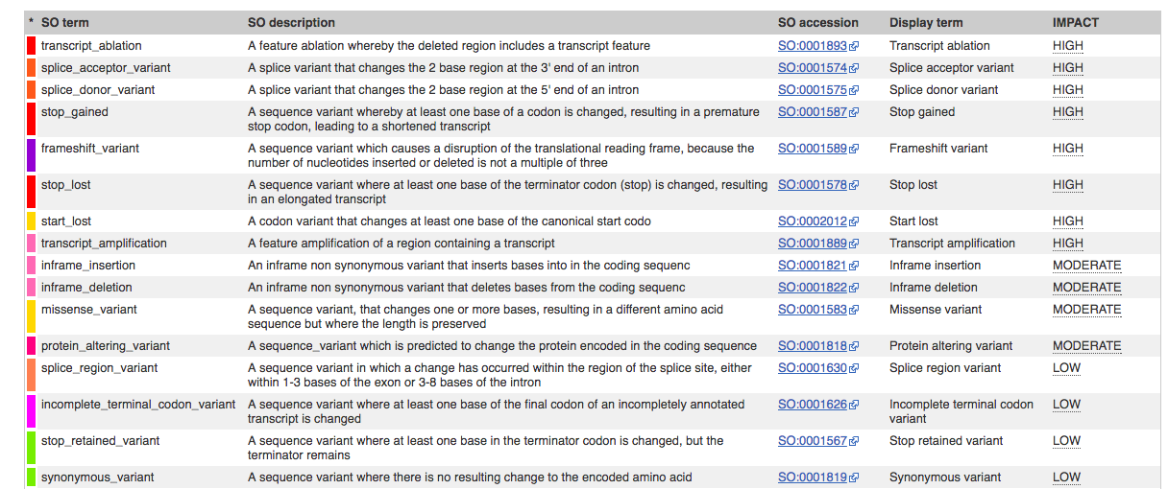
Variant Calling
Variant annotation can help variant calling significantly
Variant occurrence in normal population
  1000 genome project – above 5%
Variant consequences cut off
Database can help significantly – Sophia Genetics
27

Slide 28
NGS data analysis
Experiment design
de-multiplexing
Special cases
Raw data
.fastq
QC
Mapping
.bam
QC
Variant analysis
Expression analysis
Structural variants
28

Slide 29
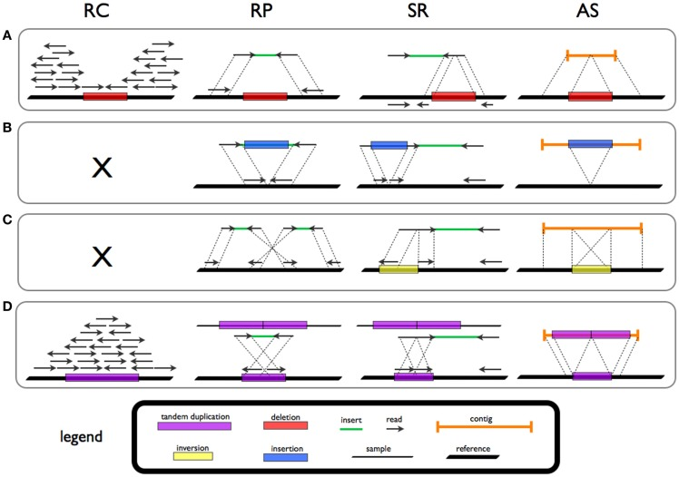
Structural variants
discordant read(-pairs) mapping
copy number variants (CNV)
29
Notes:
You are looking for something you don’t expect

Slide 30
Structural variants
CNV
long variants in WGS – ControlFreec
Smaller variants for WES / target panel
  Somatic – tumor,normal
  Germline - lot of references
    XHMM
Read-pairs very noisy expect a lot of FP
BreakPoint
  Target panel with short reads
Delly
  everything else
30
Notes:
You are looking for something you don’t expect

Slide 31
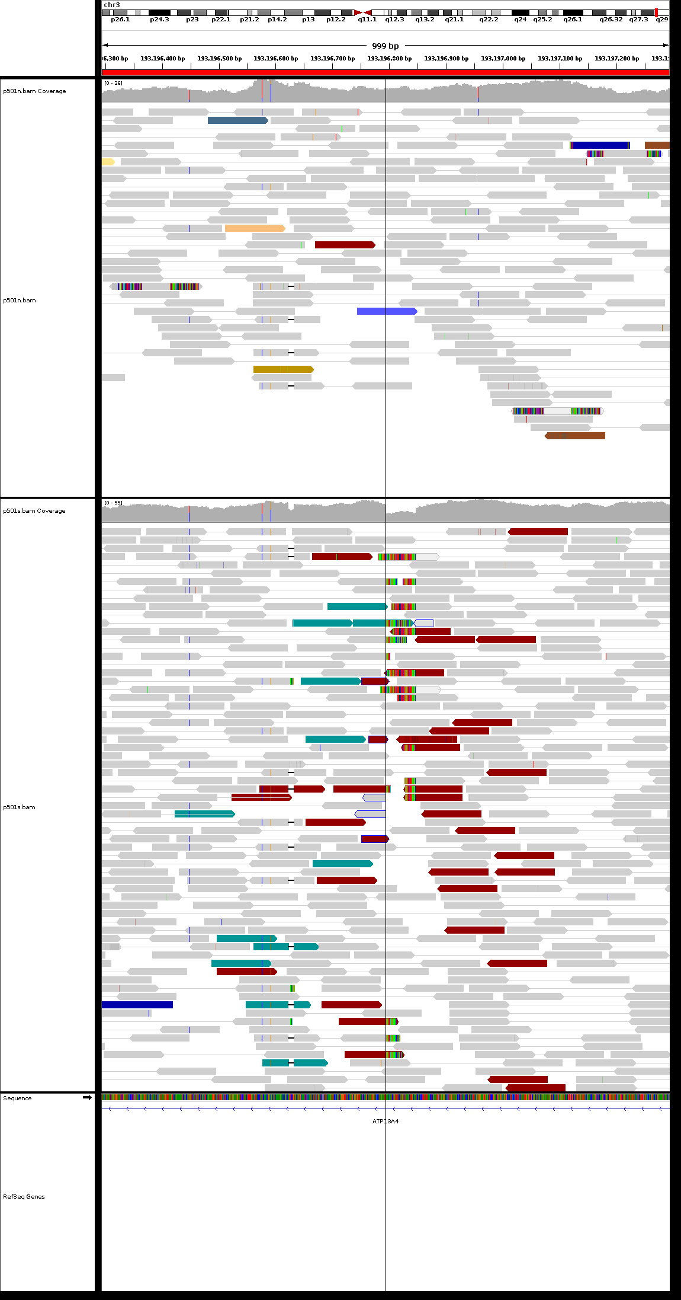
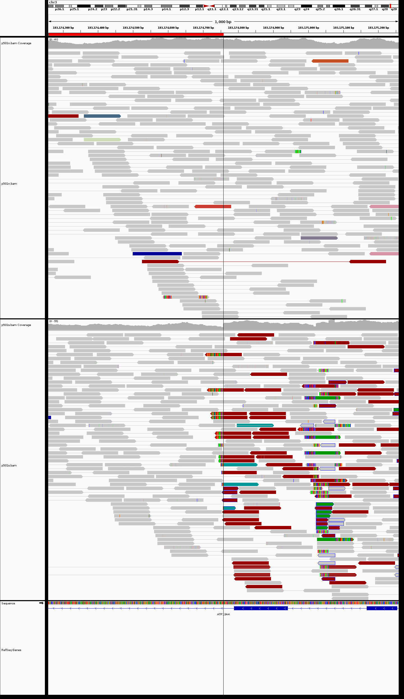
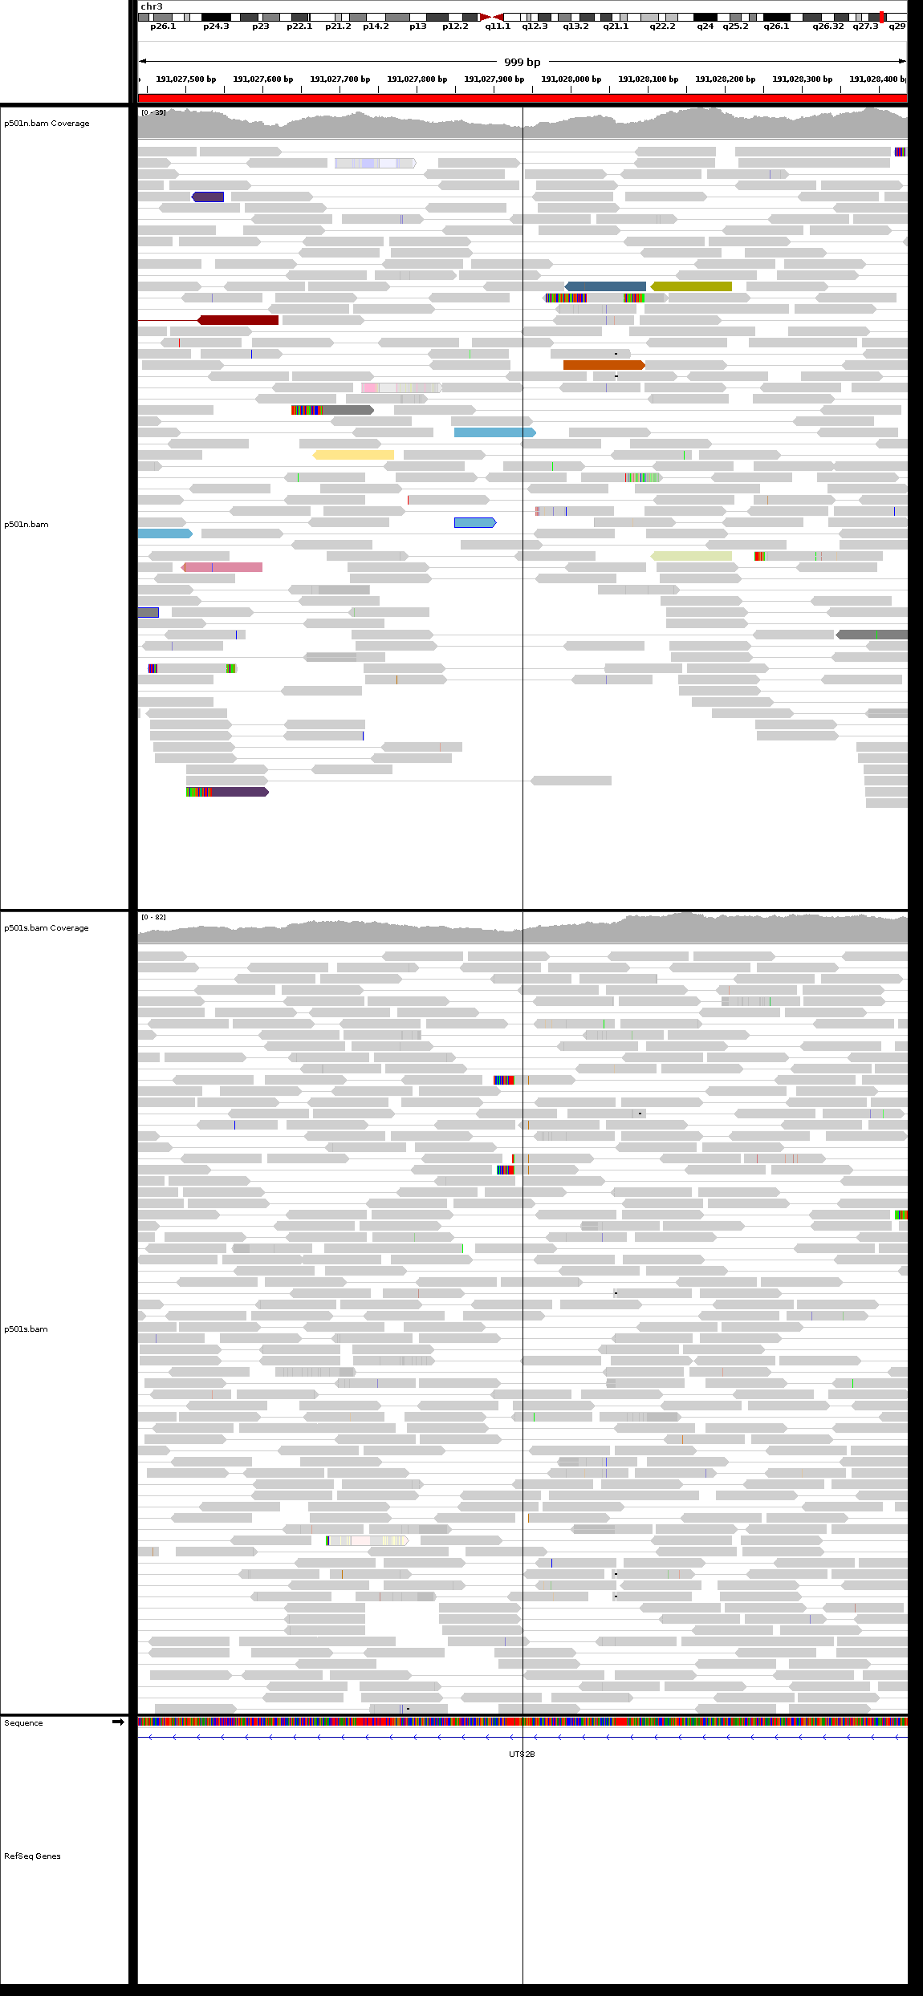
Structural variants
Manual check with IGV (batchmode)
31
Notes:
You are looking for something you don’t expect

Slide 32
NGS data analysis
Experiment design
de-multiplexing
Special cases
Raw data
.fastq
QC
Mapping
.bam
QC
Variant analysis
Expression analysis
Structural variants
32

Slide 33
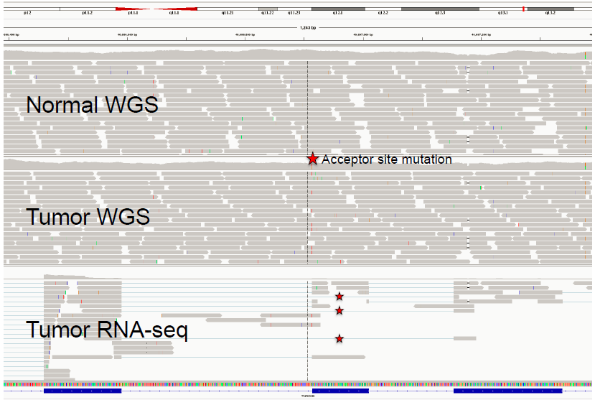
Expression analysis

Slide 34
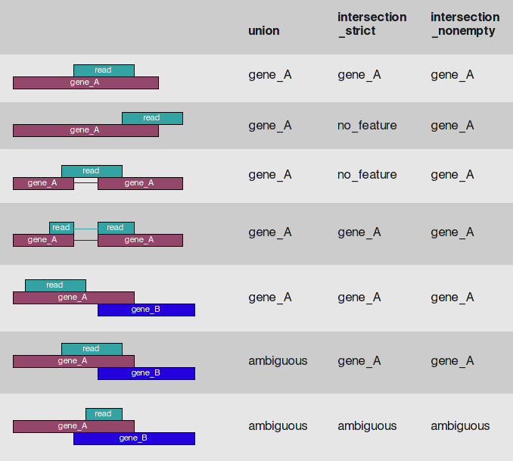
Counting schemes

Slide 35
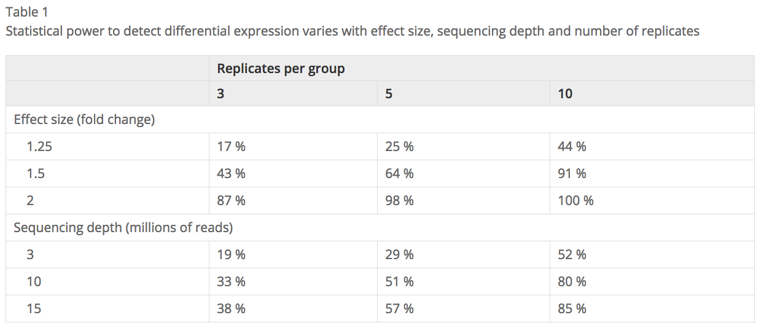
Expression analysis - planning
very sensitive
3 way balance
  Read depth
  Biological replicates
  Fold change (number of genes) sensitivity
many BR
high RD
low RD
not sensitive
1 BR
35

Slide 36
Expression analysis - planning
Replicates
Technical vs. biological
  Technical only for technique testing
Highly suggested minimum = 4 rep
N1
N2
T2
T1
N3
T3
36

Slide 37
Expression analysis - planning
Depth
Human ~ 22 000 genes = minimum 20 mil mapped reads
Good 25 mil mapped reads
Mapped reads!
  rRNA removal
  Size selection for sRNA
Trade-off
4 replicates with 20 mil vs. 3 replicates with 30 mil
9 replicates with 25 mil vs. 10 replicates with 20 mil
37

Slide 38
Expression analysis - planning
Depth
Human ~ 22 000 genes = minimum 20 mil mapped reads
Good 25 mil mapped reads
Mapped reads!
  rRNA removal – 90% rRNA
  Size selection for sRNA
Trade-off
4 replicates with 20 mil vs. 3 replicates with 30 mil
9 replicates with 25 mil vs. 10 replicates with 20 mil
Reality: 3 replicates with 15 mil reads
38

Slide 39
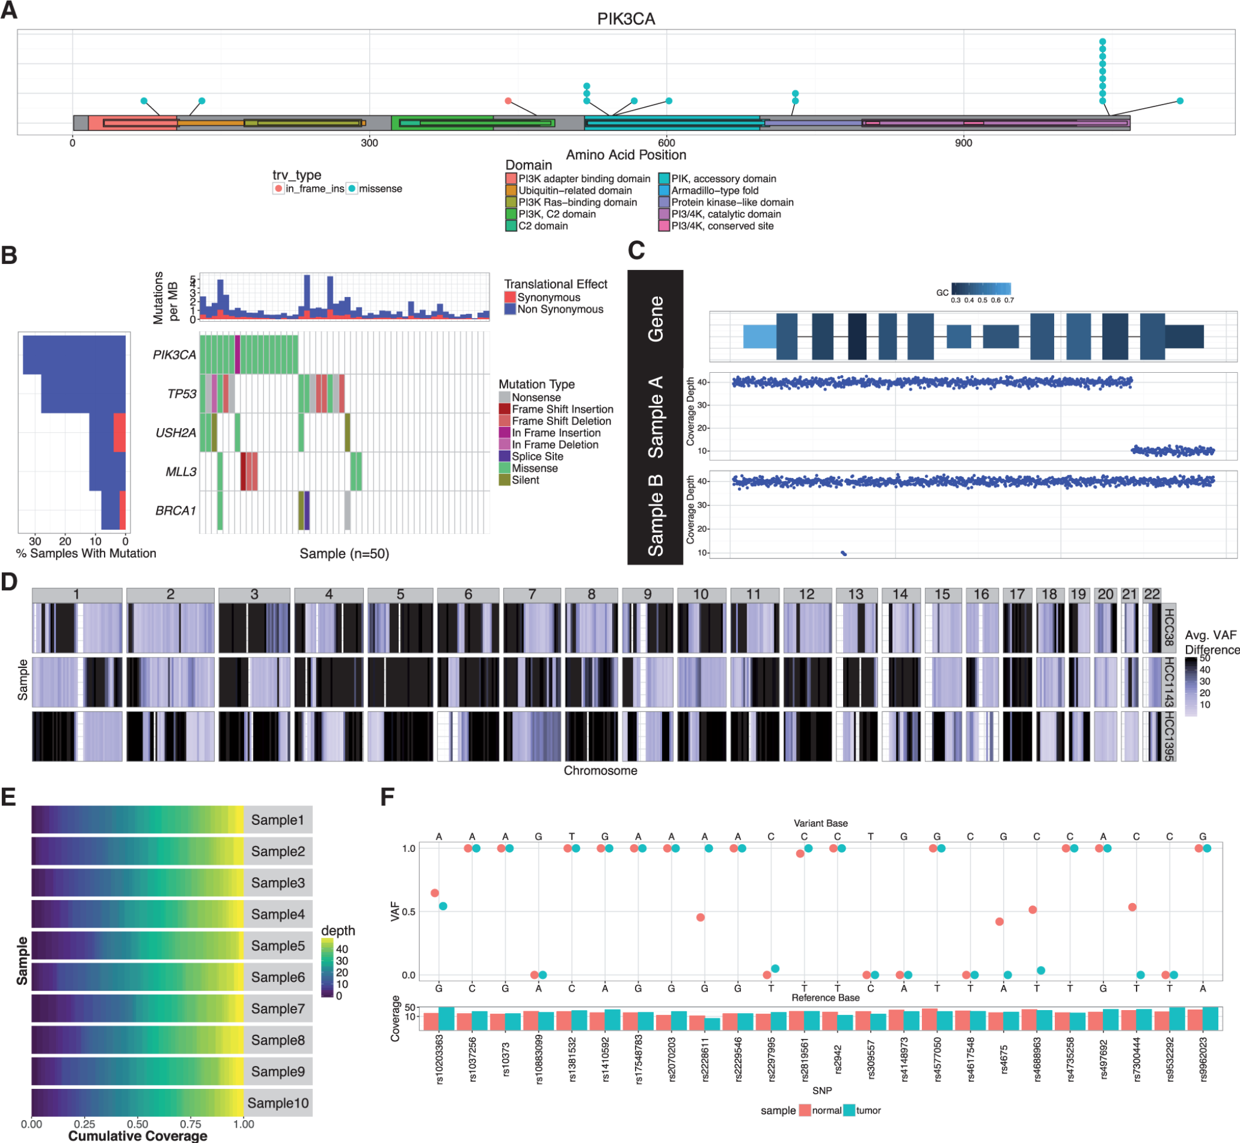
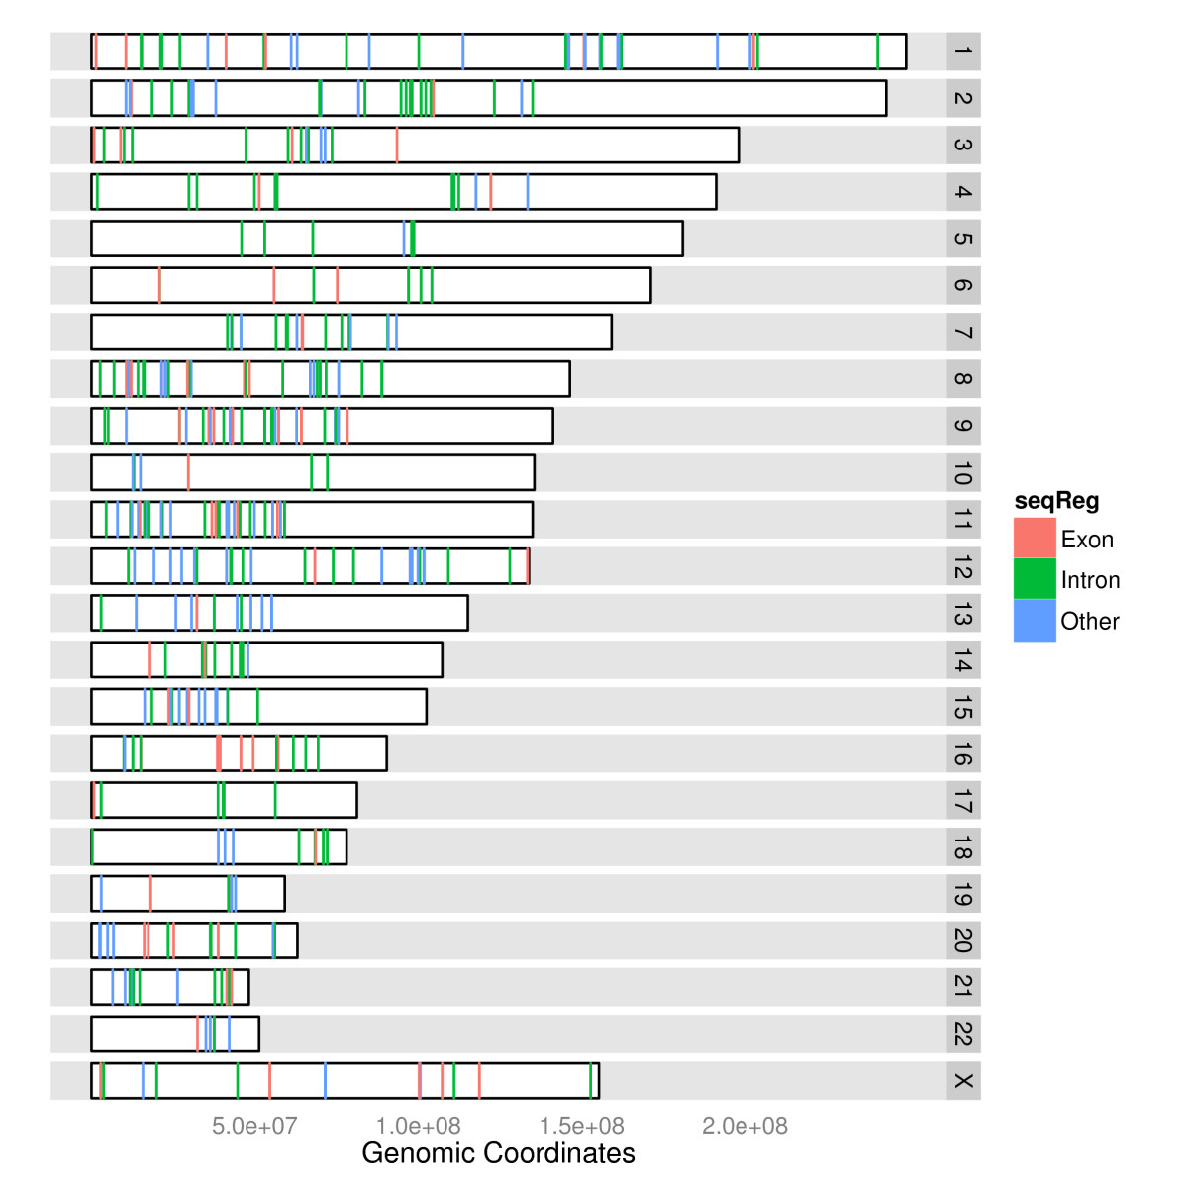
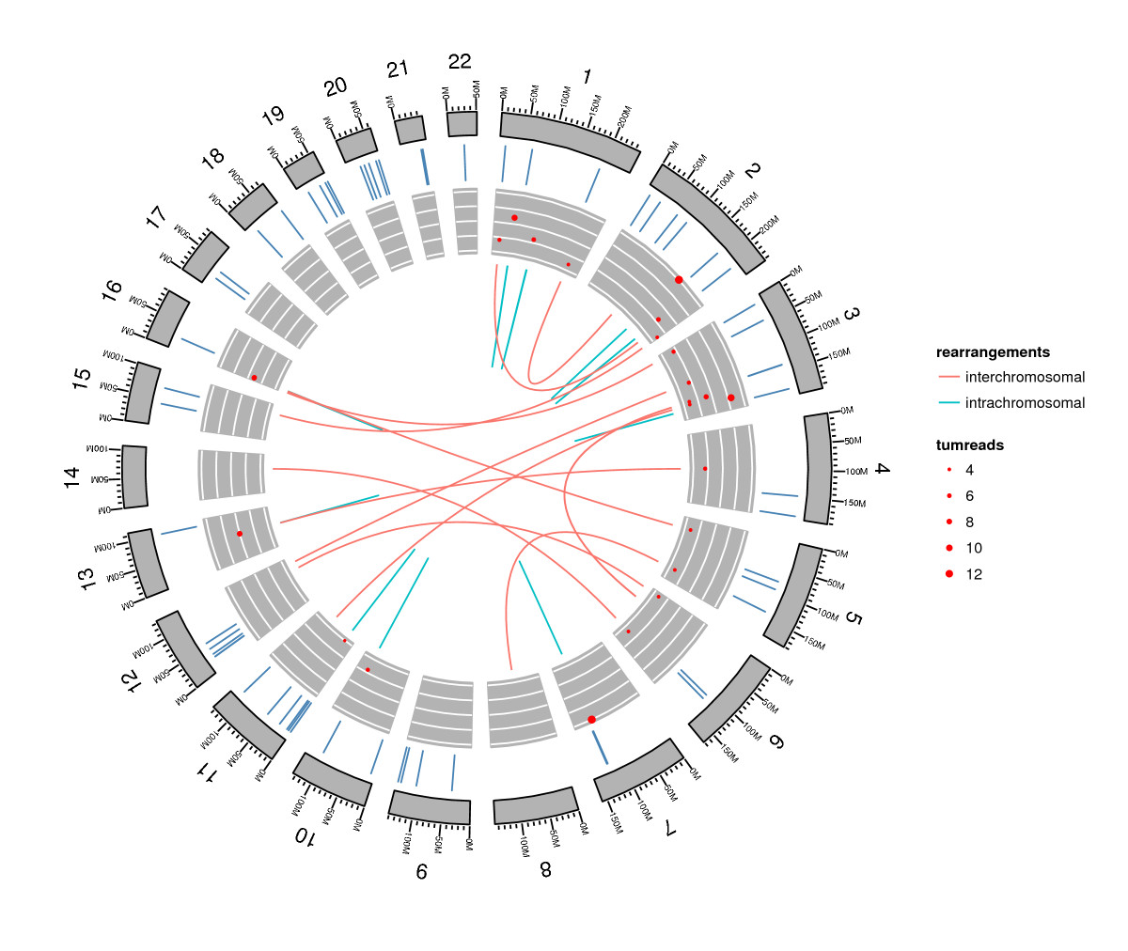
Visualization
Bioinformatician provide all he think might be helpful
Researcher requests exactly what he wants
Good to find a balance
39
Notes:
You are looking for something you don’t expect

Slide 40
Thank you for your attention
Central European Institute of Technology
Masaryk University
Kamenice 753/5
625 00 Brno, Czech Republic
www.ceitec.muni.cz | info@ceitec.muni.cz

