Slide 1
Moderní metody analýzy genomu
Bioinformatika II
Karol Pál
(Šárka Pospíšilová Research Group - Centre for Molecular Medicine CEITEC)

Slide 2
Bioinformatics
Use of computer to analyze and catalogue biological data
Interdisciplinary field
Algorithms for calculating local alignment 1970‘s
New applications in NGS

Slide 3
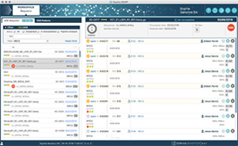
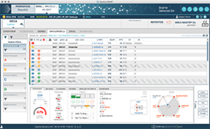
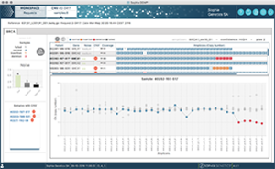
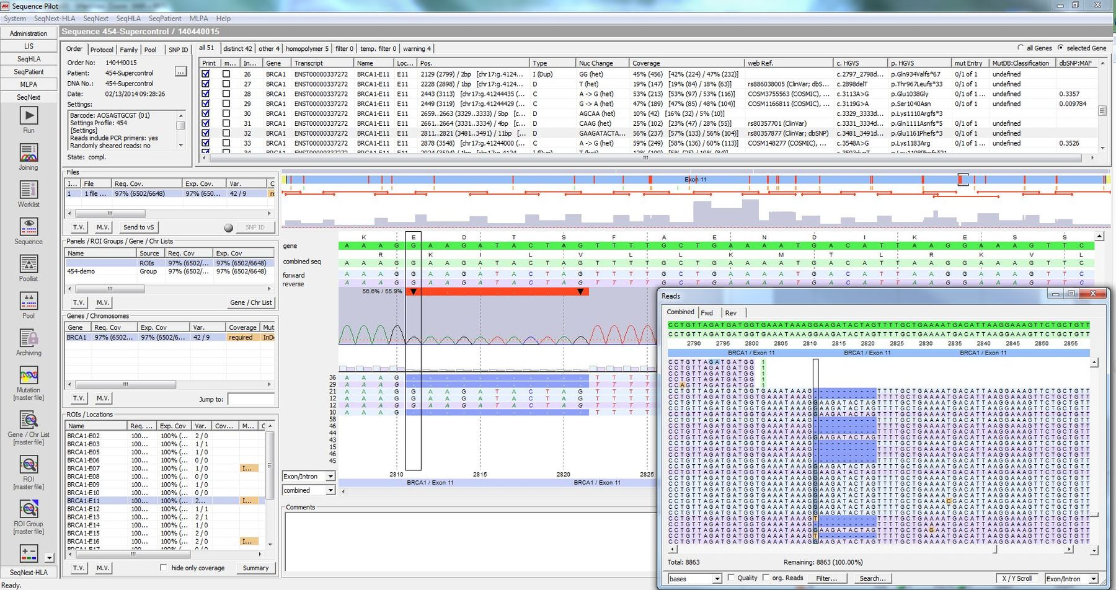
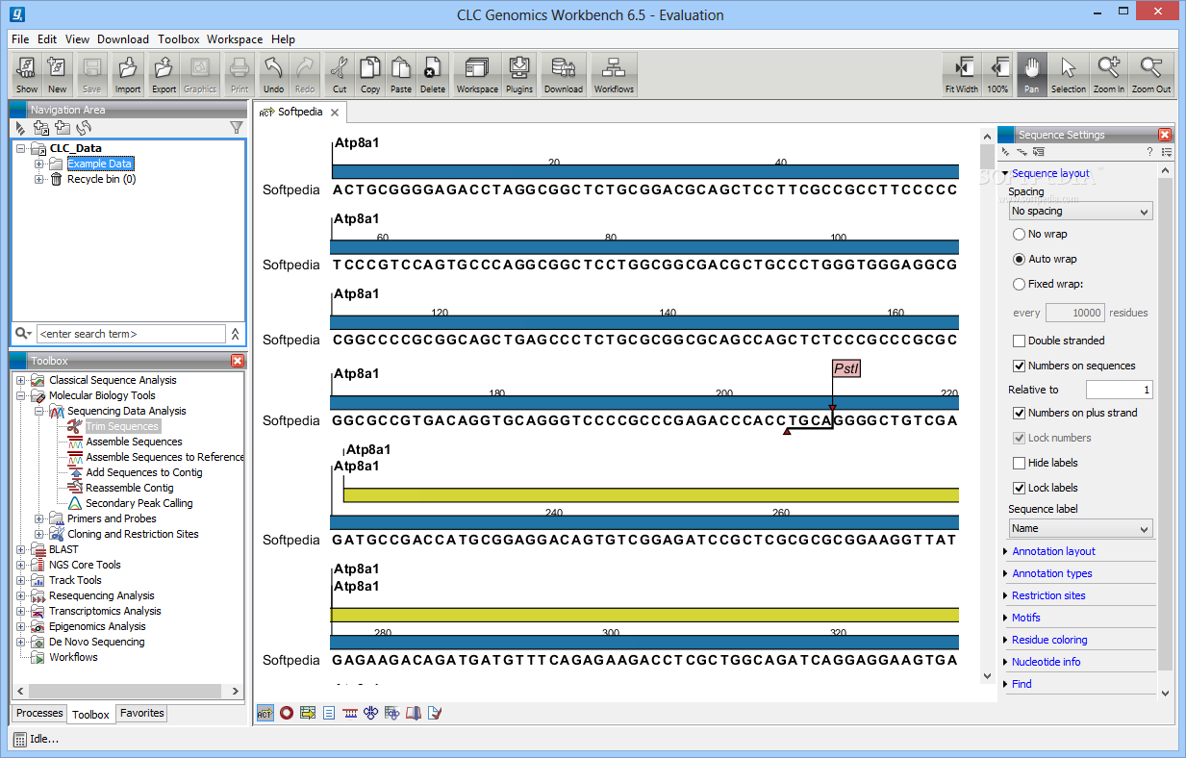
Commercial solutions
Sophia genetics
- Expensive
+ Support
Diagnostics
https://www.sophiagenetics.com/hospitals/sophia-ddm/sophia-ddmr-details.html
JSI Sequence pilot
CLC genomics workbench
https://www.qiagenbioinformatics.com/products/clc-genomics-workbench
https://www.jsi-medisys.de/products/sequence-pilot/seqnext/

Slide 4
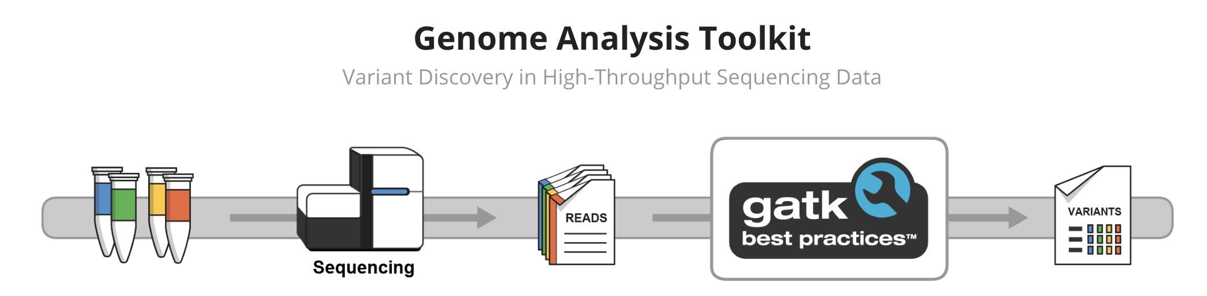
Open Source
The basic steps are the same
Community driven development by researchers
Solutions from Open Source often implemented in commercial software
- Expensive Bioinformatician
Researach

Slide 5
Pipelines
???

Slide 6
Pipelines
Workflow consisting of several steps
  Data preprocessing
  Quality Control
  Detect Variation
  Compare with known data sources
  Present/Visualize results

Slide 7
Pipelines
Workflow consisting of several steps
Each step can be a separate program in a different programming language
  Perl – Old schoolers
  R – Statisticians
  C/C++ – Programmers
  Python – Human beings

Slide 8
Pipeline manager
Combine individual steps into one ”package”
Manage reusability
Project organization
Logs
Examples
  Snakemake
  Bcbio
  Galaxy (graphical interface) https://usegalaxy.org/
  Bash

Slide 9
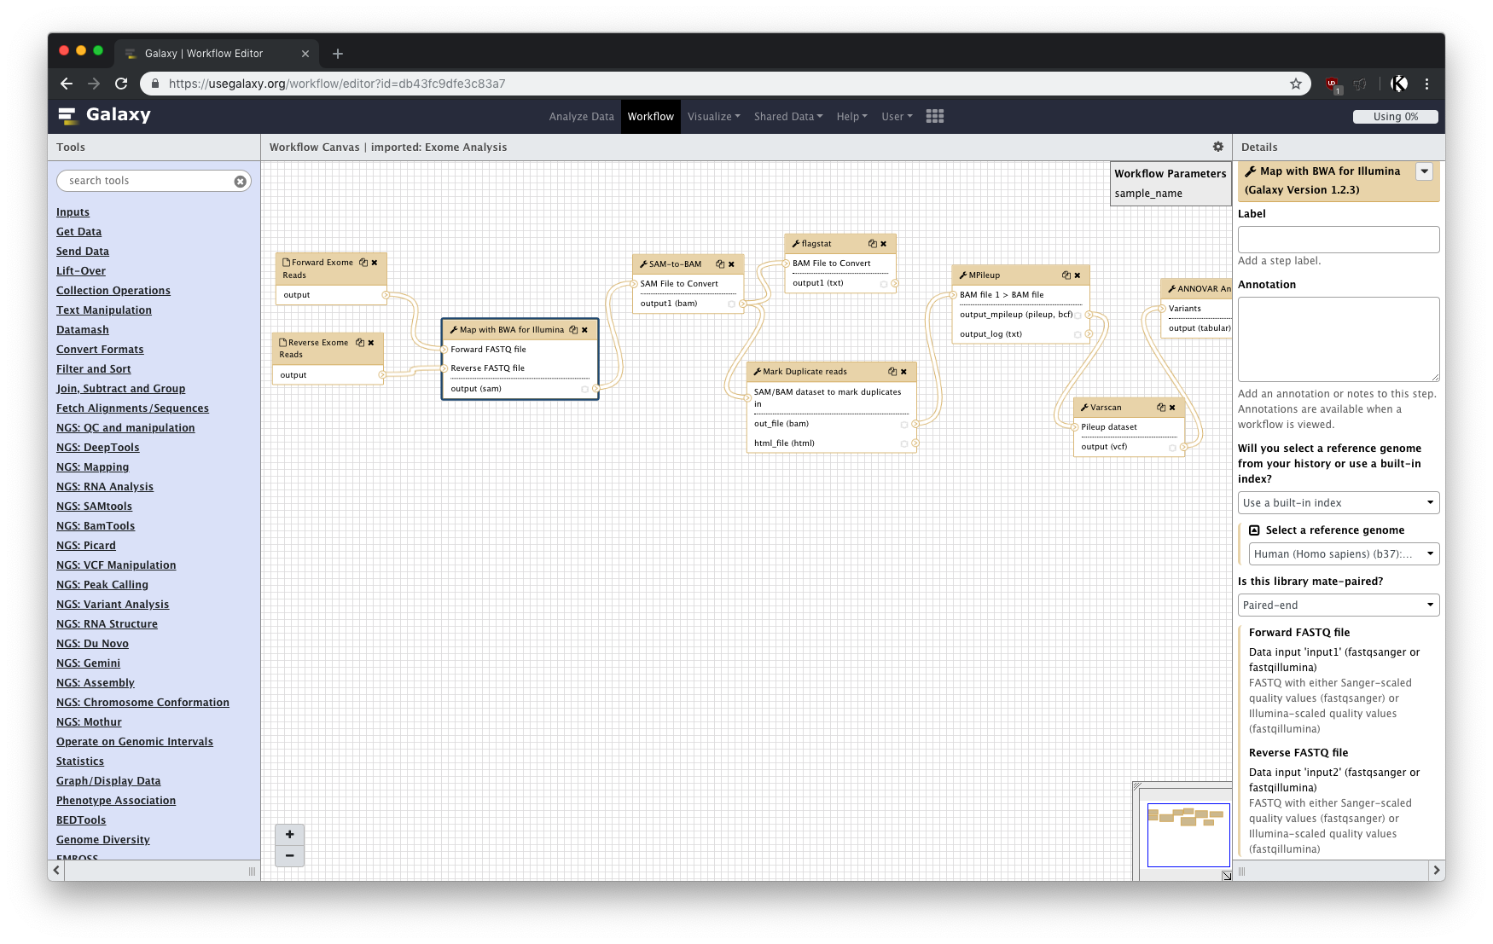

Slide 10
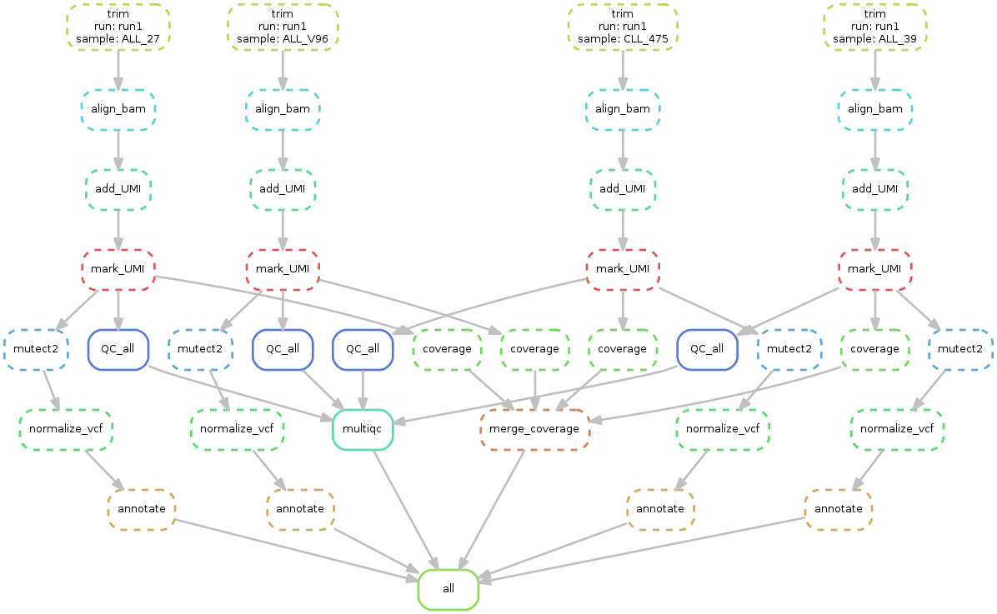
Snakemake

Slide 11
A note on bash
A command line environment for controlling the computer
Scripting language
Fast, built in command for text manipulation
Working with text files too big for a text editor

Slide 12
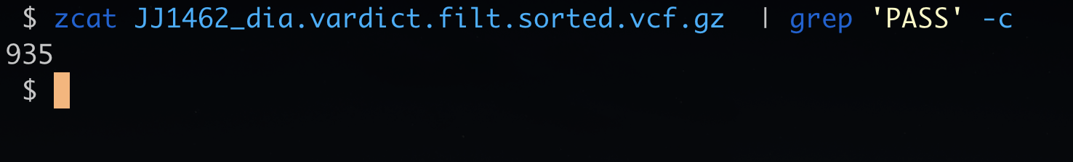
A note on bash
A command line environment for controlling the computer
Scripting language
Fast, built in command for text manipulation
Working with text files too big for a text editor

Slide 13
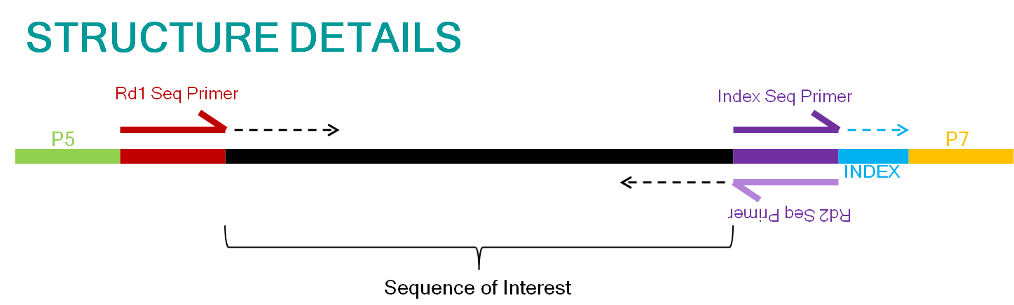
Recap – Sequencing reads
http://nextgen.mgh.harvard.edu/CustomPrimer.html

Slide 14
Data analysis pipeline (DNASeq)
Pre alignment
Quality Control
Alignment
(Mapping)
+ QC
Variant calling
Reference
Variants
Reads
Annotation
dbSNP
Cosmic
…

Slide 15
Data analysis pipeline
Pre alignment
Quality Control
Alignment
(Mapping)
+ QC
Variant calling
Reference
Variants
Reads
Annotation
dbSNP
BCL
FASTQ
SAM/BAM
VCF/MAF
Cosmic
…

Slide 16
Quality Control
Different steps
  Reads summary statistics
  Aligners
  Post alignment statistics
Different tools
  Different kinds of outputs
BCL
FASTQ
SAM/BAM
VCF/MAF

Slide 17
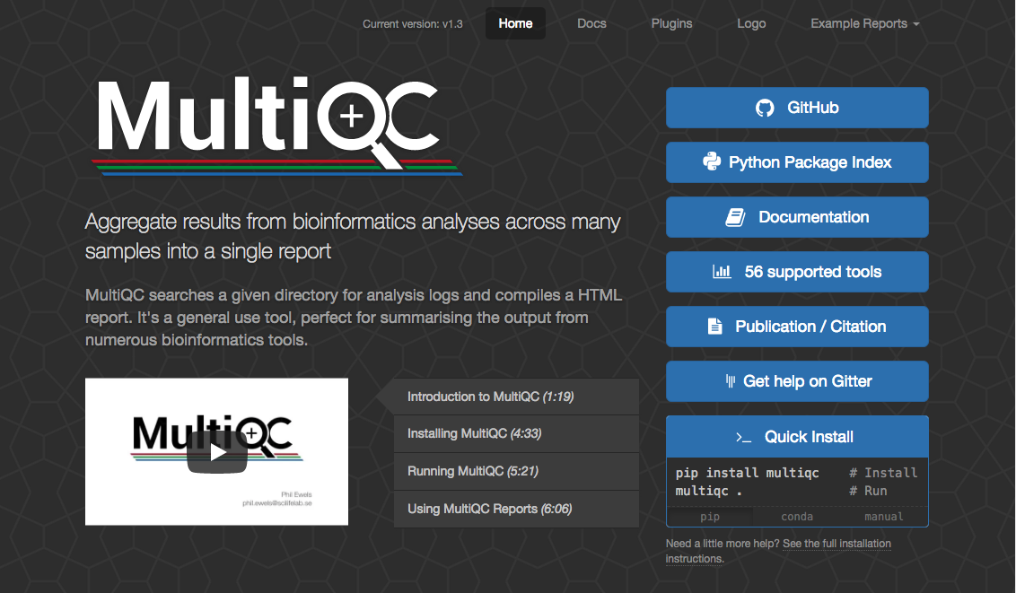

Slide 19

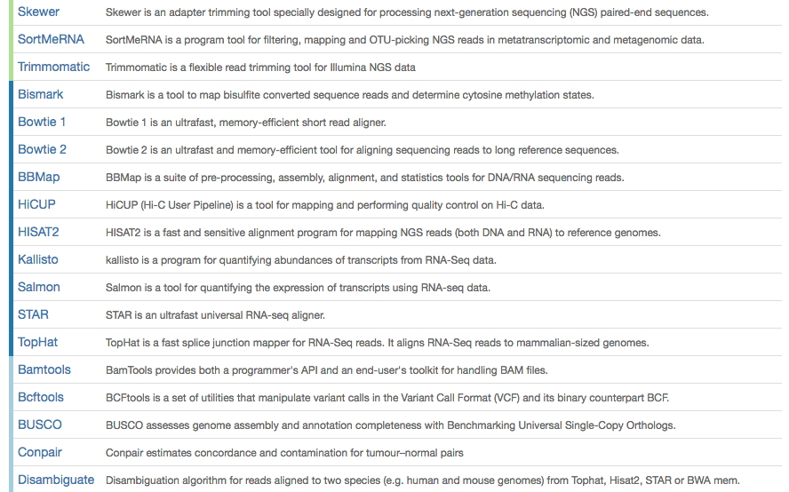
Quality Control

Slide 20
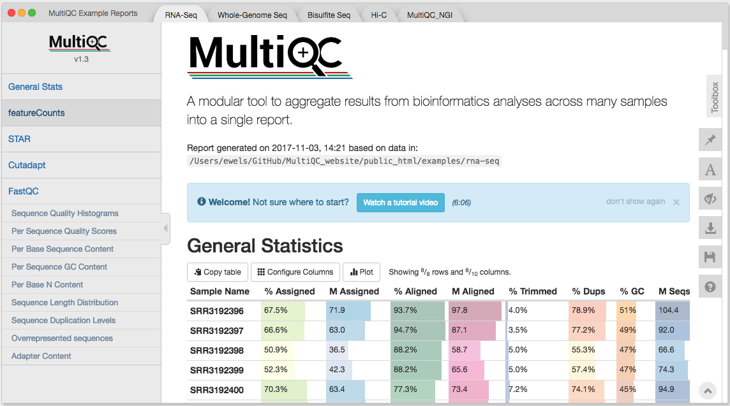
Quality Control

Slide 21
Data analysis pipeline
Pre alignment
Quality Control
Alignment
(Mapping)
+ QC
Variant calling
Reference
Variants
Reads
Annotation
dbSNP
BCL
FASTQ
SAM/BAM
VCF/MAF
Cosmic
…

Slide 22

BCL to FASTQ
BCL - raw sequencing output
Convert to FASTQ format
Split into sample files
May be automated
BCL
FASTQ
Sample Sheet

Slide 23
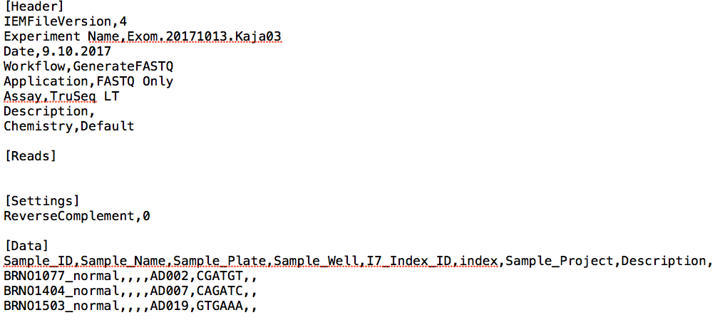
Sample sheet

Slide 24
Sample sheet

Slide 25
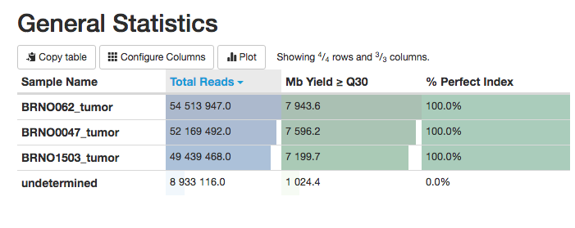
Raw reads – bcl2fastq
MultiQC output

Slide 26
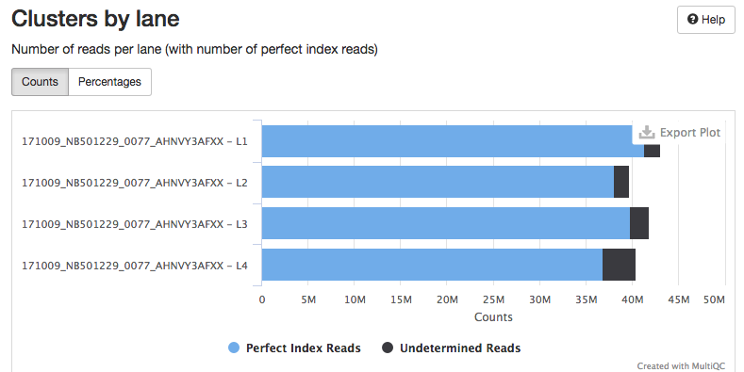
Raw reads – bcl2fastq
MultiQC output

Slide 27
Data analysis pipeline
Pre alignment
Quality Control
Alignment
(Mapping)
+ QC
Variant calling
Reference
Variants
Reads
Annotation
dbSNP
BCL
FASTQ
SAM/BAM
VCF/MAF
Cosmic
…

Slide 28
FastQC
Summary statistics
Two modes
  Stand alone program
  Command line (output can be integrated to MultiQC)
Input: Fastq or BAM file

Slide 29
Trimming
Adaptors
Low quality ends of reads
Tools:
  Cutadapt
  Trimmomatic

Slide 30
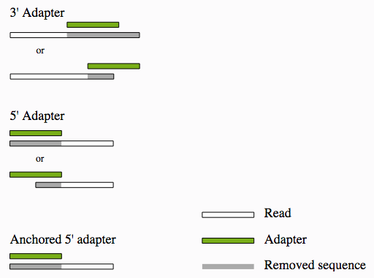
Trimming
  > cutadapt \
  -a AGATCGGAAGAGC \
  -A AGATCGGAAGAGC \
  -o BR_0296_I.trimmed.1.fastq.gz \
  -p BR_0296_I.trimmed.2.fastq.gz \ BR_0296_I.R1.fq.gz BR_0296_I.R2.fq.gz
http://tucf-genomics.tufts.edu/documents/protocols/TUCF_Understanding_Illumina_TruSeq_Adapters.pdf

Slide 31
Recap – Data analysis pipeline
Pre alignment
Quality Control
Alignment
(Mapping)
+ QC
Variant calling
Reference
Variants
Reads
Annotation
dbSNP
BCL
FASTQ
SAM/BAM
VCF/MAF
Cosmic
…

Slide 32
DNA
De Novo Assembly
  Create a new reference
  Find structural variants
Map to an existing reference
  Alignment (BWA)
Map against several references
  Blast

Slide 33
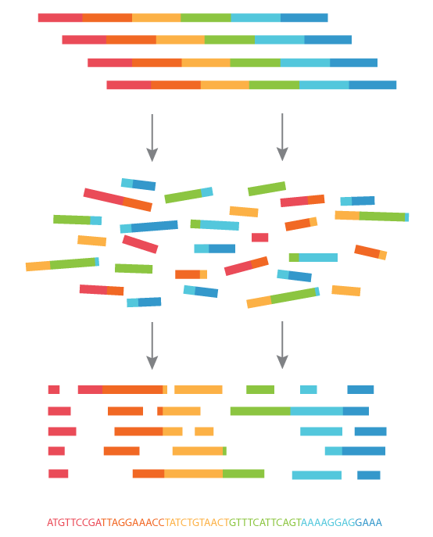
De Novo Assembly
https://www.abmgood.com/marketing/knowledge_base/next_generation_sequencing_data_analysis.php

Slide 34
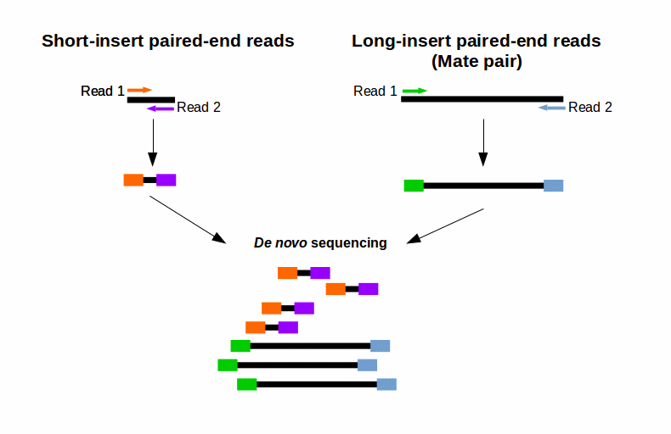
https://www.ecseq.com/support/ngs/what-is-mate-pair-sequencing-useful-for

Slide 35
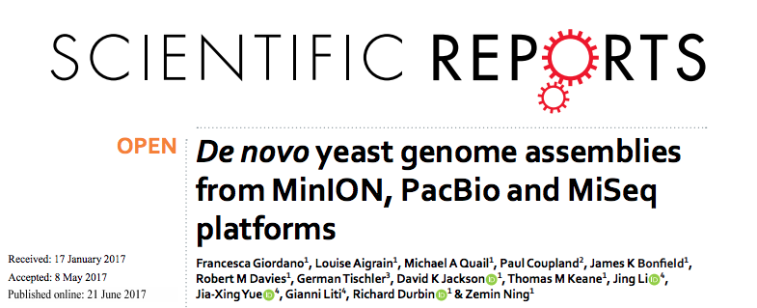
De Novo Assembly

Slide 36
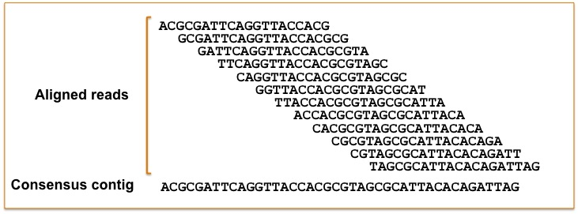
Alignment

Slide 37
Alignment
GCTGATGTGCCGCCTCACTTCGGTGGTGAGGTG Reference sequence
CTGATGTGCCGCCTCACTTCGGTGGT Short read 1
TGATGTG-CGCCTCACTACGGTGGTG Short read 2
GATGTG-CGCCTCACTTCGGTGGTGA Short read 3
GCTGATGTGCCGCCTCACTACGGTG Short read 4
GCTGATGTGCCGCCTCACTACGGTG Short read 5

Slide 38
Alignment
BED file
Chr7 127471196 127472363 Pos1 0 +
GCTGATGTGCCGCCTCACTTCGGTGGTGAGGTG Reference sequence
CTGATGTGCCGCCTCACTTCGGTGGT Short read 1
TGATGTG-CGCCTCACTACGGTGGTG Short read 2
GATGTG-CGCCTCACTTCGGTGGTGA Short read 3
GCTGATGTGCCGCCTCACTACGGTG Short read 4
GCTGATGTGCCGCCTCACTACGGTG Short read 5

Slide 39
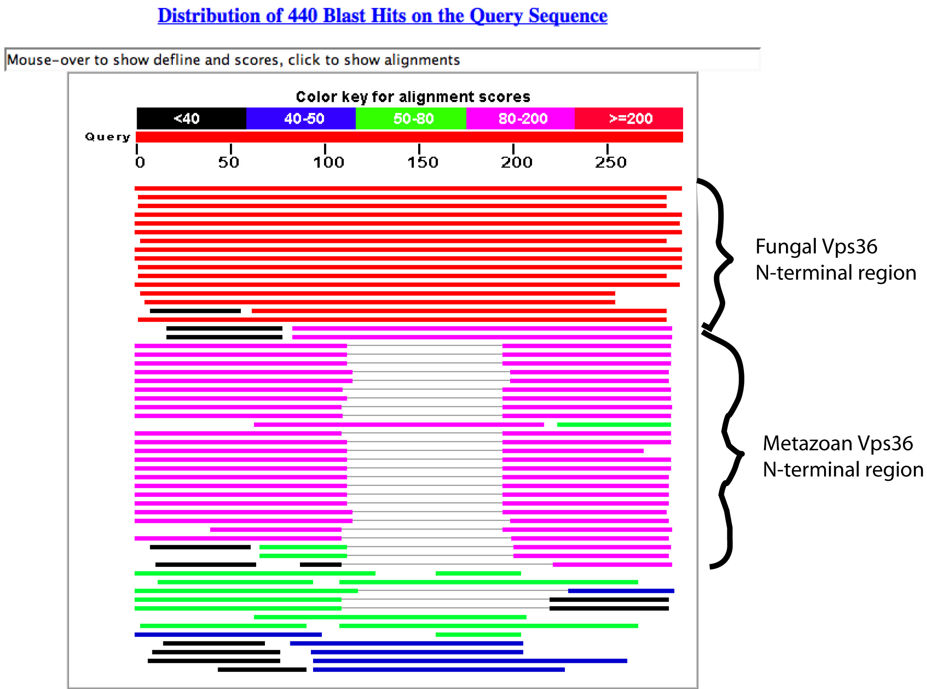
Blast
http://www.mrc-lmb.cam.ac.uk/rlw/text/bioinfo_tuto/sequence.html

Slide 40
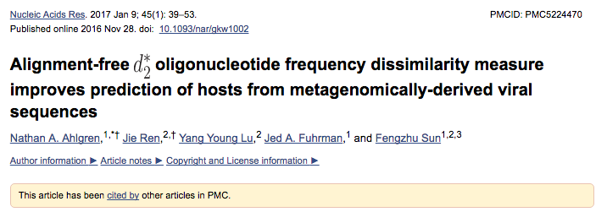
No alignment?

Slide 41
Alignment to human genome
GRCh37 vs hg19 released 2009
Fasta format:
>seq1
ACGTCGTG
>seq2 additional info
TCGCAGCG
Unique
sequence name

Slide 42
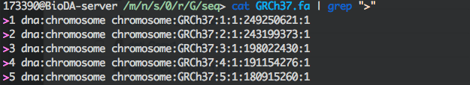
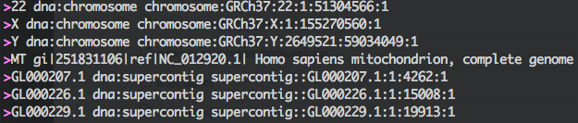
Alignment to human genome
GRCh37(NCBI) vs hg19(UCSC) released 2009
…

Slide 43
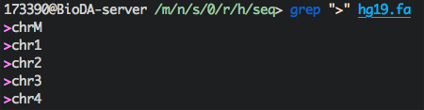
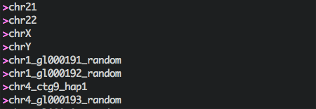
Alignment to human genome
GRCh37(NCBI) vs hg19(UCSC) released 2009
…
…

Slide 44
Alignment to human genome
GRCh37(NCBI) vs hg19(UCSC) released Feb 2009 VS
GRCh38(NCBI) or hg38(UCSC) released Dec 2013

Slide 45
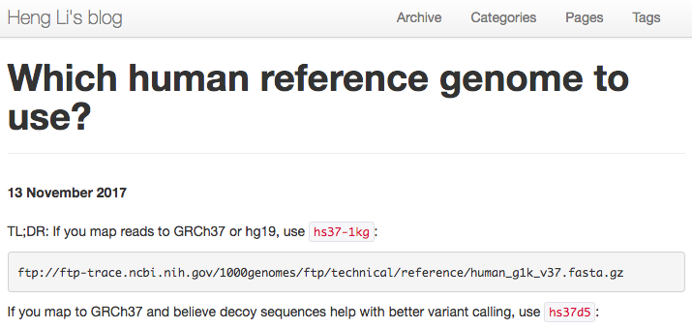
Alignment to human genome
GRCh37(NCBI) vs hg19(UCSC) released Feb 2009 VS
GRCh38(NCBI) or hg38(UCSC) released Dec 2013

Slide 46
Alignment to genome
NCBI/UCSC applies also to the mouse genome
GRCm38/mm10

Slide 47
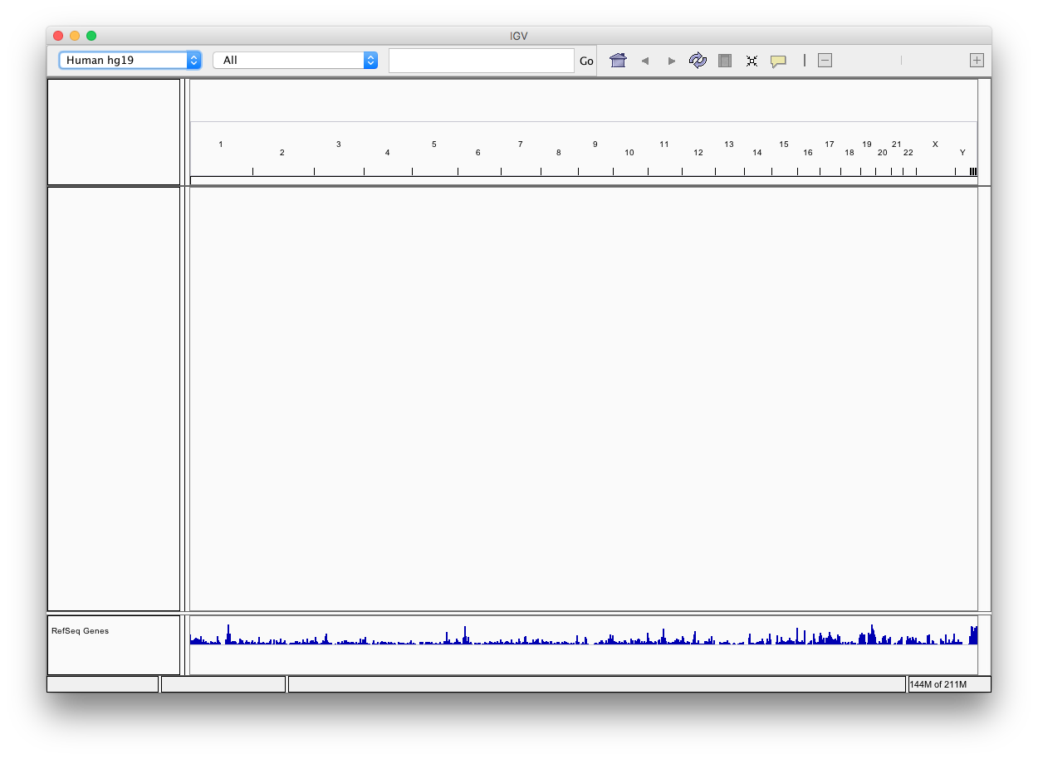
IGV

Slide 48
IGV
Navigation
Data track
Annotation Track

Slide 49
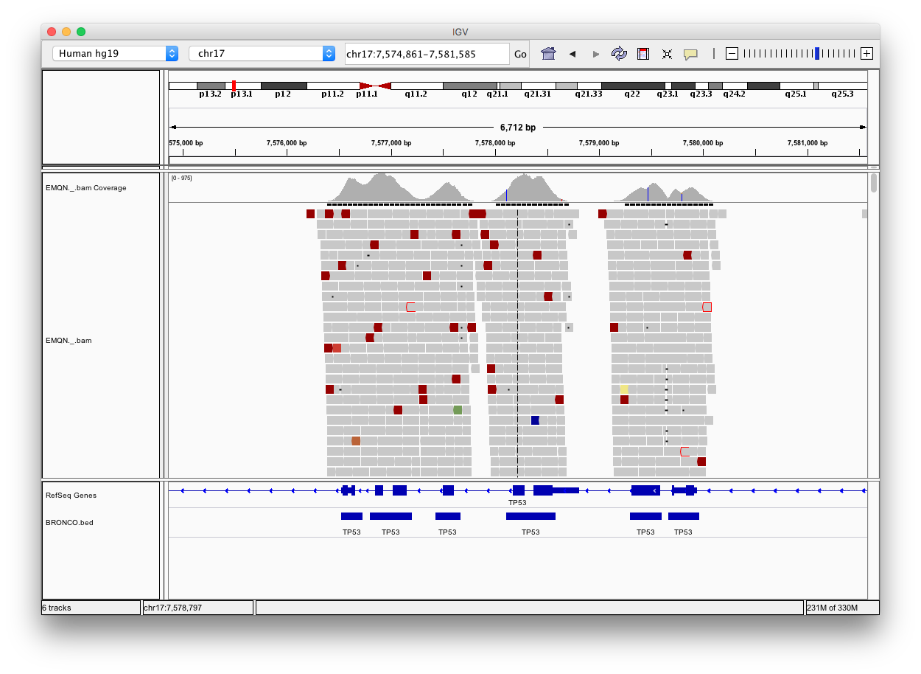
IGV
Navigation
Data track
Annotation Track

Slide 50
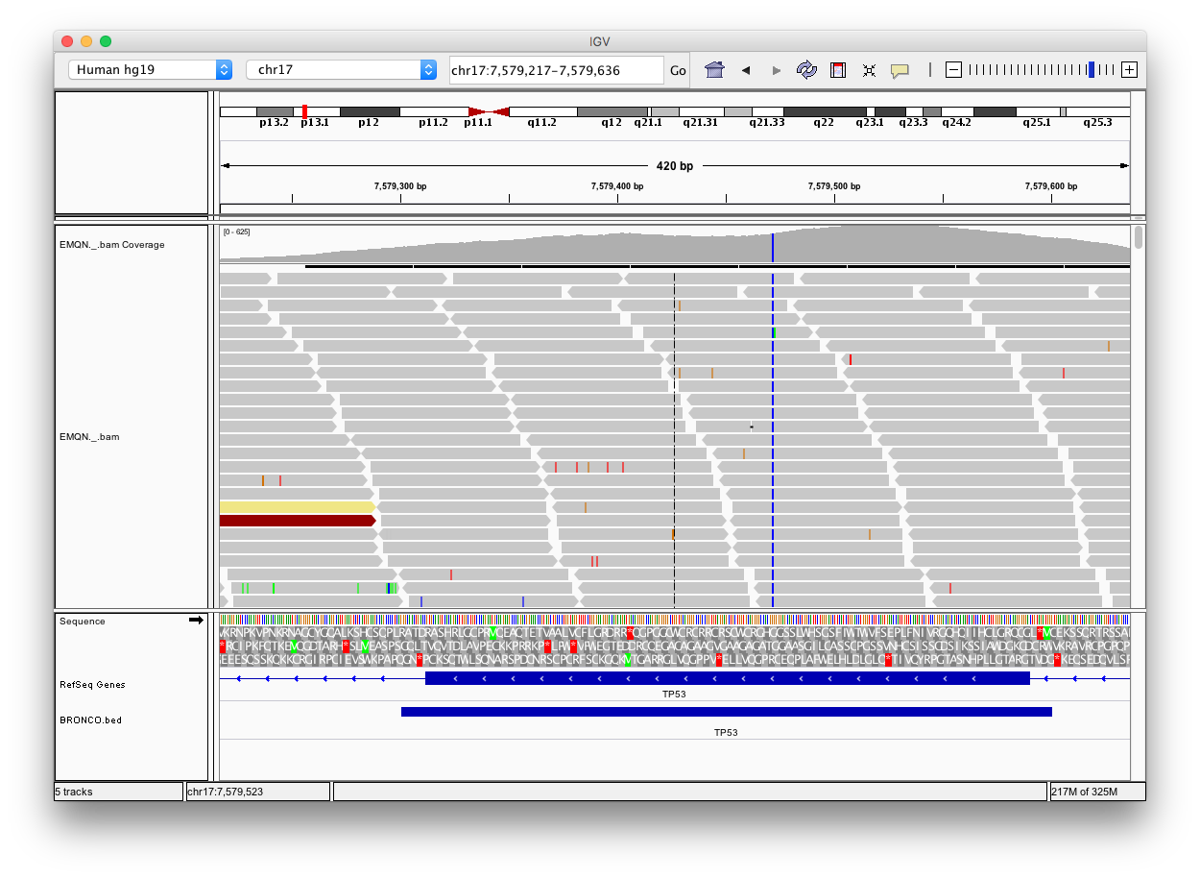
IGV
Navigation
Data track
Annotation Track

Slide 51
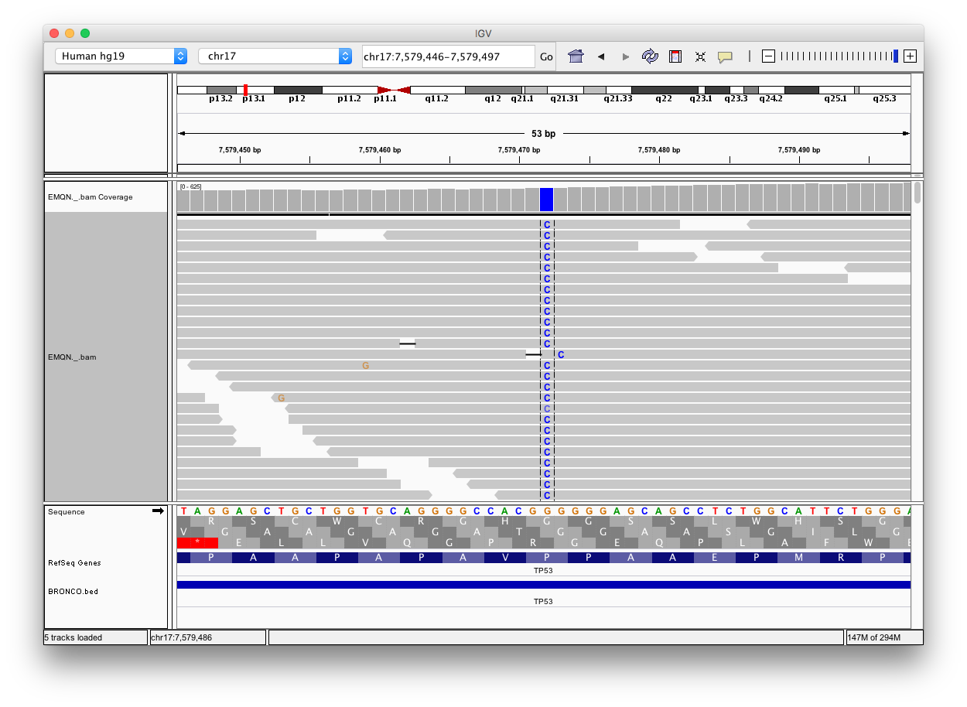
IGV
Navigation
Data track
Annotation Track

Slide 52
Alignment QC - Coverage statistics
How many reads are aligned?
How even is the overall coverage
Average insert size
How many reads come from the region of interest
  On/Off target reads
  Bed file – defines region of interest
What is the average coverage
How many % of target bases have at least X coverage

Slide 53
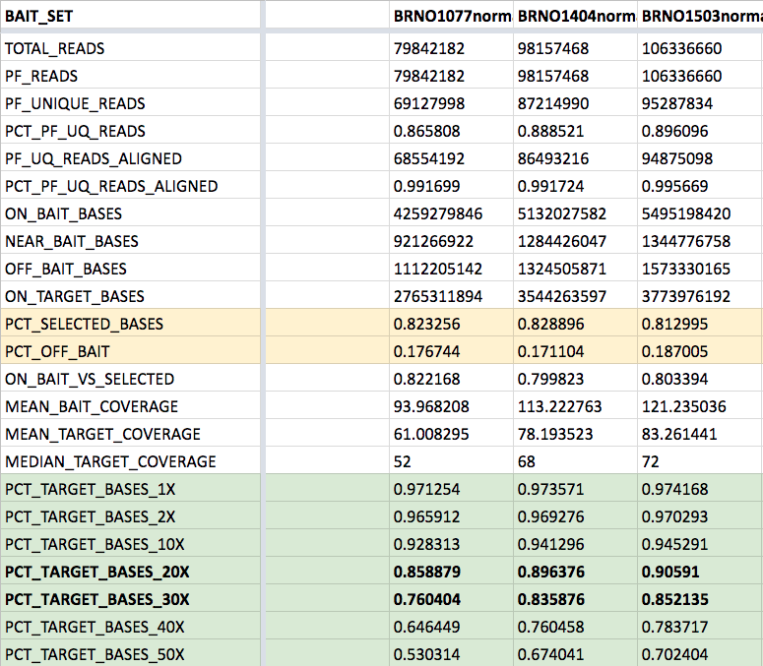
Alignment –
Coverage statistics
Picard-Tools

Slide 54
Alignment PCR library

Slide 55
Recap – Data analysis pipeline
Pre alignment
Quality Control
Alignment
(Mapping)
+ QC
Variant calling
Reference
Variants
Reads
Annotation
dbSNP
BCL
FASTQ
SAM/BAM
VCF/MAF
Cosmic
…

Slide 56
DNA Variant calling
Single Nucleotide Variants (SNV’s) + short indels
  Somatic/Germline
Copy Number variants (CNV)
Structural Variants

Slide 57
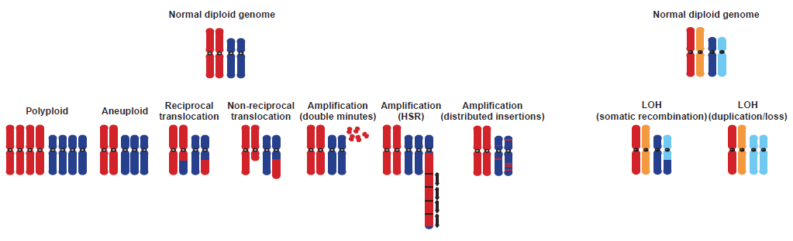
DNA Variant calling
Single Nucleotide Variants (SNV’s) + short indels
  Somatic/Germline
Copy Number variants (CNV)
Structural Variants
https://doi.org/10.1038/ng1215

Slide 58
IGV
Navigation
Data track
Annotation Track

Slide 59
Disease causing germline mutations

Slide 60
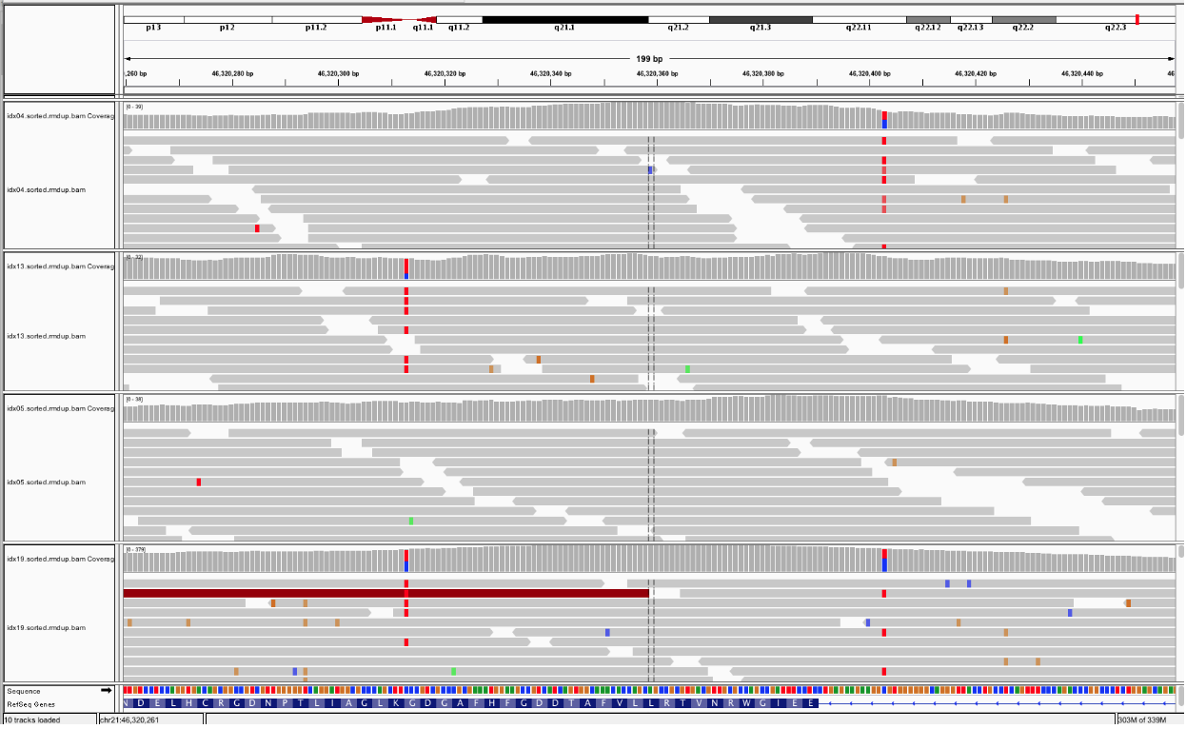
Compound Heterozygote

Slide 61
Somatic Variants
Paired analysis
Look for differences from the reference genome that do not occur in the control

Slide 62
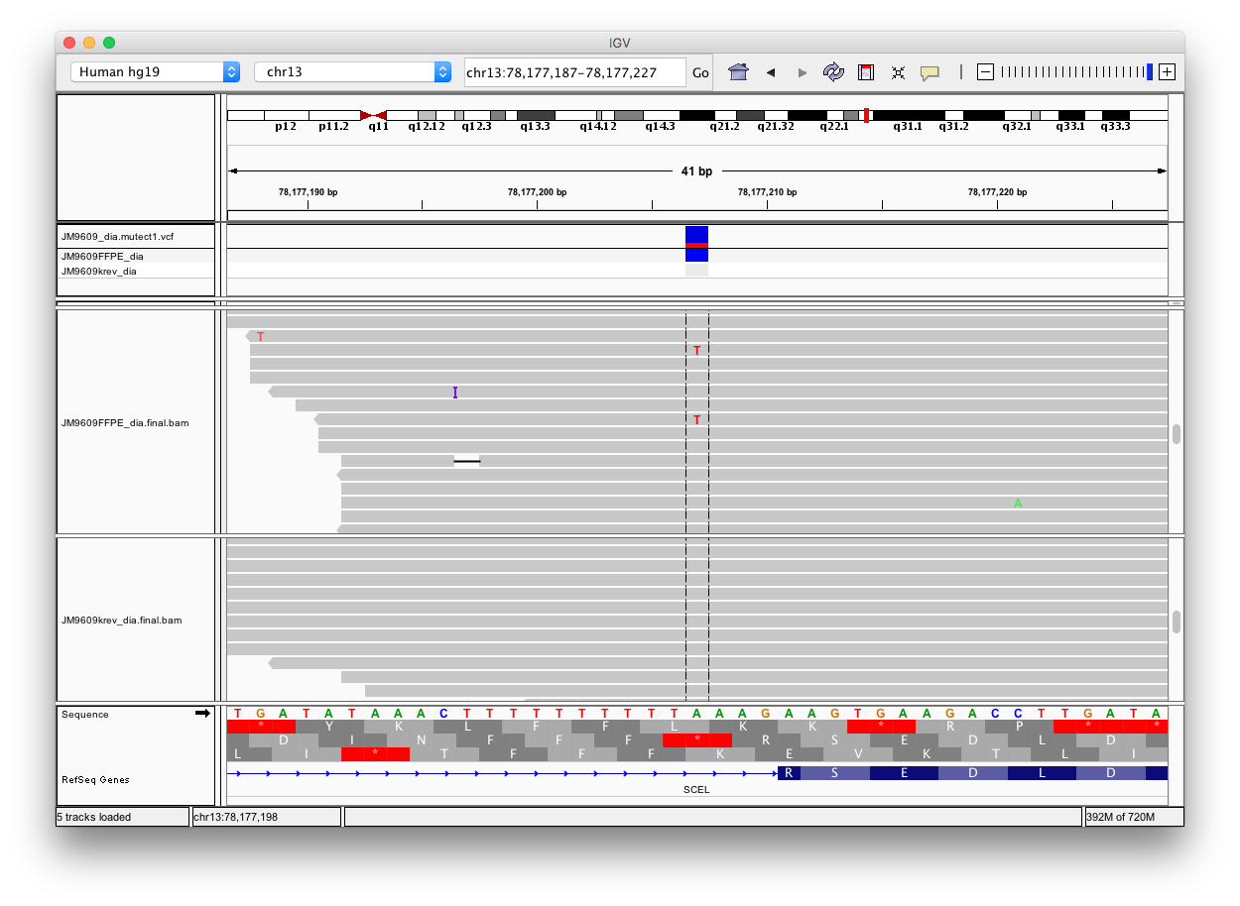
IGV inspect variants
Somatic

Slide 63
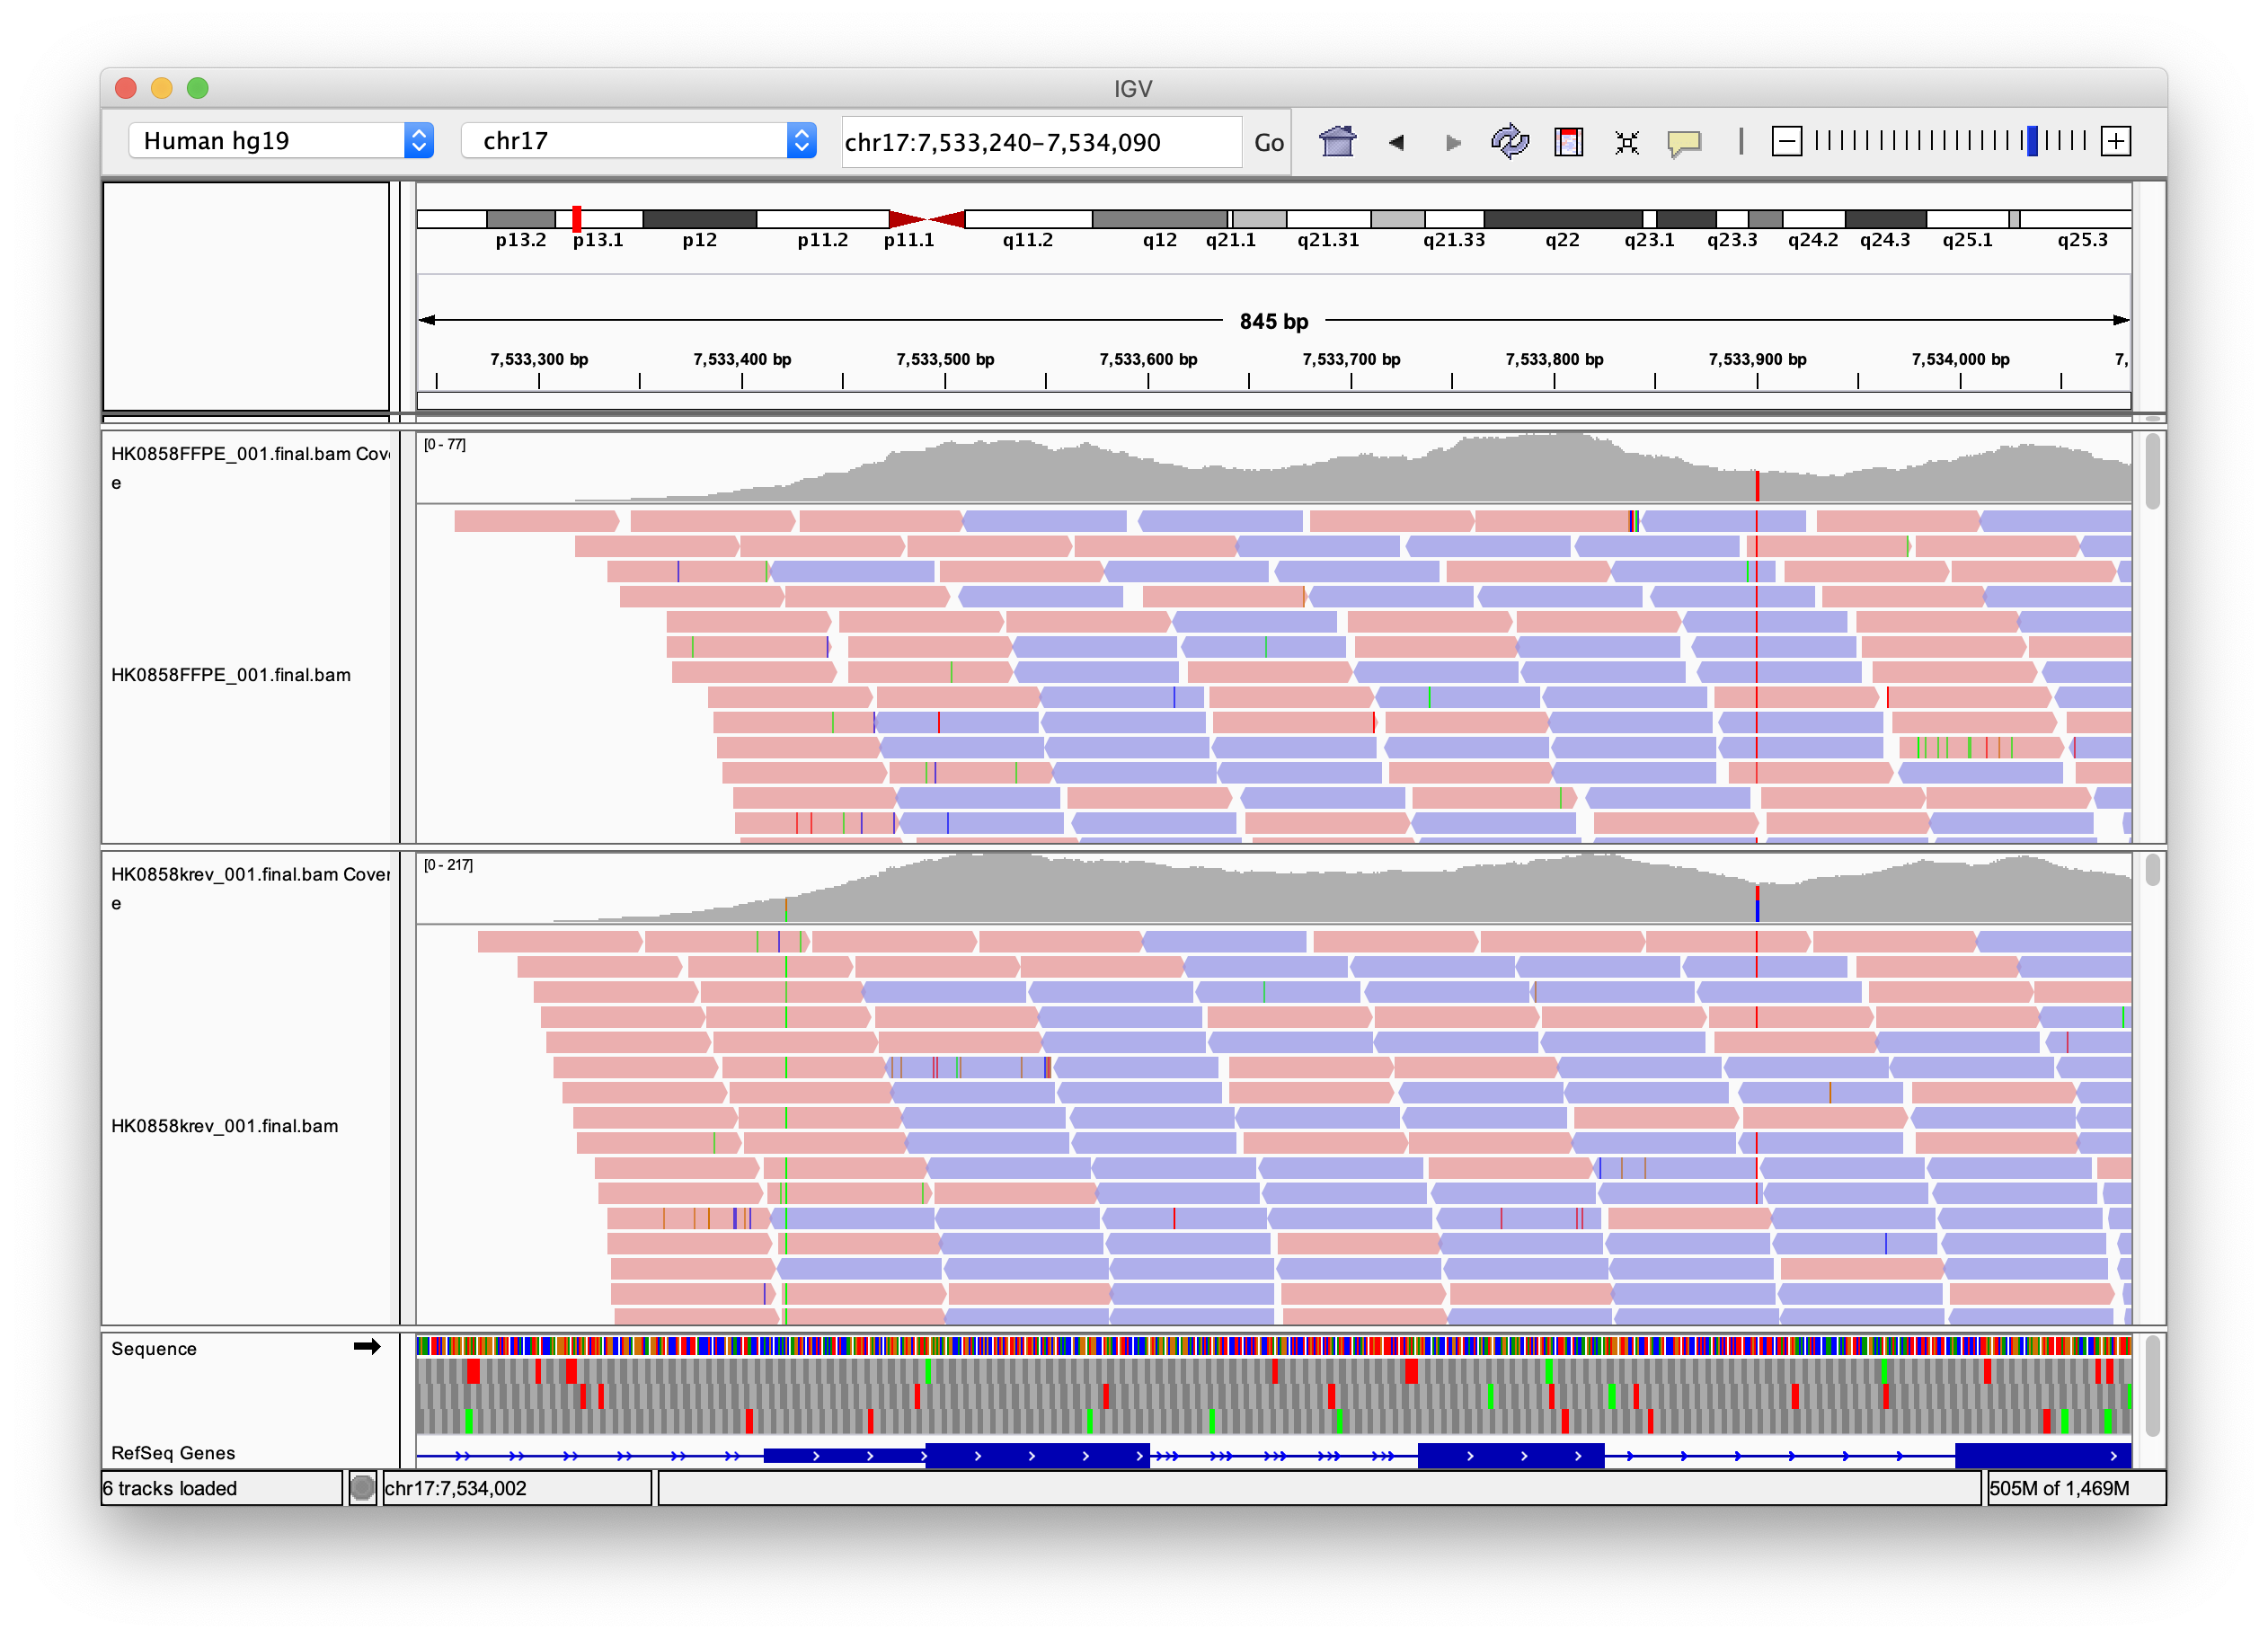
IGV inspect variants
Somatic

Slide 64
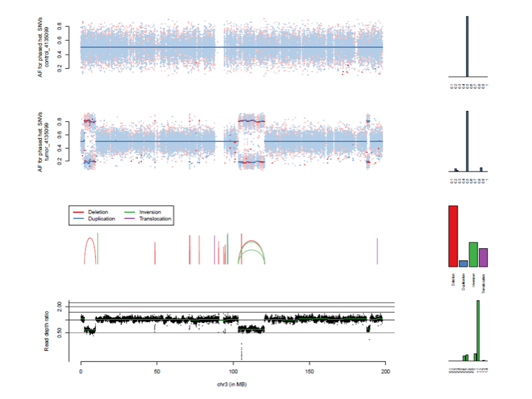
Phased het. SNPs germline vs tumor

Slide 65
CNV

Slide 66
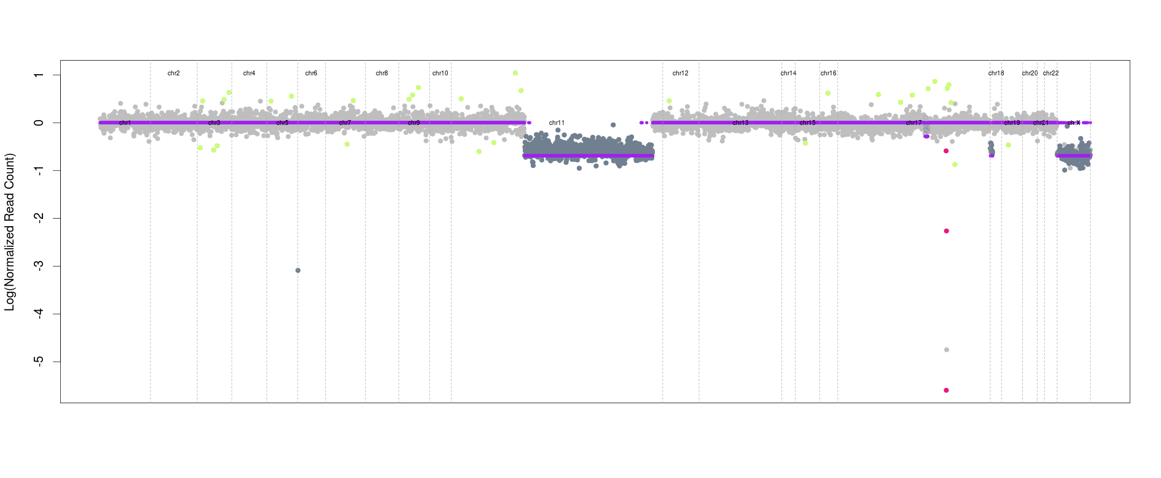
CNV

Slide 67
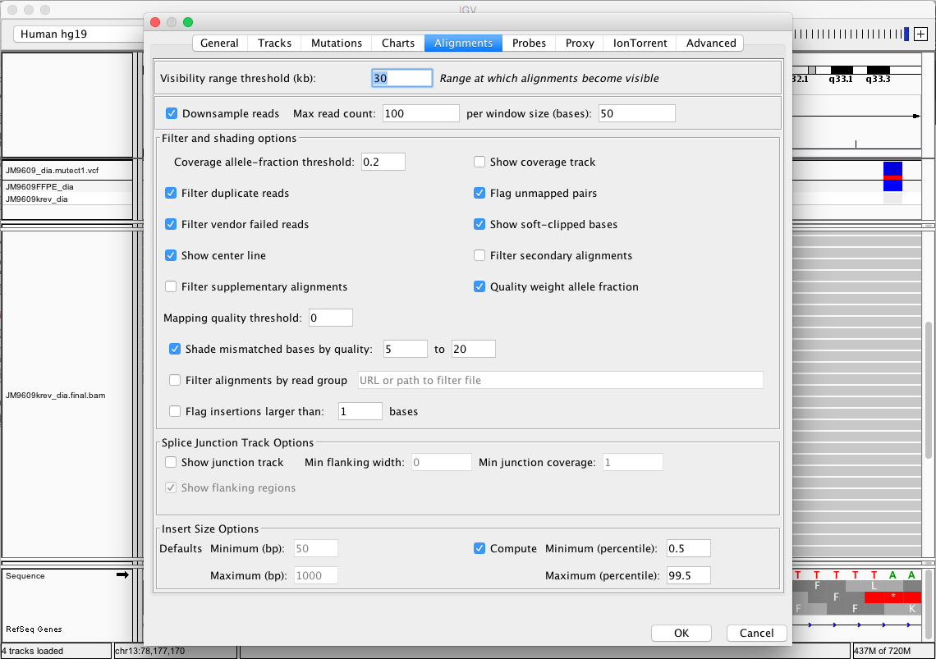
IGV soft clips

Slide 68
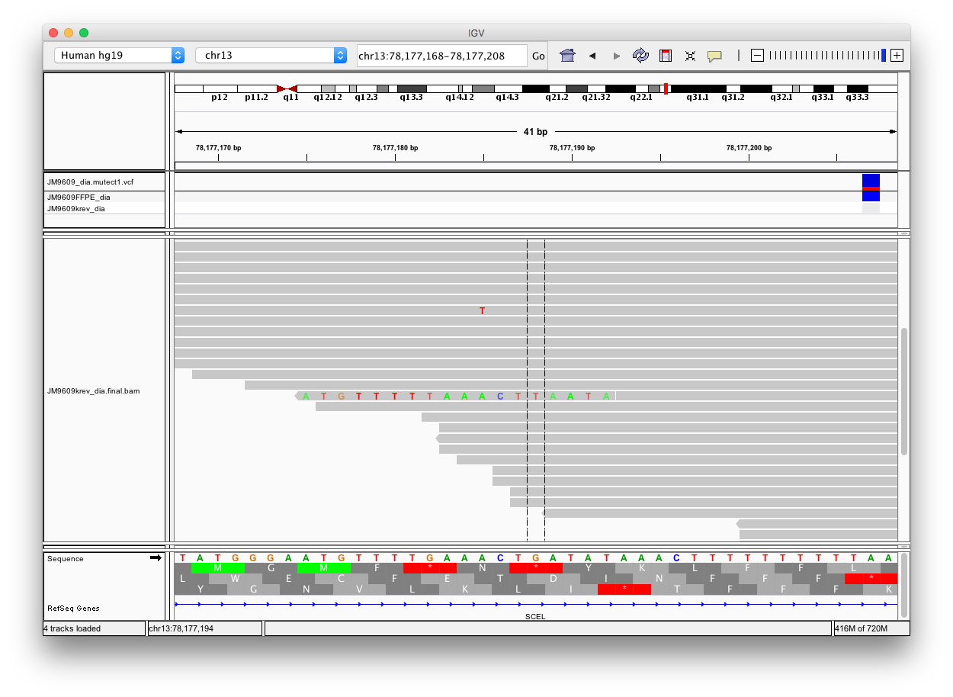
IGV soft clips

Slide 69
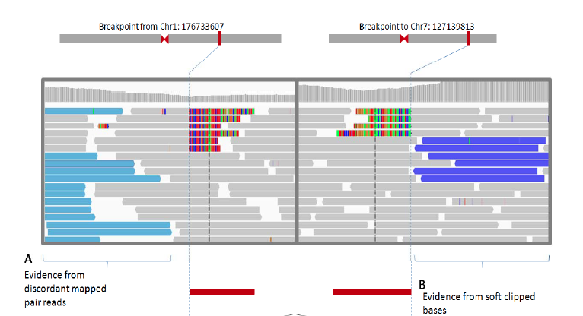

Slide 70
Recap – Data analysis pipeline
Pre alignment
Quality Control
Alignment
(Mapping)
+ QC
Variant calling
Reference
Variants
Reads
Annotation
dbSNP
BCL
FASTQ
SAM/BAM
VCF/MAF
Cosmic
…

Slide 71
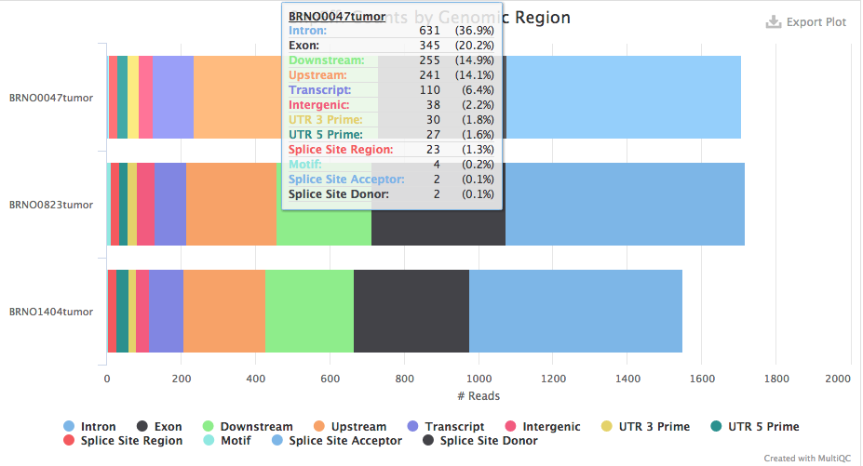
Variant annotation
MultiQC output

Slide 72
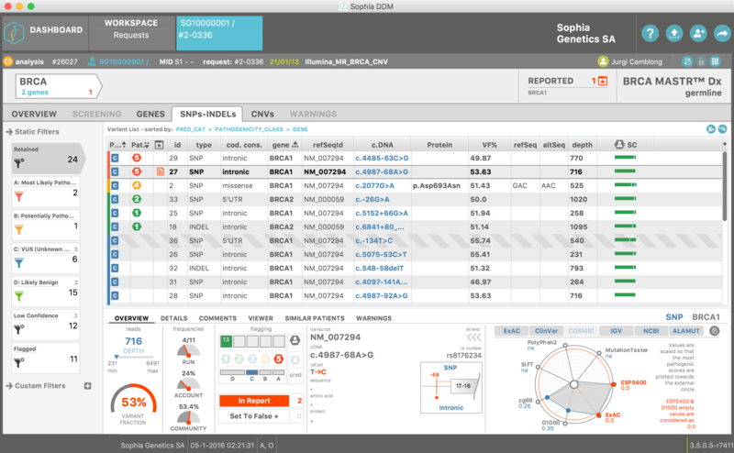
Variant annotation + report
https://www.kti.admin.ch/kti/en/home/ueber-uns/nsb-news/weitere-news/sophiagenetics.html

Slide 73
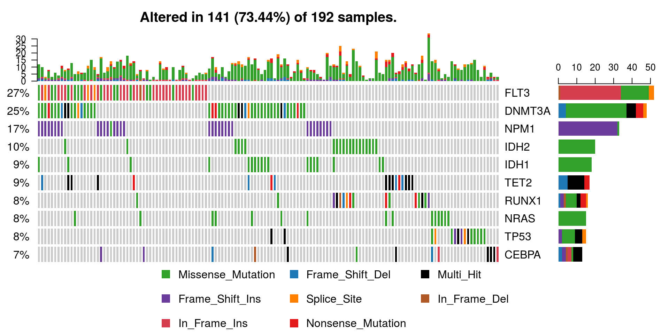
Variant annotation + report
https://bioconductor.org/packages/devel/bioc/vignettes/maftools/inst/doc/maftools.html

Slide 74
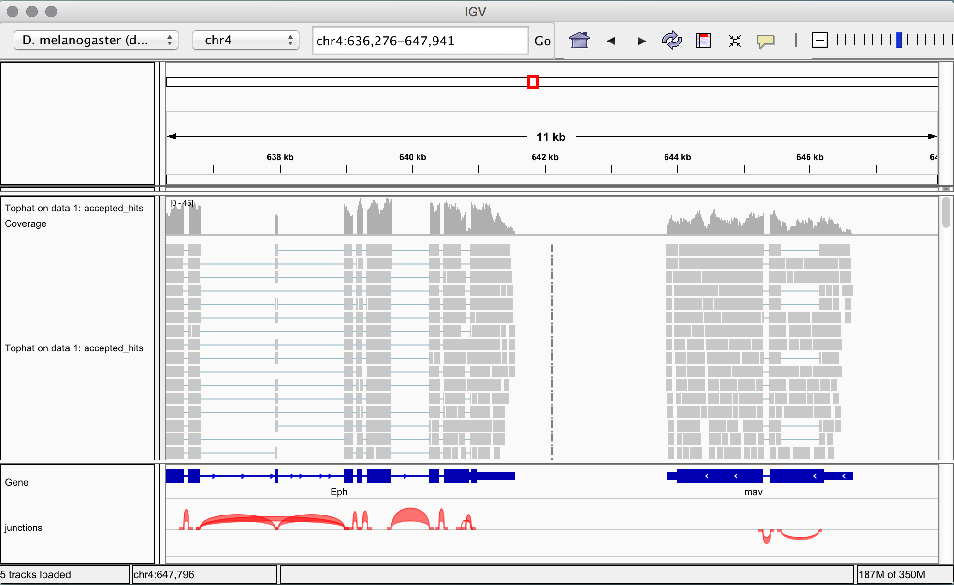
RNASeq reads aligned to the reference genome
*RNASeq
Annotation
https://www.melbournebioinformatics.org.au/tutorials/tutorials/rna_seq_dge_basic/rna_seq_basic_tutorial/

Slide 75
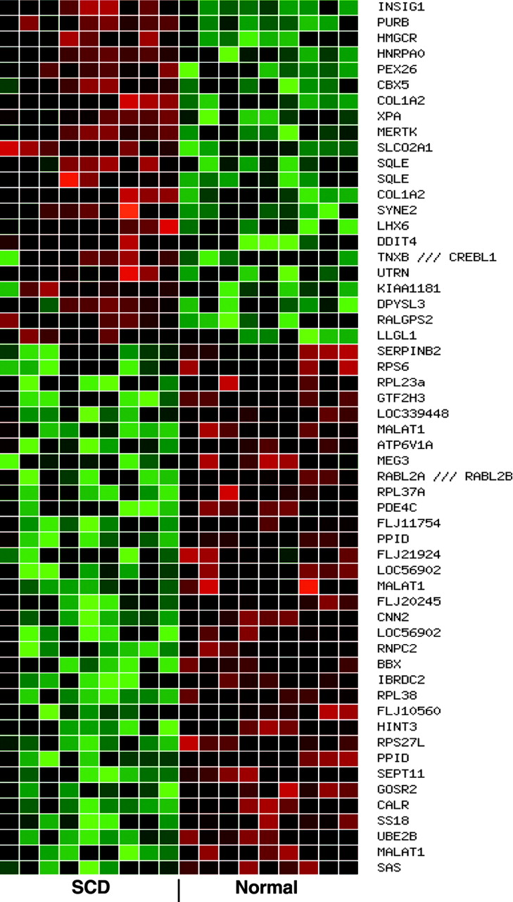
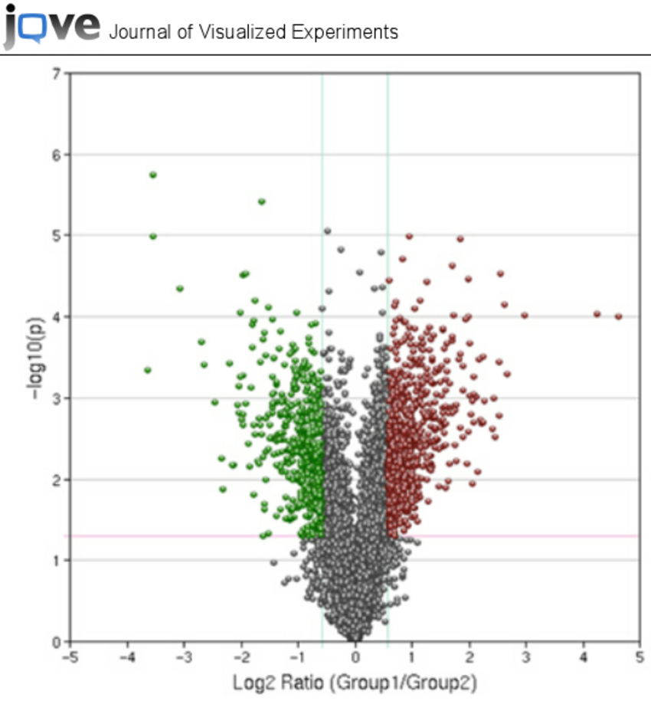
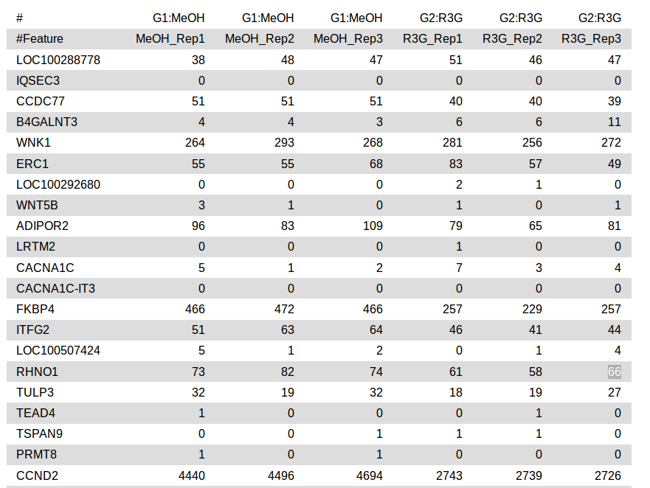
RNAseq pipeline
*RNASeq
Feature counts
(+normalization)
Volcano Plot
Heat map

Slide 76
Combined approach

Slide 77
Taka away
Terminology
Interpreting Different QC metrics
Interpreting NGS data visually
Basic intuition (reads, alignments, references, variants)
Thank you for your attention

