Slide 1
Adjectives of the 3rd declension

Slide 2
Connect adjective with different nouns
pars, ostium, regiones, ramus, aorta + abdominalis, e
regio, nervi, arteria, corpus, rami + perinealis, e
crista, glandulae, musculi + urethralis, e
segmenta, canalis, venae, foramina, nuclei + sacralis, e

Slide 3
Connect noun with different type of adjectives
ischiadicus, a, um | tuber | parietalis, e
longus, a, um | caput | brevis, e
lentus, a, um | sepsis | puerperalis, e
induratus, a, um | hepar | mobilis, e
crassus, a, um | intestinum | tenuis, e
cysticus, a, um | ren | migrans, antis
complicatus, a, um | fractura | simplex, cis
acutus, a, um | urocystitis | catarrhalis, e
magnus, a, um | musculus | biceps, pitis
transversus, a, um | colon | ascendens, entis
medius, a, um | pars | cranialis, e

Slide 4
Join the same noun with two different adjectives
centralis, e | canalis | opticus, a, um
ischiadicus, a, um | tuber | frontalis, e
tenuis, e | intestinum | crassus, a, um
rectus, a, um | musculus | biceps, pitis
ascendens, tis | colon | transversus, a, um
thyroideus, a, um | glandula | suprarenalis, e
biliaris, e | vesica | felleus, a, um
longus, a, um | caput | brevis, e
solaris, e | eczema | ruber, a, um

Slide 5
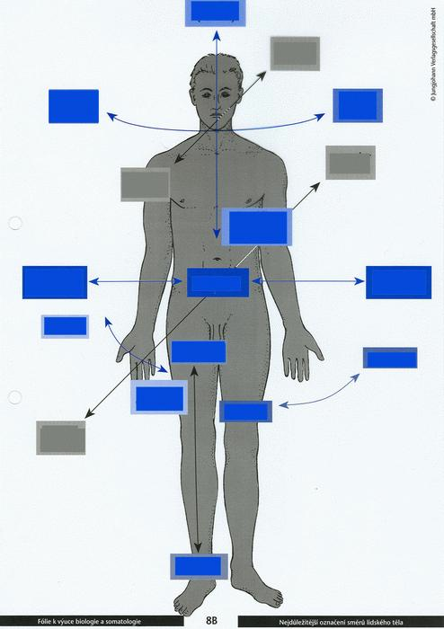

Slide 6
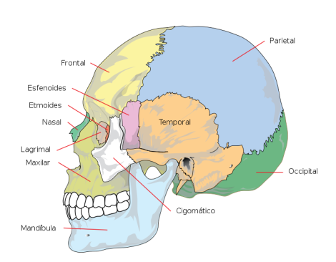
Name bones of skull, use nouns as hints
Paries, etis, m.
Frons, frontis, f.
Sphen
Ethmos
Tempus, oris, n.
Nasus, i, m.
Lacrima, ae, f.
Occiput, itis, n.
Zygon
Notes:
Os frontale, sphenoidale, ethmoidale, nasale, lacrimale, temporale, parietale, zygomaticum, occipitale

Slide 7
Fill in the missing term
The space in the body below the chest is cavitas ______________.
Channel formed of the holes in the centre of each vertebra, through which the spinal cord passes is canalis _________________.
The eight cranial nerve which governs hearing and balance is nervus ____________________.
Patient that is unable to move/walk is patiens ___________________.
Disease which develops all the time is morbus ____________________.
One of the two muscles which lie across the chest is musculus ________________________.
One of the two endocrine glands at the top of the kidneys is glandula _______________________ .
Pectoralis, e
Vertebralis, e
Abdominalis, e
Suprarenalis, e
Progrediens, entis
Immobilis, e
Vestibulocochlearis, e
Notes:
Abdominalis//vertebralis//vestibulocochlearis//immobilis//progrediens/pectoralis// suprarenalis

Slide 8
Fill in the logical opposite
Dentes lactei <> _______________
Arcus dentalis maxillaris <> _______________
Facies digitalis dorsalis <> _______________
Ligamentum palpebrale laterale <> _______________
Fractura malleoli medialis <> _______________
Caries profunda <> _______________
Os longum <> _______________
Ulcus durum <> _______________
Fractura simplex <> _______________
Pars lateralis <> _______________
Notes:
Dentes permanentes, arcus dentalis mandibularis, facies digitalis palmaris, ligamentum palpebrale mediale, fraktura malleoli lateralis, caries superficialis, os breve, ulcus molle, fractura multiplex, pars medialis

Slide 9
Form anatomical terms
Caries + dens (pl.) + permanens, entis
Rete + articularis, e + cubitus
In + canalis + centralis, e + medulla + spinalis, e
Tuber + frontalis, e + os + frontalis, e
Operatio + pars + descendens, entis + et + ascendens, entis + duodenum
Capsula + articularis, e + humerus
Processus (pl.) + vertebra (pl.) + columna + vertebralis, e
Ruptura + musculus + biceps, pitis + brachium
Septem (7) + ligamentum (pl.) + teres (pl.) + corpus + humanus, a, um
Tunica + mucosus, a, um + intestinum + tenuis, e
Vena + comitans, antis + nervus + hypoglossus, a, um
Notes:
Caries dentium permanentium, rete articulare cubiti, in canale centrali medullae spinalis, tuber frontale ossis frontalis, operatio partis descendentis et ascendentis duodeni, capsula articularis humeri, processus vertebrarum columnae vertebralis, ruptura musculi bicipitis brachii, septem ligamenta teretia corporis humani, tunica mucosa intestini tenuis, vena comitans nervi hypoglossi

Slide 10
Find mistake
Musculi levatores costarum brevium
Glandulae suprarenale
Vena iliaca communa
Organum vestibulocochlearis
Trauma gravis articulationis genus sinistri
Therapia urocystitidis gravidis
Ramus communicant cum nervi ulnari
breves
suprarenales
communis
vestibulocochleare
grave
gravis
communicans
nervo

