Slide 1
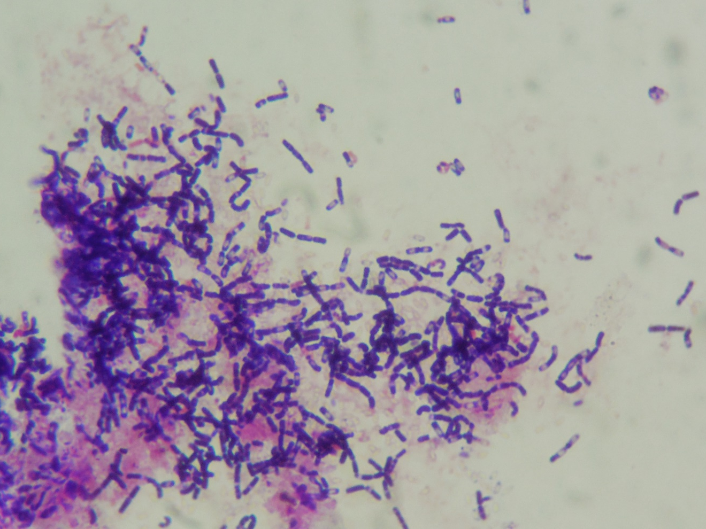
Bacillus sp. (Transparent structure inside cells are endospores .)
Gram-positive rods

