Slide 1
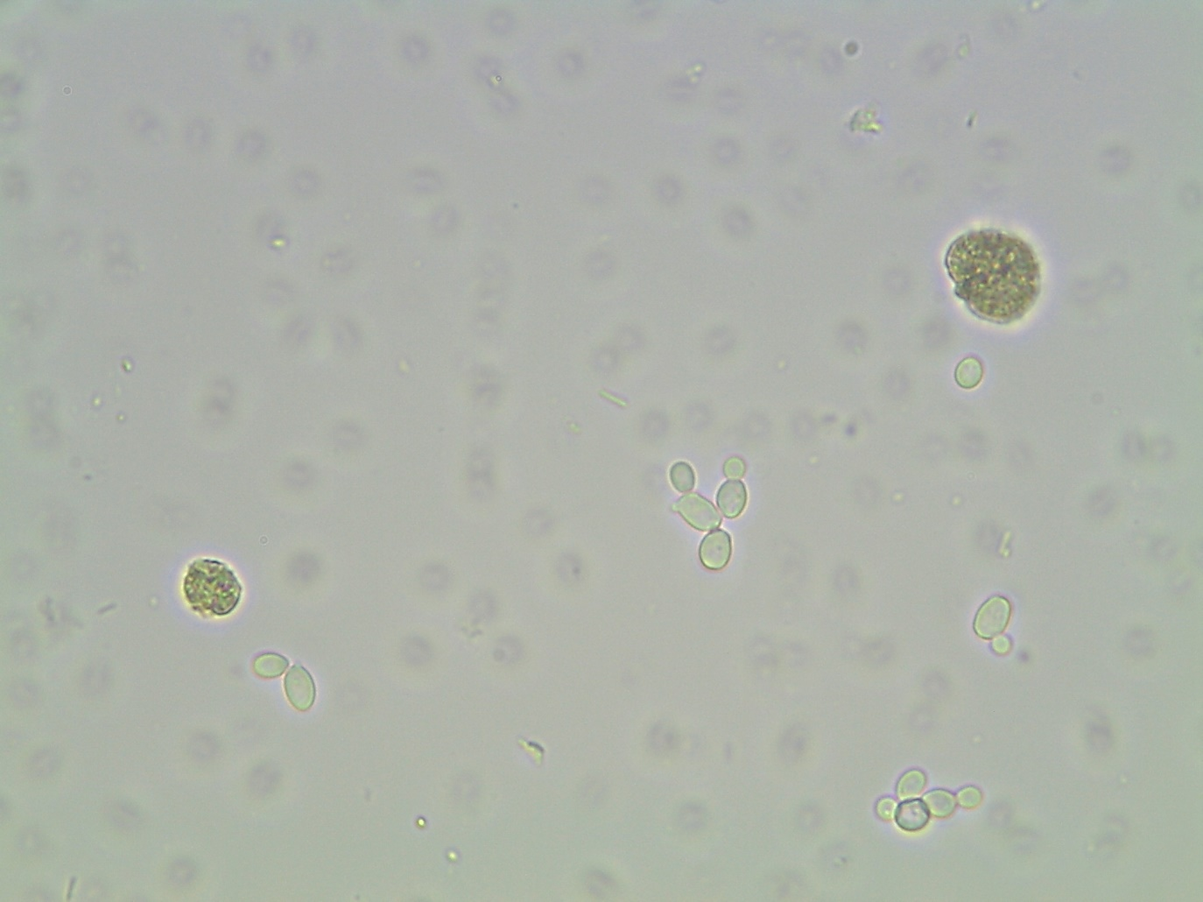
Candida sp.
Wet mount

