Slide 1
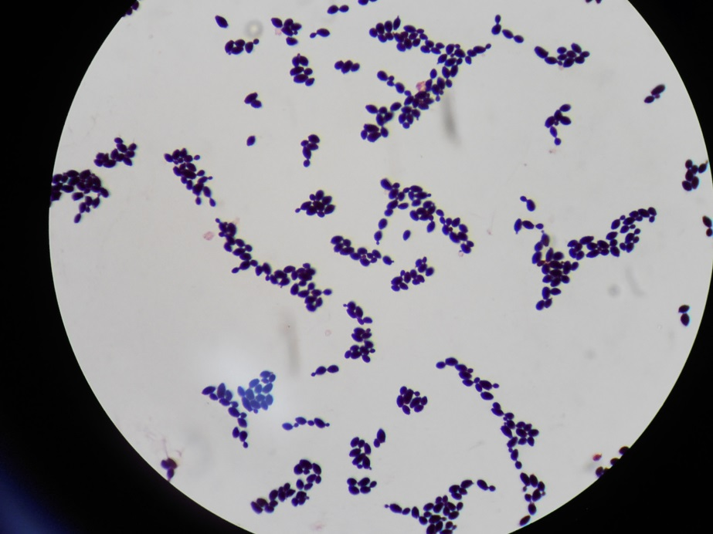
Candida sp.
Gram stain

