Slide 1
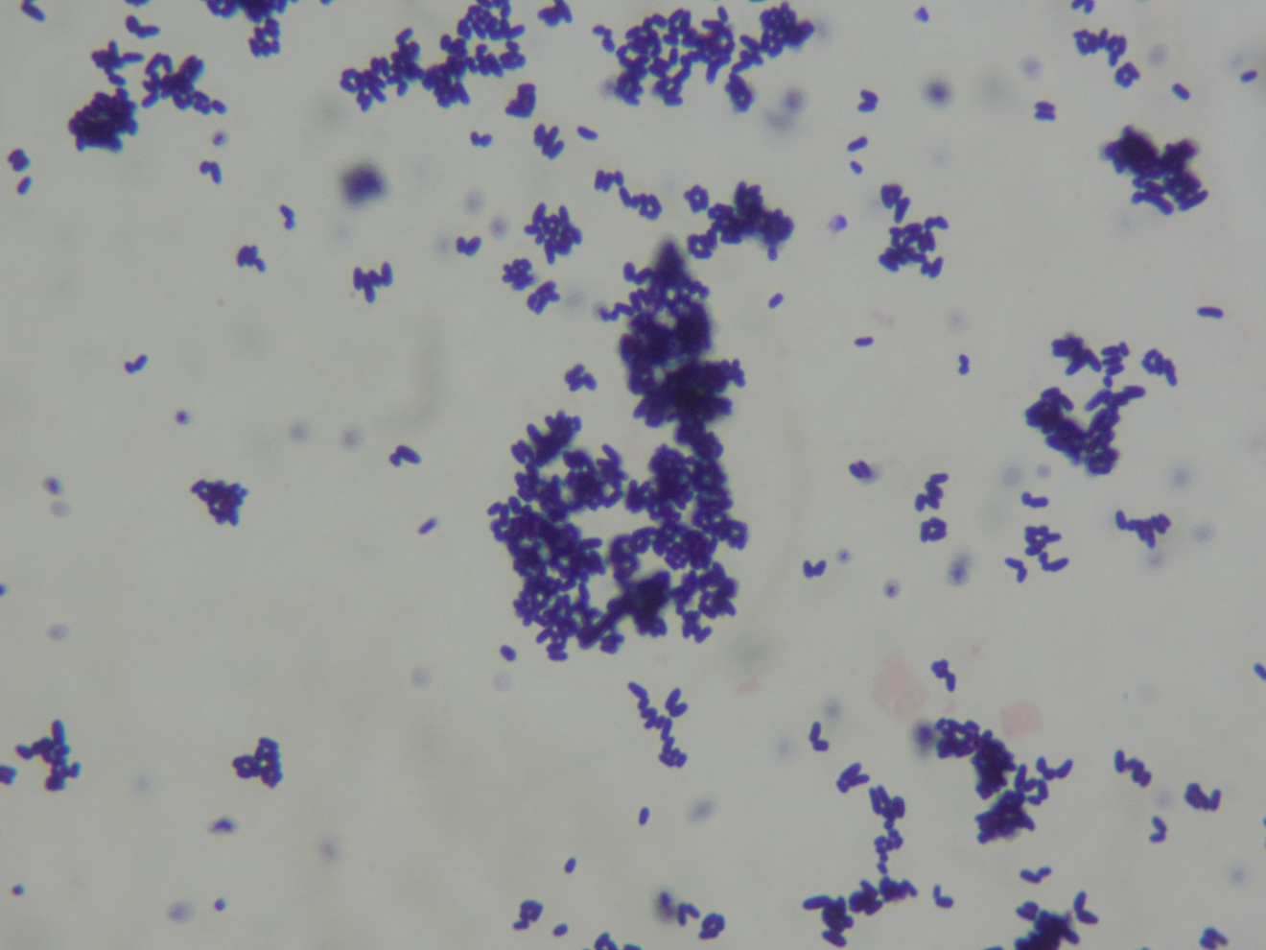
Corynebacterium sp.
Gram-positive rods

