Slide 1
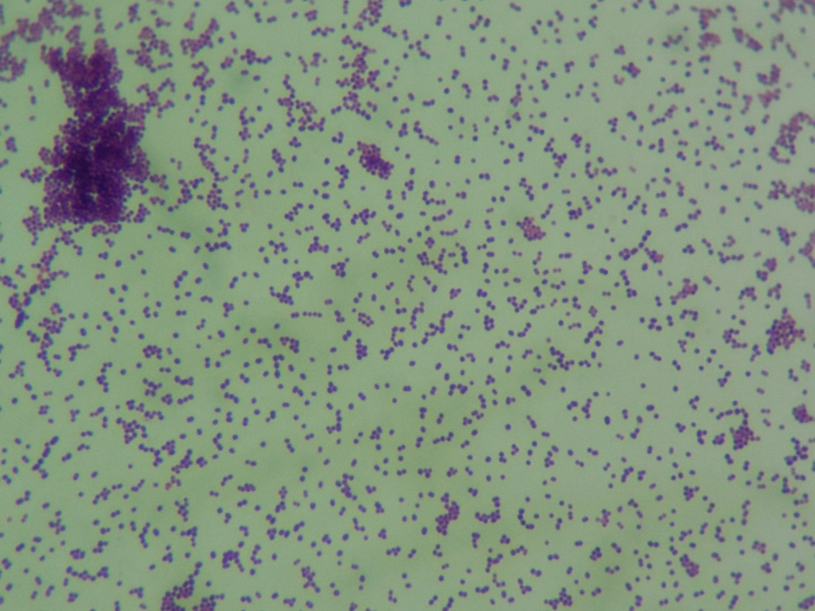
Enterococcus sp.
Gram-positive cocci

