Slide 1
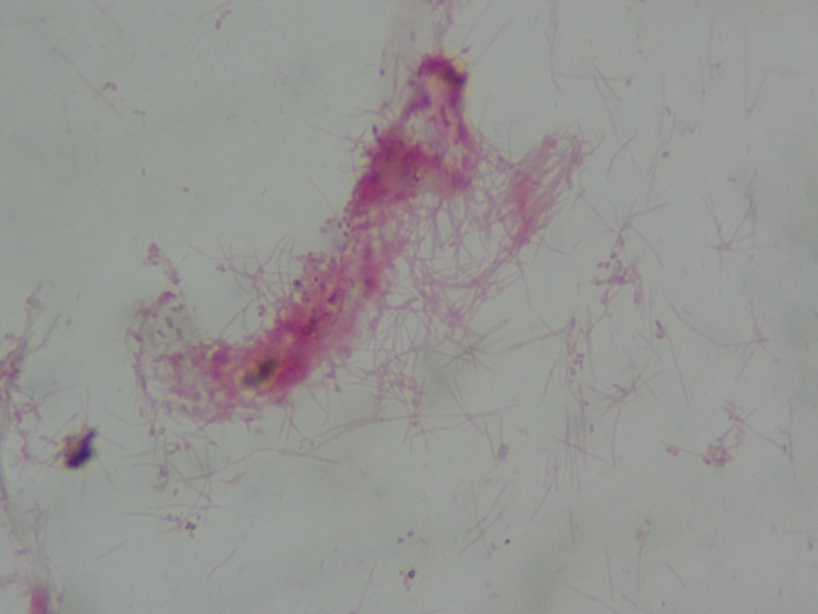
Fusobacterium sp.
Gram-negative rods

