Slide 1
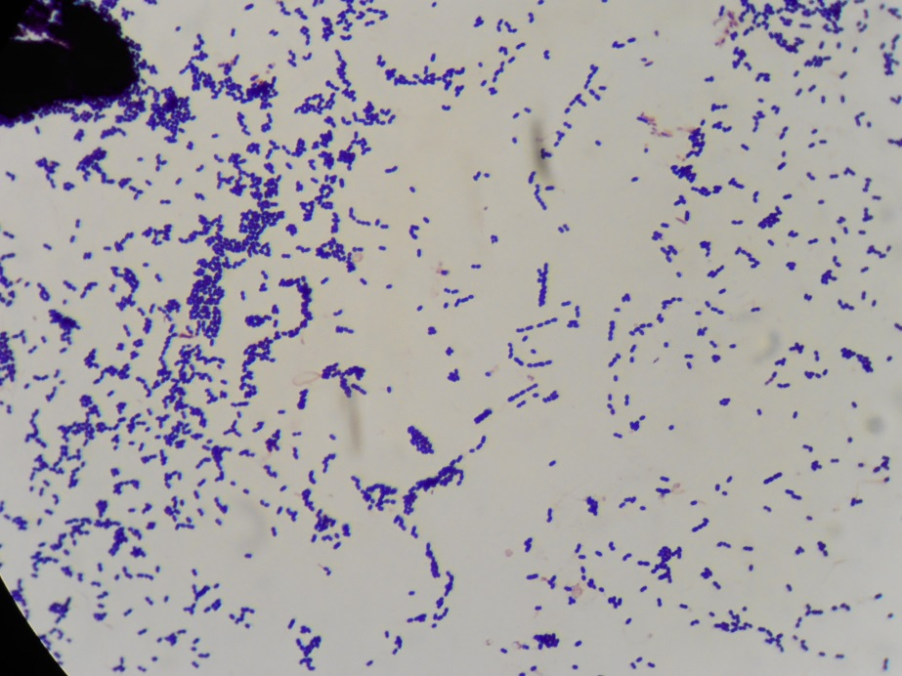
Gram-positive cocci

