Slide 1
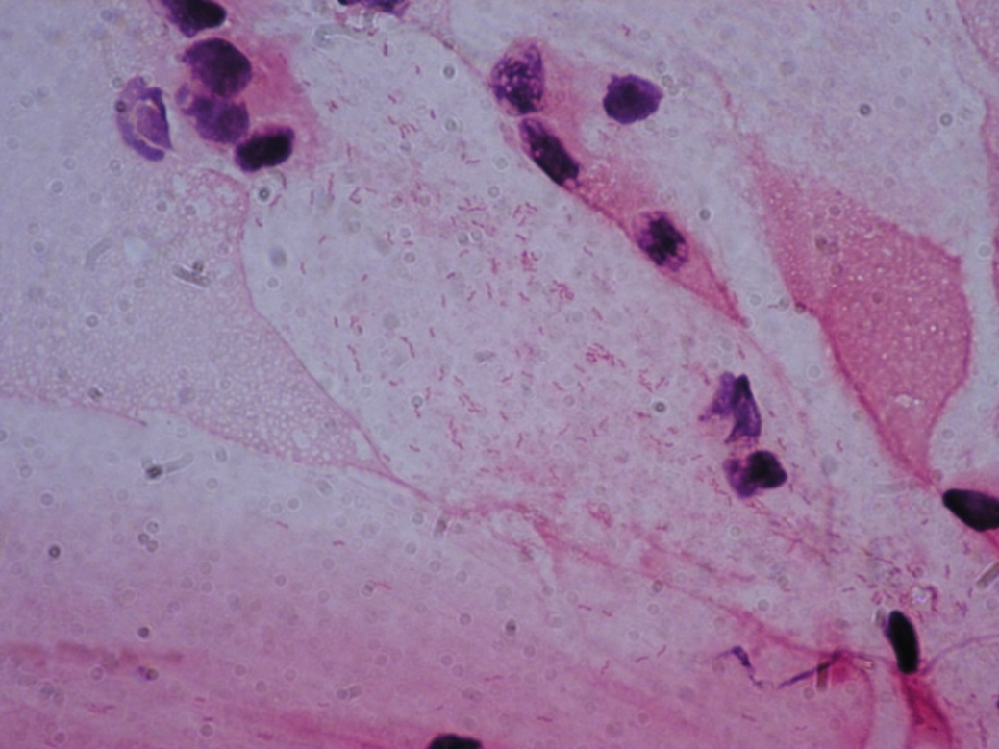
Helicobacter pylori
Gram-negative spirally shaped rods

