Slide 1
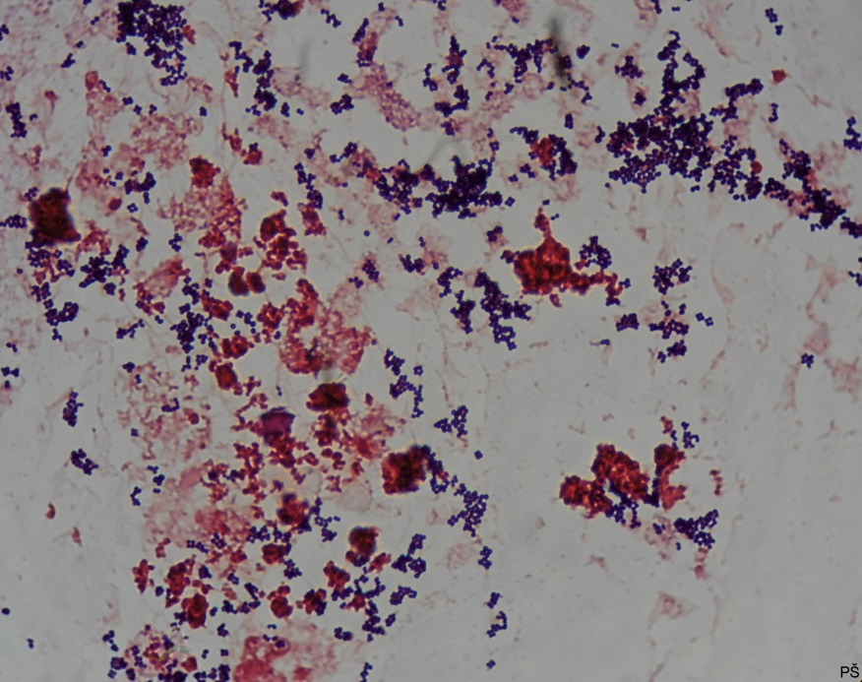
Blood culture
Gram-positive cocci arranged in grape-like clusters

