Slide 1
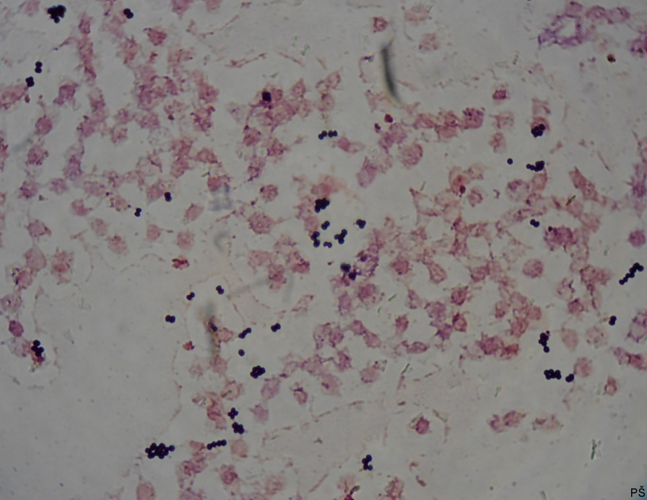
Blood culture
Gram-positive cocci

