Slide 1
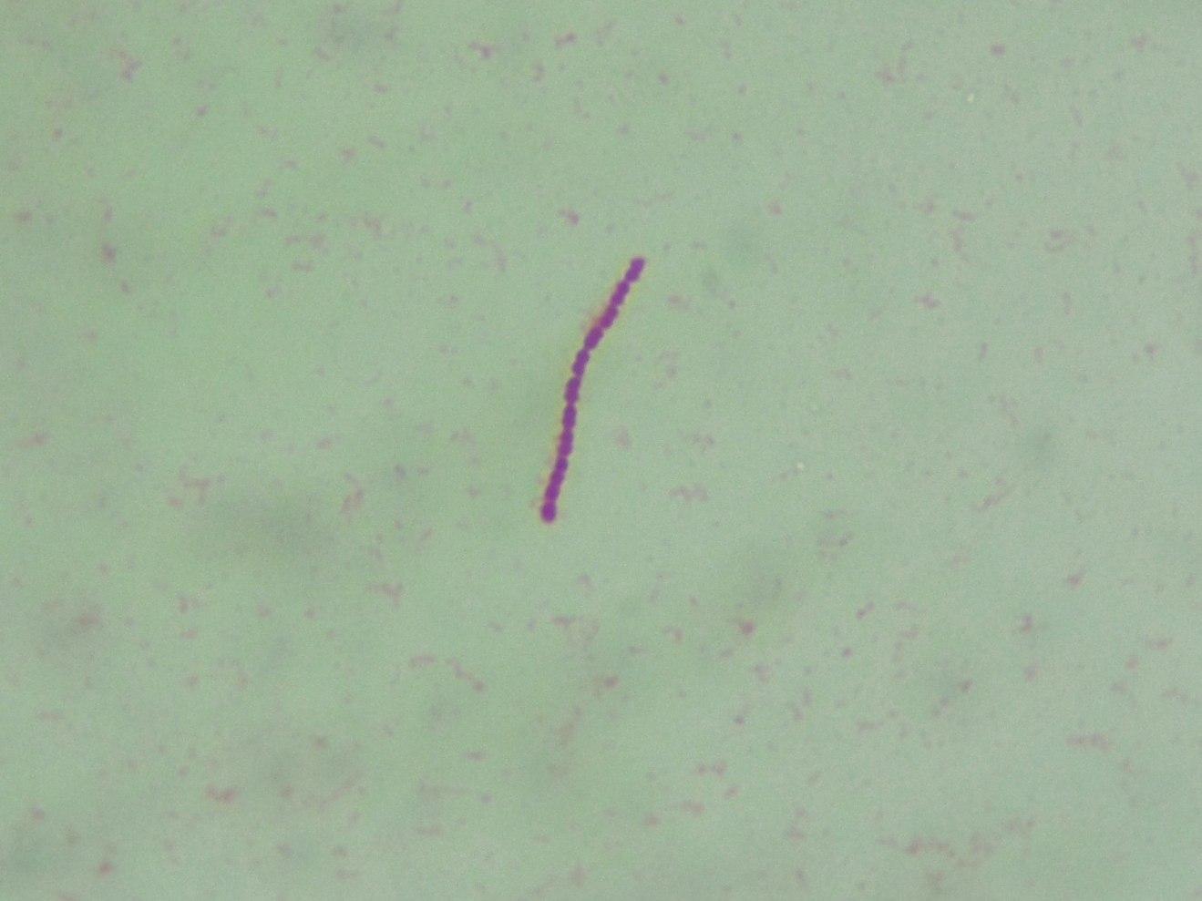
Cerebrospinal fluid
Gram-positive cocci in chain

