Slide 1
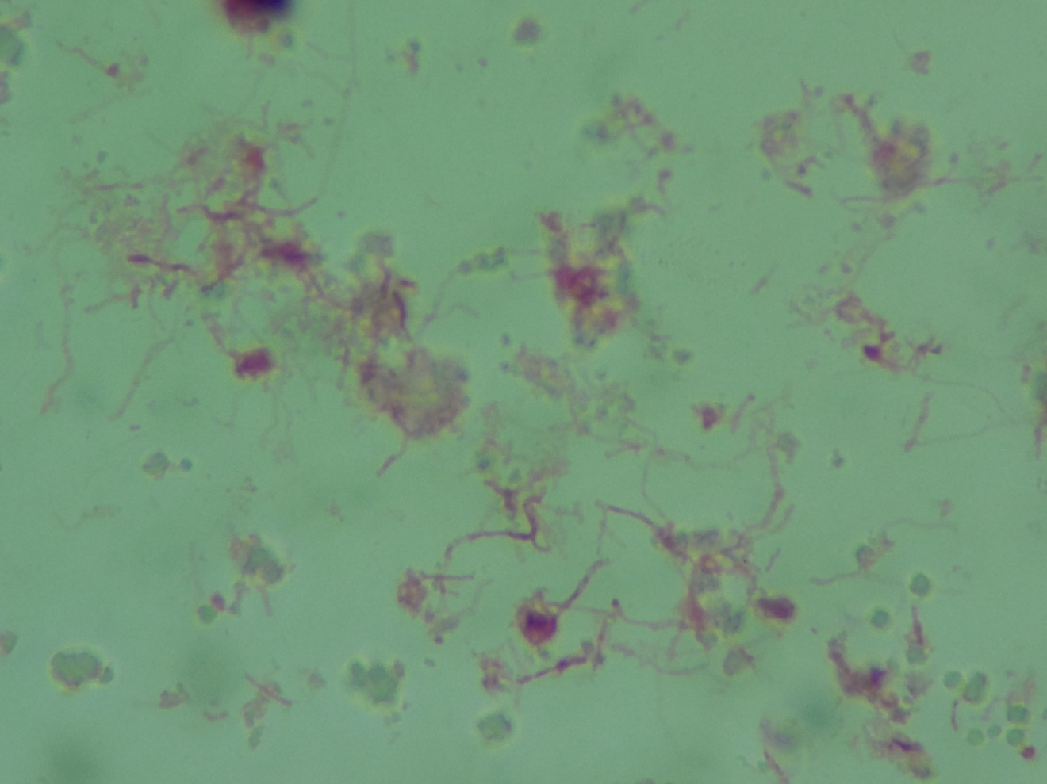
Punctate - Actinomyces sp.
Gram-labile filaments

