Slide 1
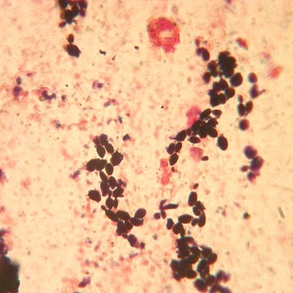
Sputum
Candida sp.

